Slide 1
Cultural Competency or Cultural Humility
What is it?
Notes:
Some of the material and activities today may challenge as we know that our own lived experiences color the way in which we view the world .
We all start the conversation about culture at different levels/degrees based on who we are.

Slide 2
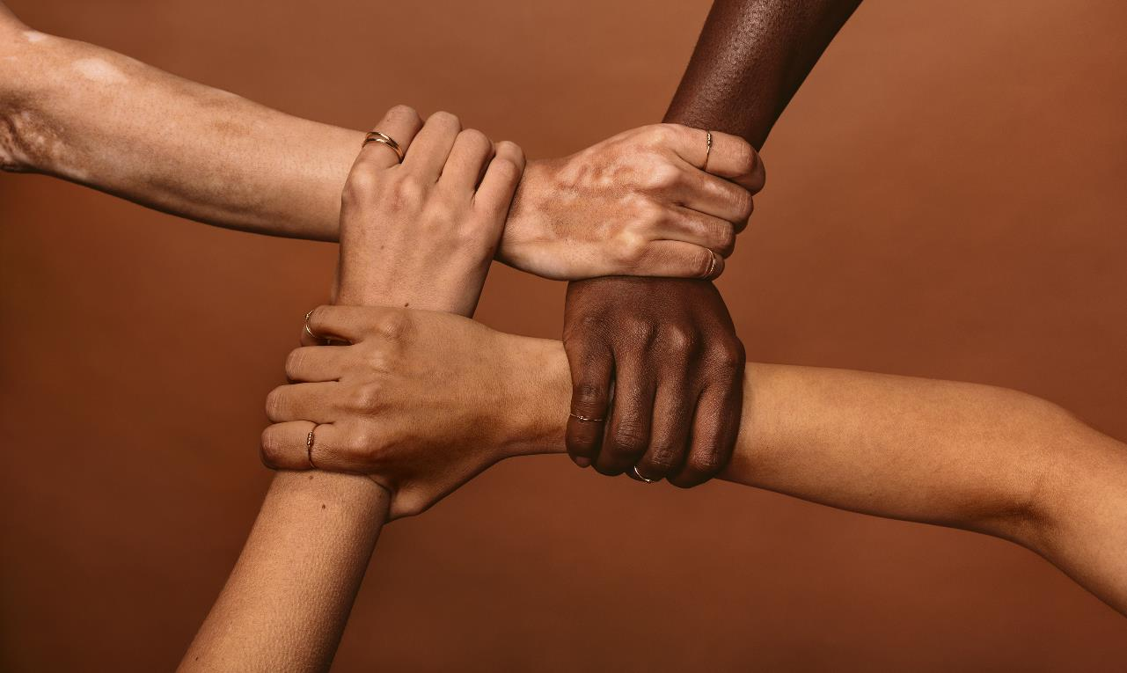
Learning Objectives
Participants will be able to:
Identify their own cultural identity, attitudes, perceptions, and feelings and how it may affect relationships with Job Corps staff and students.
Define cultural competence and cultural humility
Describe why cultural competence and cultural humility are important to creating an inclusive Job Corps campus.
Set personal goals for increasing cultural competence and cultural humility.
Notes:
Today we will spend some time reflecting on our own cultural identity, we will make sure we understand the concepts of cultural competence and cultural humility and how they are important to an equitable and inclusive Job Corps environment, and leave this session with at least one personal goal to increase your use of cultural competence and humility in the work you do with students and with each other.

Slide 3
Notes:
Think about this saying – We don’t see things as they are, We see things as we are
We carry our culture with us at all times – and it has an impact on how we view and relate to people from our own and other cultures. This is why self-reflection is so important as a starting step in our discussion today.

Slide 4
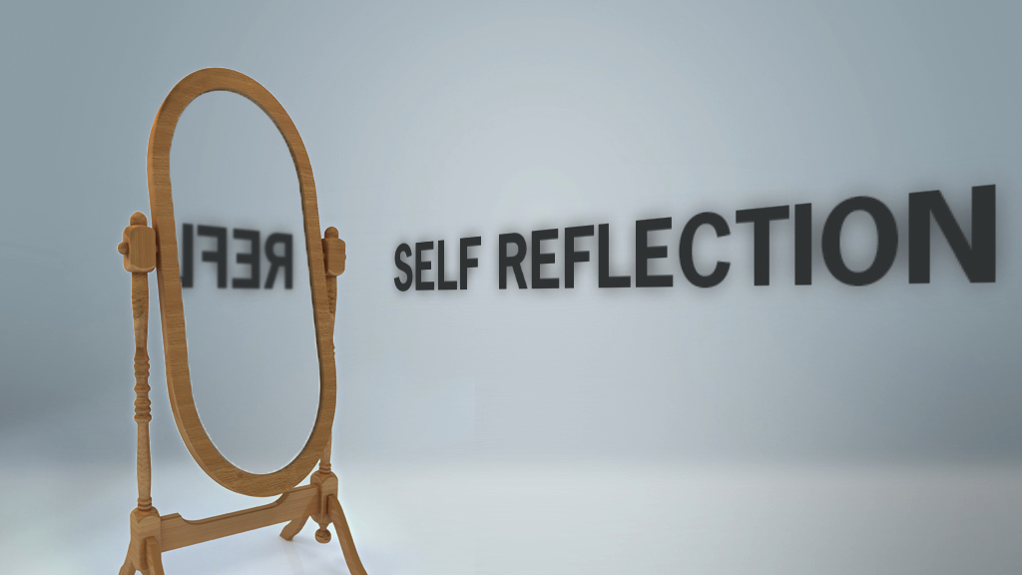
What makes up who we are - our cultural identity?
Notes:
Self-reflection allows us to reflect on our own cultural background and preferences and It also prompts us to check our assumptions, stereotypes, and our biases.
Helps us look for ways to better understand cultural groups.

Slide 5
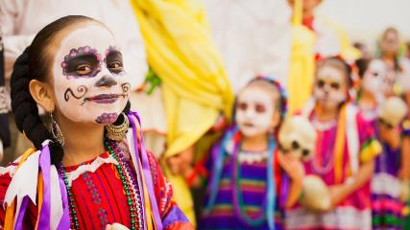
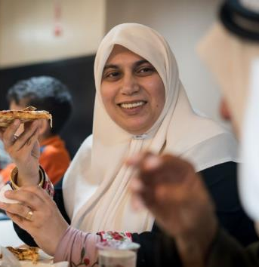
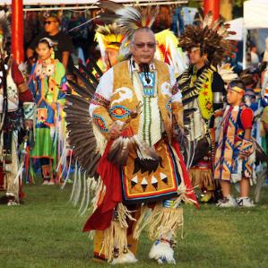
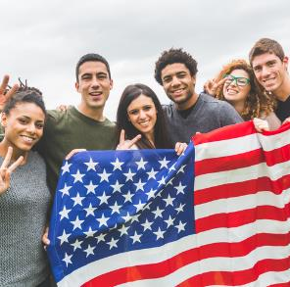
Culture encompasses religion, food, what we wear, how we wear it, our language, marriage, music, what we believe is right or wrong, how we sit at the table, how we greet visitors, how we behave with loved ones and a million other things
https://www.my-mooc.com/en/article/american-culture-traditions-and-customs-of-the-united-states/
Notes:
So, what exactly is our cultural identity?
Culture encompasses religion, food, what we wear, how we wear it, our language, marriage, music, what we believe is right or wrong, how we sit at the table, how we greet visitors, how we behave with loved ones and a million other things
.
https://www.my-mooc.com/en/article/american-culture-traditions-and-customs-of-the-united-states/

Slide 6
Primary and Secondary Dimensions
The major dimensions of identity can be categorized as primary and secondary dimensions.
The primary dimensions are unalterable and are extremely powerful in their effect.
The secondary dimensions are important in shaping us, but we have some measure of control over them.
Notes:
And when we think about our interlocking social/cultural identities It can be categorized into primary and secondary dimensions.
Primary are those things we cannot change about us
Secondary dimensions are things that we have some control over and they shape our ideas, perceptions, etc.

Slide 7
Primary or Secondary?
Gender Identity/Expression
Gender
Religious Beliefs
Marital Status
Race/Ethnicity
Parental Status
Language
Education
Occupation
Physical Ability
Learning Ability
Income
Sexual Orientation
Age
National Origin
Geographic Location
Veteran Status
Consider: Are these identity factors visible or invisible?
Notes:
Type in the chat box which identities would be considered primary.
Age, Gender (Biological sex; people’s perception of another person’s gender/sex
Man, male, woman, female,, Gender Identity/Expression(An individual’s perspective of their gender, which may or may not be congruent with bio sex Cisgender, transgender, genderqueer, gender nonconforming)., Race/Ethnicity (Social construction used to categorize people based on phenotypical features (skin color, eyes, etc.), often associated with ethnicity Asian, Multi-racial, White/Caucasian, Black/African-American, Latinx, Sexual Orientation (Describes mental, physical and emotional attraction Gay, queer, asexual, bisexual) , Physical Ability.– These are our visible identities connected to culture.
Type in the chat box which identities would be considered secondary.
Religious Beliefs, Marital Status, Parental Status, Education, Occupation, Income, Geographic Location, Veteran Status, Language.

Slide 8
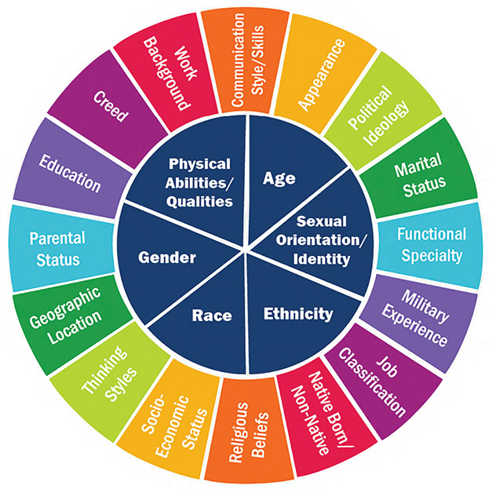
IDARE | Office of Inclusion, Diversity, Anti-Racism, and Equity. “Resources.” Johns Hopkins Bloomberg School of Public Health. Available from: bit.ly/2SRVfh1.
Notes:
This diversity wheel is a visual on primary and secondary identity.
Why is this important? Because sometimes we look at our students or those we work with only through the primary dimensions we can see but their diversity is also reflected by what we can’t easily see.

Slide 9
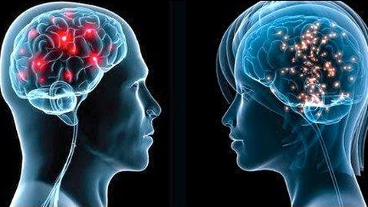
It Is How We Are Wired
Our brain is shaped by our life experiences
How, where, and by whom we were raised
Interactions with friends, peers, and coworkers
School, community, and religion
Media and news are particularly influential
Politics and policy
Our brain creates shortcuts
Heuristics are mental shortcuts that allows people to solve problems and make judgments quickly and efficiently.
Ocne uopn a tmie, terhe was a redaer.
Notes:
Our brains are wired based on our life experiences – things we hear, we see, we learn, we feel, we read, and bias is an inevitable part of the human condition. We are bombarded with so much information and we have to make hundreds or even thousands of decisions every day. What should you have for breakfast? What should you wear today? Should you drive or take an uber? So our brain creates mental shortcuts call Heuristics. They work in our subconscious and make sense of all the information we receive in our day to day lives.
Daniel Khaneman ( KAH-neh-mun), a leading psychologist in this field, explains heuristic like this. “Think of our brains like a theatre production. The stage is our conscious brain; this is what we see, understand and are aware of. Backstage is our subconscious brain; this is all the lighting, costumes, sound, orchestra, stage hands that we are unaware of, but make the performance possible.”
Here is an example of how heuristics/mental shortcuts work- type this sentence in the chat box- Does not matter that many of the letters are out of place. This is because our brains use a shortcut when reading; we focus the majority of our attention on the first and last letters of a word and ignore what is in the middle. This strategy means that we can understand the text without having to compute every single letter. We use heuristics for many daily tasks and decisions.
.

Slide 10
Life Experiences and Culture
What are some examples of your life experiences cultural programming?
Think about the family or personals beliefs or values you hold, or rituals you perform based on the cultural programming you received.
Notes:
Each of us is born into a culture. Our beliefs begin with those of our family, but they continue to be shaped by all of our experiences after birth. For the most part, family attitudes, beliefs, languages, and other behaviors are accepted without question.
Think about where you received your cultural programming? What are the various influences on your cultural programming. You probably included some of the following:
Family, neighbors ,church, media, travel, spouse/significant other, friends
other relatives

Slide 11
Cultural Programming
“The marriage will be more successful if you say your vows while the clock is on the upside of the hour, not while it is on the downside of the hour.”
“Your hair will grow back if you cut it on the full moon.”
“You can’t teach an old dog. . .”
“Big boys don’t. . .”
“You can lead a horse to water, but. . .”
Birds of a feather…….“
No need to buy the cow when you can get ………..
Notes:
I want you to tell me if you have ever heard these sayings
Now finish the statements on this slide – you can type in the chat box or just say it out allowed where you are- the one time when talking to yourself is allowed.
Most of us can finish the statements on this slide. One effect of our cultural programming is that it puts us “on automatic.”
As adults, many of us are still on automatic.

Slide 12
Cultural Programming
Read each word or phrase as it comes up. For each one, type in the chat box or if you prefer take out a piece of paper for yourself and write on that, the first word or thought that comes to your mind. Don’t spend a lot of time thinking—just write down the first thing that comes to mind.
Police officer
Man in a wheelchair
Farmer
Californian
300-pound woman
Politician
Homeless person
Lawyer
Black male teenager
Professor
Notes:
Let’s keep going – Read the slide- click through
Some of your responses will likely represent stereotypes. If you did not take time to think about them; they were automatic responses. It’s hard to get off “automatic
Politician: liar, government, white male
Lawyer: evasive, expensive, snake, someone who compromises
Professor: absent-minded, intelligent, educator, lifelong learning
Man in a wheelchair: weak, helpless, dependent, pity, suffering, asexual
Californian: surfer, physically fit, blond, tan
Homeless person: irresponsible, dangerous, drug and alcohol addict, unfortunate
Black male teenager: good athlete, drugs, aggression
Policeman: helpful, power hungry, trust, abuser, risk-taker
Farmer: hard worker, unsophisticated, country bumpkin, American
300-pound woman: motherly, lacking in discipline, lazy, greedy, unattractive, jolly

Slide 13
What can help us move “off automatic”, reduce cultural errors, and value differences?
CULTURAL COMPETENCE
(Linguistic)
CULTURAL HUMILITY!
Notes:
So what can we do to reduce these automatic errors and value differences. – Yes, learning about cultural competence and cultural humility. While today focuses on these two I did want to remind us of the importance of Linguistic competence involves communicating effectively with diverse populations, including individuals with limited English proficiency (LEP), low literacy skills or are not literate, disabilities, and individuals with any degree of hearing loss through such means as bilingual/bicultural staff, trained medical interpreters, and qualified translators. I think we can all agree There is no cultural competence or cultural humility without addressing language barriers. Let’s start with cultural competence.

Slide 14
What is Cultural Competence?
The National Institute of Mental Health defines cultural competency as “the behaviors, attitudes, and skills that allow an individual to work effectively with different cultural groups.”
Cross, T. L. Bazron, B. J. Dennis, K. W. , & Isaacs, M. R. (1989). Towards a culturally competent system of care: A monograph on effective services for minority children who are severely emotionally disturbed. Washington, DC: Child and Adolescent Service System Program (CASSP) Technical Assistance Center, Georgetown University Child Development Center.
Notes:
Cultural competence — loosely defined as the ability to understand, appreciate and interact with people from cultures or belief systems different from one's own
the term cultural competence was first used by Terry L. Cross and colleagues in 1989 as a goal for agencies working with diverse populations, but it was not until almost a decade later that health care professionals began to be formally educated and trained in cultural competence and is still used today

Slide 15
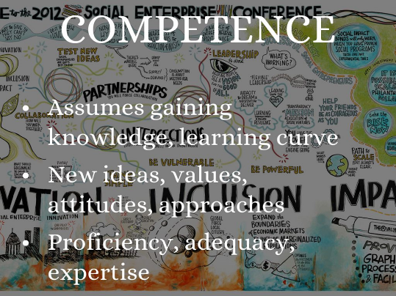
https://diversity.ncsu.edu/cultural-competence-toolkit/
Notes:
Cultural competence has four major components: awareness, attitude, knowledge, and skills. I will briefly talk about each one. These definitions are taken from a post by BCT Partners.-
“Awareness -Many of us have blind spots or unconscious bias when it comes to our personal beliefs and values. We need to bring awareness to stereotyping and prejudices that can create barriers.
Attitude- Our values and beliefs convey the extent to which we are open to differing views and opinions. Whether we are part of an underserved ethnic minority or not, the more deeply held our beliefs are, the more likely we are to react emotionally when we come up against cultural differences.
Knowledge -The more informed we are about different cultures, the more we can be considerate to others
Skills-One can have awareness, plenty of knowledge, and a good attitude about cultural differences, but these won't do much good without the skill to respond to differences effectively. To be culturally competent, one must learn and practice all of the above. “
However, over time many researchers have questioned the concept of cultural competence and whether the premise that a person could actually attain and master knowledge about a group of people was valid. The sense was there’s no way to become competent in another culture because you don’t have that lived experience or that it’s not enough to be merely competent and there is no endpoint to becoming fully culturally competent. This led to the shift from cultural competence frameworks to that of cultural humility.

Slide 16
What is Cultural Humility?
Cultural humility is a process of reflection and lifelong inquiry that involves self-awareness of personal and cultural biases as well as awareness and sensitivity to significant cultural issues of others.
Notes:
The concept of cultural humility was developed by Melanie Tervalon and Jann Murray-Garcia in 1998 to primarily address inequities in the healthcare field. It is now used in many fields, including education, public health, social work, and even library science, to increase the quality of interactions among diverse community members.
Cultural humility goes beyond the concept of cultural competence to include:
A personal lifelong commitment to self-evaluation and self-critique
Recognition of power dynamics and imbalances, and a desire to fix those power imbalances and to develop partnerships with people and groups who advocate for others a form of Institutional accountability Let’s review these components a bit closer.

Slide 17
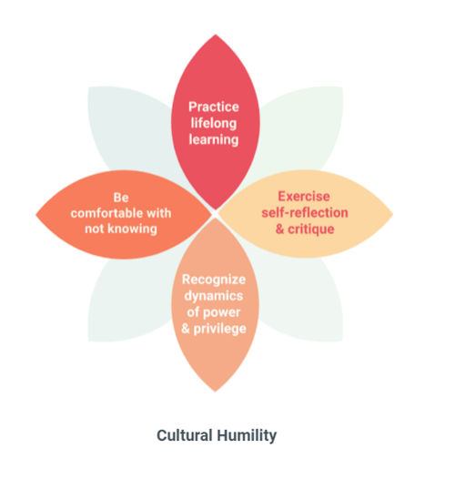
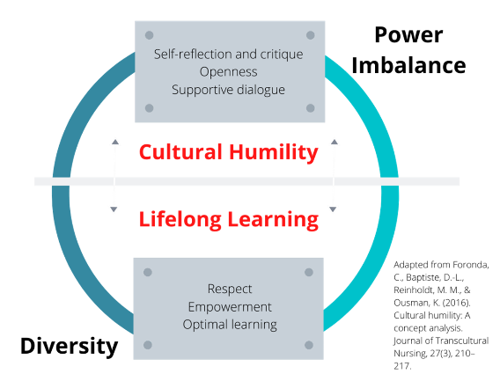
Tervalon, M., & Murray-Garcia, J. (1998). Cultural humility versus cultural competence: A critical distinction in defining physician training outcomes in multicultural education. Journal of Health Care for the Poor and Undeserved, 9, 117-125.
Notes:
Three factors
The first is a lifelong commitment to self-evaluation and self-critique -Learning is never finished.
The second is a desire to fix power imbalances. Our students are the experts on their lives, As staff or health care providers we hold a body of knowledge that the student does not; however, the student also has understanding outside the scope that staff or health providers may understand. Staff may hold power with their knowledge of academics/trades/ professional healthcare, the student holds power in personal history, lived experience and preferences.
Cultural humility requires recognizing the concept of privilege. Privilege exists when one group has something of value that is denied to others simply because of group membership and not based on what a person or group has done or failed to do.
The third is to develop partnerships with people and groups who advocate for others . We must advocate for it at the center, regional, and national levels.

Slide 18
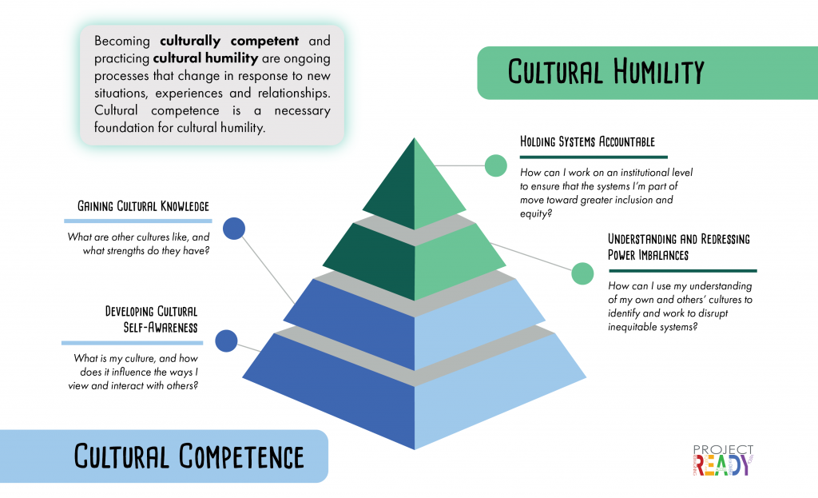
https://ready.web.unc.edu/section-1-foundations/module-8/
Notes:
So, this slide is a visual summary of our discussion of both cultural competence and cultural humility.
Ella Greene-Moton and Meredith Minkler (2020),wrote an article titled Cultural Competence or Cultural Humility? Moving Beyond the Debate and describe the belief that one needs to choose one over the other as a false choice. “Cultural competence is not something we achieve or fail to achieve but rather a reminder to continue to strive to know more about communities of all types with which we work or interact,” the authors wrote. “Together with the concept and embodied practice of deep cultural humility, it provides health educators and other public health professionals with some of our most important tools in working with diverse individuals, groups and communities in today’s complex world.”
Both concepts are valuable, both separately and in combination,

Slide 19
In the chat box type "yes" if the statement reflects cultural competency. Select "no" if the statement does not reflect cultural competency.
“I don’t like working with those students because they never get to appointments on time or follow the recommended treatment plan.”
“Our Job Corps center is working to make sure we provide written materials in the foreign languages that are commonly spoken by our English Language Learner (ELL)/Limited English Proficiency(LEP) students, and we offer interpretation services.”
“Our students are the same and just need a caring adult.”
"Our center is culturally and linguistically competent because Linda, who speaks Spanish, works with all of our Hispanic/Latinx students.“
Notes:
NO -Correct! This example does not reflect cultural competency. It presents a stereotype about a cultural group. The provider is blaming a cultural group rather than practicing cultural competency to improve adherence.
2. YES Correct! This example does reflect cultural and linguistic competency. It shows a commitment to taking clients’ language preferences into account.
3. NO Correct! This example does not reflect cultural competency. It illustrates a color blind approach, but cultural competency is about understanding and honoring cultural difference
4. NO. Correct! This example does not reflect cultural and linguistic competency. It assumes that because Linda speaks Spanish she will be able to communicate effectively with Hispanic/ Latinx clients. This office could improve its cultural competency by learning more about how to address the unique needs of its Hispanic/ Latinx clients.

Slide 20
Which of the following is NOT an effective way for health staff to engage with a student whose values conflict with the best practices they've learned in their training?
Learn more about how the student understands their condition
Take additional time to provide the student with information on their condition
Have an open conversation with the student about a variety of treatment options
Give them the preferred course of treatment as you would for any other student
D
https://thinkculturalhealth.hhs.gov/behavioral-health/
Notes:
The correct answer is d. Practicing cultural competency helps you better understand, respect, and take into account a student’s cultural background throughout the therapeutic process. It does not involve treating everyone the same without acknowledging their unique cultural identity, and it does not involve ignoring differences between you and student.

Slide 21
Which of the following is a benefit of practicing cultural competency?
It helps center staff and health providers address student’s unique needs
It helps make the relationship more friendly
It makes treatment go faster
It helps students understand the staff person’s worldview
A
https://thinkculturalhealth.hhs.gov/behavioral-health/
Notes:
The correct answer is A. Practicing cultural competency is an important way to be aware of, and adapt to, a student's unique cultural and communication needs.

Slide 22
Which of the following actions best characterizes cultural humility?
a. Acknowledging that the staff and health provider's beliefs don't matter much
b. Prioritizing the student’s values and worldview
c. Realizing that a staff person or health provider should trust their instincts
d. Memorizing everything possible about a student’s culture
B
https://thinkculturalhealth.hhs.gov/behavioral-health/
Notes:
The correct answer is B. Cultural humility emphasizes prioritizing the student’s culture, perspective, beliefs, values, and worldview, as well as a continuous process of self-reflection, an openness to learning more about student cultures, and acknowledgment of one's limitations.

Slide 23
Which of the following is NOT a component of cultural humility?
a. Recognizing that conversations about cultural identity make students and staff uncomfortable
b. Recognizing you will never know everything and committing to continued growth
c. Being open to exploring your student’s cultural identity
d. Being open to exploring your own cultural identity
A
https://thinkculturalhealth.hhs.gov/behavioral-health/
Notes:
A. Recognizing that conversations about cultural identity make students and staff uncomfortable. Framing conversations about cultural identity as “difficult” or uncomfortable and seeking to carry on with business as usual, is not in alignment with cultural humility’.

Slide 24
Which of the following is an example of privilege?
a. Being able to use a handicapped parking spot because you have a physical disability
b. People assuming that you got into a university because of affirmative action
c. Being the only person of your social group in a workplace setting
d. Feeling confident that if trouble happens you can call the police and they will help you
D
https://thinkculturalhealth.hhs.gov/behavioral-health/
Notes:
One of the most intrinsic characteristics of privilege is not realizing you’re privileged.. But it does mean you could be benefitting from your skin color without realizing it.
If you are a student or staff of color the relationship with law enforcement can be anything from strained to fatal.
.

Slide 25
Which of the following statements about privilege is true?
a. The social identities that are the most salient to us can depend on the situation
b. We can enjoy the benefits of privilege even without recognizing we have it
c. We can belong to both dominant and non-dominant social groups
d. All of the above
D
https://thinkculturalhealth.hhs.gov/behavioral-health/
Notes:
Privilege allows the flexibility to be fluid and accepted in most situations, places and groups.

Slide 26
How does understanding your own cultural identity help you practice cultural humility?
a. It helps you be more self-confident in your interactions with students and staff
b. It helps you convince your students or other staff to see things the same way you do
c. It helps you understand how your values and worldview might differ from your students and other staff
d. It helps you be more flexible about your own values and beliefs
C
https://thinkculturalhealth.hhs.gov/behavioral-health/

Slide 27
Alex is a 20 year old biracial new student who identifies as transgender. They recently moved to the midwestern city where the Job Corps center is located from the rural area where they grew up and comes from a low income family. What is the best approach to take into account when working with Alex?
a. Ignore Alex’s income level since it's probably not relevant
b. Try to understand Alex's transgender identity, rural upbringing, and income level together
c. Focus on Alex's gender identity because it is the issue that Alex brought up
d. Wait for Alex to bring up the identities that they want to talk about
e. None of these
E
https://thinkculturalhealth.hhs.gov/behavioral-health/
Notes:
The correct answer is E. B is close, but it is missing the consideration of race. The concept of intersectionality ( look at all identities- primary and secondary) helps us understand the whole student.

Slide 28
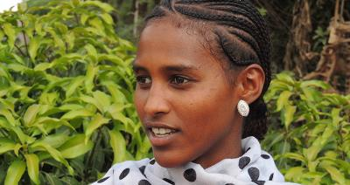
A CMHC, is treating Zande, who is Central African and recently immigrated to the U.S and is now in Job Corps. What can the CMHC do to practice cultural competency and humility when assessing and diagnosing Zande?
a. Consider the potential for bias toward a Western worldview in the tools she uses
b. Search for assessment methods that incorporate Zande's cultural practices
c. Find out what populations informed the treatment protocols she uses
d. All of the above
D
https://thinkculturalhealth.hhs.gov/behavioral-health/
Notes:
The correct answer is d. To improve the quality of care you provide to students from diverse backgrounds, it's important to consider what populations were included in the research samples used to develop the assessment methods and treatment protocols you use; the potential for cultural bias in the tools, treatments, or interventions you use; and how the assessment methods, treatments, or interventions used address the student’s clients' cultural beliefs and practices.

Slide 29
WHAT NOW?

Slide 30
Embrace the 4 C’s Curiosity, Comfort, Clarity and Confidence
1. Curiosity: Be open to explore areas of ignorance, discomfort and difference with accountability and responsiveness
Disclose your ignorance and signal your willingness to learn.
2. Comfort: Get comfortable with discomfort
You are going to make mistakes, and that’s okay. Create a safe space for people to say “that hurt” by being direct and open to feedback – and to apologizing, learning and changing.
3. Clarity: Understand yourself and how other people see you
It’s important to own your identities and experience and to know where you’re comfortable or uncomfortable.
4. Confidence: Put it all together!
How do you operationalize cultural competence and humility to know that you are changing and that these changes are meaningful and helpful to your work? Look for external evidence, such as a certain type of feedback from others – “I feel seen, I feel understood, I feel like you get me”
https://www.insidetrack.org/resources/understanding-cultural-competence-and-humility
Notes:
1. Curiosity: Be open to explore areas of ignorance, discomfort and difference with accountability and responsiveness
Disclose your ignorance and signal your willingness to learn.
2. Comfort: Get comfortable with discomfort
You are going to make mistakes, and that’s okay. Create a safe space for people to say “that hurt” by being direct and open to feedback – and to apologizing, learning and changing.
3. Clarity: Understand yourself and how other people see you
It’s important to own your identities and experience and to know where you’re comfortable or uncomfortable.
4. Confidence: Put it all together!
How do you operationalize cultural competence and humility to know that you are changing and that these changes are meaningful and helpful to your work? Look for external evidence, such as a certain type of feedback from others – “I feel seen, I feel understood, I feel like you get me”

Slide 31
ACT
Set three goals for becoming culturally competent and practicing cultural humility:
Notes:
More empathy and respect for others-
Builds trust and connection with your students and increased their sense of being seen, heard and understood. When you’re getting it right, your students will be visibly more comfortable.
Racial - important for us to understand the historical and contemporary conditions.
Cultural competence and cultural humility leads to productive dialogue about culture, differences, privilege, prejudice, power,.
Shift the conversation to understanding and respect

Slide 32
Sample Goals
Recognize student differences as diversity rather than abnormal behavior or inappropriate responses to the environment.
Respect the benefits of Job Corps student’s diverse culture, values and behaviors.
Recognize your own ethnocentricity—the ways in which you stereotype, judge, and discriminate.
Understand the effect that historic distrust has on the present-day interactions of our students.
Recognize the similarities that are shared across the “human culture,” regardless of the differences.
Learn factual information about other cultures and groups with different backgrounds represented on your Job Corps center
Make continued and sincere attempts to understand the world from a student’s point of view.
Develop a mentoring relationship with a student from a different culture or identity group represented on your center.
Show more patience and empathy when working and interacting with students who have different learning styles than you.
Integrate diversity issues as an ongoing topic in your center staff meetings.
Develop a personal plan for continued learning toward cultural humility based on the needs of your center.
Notes:
What will you do? Here are some sample goals.

Slide 33
Resources

Slide 34
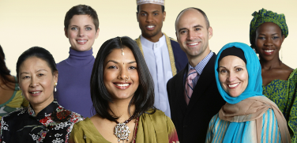
Resources
U.S. Department of Health & Human Services Improving Cultural Competency for Behavioral Health Professionals
https://thinkculturalhealth.hhs.gov/education/behavioral-health
Culturally Connected
https://www.culturallyconnected.ca/resources
Watch an 18-minute TEDx talk by Dr. Juliana Mosley, Cultural Humility
https://www.youtube.com/watch?v=Ww_ml21L7Ns
Project READY: Reimagining Equity & Access for Diverse Youth: A free online professional development curriculum
https://ready.web.unc.edu/
Notes:
The 18 minute TED Talk by Dr. Mosley is a must to watch.

Slide 35
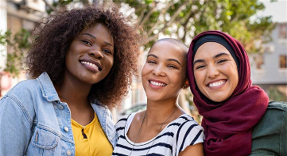
Resources
Substance Abuse and Mental Health Services Administration (SAMHSA)
https://www.samhsa.gov/section-223/cultural-competency/resources
Health Resources and Services Administration
Health https://www.hrsa.gov/about/organization/bureaus/ohe/health-literacy/culture-language-and-health-literacy
National Education Association
https://www.nea.org/professional-excellence/professional-learning/resources/cultural-competence
The Georgetown University National Center for Cultural Competence (NCCC)
https://nccc.georgetown.edu/cop/

Slide 36
Additional Resources
Brene Brown – Empathy vs Sympathy
https://www.youtube.com/watch?v=1Evwgu369Jw
Dialogues on Diversity
https://www.dialoguesondiversity.com/programs
Fenway Health-The National LGBTQIA+ Health Education Center
https://fenwayhealth.org/the-fenway-institute/education/the-national-lgbtia-health-education-center/
Project Implicit/Harvard University
https://implicit.harvard.edu/implicit/takeatest.html
Notes:
Brene Brown 2018 book entitled “Dare to Lead: Brave Work. Tough Conversations. Whole Hearts.,”
“Empathy is not connecting to an experience,” Brown wrote. “It’s connecting to the emotions that underpin an experience.” Empathy is also critical to understanding the cultural humility vs. cultural competence debate.
Implicit or Unconscious Bias is a webinar for another day, but if interested you can do an online self-assessment - Project Implicit/Harvard University

Slide 37
References
Greene-Moton, Ella, and Meredith Minkler. 2020. “Cultural Competence or Cultural Humility? Moving beyond the Debate.” Health Promotion Practice 21 (1): 142–45.
Nguyen, Peter V., Matthias Naleppa, and Lopez Yeimarie. 2020. “Cultural Competence and Cultural Humility: A Complete Practice.” Journal of Ethnic & Cultural Diversity in Social Work: Innovation in Theory, Research & Practice, April.
Danso, Ransford. 2018. “Cultural Competence and Cultural Humility: A Critical Reflection on Key Cultural Diversity Concepts.” Journal of Social Work 18 (4): 410–30.

Slide 38
THANK YOU FOR BEING HERE TODAY!

