Slide 1
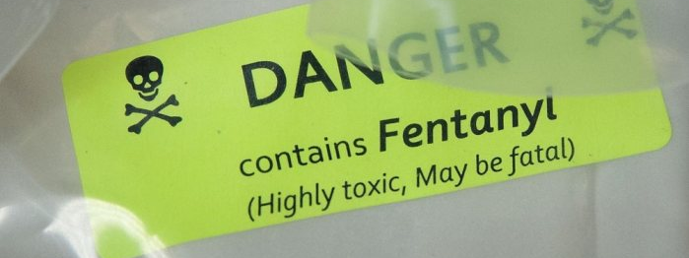
Fentanyl and Your Safety
This Photo by Unknown Author is licensed under CC BY
Christy Hicks, LCADC/CSW
Regional TEAP Specialist
Atlanta, Dallas and Chicago Regions

Slide 2
You will be able to:
Explain how fentanyl works in the body
List three short-term and three long-term effects of fentanyl use/exposure
List three safety precautions to avoid contact with fentanyl
This Photo by Unknown Author is licensed under CC BY-SA

Slide 3
What is Fentanyl?
Fentanyl is one of the most potent opioids used in medicine but is being misused as a street drug with sometimes fatal consequences.
Pharmaceutical fentanyl is n pain–killer opiate 80-100 times more potent than morphine.
Drug traffickers are using illicit fentanyl products as a cut in heroin and as a primary psychoactive ingredient in imitation Oxycodone pills.

Slide 4
Fentanyl is an Opioid
Fentanyl is a synthetic opioid (Opiate). This means it is chemically manufactured.
An Opioid is any drug compound that binds to opiate receptors (protein molecules located on the membranes of some nerve cells0 found in the brain, spinal cord and digestive tract.
Opioids are drugs derived naturally, synthetically, or semi-synthetically.
Opioids including fentanyl are legally designated as narcotics.

Slide 5
How do Opioids Work?
Our bodies naturally make opioids called endogenous opioids (endorphins).
Opioid receptors are specific receptors that attach only to opioids, which then cause pain relief.
When a person takes an opioid, such as Fentanyl or heroin, the opioids attach to the body’s opioid receptors.
Once the opioids are attached to the opioid receptors, the effects of the opioid take place (pain relief, drowsiness, confusion, nausea, etc.)

Slide 6
How is Fentanyl used?
Fentanyl is most commonly used intravenously, intramuscularly, epidural injection, or transdermal patch.
In powder form, Fentanyl can also be smoked, inhaled and snorted.
When pressed into pill form, Fentanyl can be swallowed and absorbed through the gastrointestinal tract.

Slide 7
Onset of use of Fentanyl
Intravenously
Immediate
Intramuscularly
8 minutes
Patch
12 hours
Mucus Membrane
11 minutes

Slide 8
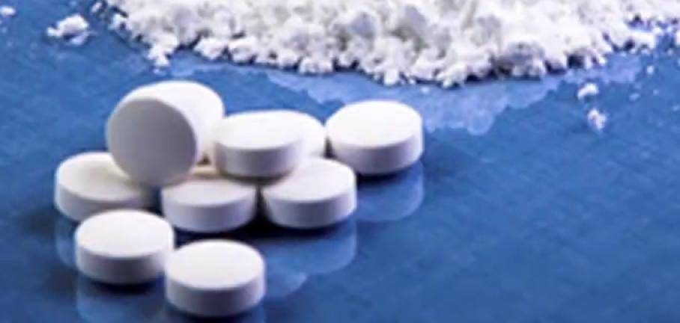
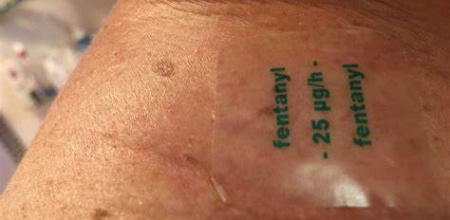
What does Fentanyl Look like?
White crystalline powder
Transdermal patch

Slide 9
Fentanyl Potency
Fentanyl | 100:1
Oxycodone (Percocet, OxyContin) | 2:1
Hydromorphone (Dilaudid) | 5:1
Codeine | 1:10
Methadone | 10:1
Comparison of potency of fentanyl and other prescription opioid drugs to morphine

Slide 10
Short-term Effects of Fentanyl Use (low dose)
Euphoria
Muscle rigidity
Respiratory depression
Pain relief
Anxiety
Depression
Drowsiness
Confusion
Dizziness
Weakness
Pupillary constriction
Suppression of cough reflex
Reduction in blood pressure
Fainting
Nausea and vomiting
Constipation
Slowing of breathing
Constriction of bronchi and impairment of ventilation

Slide 11
Short-Term Effects of Fentanyl Use (high dose)
Loss of consciousness
Cessation of breathing
Respiratory depression
Chest muscle paralysis
Increase in blood pressure
This Photo by Unknown Author is licensed under CC BY-NC-ND

Slide 12
Withdrawal Symptoms
Extreme restlessness
Yawning
Sweating
Muscle and bone pain
Anxiety
Irritability
Weakness
Stomach cramps
Insomnia
Nausea and vomiting
High blood pressure
Watery eyes and runny noes
Chills

Slide 13
Lethality
The risk for death is greater than for morphine and heroin
Death can be immediate
Even one small dose of fentanyl can be fatal
Symptoms of overdose include extreme downiness and sedation
Large does of the drug naloxone are needed to reverse overdose effects of fentanyl
This Photo by Unknown Author is licensed under CC BY

Slide 14
Potential for Abuse
Dependence liability:
As great as that of heroin
Rapid onset of action after intravenous use increases Fentanyl’s dependence liability
Inherent harmfulness:
As great as heroin and morphine, but higher risk of breathing cessation

Slide 15
Signs of Abuse
Sudden change in behavior
Mood swings
Withdrawal from family members
Careless about personal grooming
Loss of interest in hobbies, sports and other favorite activities
Changes sleeping pattern; up at night and sleeping during the day
Red or glassy eyes
Sniffing or runny nose
Tiny pupils

Slide 16
Continued
Slow breathing
Flushed skin
Tendency to nod off
scratching
Slurred speech
Complaints of constipation
Complaints of nausea
Change in appetite
Covering arms with long sleeves

Slide 17
Cross-Contamination
Cross contamination from equipment such as scales can cause fentanyl to be transferred to other dugs such as marijuana, methamphetamine, and cocaine.
In other words, drug dealers are not necessarily deliberately “lacing” other drugs with fentanyl rather, fentanyl is easily absorbed into the other drugs in the same location.

Slide 18
Fentanyl: Emergency Responders at Risk
Analyze the incident and determine if illicit drugs and/or other hazards may be present.
1
Do not eat, drink, smoke, or use the bathroom while working in an area with known or suspected illicit drugs.
2
Do not touch the eyes, mouth, or nose after touching any potentially contaminated surface. Always wear nitrile gloves when illicit drugs may be present.
3
Avoid performing tasks or operations that may cause illicit drugs to enter the air. Only trained emergency responders wearing proper PPE should conduct activities that could cause illicit drugs to enter the air.
4
Avoid direct skin contact with illicit drugs. If this occurs, immediately wash the area with soap and water and notify dispatch and/or your supervisor.
5

Slide 19
Continued
Develop an incident-specific plan to perform field-testing. Personnel specifically trained to perform field-testing should do so while wearing proper PPE.
Wash hands (or other unprotected skin) with soap and water immediately after coming into contact with illicit drugs or after leaving an area where illicit drugs may have been present. Avoid breaking the skin while cleaning and cover all open wounds.
Do not use hand sanitizer (or any alcohol-based cleaner) or bleach
Be aware that the use of illicit drugs in bathrooms is reportedly a common practice. Individuals might hide or try to get rid of illicit substances by dumping them into the toilet and flushing repeatedly. This process can increase the chances of responders inhaling harmful substances. This process may also cause bathroom surfaces and materials to be unsafe.

Slide 20
Potential Exposures for Responders
Inhalation
Breathing
Ingestion
Eating
Mucosal
Touching eyes, nose, or mouth with contaminated hands or gloves or when illicit drugs come into contact with the eyes, nose, or mouth directly
Dermal
Liquid illicit drugs may be absorbed by the skin
Percutaneous
Being stuck by a needle

Slide 21
Decontamination
Remove
Remove contaminated PPE.
Shower
Shower immediately.
Avoid
Avoid breaking the skin while cleaning and cover all open wounds.
Do not use
Do not use hand sanitizer (or any alcohol-based cleaner) or bleach to clean skin.
Remove and wash
Remove and wash all clothing. Carefully place clothing in labeled, durable 6 mil polyethylene bags and keep segregated from other laundry.
Clean
Clean reusable PPE and equipment according to the manufacturer’s recommendations.
Place
Place contaminated single-use PPE in labeled durable 6 mil polyethylene bags and dispose of appropriately.

Slide 22
Naloxone Use in a Suspected Overdose
Ensure
Ensure Emergency Medical Services have been requested.
Assess
Assess the scene and ensure it is safe to enter.
Recognize
Recognize the signs and symptoms of an overdose.
Administer
Administer naloxone. A second dose may be needed if the person is still unresponsive after 2-3 minutes. Naloxone effects are temporary. Immediate definitive professional medical attention is needed.
Start
Start other first aid such as rescue breathing or CPR if trained to do so.

Slide 23
How does this fit in with Job Corps?
We go through belongings
We clean bathrooms, dorm rooms, laundry rooms
We accept papers/forms from students and their families
High-risk population we serve
We are a residential setting

Slide 24
Questions????

