Slide 1
Measures to Keep Light Curing Safe & Effective
September 12, 2022
Dr. Pam Alston, Lead/Region 5,6 Oral Health Specialist

Slide 2
What hazards do we face in dentistry?

Slide 3
Previous teleconferences/webinars on hazards
Musculoskeletal Complications & ergonomics
Ionizing Radiation & Radiation safety
Noise induced Hearing Loss
COVID-19
Latex allergies
Monkeypox

Slide 4
Electromagnetic Spectrum
Reference: What Is Blue Light? (webmd.com), accessed on 9/6/22

Slide 5
Webinar Objectives—You will learn:
1) The potential risks of using dental light cure units
2) Safety measures when using light cure units
3) Practical tips and guidelines that clinicians can use to ensure that their light-cured resin restorations are adequately polymerized

Slide 6
Ayatollahi J, Ayatollahi F, Occupational hazards to dental staff, Dental Research Journal, January 2012, Issue 1

Slide 7
Reference:
Fluent MT, Ferracane JL et al, Shedding Light on a Potential Hazard, JADA, Volume 150, Issue 2, December 2019

Slide 8
Polymerization of Dental Materials
Some dental materials have polymerization initiators.
The UV light curing unit emits lights that activates the polymerization initiators.
Molecules of some of the photoinitiators absorb light of a determined wavelength causing the photoinitiators to decompose.
The decomposed photoinitiators give off free radicals.
In the presence of free radicals, monomers and oligomers react and very quickly form polymer chains forming webs.
By converting monomers and oligomers into polymers, dental material becomes solid.
Reference: Photopolymerization of Dental Materials: Types and Characteristic of the Light Source,
Serbian Dental Journal, Volume 56, Number 4, 2009

Slide 9
“Blue light” & “UV light” are the same
Computer Screen
Light Cure Unit

Slide 10
“Absence of evidence is not evidence of absence.”—Carl Sagan

Slide 11
Blue Light Hazard
Exposure to high levels from light cure units can cause soft tissue burns and eye damage

Slide 12
What is wrong with this picture?

Slide 13
Safety breaches when using light cure units
No eyewear
Inappropriate eyewear
Misuse of eyewear
Eye protection should be covered by National Standards Institute/International Safety Equipment Association standard Z87.159 and International Organization for Standardization standard 12609

Slide 14
An experiment to make sure your blue light filtering device is effective
Take your light-cured resin-based restorative material into a dark room
Distribute a clinically relevant increment of the material (about 6 mm in diameter and 2 mm thick) on a pad
Place your protective filtering device just above the material
Place your curing unit just above the protective filtering device
Cure for about 20 seconds
After performing this procedure, if the restorative material shows signs of curing, then the protective filtering device is not adequately blocking transmission of blue-light.

Slide 15
Select Appropriate Eye Protection
Use the eye protection provided by the manufacturer of your curing light
Eye protection should be covered by National Standards Institute/International Safety Equipment Association standard Z87.159 and International Organization for Standardization standard 12609.
If a third party manufactures the orange shields or glasses, ensure that they protect against the wavelengths emitted by the light cure unit that you use.

Slide 16
Orange round or oval shields attached to the light guide that are designed to protect against the wavelengths of light from the LCU being used
Advantages | Disadvantages
Can be adjusted to provide best eye protection for the operator | The surface area of the protective eye filter of most LCUs is not sufficient to protect the dentist and the assistant at the same time May restrict correct access of the light the restoration If using this method, consider providing additional protective eyewear for the assistant

Slide 17
Orange goggles or glasses (especially those with side protection) that are designed to protect against the wavelengths of light from the LCU being used
Advantages | Disadvantages
Provide optimum protection, eliminate scatter irradiation Allows for hands-free eye protection | If using loupes, may be inconvenient to change between the application of dental materials and light curing

Slide 18
Antiglare cones that fit on light guide or tip
Advantages | Disadvantages
Easy to use Allows hands-free protection | May obstruct the view and may prevent ideal placement of the light tip over the restoration Can increase the distance between the tooth and the light tip May not provide sufficient eye protection in some light tip positions or if cone slips from the proper location

Slide 19
Paddles
Advantages | Disadvantages
May provide adequate coverage for both the dentist and assistant (depending on design and placement of paddle) Curved paddles allow for better fit around the patient’s face than a rectangular paddle | Requires an extra hand to hold the paddle in place. Does not allow hands-free protection

Slide 20
Paddles
Advantages | Disadvantages
May provide adequate coverage for both the dentist and assistant (depending on design and placement of paddle) Curved paddles allow for better fit around the patient’s face than a rectangular paddle | Requires an extra hand to hold the paddle in place. Does not allow hands-free protection

Slide 21
“Look away”: In this method, the user places the curing light tip over the restoration to be cured and subsequently looks away when the LCU is turned on
Advantages | Disadvantages
None | This method does not provide adequate ocular protection

Slide 22
Instructions for Use (IFU)
Use appropriate light-blocking eye protection during light-curing procedures.
Do read and understand the instructions for use or IFUs from the curing light manufacturer.
Position the light shield to maximize eye protection when light curing.
Do use appropriate barrier sleeves that are recommended by your light care unit manufacturer
Follow the IFU regarding covering the tip of the light guide and the control buttons.
Avoid covering the whole light cure unit and therefore blocking the vents on the unit.
Do routinely test curing light output with a radiometer per manufacturer recommendations.

Slide 23
Instructions for Use (IFU)
Do follow the dental material instructions for the dental materials as well. Stick to the exposure times recommended by they manufacturer.
Do not operate the curing light without using the correct eye protection.
Do not look directly or indirectly at the light from the curing unit.
Do not just look away when light curing. You must wear the appropriate eye protection so that you can watch what you are doing.
Some oral health personnel rely upon judging the heat output from the Light cure unit by shining the light tip on the fingernail or on the back of the hand. Don’t do it.
There is something you can do to see if you are getting sufficient output from our LCU. Use a radiometer on a regular basis to ensure that the LCU is functioning optimally, and take appropriate steps to remove adherent resin from tipend-surfaces.

Slide 24
Practical tips and guidelines that clinicians can use to ensure that their light-cured resin restorations are adequately polymerized

Slide 25
Technique Tips
To minimize heat development, cool the tooth and tissues with a flow of air.
Consider curing at intermittent intervals (for example, 2 exposures each lasting 10 seconds with a 5-second pause in between each instead of 1 continuous exposure lasting 20 seconds).
Do not expose oral tissues for longer times than recommended in the light manufacturer’s instructions for use. Cosmetic dentists know that different shades of composite supplied from the same manufacturer often require different exposure times.

Slide 26
Technique Tips
Clinicians should monitor the output from their LCUs using a radiometer on a regular basis to ensure that the LCU is functioning optimally, and take appropriate steps to remove adherent resin from tip end-surfaces.
Protect the eyes of everyone in the operatory who could be directly exposed to the bright blue light, using appropriate orange (blue-light blocking) safety glasses.
• Position the patient so that the person using the LCU can see the restoration and so that the LCU can access the restoration.

Slide 27
Tips to protect the students you are treating
Know that some patients are more sensitive to light exposure than the average person. Is the student taking a medication that makes his or her eyes more photosensitive?
Do not shine the light directly on unprotected oral mucosa or skin.
To protect soft tissues, especially when light-curing Class V restorations, cover gingiva with a gauze
Avoid shining the light onto the mucosa.

Slide 28
Tips to protect the students you are treating
No soft tissue should be near the tip of the curing light.
The Light Cure Unit should be activated over the resin based composite material only and to place gauze under the rubber dam to reduce heating the soft tissues underneath.
Do not arbitrarily use exposure durations in excess of those recommended by the manufacturer in an attempt to ensure that their resin-based composite restoration has received sufficient light energy.
Take steps to avoid overheating the tooth when using the curing light for the same reason.

Slide 29
Another tip to protect the students you are treating
Do not allow restorative materials to contact the end of the curing light (light guide, tip, or wand), as it will adhere to the tip and reduce light output. Using a protective barrier (if recommended by the manufacturer of the LCU) will prevent this from occurring.

Slide 30
Insufficient Light Output
Inadequate maintenance
Surveys published worldwide on LCUs used in dental offices have shown that many deliver less than 300 mW/cm^{2,} which is insufficient for satisfactory light-curing.
Light tips of many LCUs were either damaged or covered in resin, which will also reduce the light output. Oral Health
Personnel should regularly check their LCU for adequate output and inspect the light tip for damage or debris before each use.

Slide 31
Ensuring that their light-cured resin restorations are adequately polymerized
Clinicians must use the correct amount of curing time and should follow the manufacturer’s instructions for each brand and shade of resin-based composite
There can be an eight-fold difference in the curing time recommended by the manufacturer to effectively light-cure different shades and types of their own resin-based composites with their own light.
Doubling the irradiance, that is, the amount of UV energy that falls on a particular tooth surface, does not necessarily cut the curing time in half.

Slide 32
Shopping for a new curing light
Broad-spectrum quartz-tungsten halogen lights are being replaced by narrow-spectrum light-emitting diode (LED) units.
• Make that your curing light can emit light in the range that some resins need. For example, some resin manufacturers are using photoinitiators that require light to be in a certain range for optimum polymerization, yet the LED units you are looking to buy may not deliver any light that range
. • When you go shopping for a new light curing unit, you will observe light cure units that are becoming increasingly more powerful, with curing times being reduced to as little as 1 second. Unfortunately, there are no good clinical trials that clearly show the effectiveness of fast-curing protocols, or one LCU over another LCU.
An influx of inexpensive, poorly designed LCUs has occurred.
Ensure that both the LCU* and its charger are approved medical devices.
The US Food and Drug Administration list of registered medical devices can be found at https://www. accessdata.fda.gov/scripts/cdrh/cfdocs/cfRL/TextSearch.cfm.

Slide 33
Shopping for a new curing light
Ensure that the photoinitiator systems of the dental material to be cured are compatible with the light emitted from the LCU
For resins that use only camphorquinone, a monowave light-emitting diode device delivering blue light (430-500 nanometers) is recommended.
For resins that use additional photoinitiators that absorb almost exclusively < 420 nm and into the ultraviolet range, such as Lucirin TPO (BASF Formulation Additives) or phenyl-propanedione, a light delivering a broad spectrum of light from 380-515 nm.64 is recommended.

Slide 34
Cleaning, disinfection and sterilization tips
Once the light-curing procedure is complete, follow the manufacturer’s IFU regarding methods for cleaning and disinfect the curing light and light shield, antiglare shield, cone, or other eye protection.
To avoid damage, ensure that the disinfectant is compatible with the surface of the curing light and the shield used.
Barrier sleeves are labeled as “single-use.” So always discard after each use to prevent cross-contamination.

Slide 35
Cleaning, disinfection and sterilization tips
If cured dental materials are visible at the end of the light guide or light attachment lens, use an alcohol wipe and a plastic-edged instrument to gently scrape them away.
Always be careful handling the light cure unit.
ANSI/ADA and ISO standards require curing unit manufacturers to provide appropriate cleaning and disinfection methods in the instructions for use, which should be followed between each patient

Slide 36
Exercises to reduce eye strain

Slide 37
The 20-20-20 Rule
Digital eye strain can become a problem for people who need to focus on a computer screen all day while working.
The 20-20-20 rule helps ease digital eye strain. The rule is easy: a person needs to look at something 20 feet away for 20 seconds every 20 minutes while working on a computer.
Reference: Sheppard AL, Wolffsohn JS. Digital eye strain: prevalence, measurement and amelioration.
BMJ Open Ophthalmol. 2018 Apr 16;3(1):e000146. doi: 10.1136/bmjophth-2018-000146.
PMID: 29963645; PMCID: PMC6020759.

Slide 38
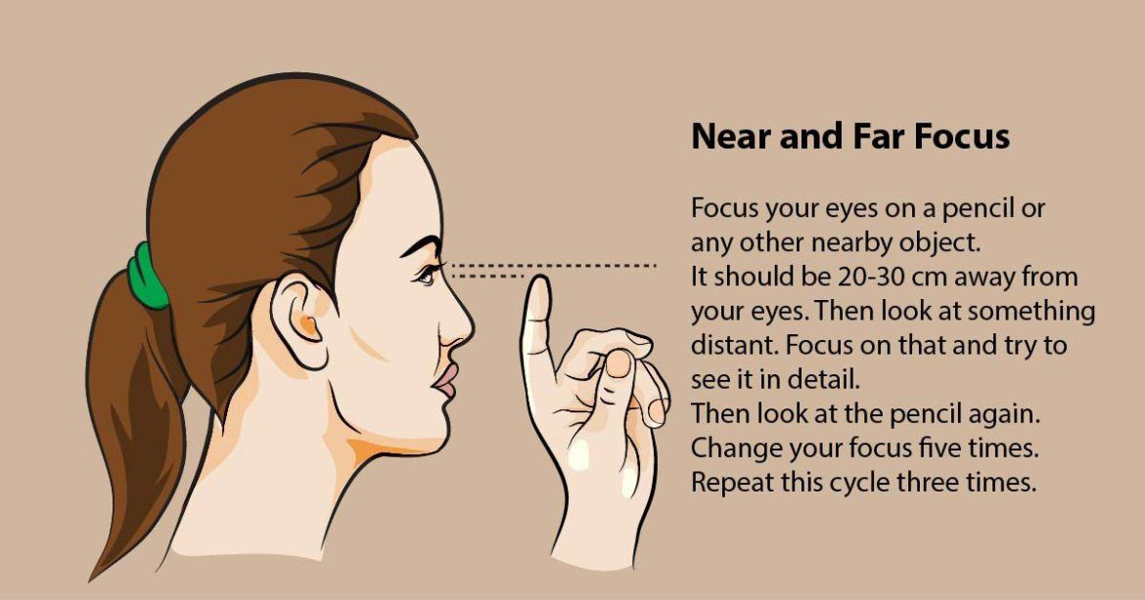

Slide 39
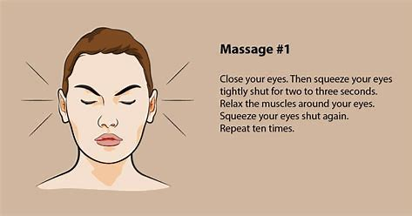
It is important to note that people with eye conditions such as retinopathy, cataracts, or glaucoma are unlikely to benefit from trying the eye exercises below.

Slide 40
Focus Changes
The focus change exercise can also help with digital eye strain. People should perform this exercise while sitting.
Hold one finger a few inches away from one eye.
Focus the gaze on the finger.
Move the finger slowly away from the face.
Focus on an object farther away, and then back on the finger.
Bring the finger back closer to the eye.
Focus on an object farther away.
Repeat three times.

Slide 41
6. Figure of Eight
This is a great exercise to ensure flexibility of the eye muscles. It is simple to perform. Staring at a blank wall, imagine a large figure 8 tilted on its side 10 feet away from you. Now trace this path of the figure 8 with your eyes without moving your head. Do this one way for a minute and then the reverse way for a minute.

Slide 42
Caveat
There is not much scientific evidence to suggest that eye exercises help improve vision in general. However, eye exercises and vision therapy can help with digital eye strain and certain eye conditions.
A person can easily perform eye exercises such as the 20-20-20 rule, figure 8, and pencil pushups at home.
If a person experiences blurred vision, red eyes, or eye pain or has concerns about their vision, they should contact their doctor.

Slide 43
References
Dental Curing Lights | American Dental Association (ada.org)
Effective Use of Dental Curing Light: A Guide for the Dental Practitioners, ADA Professional Product Review, Volume 8, Issue 2, 2013
Price R, Light Curing in Dentistry, Dental Clinics of North America, Volume 61, Issue 4, 2017, Pages 751-778, https://doi.org/10.1016/j.cden.2017.06.008.
Price RB, Ferracane JL, Hickel R, Sullivan B. The light-curing unit: An essential piece of dental equipment. Int Dent J. 2020 Dec;70(6):407-417. doi: 10.1111/idj.12582. Epub 2020 Jul 21. PMID: 32696512; PMCID: PMC9379154.

Slide 44
References
Price R., Avoiding Pitfalls when using a Light-Curing Unit, Compendium of Continuing Education in Dentistry Volume 34, Issue 4, April 2013, Accessed 9/11/22 at: https://www.aegisdentalnetwork.com/cced/2013/04/
OSHA Technical Manual (TED 1-0.15A, Section III - Chapter 6))
American Conference of Governmental Industrial Hygienists (ACGIH) http://www.acgih.org

Slide 45
References
Mousavinasab SM, Meyers I. Curing efficacy of light emitting diodes of dental curing units. J Dent Res Dent Clin Dent Prospects. 2009 Winter;3(1):11-6. doi: 10.5681/joddd.2009.004. Epub 2009 Mar 16. PMID: 23230474; PMCID: PMC3517196.

