Slide 1
Oral Health Personnel Teleconference
Drs. Pamela Alston and Kevin Avery
Oral Health Specialists
Thursday, March 17, 2022

Slide 2
To have your attendance recorded in the minutes
Attendance is taken by a survey.
The survey link is placed in the chat box during the teleconference
It is also read aloud at least once.
If an attendee is not able to go to the link, the attendee should email Leah Pan at: Leah.Pan@humanitas.com
Each attendee must complete a separate survey.
It is recommended that you complete the survey link within 48 hours after the teleconference.
Once the minutes are submitted to the National Office, there is no opportunity to make edits. Attendance cannot be updated

Slide 3
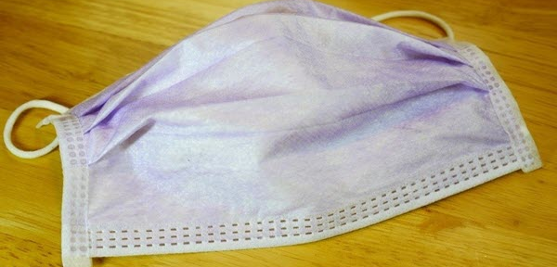
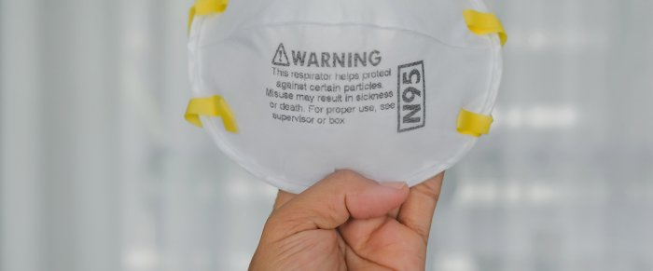
Masks and Masking for Oral Health Personnel
Objectives:
Learn the features of different masks
Learn the CDC mask updates
Learn Job Corps current masking policy

Slide 4
What do seat belts & masks have in common?

Slide 5
Time it takes to transmit an infectious dose of COVID-19
Infectious person
 | Nothing | Cloth Mask | Surgical Mask | N95
Nothing | 15 minutes | 20 minutes | 30 minutes | 2.5 hours
Cloth Mask | 20 minutes | 27 minutes | 40 minutes | 3.3 hours
Surgical Mask | 30 minutes | 40 minutes | 1 hour | 5 hours
N95 | 2.5 hours | 3.3 hours | 5 hours | 25 hours
Note: It will take 25 hours for an infectious dose of COVID-19 to transmit between people wearing non-fit-tested N95 respirators. If they’re using tightly sealed N95s—where only 1% of particles enter the facepiece—they will have 2,500 hours of protection.
Source:
ACGH’s Pandemic Response Task Force

Slide 6
Surgical Masks

Slide 7
Surgical Masks
Loose-fitting, disposable device that creates a physical barrier
Regulated under 21 CFR 878.4040
Labeled as surgical, isolation, dental, or medical procedure masks
Sometimes referred to a face masks
Made in different thicknesses
Vary in ability to protect wearer from contact with liquids

Slide 8
Surgical Masks
Meant to block large-particle droplets, splashes, sprays or splatter
May help reduce exposure of the wearer’s saliva and respiratory secretions to others
Does not filter or block very small particles in the air
Does not provide complete protection from germs and other contaminants due to loose fit
Not intended to be used more than once

Slide 9
N95 Respirator

Slide 10
N95 Respirators
N: respirator rating letter class. It stands for “non-oil.”
95: 95 percent efficiency
.3 microns: the minimum size of particulates that won’t pass through the barrier
Material: electrostatic non-woven polypropylene fiber
Valve: optional and presence reduces exhalation resistance
Reference: https://www.honeywell.com/us/en/news/2020/03/n95-masks-explained

Slide 11
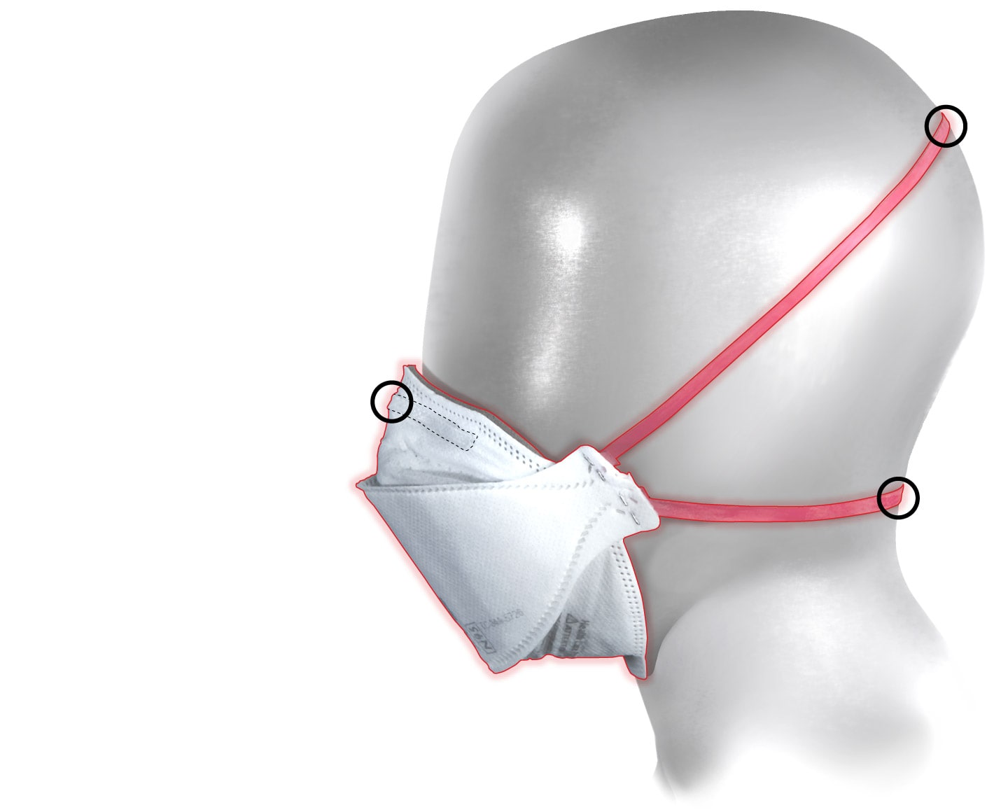
Steckelberg A, Berkowitz B, Why Most of Us Should Be Wearing N95 Masks, January 20, 2022, The Washington Post, accessed on 1/31/22 at: Why N95 masks are so effective and how to wear one - The Washington Post
Illustrations use photographs shot by Amanda Voisard for The Washington Post.

Slide 12
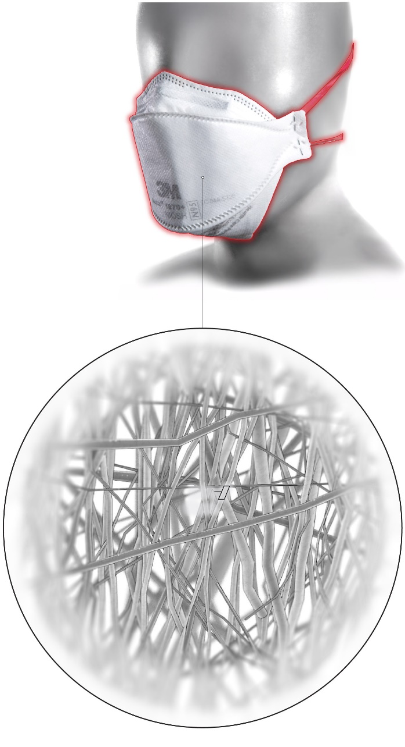
Source: Steckelberg A, Berkowitz B, Why Most of
Us Should Be Wearing N95 Masks,
January 20, 2022, The Washington Post,
accessed on 1/31/22 at:
Why N95 masks are so effective and how to wear one - The Washington Post
Illustrations use photographs shot by Amanda Voisard for The Washington Post.

Slide 13
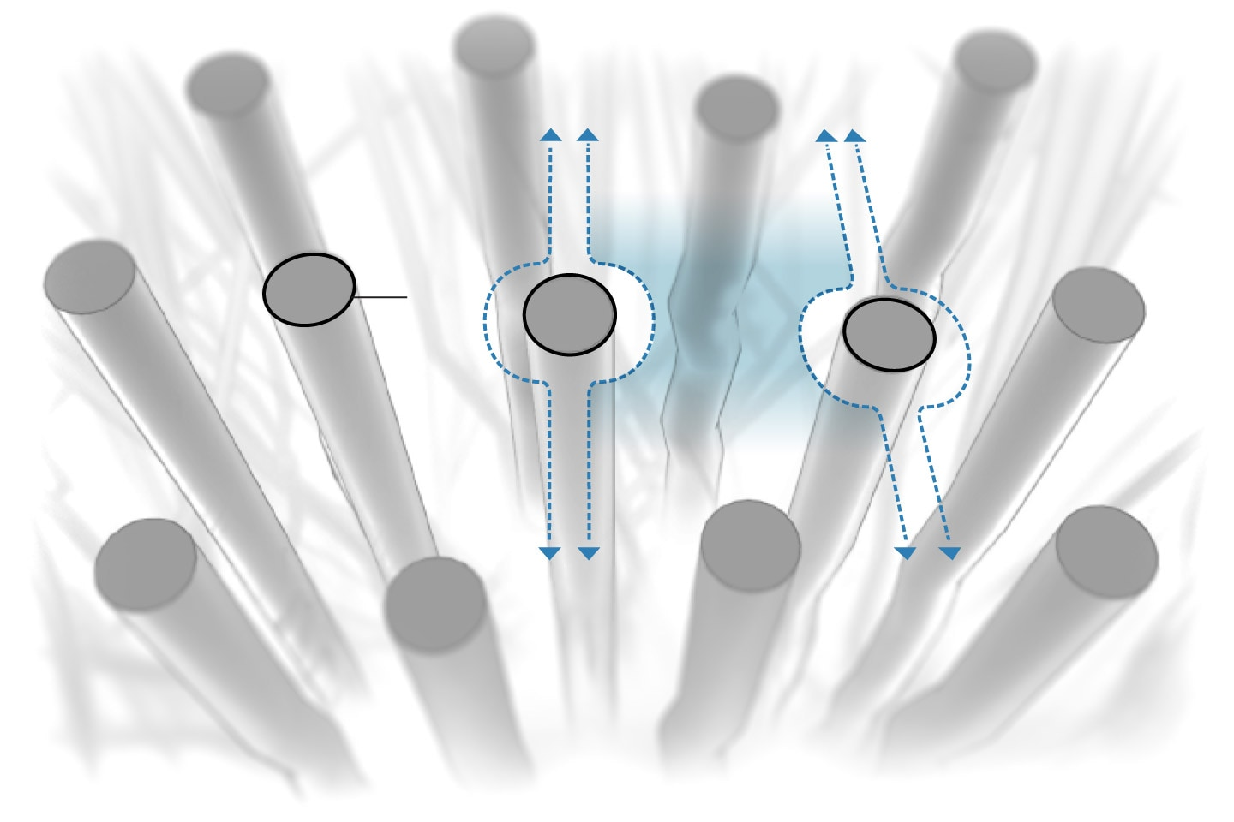
Source: Steckelberg A, Berkowitz B, Why Most of
Us Should Be Wearing N95 Masks, January 20, 2022, The Washington Post,
accessed on 1/31/22 at:
Why N95 masks are so effective and how to wear one - The Washington Post
Illustrations use photographs shot by Amanda Voisard for The Washington Post.

Slide 14
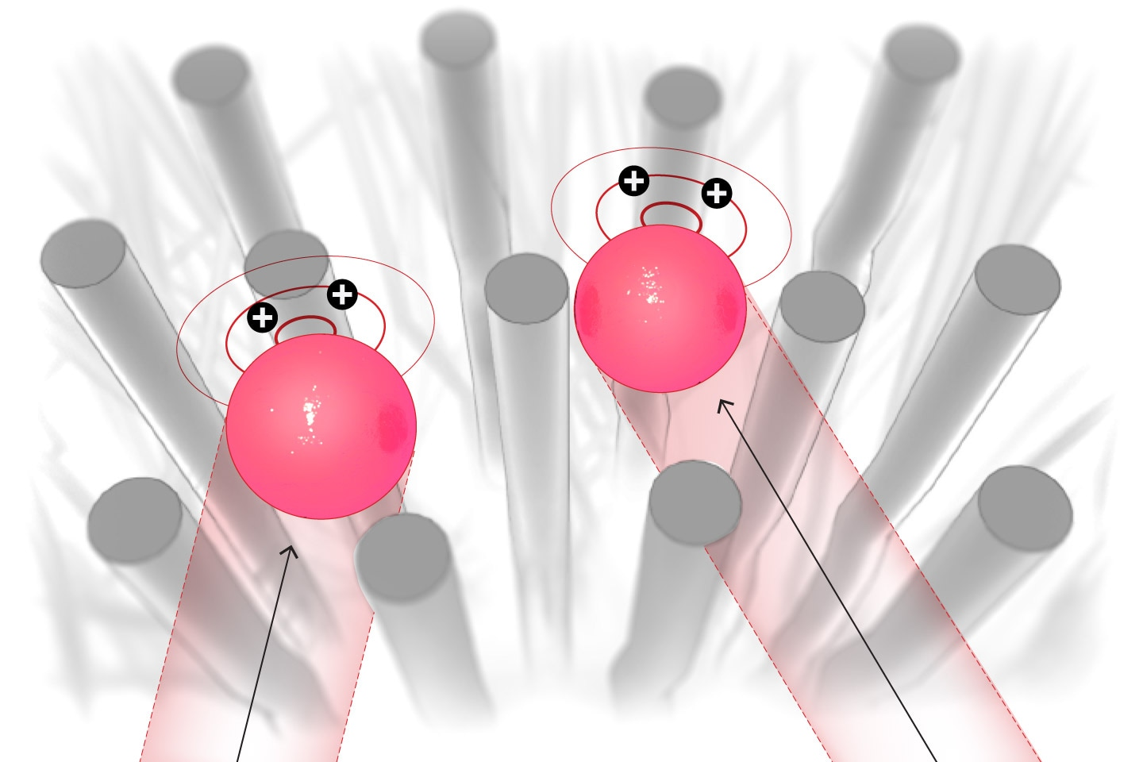
Source: Steckelberg A, Berkowitz B, Why Most of
Us Should Be Wearing N95 Masks, January 20, 2022, The Washington Post,
accessed on 1/31/22 at:
Why N95 masks are so effective and how to wear one - The Washington Post
Illustrations use photographs shot by Amanda Voisard for The Washington Post.

Slide 15
Source: Steckelberg A, Berkowitz B, Why Most of
Us Should Be Wearing N95 Masks, January 20, 2022, The Washington Post, accessed on 1/31/22 at:
Why N95 masks are so effective and how to wear one - The Washington Post
Illustrations use photographs shot by Amanda Voisard for The Washington Post.

Slide 16
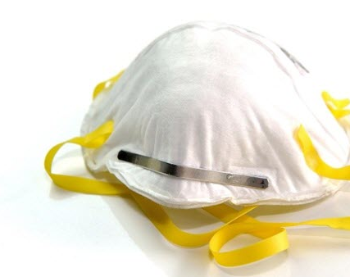
N95 Respirators
“Well-fitting N95s are the most protective, followed by KN95s and surgical masks. Chines-made KN95s are supposed to be of a standard comparable to N95s, and many are of high quality, but they do not go through the NIOSH approval process.”—CDC

Slide 19
Job Corps Protocol for Oral Health Personnel
If aerosol-generating procedures must be performed, Oral Health Personnel must wear an N95 respirator.
The following PPE guidelines must be followed by oral health staff:
Face masks | In the treatment and sterilization area, OHP will wear fit-tested NIOSH-approved N95 respirators or duck-bill respirators that do not require fit testing for extended use until they become visibly contaminated.
Reference:
Appendix 9: Personal Protective Equipment (PPE) Requirements for Oral Health Personnel (OHP)

Slide 20
Wear your N95 so it is effective

Slide 21
Keep your N95 Snug and Remove it properly

Slide 22
Summary of CDC Update 1/28/22
Added information to present similar content for masks & respirators
Removed concerns related to supply shortages for N95s
Clarified that “surgical N95s” are a specific type of respirator that should be reserved for healthcare settings
Clarified that some types of masks and respirators provide more protection to the wearer than others
Reference: https://www.cdc.gov/coronavirus/2019-ncov/prevent-getting-sick/types-of-masks.html

Slide 23
Key CDC Messages
Masking is a critical public health tool for preventing COVID-19 spread
Wear the most protective mask that you can that fits well and that you will wear consistently
Wear masks correctly
It is most important to wear a well-fitting mask or respirator correctly that is comfortable for you and that provides good protection
Properly fitting respirators provide the highest level of protection

Slide 24
Masking on Job Corps Centers
Source: Job Corps Mission Critical Meeting, March 15, 2022

Slide 25
REMEMBER—Time it takes to transmit an infectious dose of COVID-19
Infectious person
 | Nothing | Cloth Mask | Surgical Mask | N95
Nothing | 15 minutes | 20 minutes | 30 minutes | 2.5 hours
Cloth Mask | 20 minutes | 27 minutes | 40 minutes | 3.3 hours
Surgical Mask | 30 minutes | 40 minutes | 1 hour | 5 hours
N95 | 2.5 hours | 3.3 hours | 5 hours | 25 hours
Note: It will take 25 hours for an infectious dose of COVID-19 to transmit between people wearing non-fit-tested N95 respirators. If they’re using tightly sealed N95s—where only 1% of particles enter the facepiece—they will have 2,500 hours of protection.
Source:
ACGH’s Pandemic Response Task Force

