Slide 1
Suicide prevention via developing healthy communication, interaction and selves:
Alec Mendelson, Ph.D.
center mental health consultant

Slide 2
This presentation is about how staff and students on Job Corps campuses can each do their part to promote:
Healthy coping skills
Safe & supportive center environments
Positive and constructive connectedness
Toward decreasing depression,
suicidal ideation and self harm.

Slide 3
3 Parts:
Some background on suicide.
What staff can practice and do, especially in their communications and interactions.
Perspectives on campus life that can help students avoid social and emotional pitfalls.

Slide 4
Suicidal Warning Signs:
Has attempted suicide before
Takes unnecessary and dangerous risks
Has recently experienced significant losses (often with survivor guilt)
Increased trouble with eating or sleeping
Loss of interest in his or her personal appearance
Loss of interest in school, work and leisure time activities
Exhibits dramatic change in mood and/or behavior
Gives away (prized) possessions
Withdrawal from friends and social activities
Increased alcohol or drug use
Preoccupation with death and dying
Talks about committing suicide

Slide 6
Males
Notes:
Firearms – 58% Males - Methods
Suffocation – 27%
Drugs – 5%
Non –drug – 2%; Fall – 2%; Cut/Pierce – 2% Drowning – 1%

Slide 7
Females
Notes:
Firearm – 33% Female Methods 2020
Suffocation – 29%
Drug Poisoning – 25%

Slide 8
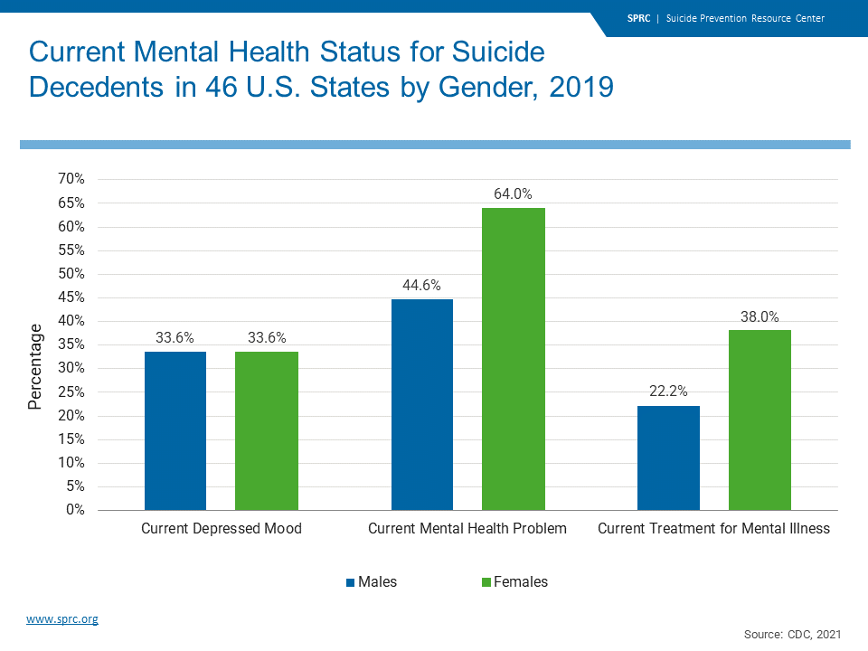

Slide 9
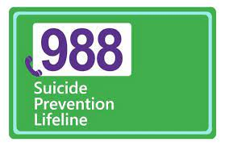

Slide 10
A few facts:
In 2009, 8.1% of young adults reported an incidence of major depression in the past month.
In 2017, the rate jumped t0 13.2%, over a 50% increase in 8 years.
The change is from 1 in 12 to about 1 in 8.
Similarly, young adults reporting suicidal thoughts, plans or attempts from 7% in 2008 to 10.3% in 2017.
Notes:
50% increases in less than a ten year period

Slide 11
A few facts:
Trauma and Post Traumatic Stress Disorder are risk factors for suicide.
One study found that those with PTSD had 5.3 times the rate of death by suicide than those without PTSD. (Gradus et al, 2015).
PTSD is a mental health condition that’s triggered by a terrifying (traumatic) event – either experiencing it directly or witnessing it.
PTSD symptoms include but are not limited to: Intrusive memories, flashbacks, nightmares, irritability, trouble concentrating, trouble sleeping, overwhelming sense of guilt or shame, easily startled, on guard for danger, self-destructive behavior.
Notes:
We have heard a lot about high suicide rates for people in the military, while serving and after discharge.
There is no shortage of students with trauma at Job Corps.

Slide 12
A few facts:
Suicide attempts are nearly two times higher among Black and Hispanic youth than White youth.
LGBTQ youth are nearly four times more likely and questioning youth are three more times likely to attempt suicide as compared to their straight peers.

Slide 13
LGBTQ
Substance Use:
Gay, lesbian, bisexual and transgender youth are more than twice as likely to experiment with drugs and alcohol than heterosexual youth.
Happiness:
Only 37% of LGBT youth report being happy compared to 67% of non-LGBTQ youth. Yet 80% of LGBTQ youth believe they will be happy eventually if they move away from their current town.
Notes:
So it is important not to repeat history here at Job Corps.

Slide 14
Our Population:
18–25-year-olds have reported major depression at a rate 70% higher than 26–49-year-olds.
While females report higher rates of depression than males, males attempt suicide at more than twice the rate of females.
Suicide is the second leading cause of death in individuals aged 15-24.
Notes:
Males act rather than talk. Hope this is changing.
Leading cause of death = firearms.

Slide 15
Our Population:
Students who are isolated and targeted by peers’ rumors in early adolescence are more likely to experience symptoms of depression by high school (Journal of Developmental Psychology).
Research suggests that youth who are bullied over time are more likely than those not bullied to experience
Depression
Anxiety
Low self-esteem
School avoidance
Notes:
Rumors are as damaging as behavior.

Slide 16
Varied presentation:
Depressed mood presentations vary;
Some may present as lethargic, fatigued and down.
Others may present as angry, irritable and behaviorally activated.
Some may appear cheerful or pleasant but avoid active engagement in their environments.

Slide 17
Suicidal Warning Signs:
Increased trouble with eating or sleeping
Increased alcohol or drug use
Loss of interest in his or her personal appearance
Loss of interest in school, work and leisure time activities
Withdrawal from friends and social activities
Exhibits dramatic change in mood and/or behavior
Preoccupation with death and dying
Talks about committing suicide
Gives away (prized) possessions
Has recently experienced significant losses (often with survivor guilt)
Takes unnecessary and dangerous risks
Has attempted suicide before
n
Notes:
Many of these warning signs can occur without suicidal ideation or intent. More so the behaviors on the left.
Often, any one staff member will not see all these signs. So how do we KNOW when to take these factors seriously. Answer = err on the side of safety.
Our challenge is to be able to collaborate with one another about high acuity students. Then we want to be able to connect effectively with students. More on that soon.

Slide 18
Notes:
Sometimes there is not a build up to suicidal thoughts and self-destructive action. It can be impulsive, for example following a breakup.
Example: She doesn’t want to be with me. I am such a loser. The future will suck much like now. SO … I would be better off dead.

Slide 19
OK here is the part I really want you to Hear
Notes:
Students come to JC with an old script that is negative.
Negativity reinforces negativity whether in thoughts, emotions or actions.

Slide 20
Notes:
Many of our students do not know how to care about themselves. External locus of control
Lack of experience with success = so even when start off strong, stop trying out of fear of success. Self-sabotage.
Hopelessness and despair can not only lead to “why bother”? But ”why am I here”? Or “No one would miss me if I was dead”.

Slide 21
Passive Ideation vs. active intent
Passive suicidal ideation:
is when you have thoughts of suicide or self harm but no plan to carry it out.
“I wish I could go to sleep and not wake up,” or “I wish I could die in a car accident.”
Although passive suicidal ideation is perceived as less of a risk compared to active suicidal ideations, these thoughts can still be dangerous as perspective and intent can change quickly.
Active Suicidal thinking:
is when you have thoughts of suicide or self harm and have developed a plan to carry it out.
Direct thoughts of wanting to end one’s life.
Passive suicidal ideations can be triggered to become active by:
An unpredictable event like a fight, bad day, or mental health trigger like a breakup.
Physical illness
Notes:
I am sharing this for informational purposes. As staff members, our mandate is to reduce risk, promote healthy connection and well-being wherever possible.

Slide 22
Suicide Prevention strategies:
Identify and support people at risk.
Strengthen access and delivery of mental health care.
Strengthen economic supports.
Teach coping and problem-solving skills.
Create protective environments
Promote connectedness
Notes:
2. Cover MH in insurance policies; new 988 #
Housing and financial security reduces risk
For mental health and counselors to promote.
This is our domain – we reduce access to weapons, A&D and have policies to promote safety. Also, where we must promote a racist, sexist, and bullying free environment.
We connect by being warm, compassionate, empathic human beings.

Slide 23
Changing the negative
To do so:
Identify and become more aware of automatic negative thoughts or ANTS (as well as their impacts).
Notes:
So let’s start with coping skills

Slide 24
Dealing with ants:
A negative thought:
“No one likes me”.
Change the negative that is:
Personal
Permanent
Pervasive
To
Impersonal
Temporary
Situation Specific
Notes:
3Ps –Martin Seligman

Slide 25
Dealing with ants: “no one likes me”.
“Joey is in a bad mood and is treating me poorly”.
(Impersonal – not really about me)
“Today, I am felling apart from everyone”. (Today does not mean always = temporary).
“That clique of girls don’t seem to like me, but I have but I have my small group of friends”. (moving away from black and white or all or nothing thinking).

Slide 26
Reframing ants:
Negative View of Self
Negative View of the World
Negative View of the Future
Notes:
Reframing gives an alternative perspective.

Slide 27
So, what can I do as a staff member?
Let’s give students what they want most…
but often do not ask for.

Slide 28
What students want most:
1. To be listened to.
2. To be heard.
3. To be understood
4. To feel like they are NOT crazy.
5. To be respected.
Notes:
All of these provide stability – a counterbalance to depression and suicidal thinking
This is positive connection.

Slide 29
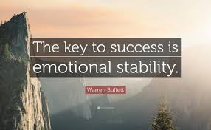
Notes:
Not like Buffett is a psychologist

Slide 30
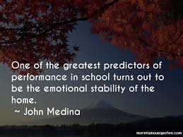
Job corps is Now the home.
1. Listen
2. Hear
3. Understand
4. Empathize / Validate
5. Respect

Slide 31
The ABCds of promoting skills and decreasing mood related issues
Notes:
OK JC staff here we go.

Slide 32
Suicide Prevention strategies:
How staff can interact & engage effectively.
Teach
Teach coping and problem-solving skills.
Promote
Promote healthy connectedness.
Create
Create protective and safe environments.

Slide 33
Actions:
A:
Awareness
Acknowledge
Accommodate
Acceptance

Slide 34
Being:
B:
Breathe
Boundaries
Build (a healthier version of you)
Better (behavior and mindset)
Beliefs that challenge the negative triad
Notes:
Beliefs that are an update and an upgrade – more positive.
Being a “good” human being with students who are hurting is huge.

Slide 35
Connection – Verbal & Nonverbal communication:
C:
Caring
Compassion
Consistency
Cooperation
Coping Skills

Slide 36
Developing:
D:
De-escalation
Desire
Discipline
Discovery

Slide 37
The ABCds
A:
Awareness
Acknowledge
Accommodate
Acceptance
B:
Breathe
Boundaries
Build positive beliefs
(a healthier version of you)
Better
(behavior and mindset)

Slide 38
The ABCds
C:
Caring
Compassion
Consistency
Cooperation
Coping Skills
D:
De-escalation
Desire
Discipline
Discovery

Slide 39
10 Concepts I Wish Students Knew Before Coming to Job Corps (& would keep in mind and practice regularly on center.)
Alec Mendelson, Ph.D.
Center Mental Health Consultant
Notes:
So I have discussed data on suicide and how we as staff engaging with students can positively impact the negative triad with

Slide 40
Knowing & practicing these 10 things on center could …
Decrease depression
Foster positive connection
Promote enhanced self-care
Develop healthier relationships
Create a stronger sense of community
Notes:
These 10 things is what I would want to present to incoming students.
During this presentation, I will be sharing as though talking to students alternating with addressing you as the audience.

Slide 41
Perspective:
These ideas are not right or wrong.
They are not good or bad either.
These 10 concepts are not an exhaustive list.
They are just one person’s perspective.
Instead, they can be viewed as ideas presented toward promoting a positive outcome.
Notes:
In general, let’s avoid judgment and evaluation.

Slide 42
10
It’s a marathon,
not a sprint.
Notes:
Sprinters
Joggers
Crawlers
Standing & Watching

Slide 43
10
Pace is important.
This is going to take longer than you want it to.
And yet, Job Corps can be a place where you learn how to finish what you started.
Notes:
Most of our students have started lots of things but not completed. Many factors or obstacles.
How are we going to be different?

Slide 44
9
(As many students have told me over the years,)
“It’s just like high school, except you don’t leave”!

Slide 45
9 Your choices matter!
Just like at home, there are 24 hours in a day.
At Job Corps since you don’t leave (unless you are non-res), what you do (or don’t do) after 4 PM, will have a lot to do with how you experience the program.
Notes:
We have the first part of the day structured for you. Sometimes you’ll like that, sometimes you won’t.
After the training day, it is up to you. What do you do? Who do you engage with (or not)?

Slide 46
9
Make choices that help avoid pitfalls:
Decline DRAMA
Prolonged social Isolation
Late night gaming / Insomnia
Negatively comparing self to others
Notes:
We spell DRAMA with large font and bold face. You can be motivated to avoid drama and still find yourself in it.
Some alone time can be constructive. Too much leading to isolation often is not.
How you provide yourself structure matters. That includes deciding actions like eating, sleeping, hygiene.

Slide 47
8
The students who graduate figure out how to take care of themselves at Job Corps.
(more on self-care later.)
Notes:
Instructors can think of students who “get it” in trade and you like teaching.
It’s painful when they leave or get terminated.

Slide 48
8
Along the way there will be no shortage of things to feel frustrated, upset, or disappointed about.
Among the things to figure out and learn is how to handle these feelings and experiences effectively.
(And by the way, while you do not get TAR item credit for learning those skills, you’ll be glad to take them with you too when you’re done.)
Notes:
Predict the obvious. Feeling any of these emotions is “normal”. How you deal with them often is a make or break.
We can say “hey make mistakes – it’s part of learning”. But here we have ZT offenses which results in GAME OVER.

Slide 49
7
Job Corps works better when you want something.
Notes:
Corollary: It is a better idea when it is your idea.

Slide 50
7
Knowing what you want
(even kind of, sort of)
is harder than knowing what you don’t want.
So let us work with you toward discovering a constructive path.
Notes:
Typically, when people are upset, they express/vent what is upsetting that they don’t want/need.
Focusing on the attainment of something OR the positive outcome!

Slide 51
7
In coming to Job Corps, not only is it important to want something, but to want to change something (for the better).
Notes:
If I want something, I can approach it. Or at least I can search what direction it is in.
Avoidance is about moving AWAY from something – it is disengaging.

Slide 52
6
Change is hard work!
(even when you want it.)
The degree to which you are ready for change – matters.
Notes:
Readiness for change or stages of change. Motivational interviewing
Few come here ready to take action.

Slide 53
Notes:
I want something different is not the same as I am ready to change.
Let’s think about how hard we work because we do. Where does the majority ofour efforts and energies go? To students where on this scale?

Slide 54
6
It’s OK to not know what you want or how ready you are to change … at first.
It’s important to make a commitment to yourself & figure that out. (We can help you … if you let us.)
Notes:
People going to college often do not have a major picked out before going. And when they do, they may change it along the way.

Slide 55
5
Almost everyone learns better or easier, when they feel safe, stable and comfortable.

Slide 56
5
Job Corps staff prioritize safety for all. There are staff here to assist you with feeling stable and comfortable on center.
How do you promote safety, stability and comfort for yourself?
Notes:
Communicating this suggests to the students that creating a comfortable environment is a joint responsibility.

Slide 57
5
As stated before, the students who graduate figure out how to take care of themselves.
Comfort and safety can be promoted in these areas:
Physical
Emotional
Social
Behavioral
Notes:
Self-care. If students were better at it, they might not be at Job Corps.
Students coming to Job Corps in 2022 often are more compromised than those who came in 2002. How come?

Slide 58
5
Physically:
Sleeping well is critical. Learning and following the daily structure of Job Corps takes brain power.
Help your brain to help you.
Develop a positive sleep routine.
Enough but not too much
At the right time and place
Ability to fall asleep and stay asleep
Notes:
So many coming to center have a sleep disturbance.
We have worked with many to get sleep studies or C-PAP machines.

Slide 59
5
Emotionally: How do you promote safety, stability and comfort for yourself?
How do you deal with (regulate) anxiety, depression, and other uncomfortable feeling states or experiences (self-loathing, sadness, past trauma)?
It’s OK not to know. Yet it would be beneficial to have this be the time to find out.
Notes:
Most common answer = “I don’t know”.
With a relationship, it is Ok to ask questions. Remember the ABCDs – this is where relationship and effective communication excel.

Slide 60
5
Socially & Behaviorally:
(No matter how many “friends” you have on your social media accounts), you don’t need hundreds of friends on campus
It’s nice to be “friendly” with many.
It’s nice to have at least one if not a few true friends who you get to know over time, and they get to know the real you. And you have each others backs (appropriately) especially when the emotional and social get tough.
Notes:
Learning to have a positive or healthy relationship with other people is NOT why people come to Job Corps. But many graduates do learn this along the way – sometimes with staff.
Some say, “I didn’t come here to make friends” and speak to their vocational goals. OK. But this is a tough place to get through on one’s own.

Slide 61
4
Think of Job Corps like a video game that you would like to beat, complete or conquer.
So have or develop a strategy!
Remember Job Corps is a place for you to finish what you start.
“Success” is about what you actually do, how you navigate and avoid the pitfalls and booby traps.
Notes:
See obstacles as challenges to be overcome. See difficulties and problems as temporary instead of permanent.
Discover what you feel competent in doing. Use strengths to compensate for weaknesses.
Change the I don’t know to you know more than you think you do.

Slide 62
4
Updating your skill set or strategy skills to YOU 2.0
To do so takes replacing old, counterproductive but familiar behaviors with newly learned and practiced healthier behavioral, social and coping skills.
Notes:
I only missed by two points so I know I can pass.

Slide 63
3
Practice noticing without judging.
Be a keen observer (which helps with navigating).
Notes:
“This is hard” differs from “I suck”.
Instead of “I’m a failure” – see what can be improved upon to enhance your ability.

Slide 64
3
Without judgment or evaluation means out with:
Good / bad
Right / wrong
Beautiful / ugly
Fantastic / terrible
Notes:
Unavoidable but can be minimized.
Learn how not to personalize some of your setbacks. In with, hmm, oh, wow.

Slide 65
2
Stability rules!
Take the first few weeks to become familiar with the:
Environment
Procedures & Rules
Structure & Schedule
Allow familiarity to foster a healthy adjustment and comfort.

Slide 66
2
Stability rules!
How many legs do you want a stool to have before you’re willing to sit on it
(with your legs up/off the floor)?
So, what are the things that would create your foundation of stability?
Notes:
Hey I Have a fantastic one legged stool for you!

Slide 67
1
It’s OK not to like everything about yourself.
Yet too much self-criticism or dislike of oneself can be your single biggest obstacle to having a positive, successful experience at Job Corps.
Notes:
Students have often said they are their own worst critic. It may have been someone else prior to JC but now they have adopted it.

Slide 68
1
Use noticing and observation skills to catch how easily you negatively compare yourself to others.
In the coming week, explore treating yourself with a fraction of thekindness and consideration you would give to others.
Notes:
Huge challenge to many.

Slide 69
1
Give yourself permission to:
Learn and practice self-compassion.
See your strengths and weaknesses without harsh evaluation.
Practice using what you know about yourself to your advantage rather than to your detriment.
Challenge yourself to give yourself half the consideration and regard that you would give to your best friend.
(Again, none of this gets you TAR item credit but puts you in a better position to earn it.)

Slide 70
Summary
10. It’s a marathon, not a sprint.
9. The students who graduate figure out how to do self-care.
8. Job Corps is 24-7. It’s not just about the training day.
7. Knowing what you want is harder than knowing what you don’t want. (Want something.)
6. Change is hard work! Be ready.
5 Physical safety, emotional stability and social comfort are essential to learning.
4. Finishing what you start involves having a strategy.
3. Suspend judgment in favor of noticing and redirecting.
2. Stability rules!
1. It’s important to be on your team.

Slide 71
So…
What do you think?
What do you think the impact would be when students have these 10 concepts at the beginning of their time at Job Corps?
Notes:
Career Prep

Slide 72
What makes this place work is …
You (singular)
Me (singular)
You all (plural)
Us - together
Notes:
I don’t know if this will get easier. I hope so.

Slide 73
Dr. Alec Mendelson
CMHC
Springdale &
Tongue Point JCC

