Slide 1
TEAP Collaboration: TEAP is a Program Not a Person
Diane A. Tennies, PhD, LADC LEAD TEAP Regional Health Specialist
11/10/2022

Slide 2
Learning Objectives
Define
Define what is Collaboration as it applies to JC and TEAP.
Identify
Identify three other programs that require TEAP collaboration.
Develop
Develop 5 strategies to enhance collaboration at JC.

Slide 3
Why Collaborate?
Shifts your perspective to TEAP as Program
Model employment skills
Organization memory
Enhances program and student experience/success

Slide 4
A Word about Confidentiality
HIPPA/42 CRF Part 2: What can you tell staff?
Wellness staff vs management staff vs other staff
Certain information is protected
Think “need to know”
Collaboration vs Consulting vs Coordinating

Slide 5
TEAP Components – Avenues for Collaboration
Prevention/education
Assessment
Overcoming barriers aka drug testing
Documentation
Training
TUPP

Slide 6
What does this mean?

Slide 8
PRH Guidance: Assessment
c. Assessment for identification of students at risk for substance use problems to include…
3. Collaboration with the Center Mental-Health Consultant to determine when a MSWR or medical separation is appropriate and should be recommended for a student with substance use conditions (see Chapter 2, Section 2.3, R5, e.5)

Slide 9
PRH Guidance: Intervention Services
d. Intervention services for students identified at an elevated risk for substance use, to include…
Collaboration with the Center Mental-Health Consultant for students with cooccurring conditions of mental health issues and substance use
[Parallels in MHWP section (2.3 R4)
d. Treatment, to include…
2. Collaboration with TEAP specialist for short-term counseling of students with cooccurring conditions of mental-health issues and substance use]

Slide 10
PRH Guidance: MSWR
5. Medical Separations with Reinstatement Rights (MSWR) for substance use conditions:
(a) Students may be given a MSWR for a diagnosed substance use condition, allowing the student to return to Job Corps to complete his or her training within 180 days. To return to Job Corps, proof of treatment completion from a qualified provider must be received.
(b) A MSWR for substance use conditions can only be given if the following conditions are met:
(1) The TEAP specialist and Center Director agree that the student has a diagnosed substance use condition.
(2) There is a documented assessment of the student’s diagnosed substance use condition by the TEAP specialist in collaboration with the center mental health consultant.

Slide 11
PRH Guidance: HEALs
R9. Healthy Eating and Active Lifestyles
Centers must provide students with an environment that supports healthy eating and active lifestyles and provide students with education and experiences that promote lifelong health and physical well-being.
At a minimum, this program must include the following components:
a. Planning
1. Establish a Healthy Eating and Active Lifestyles Committee to oversee and coordinate this program. At a minimum, this committee must include the Health and Wellness Director, Food Services Manager/Supervisor, Recreation Supervisor or Specialist, TEAP Specialist, Residential Manager/Counseling Manager, and student representative…
3. Demonstrate collaboration between various departments on center.

Slide 12
Collaboration also means…
Consulting
Coordination

Slide 13
EXHIBIT 2-4 JOB CORPS BASIC HEALTH CARE RESPONSIBILITIES
Trainee Employee Assistance Program (TEAP)
1. Substance use prevention and education, to include:
• Minimum of a 1-hour interactive presentation on substance use prevention for all new students during the Career Preparation Period.
• Presentation(s) on managing substance misuse, abuse and dependency conditions in the workplace students during the Career Development and Transition Periods.
• At least three annual center-wide substance use prevention and education activities.
• Clinical consultation with Center Director, management staff, Center Mental Health Consultant, and Health and Wellness Director regarding substance use related prevention and education efforts for students and staff.
• Coordination with other departments/programs on center to develop integrated prevention and education services.

Slide 14
Exhibit 2.4 Continued
2. Assessment for identification of students at risk for substance use problems to include:
• Review of Social Intake Form (SIF) or intake assessment of all students performed by counseling staff within 1 week of arrival.
• Formalized assessment measures (e.g., SASSI3 or SASSIA2) and clinical judgment to determine students’ risk levels for substance use.
• Collaboration with the Center Mental Health Consultant to determine when a MSWR or medical separation is appropriate and should be recommended for a student with substance use conditions.

Slide 15
Exhibit 2.4 Continued
3. Intervention services for students identified at an elevated risk for substance use, to include:
• Individual and group intervention services with a focus on behaviors that represent employability barriers.
• Collaboration with the Center Mental Health Consultant for students with co-occurring conditions of mental health and substance use.
• Referral to off-center substance abuse professionals or agencies for ongoing treatment and/or specialized services.
4. Drug and alcohol testing, to include:
• Drug and alcohol testing procedures
• Policies related to positive drug or alcohol tests
• Notification of drug or alcohol test results

Slide 16
Enhancing Collaboration

Slide 17
Substance Use Prevention and Education
1. Minimum of a one-hour presentation on substance use prevention for all new students during the Career Preparation Period
Done jointly with CMHC or others
2. Presentation(s) on managing substance misuse, abuse, and dependency symptoms and issues in the workplace for students during the Career Development and Transition Periods
Coordinate with Trades to integrate vocational specific information

Slide 18
Substance Use Prevention and Education
3. At least three annual center-wide substance use prevention and education activities
Present with other departments
External Collaboration (Speakers such as local law enforcement, community agencies and self-help groups)
4. Clinical consultation with Center Director, management staff, Center Mental Health Consultant, and Health and Wellness Director regarding substance use prevention and education efforts for students and staff
Attend monthly meeting with CD
Attend case management meetings with counselors and CMHC
Participate in Wellness Staff meetings
Maintain high level of visibility (office in wellness)

Slide 19
Substance Use Prevention and Education
5. Coordination with other departments/programs on center, to include, but not be limited to…to develop integrated prevention and education services
Residential : Participate in meetings and activities
Recreation
Develop specialized Exercise
Plan specialized rec activities as part of relapse prevention
Student government association
Partner with joint activities
Attend SGA meetings
Participate in SGA store
HEALs
Required participant
Attending meetings
Participate in activities

Slide 20
PRH Guidance: Assessment
2.3 R5 c: Review of Social Intake Form (SIF) or intake assessment of all students performed by counseling staff within one week of arrival.
What ways could TEAP collaborate with Counseling?
When a referral is made to TEAP after SIF completed
Offering feedback to counselors and follow-up on support plan

Slide 21
Intervention Services
d. Intervention services for students identified at an elevated risk for substance use, to include…
Collaboration with the Center Mental-Health Consultant for students with co-occurring conditions of mental health issues and substance use
What does this look like?
Attend medication management meetings
Attend case management meetings
Schedule regular consultation
CMHC as guest speaker in intervention groups

Slide 22
Assessment and MSWR
5. Medical Separations with Reinstatement Rights (MSWR) for substance use conditions:
(2) There is a documented assessment of the student’s diagnosed substance use condition by the TEAP specialist in collaboration with the center mental health consultant.
How do you implement this?
Key here is documentation to demonstrate collaboration

Slide 23
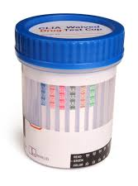
Drug and alcohol testing
New and readmitted students must be tested within 48 hours of arrival on center.
Nursing staff
Students who are reasonably suspected of using drugs
Security/safety and residential staff

Slide 24
Relapse Prevention – Collaboration Opportunity
Think Community – how to provide support
What are goals of RP?
Identifying high-risk situations for relapse and developing appropriate solutions.
Model seeking assistance and support

Slide 25
Documentation

Slide 26
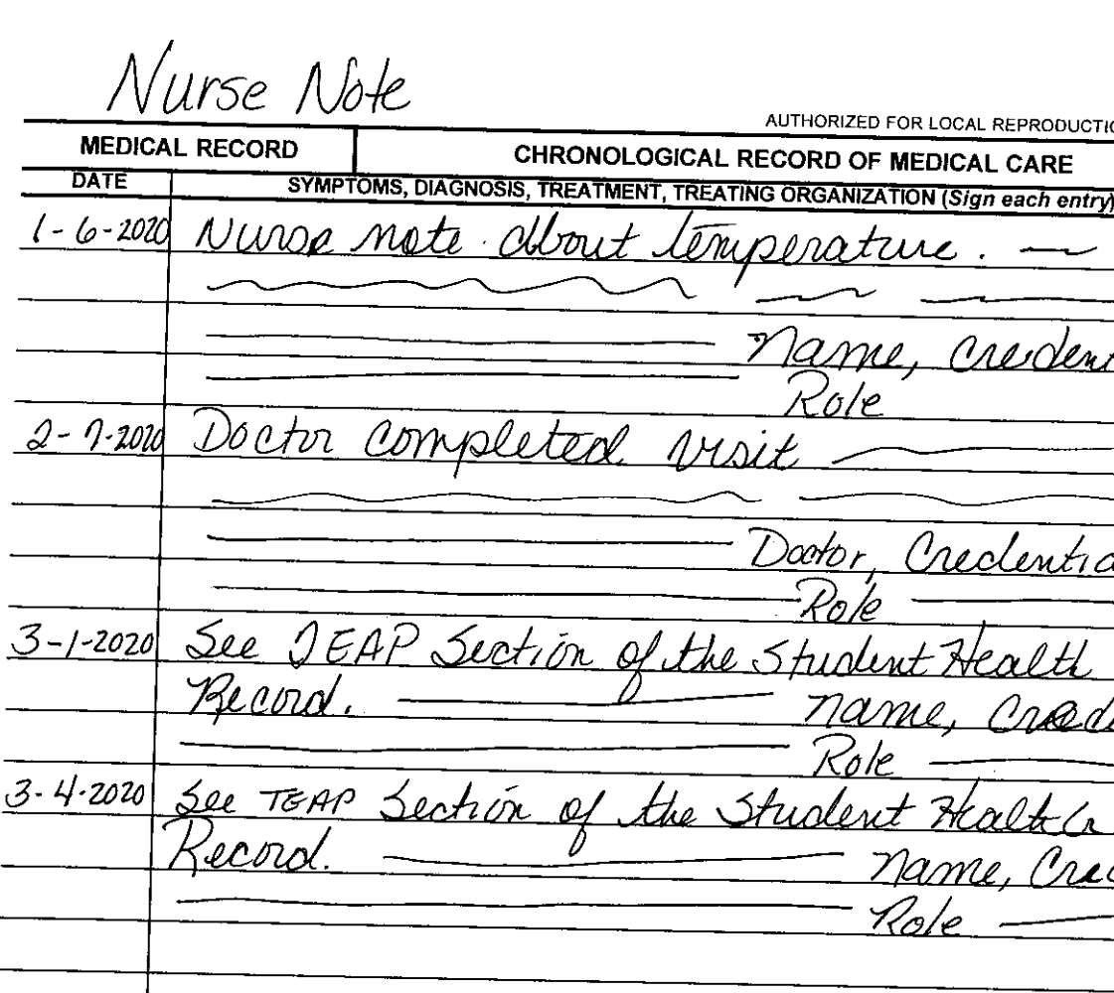
Example for
Chronological

Slide 27
Staff Training and Reporting
Staff Training Requirements for Alcohol Testing Health and Wellness staff is responsible for training designated center staff, including documentation procedures. This training should be provided based on manufacturer-supplied materials.
Quarterly Alcohol Testing Reporting Procedures Centers must submit a quarterly report on center alcohol testing (PRH 5.1, R4). This report must be submitted by the tenth day following the end of each quarter (i.e., January 10, April 10, July 10, and October 10). The Alcohol Screening Report is available on the Data Submission webpage.

Slide 28
Training of Staff
Required training around suspicion screen process and reasonable suspicion
TGs and SMGs
TEAP referral form
Emphasize TEAP referral as separate from suspicion screen referral
Be visible and available

Slide 30
Applicant File Review
Where is the collaboration opportunity?
HWD
Disability coordinator
If dual review – then with CMHC
Outside providers/CCMP

Slide 31
TUPP Collaboration Opportunities
Implement a program to prevent the onset of tobacco use and to promote tobacco-free environments and individuals.
To support this program, a TUPP Coordinator must be appointed (he or she need not be a health services staff member).
Educational materials and activities that support delay and/or cessation of tobacco use
Where would these be located?
Minors who use tobacco products must be referred to the TUPP
Nursing staff (who completed HHQ)
Security who may observe students using tobacco/nicotine

Slide 32
TEAP Components – Avenues for Collaboration
Prevention/education
Assessment
Overcoming barriers aka drug testing
Documentation
Training
TUPP

Slide 33
5 (ish) Strategies to Enhance Collaboration
Be visible on center
Conduct trainings with staff
Case management with counselors
Consultation with CMHC
Be active part of wellness team/Documentation is collaboration
Involved in other programs such as HEALs and Recreation

Slide 34
QUESTIONS?

