Slide 1
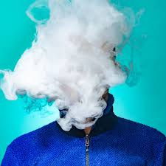
Vaping and eCigarettes
Gary Strokosch, MD, Regional Medical Specialist
Diane Tennies PhD, LADC, Lead TEAP Specialist
Office of Job Corps
Tuesday 06/28/2022

Slide 2
Learning Objectives
• Describe the History and epidemiology of vaping among youth
• Educate about synthetic nicotine
Explain the consequences of vaping, both short-term and long-
term
• Articulate the current CDC advice on vape usage for adolescent
and young adults
• Recommendations on what each Job Corps Center can do to
assist our youth to either cease using or not start vaping

Slide 4
Brief Intro to Tobacco and Nicotine Use
For thousands of years, people have enjoyed the effects of smoking tobacco leaves (ingesting nicotine) provides.
In 1798 - Dr. Benjamin Rush one of the first to label tobacco smoking "offensive" and correctly pointed out it caused “incurable diseases" and cancers.
1800’s – lip cancer cases reported
Photograph from 1865
1950’s saw increase in health concerns

Slide 5
Earliest Vaping
James Robinson obtained patent on “electronic vaporizer” in 1927.
He dreamed the device made it easier to inhale vapors "without any possibility of being burned.”

Slide 6
Vaping: Another Attempt
1963 Herbert Gilbert proposed the “smokeless non-tobacco cigarette” – filed for a patent in April 1963.
But he could not find any manufactures interested.

Slide 7
Modern Vaping
In 2003 Chinese smoker and pharmacist Hon Lik introduced the modern e-cigarette and is credited with being the “inventor.”
He smoked three packs per day and said he was motivated to find a ”safer” alternative to cigarettes after his father died of lung cancer.
He had the idea to use a high frequency ultrasound-emitting element to vaporize a forced stream of liquid containing nicotine into a vapor.

Slide 8
Modern Vaping Evolution
Around 2006, vaping was introduced in Europe and quickly spread to United States.
In 2008 the World Health Organization (WHO) wrote: “As far as WHO is aware, no rigorous, peer-reviewed studies have been conducted showing that the electronic cigarette is a safe and effective nicotine replacement therapy".

Slide 9
Into the United States
N’Joy was an early manufacturer and introduced the product in the United States.
They went bankrupt in 2016 as they struggled to find a strong consumer base as adult smokers were not interested.
Early e-cigarettes were cost-prohibitive for most.
But then…what about youth??

Slide 10
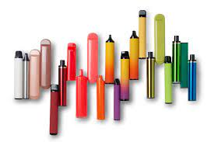
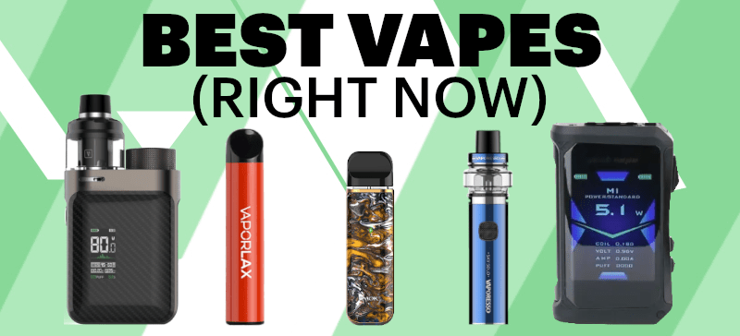
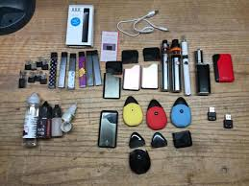
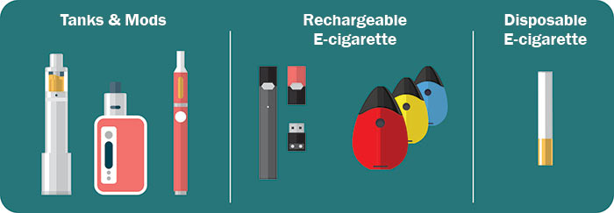
Examples of Vaping Devices

Slide 11
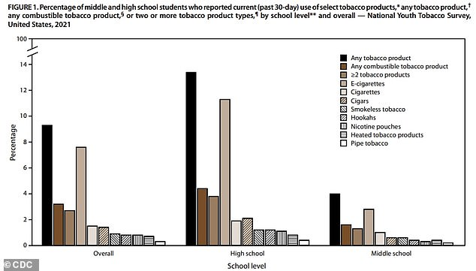
The Epidemiology of Vaping Among Youth

Slide 12
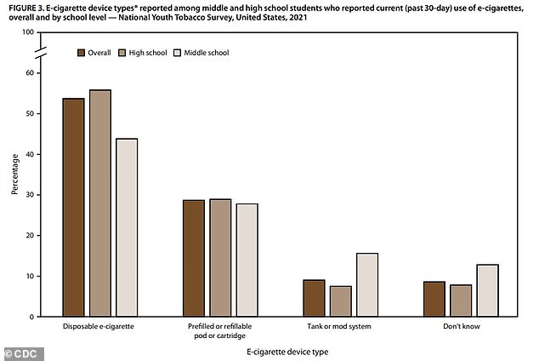

Slide 13
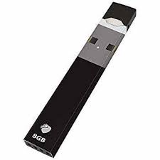

Slide 14
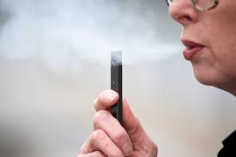

Slide 15
What about JUUL?
JUUL is shaped like a USB flash drive.
Battery-powered device that heats a nicotine-containing liquid to produce an aerosol that is inhaled.
According to the manufacturer, a single JUUL pod contains as much nicotine as a pack of 20 regular cigarettes.
JUUL is one of a few e-cigarettes that use nicotine salts, which allow particularly high levels of nicotine to be inhaled more easily and with less irritation than the free-base nicotine that has traditionally been used in tobacco products, including e-cigarettes.
News outlets and social media sites report widespread use of JUUL by students in schools, including classrooms and bathrooms.
Approximately two-thirds of JUUL users aged 15 – 24 do not know that JUUL always contains nicotine.
Although JUUL is currently the top-selling e-cigarette brand in the United States, other companies sell e-cigarettes that look like USB flash drives. Examples include the MarkTen Elite, a nicotine delivery device, and the PAX Era, a marijuana delivery device that looks like JUUL.

Slide 16
Timeline of FDA Ban
2004: At Stanford, two graduate students create the idea for Ploom, Juul’s precursor
2016: Juul sales skyrocket 700%
On 06/23/2022 The Food and Drug Administration ordered Juul Labs to pull its e-cigarettes off the American market.
On 06/24/2022 - Federal court temporary blocks FDA ban on Juul e-cigarette sales in US after the e-cigarette maker had asked the court to pause what it called an “extraordinary and unlawful action” by the FDA that would have required it to immediately halt its business.

Slide 17
WHY and WHAT is SYNTHETIC NICOTINE?
In February 2021, the disposable electronic cigarette brand, Puffbar, started selling a new product line in the United States, advertised as containing “synthetic nicotine.”
Manufacturers claimed that Food and Drug Administration (FDA) could not regulate synthetic nicotine as a tobacco product, allowing them to skirt the costly premarket authorization process. This just recently changed.
Synthetic nicotine, also known as tobacco-free nicotine (TFN), is exactly what it sounds like: nicotine created using synthetic means, which contains zero traces of the tobacco plant, and is not derived from tobacco in any way.

Slide 18
THE NEW SOURCE OF TWO NICOTINES
The tobacco industry considered using synthetic nicotine in the 1960s, but efforts were abandoned due to high costs and insufficient purity.
Nicotine exists as two stereoisomers, S-nicotine and R-nicotine. S-nicotine is the prevalent (>99%) form found in tobacco. Of note, R-nicotine is a 10-fold less potent agonist of nicotine receptors than S-nicotine.
One market product with synthetic nicotine contains both stereoisomers in equal amounts, raising concerns about inaccurate labelling and the poorly understood health effects of none-tobacco R-nicotine.
Other manufacturers, including a leading vendor of pharmaceutical grade nicotine, developed stereospecific strategies to synthesize pure S-nicotine, now added to electronic cigarette products marketed in the USA and UK.

Slide 19
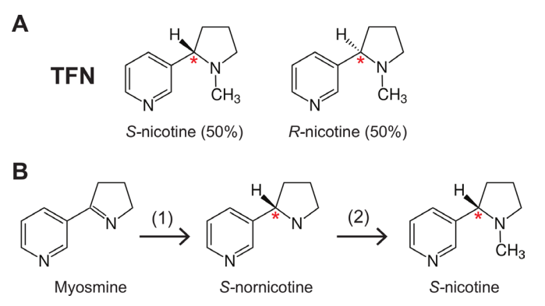
SYNTHETIC NICOTINE MANUFACTURING
Synthetic nicotine is a mimic of tobacco plant nicotine and is created in the laboratory. Molecular technology allows chemists to rearrange other molecules in order to create 100% pure nicotine, identical to tobacco plant nicotine.
If unflavored, it is free of any other compounds, and completely odorless and flavorless, unlike tobacco source nicotine.

Slide 20
“SYNTHETIC NICOTINE HAS ARRIVED” 16 August 2021 by Sven-Eric Jordt

Slide 21
WITH A FEW THINGS ADDED

Slide 22
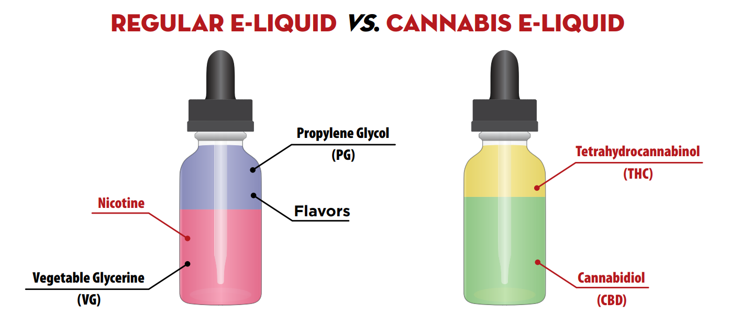
AND A FEW MORE THINGS ADDED
E-CIGARETTE, OR VAPING, PRODUCTS VISUAL DICTIONARY - CDC

Slide 23
EXAMPLE OF EXTENT OF LABELING
2One is a 100% nontobacco nicotine pouch made with patented TFN nontobacco nicotine manufactured by San Diego-based Next Generation Labs.
The pouch comes in nine flavors: very berry, eucalyptus rush, glacier mint, chocolate dream, ginger mint, strawberry lemonade, citrus chill, mocha java and pineapple mango.
It comes in strengths of 3 and 6 milligrams.

Slide 24
TOBACCO CONSEQUENCES
For thousands of years, people have enjoyed the effects of smoking tobacco leaves (and ingesting nicotine).
In 1798 Dr. Benjamin Rush was one of the first to label tobacco smoking "offensive" and correctly pointed out it caused “incurable diseases" and cancers.
1800’s – lip cancer cases reported
Photograph from 2022 → → → → →
1950’s saw increase in health concerns

Slide 25
NON-NICOTINE-CAUSED MORBIDITY AND MORTALITY - Cancer and Pulmonary Disease -
Tobacco use causes many types of cancer, including cancer of the lung, larynx, mouth, esophagus, throat, bladder, kidney, liver, stomach, pancreas, colon, rectum, cervix, as well as acute myeloid leukemia.
People who use smokeless tobacco (snuff or chewing tobacco) have increased risks of cancers of the mouth, esophagus, and pancreas.
Cigarettes can harm the tissue of the lungs, increasing the risk for conditions such as emphysema, lung cancer, and chronic obstructive pulmonary disease (COPD).

Slide 26
NON-NICOTINE CAUSED MORBIDITY AND MORTALITY
Cigarettes, cigars, and pipe tobacco are made from dried tobacco leaves. Other substances are often added for flavor and to make smoking more pleasant. Tobacco smoke is made up of thousands of chemicals, including at least 70 known to cause cancer. Most of the substances come from the burning tobacco leaves themselves, not from additives.
Radioactive materials are in the tobacco leaves. These materials come from the fertilizer and soil used to grow the tobacco leaves.

Slide 27
NON-NICOTINE CAUSED MORBIDITY AND MORTALITY
Smokeless tobacco products (most are finely ground tobacco) contain a variety of potentially harmful chemicals, including high levels of tobacco-specific nitrosamines. Carcinogens are absorbed through the mouth and may be why several types of cancer are linked to the use of smokeless tobacco.

Slide 28
IS SYNTHETIC NICOTINE BETTER THAN TOBACCO NICOTINE?
No one can make the claim without proper research - those studies have not been conducted.
Pure synthetic nicotine is preferable to nicotine from tobacco leaves.
The quantity of nicotine in each vape may be equivalent to as much 1-2 packs of cigarettes! The use of nicotine salts also lowers the pH of e-liquids, which allows higher concentrations of nicotine to be delivered with less irritation. The “nicotine arms race” is on with vape products ranging between 3% and 7% nicotine.

Slide 29
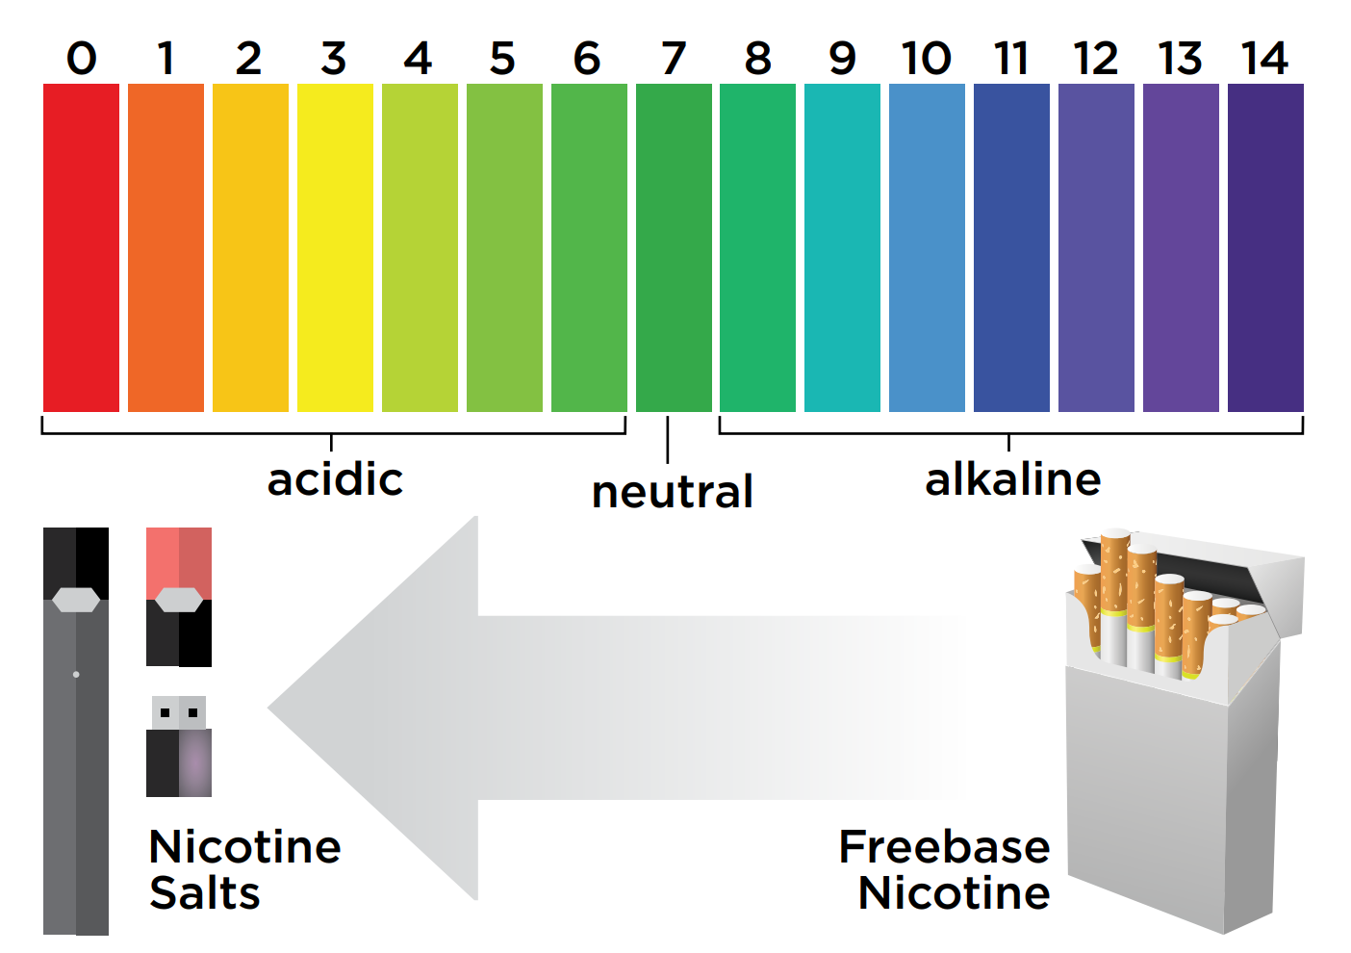
THE NICOTINE ARMS RACE IS ON

Slide 30
IS SYNTHETIC NICOTINE SAFE?
It is too early to know whether the health effects of synthetic nicotine are different from those of tobacco-derived nicotine.
Nicotine from any source is addictive. Research has shown that early age of smoking and pleasurable initial experiences are correlated with daily use and lifetime nicotine dependence.
Nicotine use during adolescence (<25 years of age) can disrupt the formation of brain circuits that control attention and learning.

Slide 31
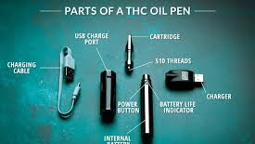
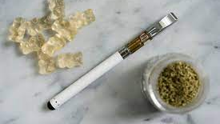
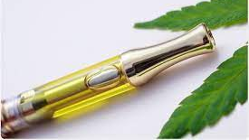
But….It is More Complicated

Slide 32
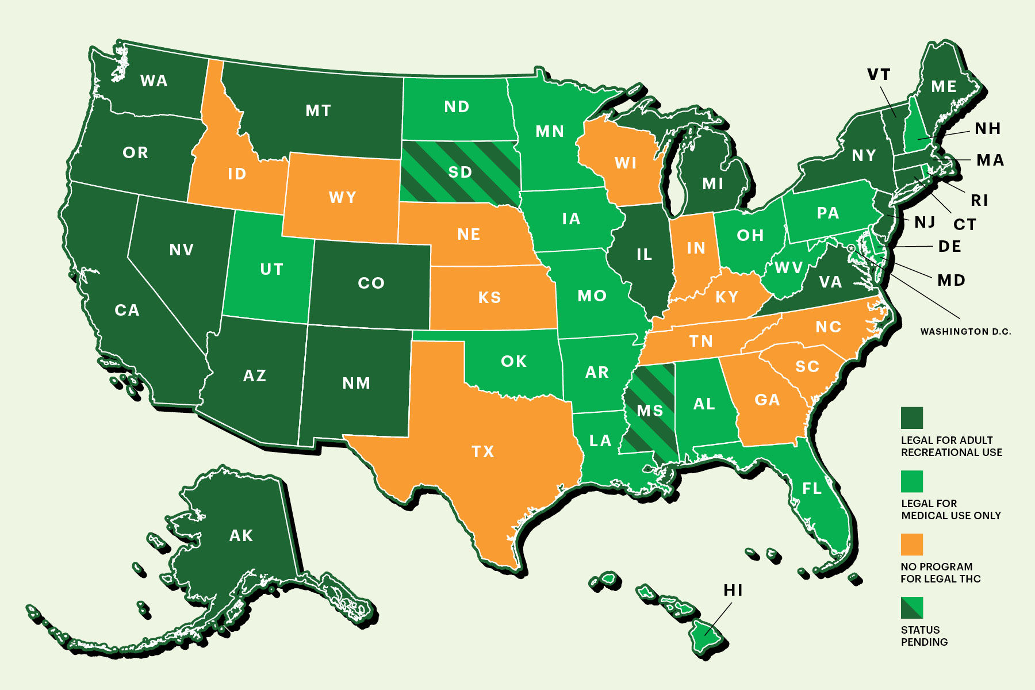
THC and Vaping
That means that THC is available in cartridges for vape pens as well.
How do you determine if THC and/or nicotine in cartridge?
Increased health risk associated with THC Vaping

Slide 33
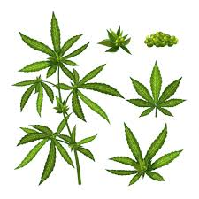
E-cigarette or vaping associated lung injury (EVALI)
All EVALI patients report a history of using e-cigarette or vaping products.
THC is present in most of the samples tested by FDA to date, and most patients report a history of using THC-containing e-cigarette or vaping products.
The latest national and state findings suggest THC-containing e-cigarette or vaping products, particularly from informal sources like friends, or family, or in-person or online dealers, are linked to most of the cases and play a major role in the outbreak.

Slide 34
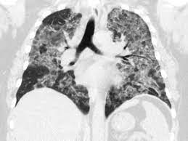
Possible Etiology of EVALI
CDC has identified vitamin E acetate as a chemical of concern among people with e-cigarette or vaping product use associated lung injury (EVALI).
Recent CDC laboratory testing of bronchoalveolar lavage (BAL) fluid samples (fluid samples collected from the lungs) from 29 patients with EVALI submitted to CDC from 10 states found vitamin E acetate in all of the samples.
Vitamin E acetate is used as an additive, most notably as a honey-like thickening agent in THC-containing e-cigarette or vaping products.

Slide 35
CDC Recommendations
CDC recommends that people should not use THC-containing e-cigarette or vaping products, particularly from informal sources like friends, or family, or in-person or online dealers.
Vitamin E acetate should not be added to e-cigarette or vaping products.
People should not add any substances to e-cigarette or vaping products that are not intended by the manufacturer, including products purchased through retail establishments.

Slide 36
Specific to Youth: Direct from CDC
The use of e-cigarettes is unsafe for kids, teens, and young adults.
Because e-cigarettes contain nicotine, it is highly addictive and harms adolescent brain development, which continues into the early to mid-20s.
E-cigarettes can contain other harmful substances besides nicotine.
Young people who use e-cigarettes are more likely to use tobacco in the future.

Slide 37
What about Vaping for tobacco Cessation?
2019 article in New England Journal of Medicine found that while E-cigarettes are commonly used in attempts to stop smoking, evidence is limited regarding their effectiveness as compared with that of nicotine products approved as smoking-cessation treatments
Hajek, P., Phillips-Waller, A., Przulj, D., Pesola, F., Myers Smith, K., Bisal, N., ... & Ross, L.
(2019). A randomized trial of e-cigarettes versus nicotine-replacement therapy.
New England Journal of Medicine, 380(7), 629-637.

Slide 38
What Job Corps can do to Support our Youth
Wellness staff provide education on vaping and the dangers during encounters with students. Many current resources available online.
TEAP specialist include this material in the CPP presentation as well as other classes.
Ban E-cigarettes/vaping items at Job Corps as contraband so not allowed on center.
Train security staff to recognize vaping products.
Ensure that students found in possession of vaping items or who report use are referred to the TUPP for intervention.

Slide 39
https://www2.heart.org/site/DocServer/Tobacco-Free_School_District_Policy.pdf

Slide 40
e.g., TOBACCO-FREE SCHOOL POLICY
The policy applies to ALL tobacco products
The policy prohibits use of ALL tobacco products by students, staff and ALL visitors while on school property and at ALL school sponsored events
The policy prohibits tobacco industry promotional activities, including industry-supported prevention and cessation programs
The policy reflects a supportive approach to discipline for students
The policy ensures students interested in quitting will be referred to a cessation program

Slide 41
Use available local and federal materials for education efforts.

