Slide 1
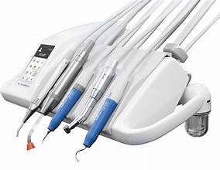
Dental Unit Water Line Quality
Pamela Alston, DDS, MPP
Lead Oral Health Specialist
August, 2023

Slide 2
Fatality due to Legionella in a dental unit water line

Slide 3
The standard for drinking water is < 500 CFU/mL of heterotrophic water bacteria
Environmental Protection Agency
CDC
American Public Health Association
American Water Works Association

Slide 4
Dental Unit Waterlines
Defined as “narrow boare plastic tubing that carries water to the high-speed handpieces, air/water syringes and ultrasonic scalers with a water supply”

Slide 5
The objectives of today’s webinar are to:
describe the effective treatment measures to ensure that water from the dental unit waterlines entering patients’ mouths meets the safe drinking water standard
explain routine preventive measures to keep water flowing through dental unit waterlines safe throughout the day
3. list the options for waterline testing

Slide 6
Bacteria’s cycle of growing and multiplying in dental unit waterlines
Bacteria attach to the moist surface.
Bacteria multiply and form a slimy biofilm layer.
A microcolony is formed.
Colonies form a mushroom structure
Bacteria detach and the biofilm disperses to form new colonies.

Slide 7
Why does bacteria grow so well in DUWLs?
Dental Unit Waterlines
Tap Water Lines
Small Diameter (1/16” – 1/8”)
Very slow rate drips/second
Plastic tubing is hydrophobic making biofilm attachment easy
The tubing is also a source of carbon (food) for bacteria
½” diameter
5L/minute flowrate (>1000x dental
Copper as a metal and as a dissociated ion is antimicrobial/ bacteriostatic
Small surface are to water volume ration
Source: Mike Willroul, Tech Dental LLC

Slide 8
Why does bacteria grow so well in DUWLs--continued
Dental Unit Waterlines
Tap Water Lines
Large surface area to volume ratio
Left stagnant for long periods of time
Chlorine rapidly dissipates over 24 hours and can even be absorbed by tubing
Smooth interior
Fresh every time turned on
Chlorinated and replenished with every use
Source: Mike Willroul, Tech Dental LLC

Slide 10
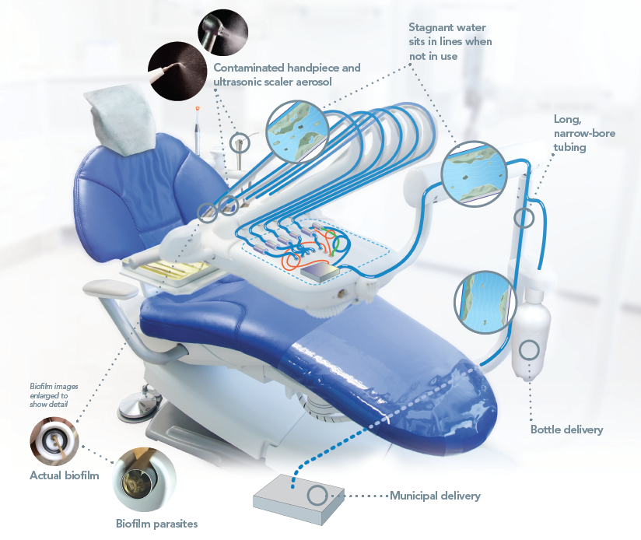

Slide 11
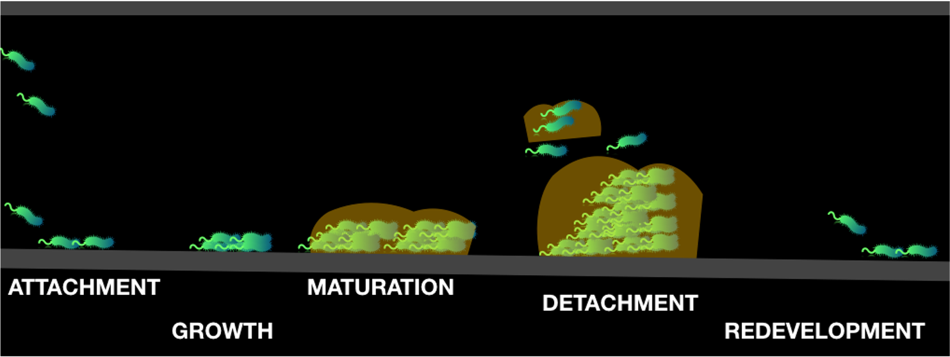
1. Bacteria attach to the inside of dental unit waterlines. 2. The bacteria grow and multiply and form a slimy biofilm layer. 3. The bacteria mature to form a microcolony and the colonies form a mushroom structure. 4. Bacteria detach and the biofilm disperses. The detached bacteria attach to the DUWL and form new biofilm.
Notes:
.

Slide 12
The potential of bacterial growth
Bacteria counts can grow to 200,000 CFU/mL in 5 days
Colony = the number of bacteria or fungi growing in a milliliter
Heterotrophic bacteria not necessarily indicators of disease conditions
Babeau J, Tanguay R, Faucher E, Avezard C, Multiparametric analysis of waterline contamination in dental units
Applied and Environmental Microbiology, 62(11): 3954-9, December 1996, DOI: 10.1128/AEM.62.11.3954-3959.1996

Slide 14
Self-Contained Water Bottles
Configured to feed water to the handpieces, syringes, and ultrasonic cleaner
Useful to introduce chemicals
Do not exclude the need for periodic waterline cleaning

Slide 15
Measures for safe water from DUWLs

Slide 16
Dental Unit Waterline Management Recommendations
Stay informed about best practices for managing treatment and controlling biofilm in dental waterlines.
Review instructions for use from the dental unit or manufacturer.
Review information on products’ infection control safety, effectiveness and compatibility with dental equipment.

Slide 17
Dental Unit Waterline Management Recommendations--continued
4. Flush lines for 20 seconds to 30 seconds.
5. Use only sterile solutions for coolant and irrigation for surgical procedures.
6. Monitor and document dental unit water quality regularly.
7. Develop and implement standard operating procedures.

Slide 18
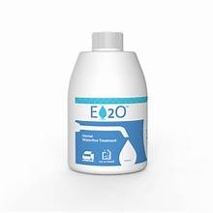
The “Maintainers”

Slide 19
3 Steps to Dental Unit Waterline Maintenance
Shock
Shock the DUWLs
Treat
Treat the DUWLs daily
Test
Test DUWLs

Slide 20
How to Shock Dental Unit Waterlines--ProEdge
How to Shock Your Dental Unit Waterlines - YouTube

Slide 21
In-office dental waterline testing--ProEdge
The QuickPass® In-Office Dental Water Test - YouTube

Slide 22
Mail-in Water Test Kits--ProEdge
Dental Waterline Testing - How to test with a ProEdge Mail-In Water Test Kit - YouTube

Slide 23
“Regardless of whether or not your state mandates compliance with the CDC infection control guidelines, failure to keep patients’ treatment water at or below the EPA drinking water standard of 500 CFU/mL is a failure to meet the standard of care.”
Reference:
Dental Water: The Dirty Little Secret | Registered Dental Hygienists (rdhmag.com)
PRH-2.3,R17(b)(d): The Center must…use protective measures as recommended by the CDC.

Slide 24
Recommendation by the Organization for Safety, Asepsis, and Prevention
“Dental practices should have a standard
operating procedure outlining the process
of maintaining and monitoring dental unit
waterline quality.”

Slide 25
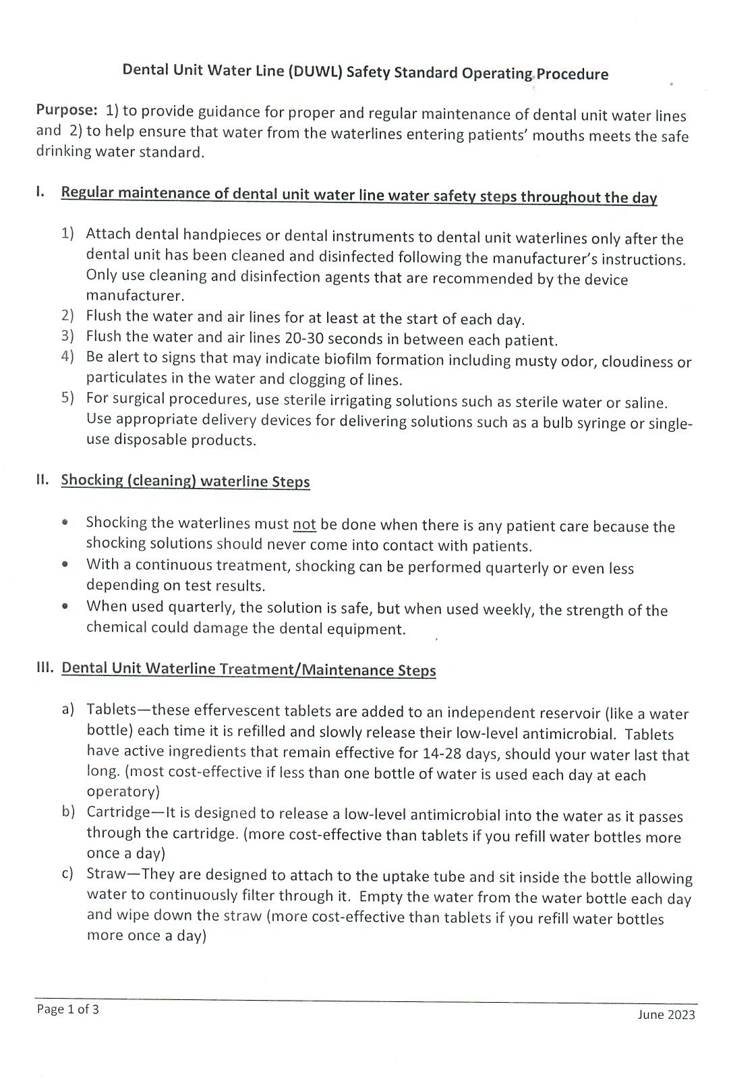
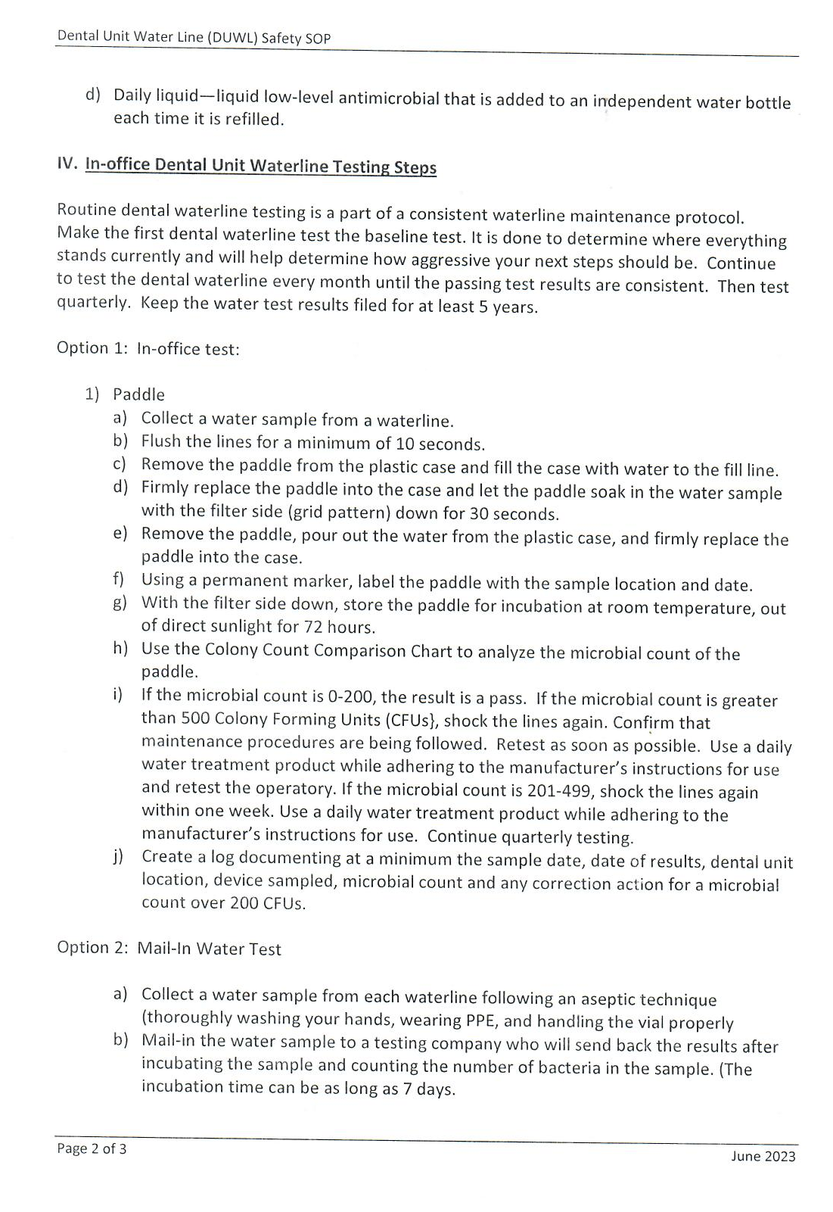
Dental Unit Water Line SOP located on the Job Corps Health Support Services Website

Slide 26
References:
Infection Control Guidelines (CDC)
Kohn WG, Collins AS, Cleveland JL, Harte JA, Eklund KJ, Malvitz DM; Centers for Disease Control and Prevention (CDC). Guidelines for infection control in dental health-care settings--2003. MMWR Recomm Rep. 2003 Dec 19;52(RR-17):1-61. PMID: 14685139.
Dental Unit Waterline Fact Sheet (OSAP)
Dental Unit Waterlines | American Dental Association (ada.org)

