Slide 1
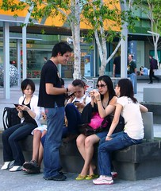
We are Better Together: Interdisciplinary Health and Wellness Case Studies
Brian Swann, DDS
Jason Young, RN
Valerie Cherry, PhD
Diane Tennies, PhD, LADC

Slide 2
Learning Objectives
Describe multidisciplinary case management strategies
1
List strategies to enhance communication within the Health and Wellness Center
2
Articulate sources of health data on students, including the Health History Form, ETA-653, and Social Intake Form (SIF)
3
Notes:
Brian

Slide 3
Maria
19-year-old female student
Entered Job Corps 2 months ago
Hometown is about an hour from the center
Studying Welding
Notes:
John/Jason

Slide 4
Health History Form
Notes:
John/Jason
What do you do with these answers?
What procedures do you have in place to ensure TEAP specialist and CMHC review Health History?

Slide 5
Health History Form
Notes:
John/Jason
What do you do with these answers?
What procedures do you have in place to ensure TEAP specialist and CMHC review Health History?

Slide 6
Annotation
Notes:
John/Jason
What would improve this annotation?

Slide 7
SIF (CRAFFT)
Notes:
Discuss that this piece of info doesn’t trigger an assessment
diane

Slide 8
Notes:
diane

Slide 9
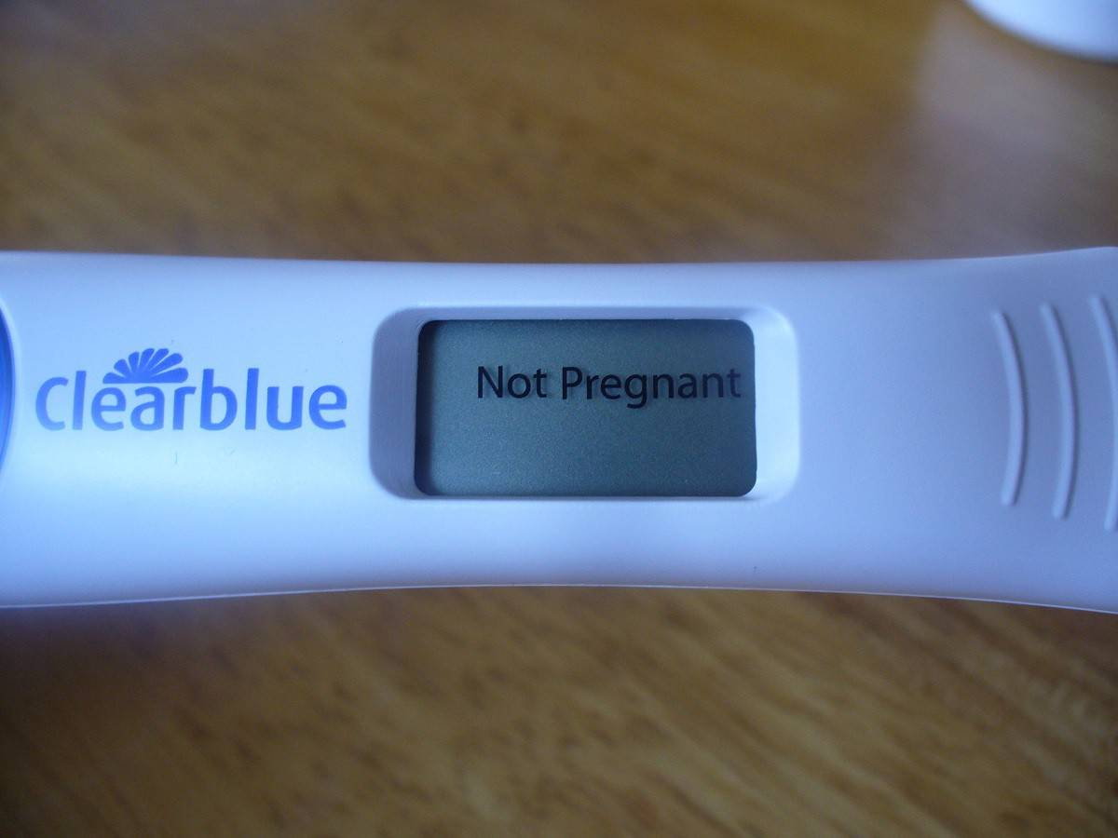
Notes:
John/Jason

Slide 10
Physical Exam
Nothing remarkable
Doctor offered birth control; student declined
Notes:
John/Jason
Said on HH that she wants birth control. Great opportunity to discuss further.

Slide 11
Elective Oral Exam – 2 months after entry
Notes:
Brian
Counseling on the effect of vomiting, don’t do xrays
swelling above a tooth

Slide 12
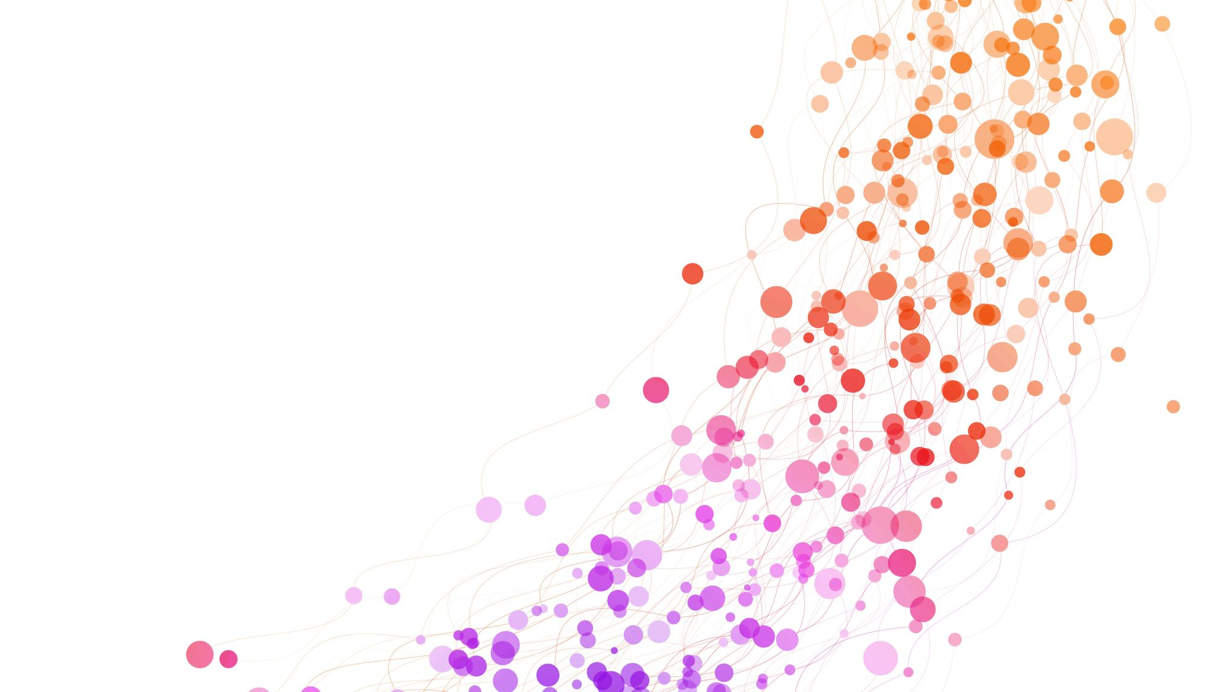
What should the dentist do?
Answer in chatbox!
Notes:
Brian--chatbox

Slide 13
SF-600 Nurse Note
Vital signs
BP: 110/60
Pulse: 66
Respiratory rate:14 breaths/minute
Temperature: 98.6°F
O2 Sat: 97%
BMI: 23
Maria says she only vomited today but has been nauseous for three days.
She does not know why she is vomiting.
Notes:
John/Jason

Slide 14
What do you do next?
Use the chatbox!
Notes:
John/Jason

Slide 15
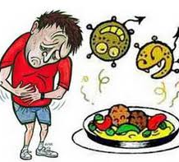
What do you think is going on?
A
C
B
D
E. More than one thing
This Photo by Unknown Author is licensed under CC BY-NC
Notes:
Valerie/Diane
Vote
E more than one thing

Slide 16
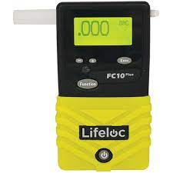
The answer is…
Notes:
Valerie/Diane

Slide 17
Case Conference
Who should be involved?
What are the next steps for helping Maria?
Notes:
Valerie/Diane
Oral health might be forgotten

Slide 18
Oral Health Considerations
Effect of vomiting on the teeth
Don’t brush the acid from vomit into the teeth
Gingivitis and Pregnancy
Low birthweight/preterm delivery
Pregnancy tumor
Notes:
Brian

Slide 19
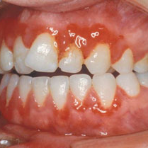
Pregnancy Gingivitis
Most common oral disease during pregnancy
Prevalence - 60-70%
Pre-existing gingivitis is exacerbated
Progesterone/estrogen changes and decreased immunity cause exacerbation of gingivitis
Severe conditions require professional cleaning and prescription mouth rinse

Slide 20
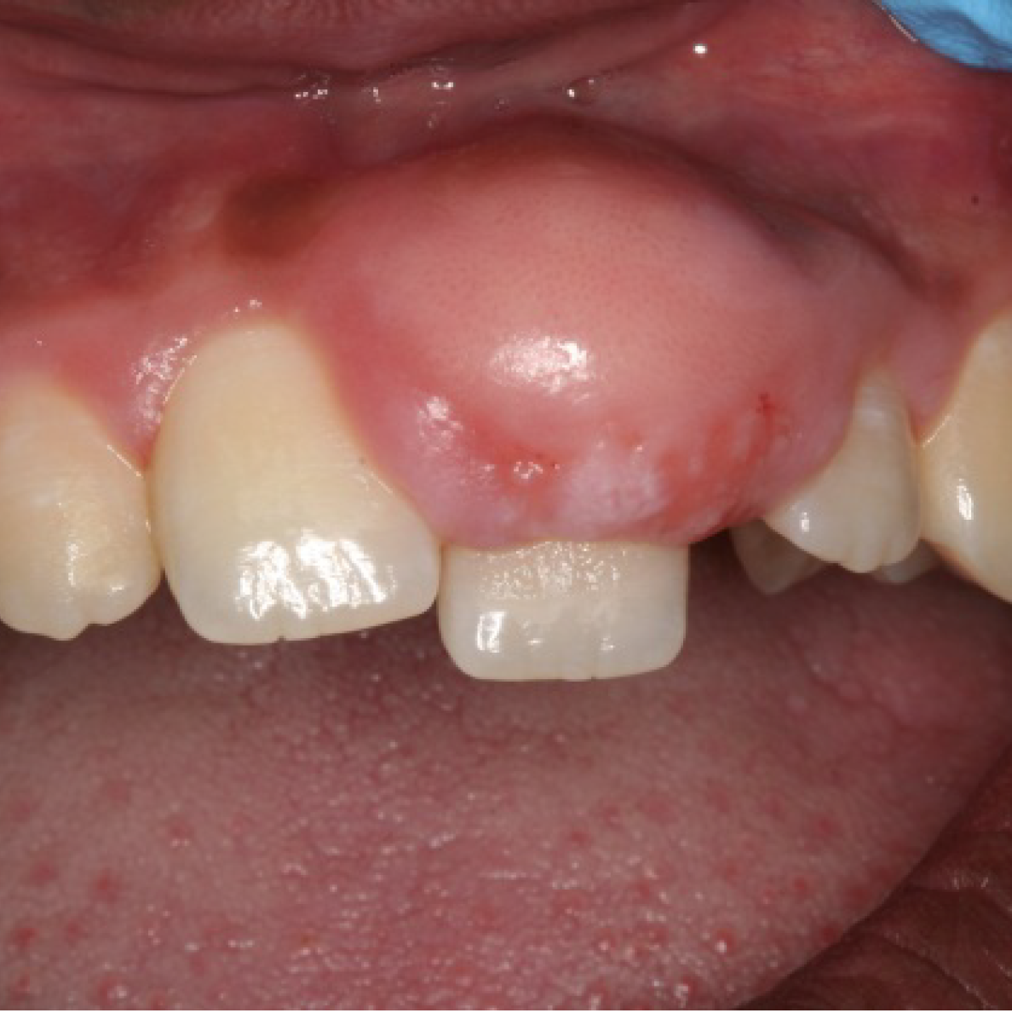
Pregnancy Oral Tumor
Prevalence - 5%
Looks like pyogenic granuloma
Caused by an increase in progesterone
Location - gingiva, tongue, palate, buccal mucosa
Most commonly seen after the first trimester, grow rapidly and disappear after delivery
Lesions removed during pregnancy are likely to recur

Slide 21
Other Action Items
Pregnancy options counseling
Begin prenatal vitamins
Arrange prenatal care
Education – fetal alcohol syndrome
TEAP/Alcohol counseling
Notes:
John/Jason

Slide 22
Teagan
A 21-year-old
Multiracial
Trans male
Studying Culinary Arts
Notes:
Valerie

Slide 23
Health History
Notes:
John/Jason
Hormone treatment

Slide 24
Health History
Notes:
Valerie/diane

Slide 25
Annotation
Notes:
Valerie/Diane
What would make this annotation better?

Slide 26
Notes:
Diane

Slide 27
SIF (Emotional Wellness)
Notes:
Valerie/Diane

Slide 28
SIF (Emotional Wellness)
Notes:
Valerie/Diane

Slide 29
SIF (CRAFFT)
Notes:
Diane

Slide 30
SF-600 Nurse Note
Complains of jaw pain x 2 weeks
Progressively worse
Wants OTC medication, but does not want to see the dentist or MD and says “I don’t trust health providers”
Notes:
John/Jason

Slide 31
Case Conference
Who should be involved?
What are the next steps for helping Teagan?
Notes:
Valerie/Diane

Slide 32
What can you do to encourage him to see health care providers?
Use the chatbox!
Notes:
Valerie/diane

Slide 33
Gender Affirming Care
A safe and affirming healthcare environment in the Health & Wellness Center
Judgment-free, individualized care oriented toward understanding and appreciating a person’s gender
Notes:
diane

Slide 34
Trauma Informed Care/ Resilience Informed Care
Ensure provider and student collaboration by bringing the student into the treatment process and discussing mutually agreed upon goals for treatment
Recognize, understand, & empathize with the impact of trauma
Notes:
diane

Slide 35
Trauma-Informed Strategies for Dental Care
"I know you have concerns about dental care today. Are there things that worry you that I can try to avoid?”
Developing a sign system with the student so they can signal when they need to sit up or swallow.
Allow the student to be treated in an upright or semi-reclined position, with one foot on the floor.
Allow student to be accompanied by a friend, to give them some power; or they may want to bring a blanket, to act as a barrier between them and the practitioner.
Post-treatment instructions should always be written down, particularly for students who dissociate and shut down in the chair.
Notes:
Brian
Recognizing the signs of a trauma victim and avoiding triggers will not only improve their oral health, but also may contribute to their overall recovery.

Slide 36
Elective Oral Exam
Early periodontitis
Grinding/bruxism
Dry mouth/xerostomia
Trismus/pain in jaw
Notes:
Brian

Slide 37
Transgender Medical Care
Job Corps will continue prescription hormonal treatment initiated by a specialist in transition
Job Corps will seek a referral for a student who wishes to initiate transition while enrolled
The student will be followed by the specialist in collaboration with the center physician/NP/PA
Notes:
John/Jason

Slide 38
Tips to Improve Teamwork
Scheduling multiple providers at the same time
SF-600 for all notes
Monthly department meeting (can be virtual)
Notes:
Jason

Slide 39
What unexpected issues has another discipline brought to light?
Use the chatbox!
This Photo by Unknown Author is licensed under CC BY-NC-ND

Slide 40
Questions?

