Slide 1
Reproductive Health and Job Corps
Sara Mackenzie, MD, MPH
Regional Medical Specialist
March 2023
Notes:
Pills patches rings and things/ put a ring on it alt title

Slide 2
At the end of this session, participants will be able to:
Assess
Assess a student’s reproductive health needs
Counsel
Counsel a student regarding comprehensive, patient-centered contraception
Start
Start contraception or schedule next steps

Slide 3
Question
What proportion of all US pregnancies are unintended?
75%
45%
25%
10%
*Unintended = either unwanted (no children desired) or mistimed (wanted later)
Notes:
2011 data – most recent reported by CDC & Guttmacher

Slide 4
Question
What proportion of all US pregnancies are unintended?
75%
45%
25%
10%
*Unintended = either unwanted (no children desired) or mistimed (wanted later)

Slide 5
Question
What proportion of pregnancies in 15 to 19 year olds are unintended?
75%
45%
25%
10%
*Unintended = either unwanted (no children desired) or mistimed (wanted later)

Slide 6
Question
What proportion of pregnancies in 15 to 19 year olds are unintended?
75%
45%
25%
10%
*Unintended = either unwanted (no children desired) or mistimed (wanted later)

Slide 7
Unintended pregnancy rates highest among people who:
Are less than 24 years old
Have low-income (<100% federal poverty level)
Have not completed high school
Are non-Hispanic Black or African American

Slide 8
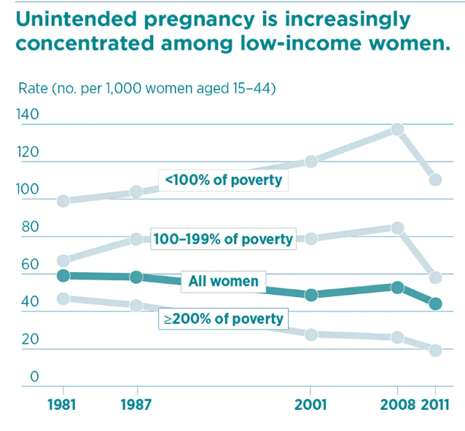
Unintended Pregnancy in the United States | Guttmacher Institute

Slide 9
Quotes from Youth Employment Works Summit 3/9/2023
Meet youth where they are
Revolution of inclusion
How to make it easy
Love and respect
Systems designed to fail (fix*)
Belief youth have the capacity to achieve greatness
*DOL-ETA Youth Employment Works Summit

Slide 10
Assess a student’s reproductive health needs

Slide 11
Policy and Requirements Handbook: Family Planning Program Chapter 2, R(7)
A. A family planning program must be provided to all students on a voluntary basis. At a minimum, this program must include counseling, health promotion activities, and medical services, including birth control. The Center Director must appoint a staff member to implement and monitor this program.
Notes:
Voluntary for student
Required for center to provide
Required for center to appoint person to implement and monitor

Slide 12
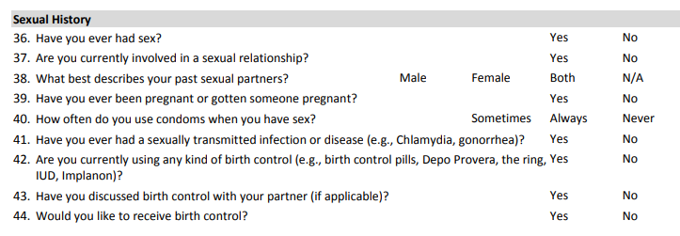
Available information: Health history form & 653 (in process of updates)
Notes:
Currently the 653 and health history under review to be more inclusive language

Slide 13
“Just in time” visits…
Review of Health History
Entrance Physical
In clinic for another reason
Document clearly a student's family planning goals and plans for achieving

Slide 14
Apply Trauma-Informed Care Approach?
Patient empowerment – use strengths to empower student in development of treatment plan
Choice – inform about treatment options so student can choose what they prefer
Collaboration – student, staff, community (if necessary)
Safety – create environment that ensures student feels physically and emotionally safe
Trustworthiness – create clear expectations about options and next steps
Notes:
Welcoming environment – respect and support;
Aligns with the Job Corps 2.0 changes

Slide 15
Trauma-informed sexual history – why important?:
Students may have prior trauma related to sexual health, pregnancy, and healthcare settings
Make space welcoming for all – posters, signs, inclusive language
Be careful about assumptions (yours)

Slide 16
Trauma-informed sexual history:
Ask permission
“May I ask you some (further) questions about history that affects your sexual health?”
“May I ask you some questions to help me understand your family planning needs/goals/desires?”
“Do you have concerns or questions about your sexual health?”
Respect autonomy
“Do you have thoughts or plans around becoming a parent?”

Slide 17
Trauma-Informed Care Approach to Reproductive Care
Patient empowerment:
“What has worked well for you before?”
“It sounds like you are very clear about your goals”
Choice
“There are a lot of options, would you like to learn more about some other types of contraception?”
“Would you like me to tell you about the pros and cons of different contraceptives?”
“Given your goal of not having children for several years, would you like to learn about some methods that seem to help with that goal?”

Slide 18
Trauma- Informed Care Approach to Reproductive Care
Collaboration – student, staff, community (if necessary)
Safety – create environment that ensures student feels physically and emotionally safe
Trustworthiness – create clear expectations about options and next steps

Slide 19
Counsel a student regarding comprehensive, patient-centered contraception

Slide 21
Comprehensive, patient-centered contraception:
Elements to consider:
Effectiveness
Safety
Availability
Acceptability

Slide 22
An overwhelming array of choices!
Students in Job Corps have the right to informed choice
How we present options or create/reduce barriers to options influences decision-making
Current standard of care: recommended tiered approach to contraceptive counseling starting with most effective methods first!*
Condom access is important for STI prevention and dual contraception
*Ott, M.A. et al. (2014) Contraception for Adolescents, Pediatrics 134 (4).

Slide 23
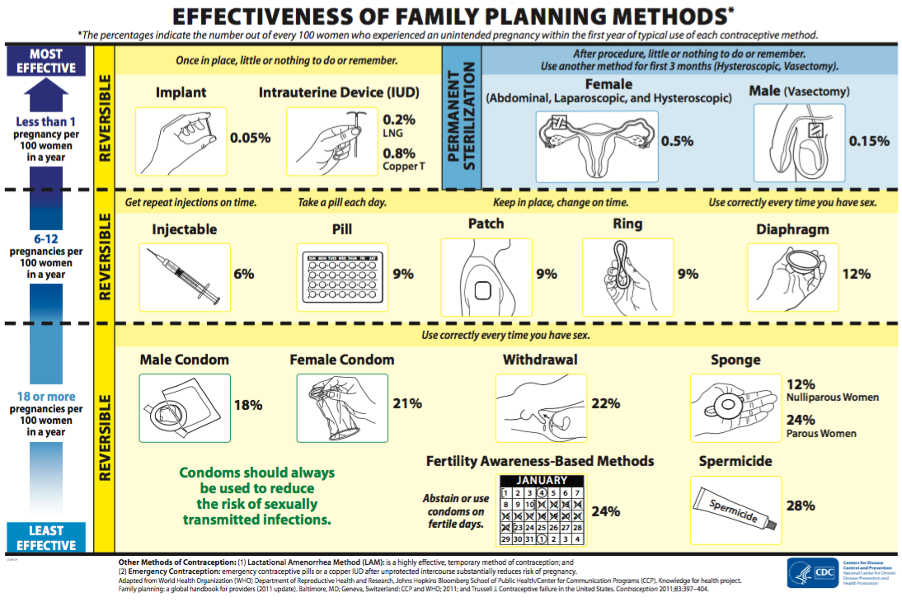

Slide 24
Summary Chart U.S. Medical Eligibility Criteria for Contraceptive Use:
Summary Chart of U.S. Medical Eligibility Criteria for Contraceptive Use. (cdc.gov)
CDC Contraceptive Guidance | Health Care Providers | Unintended Pregnancy | Reproductive Health | CDC
DMPA- depo; POP – progestin only pill; CHC- combined hormonal contraception (pill,patch, ring)
Notes:
1= no restrictions
2= advantages generally outweigh risks
3= theoretical or proven risks usually outweigh advantages
4= unacceptable health risk

Slide 25
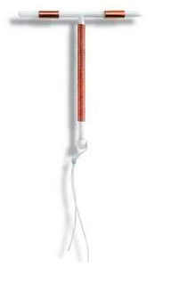
Nonhormonal Copper IUD – Cu-IUD (ParaGard T380A)
What is it?
A T-shaped device with a copper wire wound round it
Inserted into uterus by a health professional
Can be used as emergency contraception
Effective for up to 10 years
How does it work?
Causes changes in uterine lining
Prevents the sperm from fertilizing egg
Decreases sperm’s ability to penetrate cervical mucus
How well do they work?
Typical Use: <1 per 100 women become pregnant in a year
Perfect Use: <1 per 100 women become pregnant in a year

Slide 26
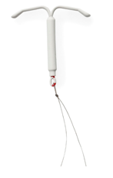
Levonorgestrel IUD – LNG IUD (Mirena, Skyla, LILETTA, Kyleena)
What is it?
A T-shaped intrauterine device that releases progesterone
Inserted into uterus by a health professional
Effective for up to 8 years
How does it work?
Thickens cervical mucus
Thins uterine lining
Prevents sperm from reaching or fertilizing egg
How well do they work?
Typical Use: <1 per 100 women become pregnant in a year
Perfect Use: <1 per 100 women become pregnant in a year

Slide 27
Emergency Contraception: Copper IUD & Mirena, Liletta
More effective than either emergency contraceptive pill – if unprotected sex during fertile period
Within 120 hours (5 days) unprotected sex
99.9% effective preventing pregnancy
Lasts for 8-12 years!
What is the Effectiveness of the IUD? (plannedparenthood.org)
Notes:
As emergency contraception, the Copper-T IUD is much more effective than either type of emergency contraceptive pill (or “morning after pill”) because it reduces your risk of getting pregnant by more than 99%. Another advantage to the Copper-T IUD is that you can keep it in place to prevent pregnancy for up to ten years.

Slide 28
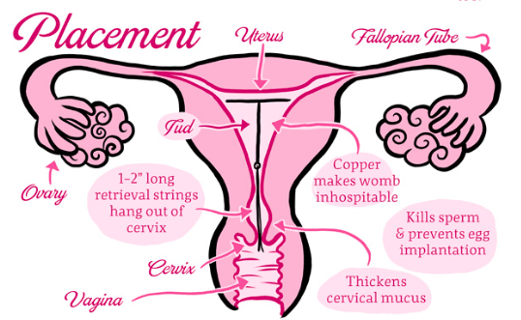

Slide 29
Hormonal Implant (Nexplanon)
What is it?
A single rod containing etonogestrol & barium sulfate (radio opaque)
Inserted inside of the nondominant upper arm, 6 to 8 cm above the elbow,
Effective for up to 5 years
Placement takes 1 minute; removal 5 minutes
How does it work?
Thickens cervical mucus
Thins uterine lining
How well do they work?
Typical Use: <1 per 100 women become pregnant in a year
Perfect Use: <1 per 100 women become pregnant in a year

Slide 30
Method | Pros | Cons
Non-Hormonal IUD | Regular menses continues | May increase menstrual bleeding and cramps Risk of perforation: 1/1000 Risk of expulsion: 2-10/100 Not use if allergy copper or Wilson’s
Hormonal IUD | Reduces heavy menstrual bleeding (on average by 90%) menses may cease; decrease cramps No weight gain May decrease endometriosis Can be used if can’t take estrogen | Irregular bleeding Risk of perforation: 1/1000 Risk of expulsion: 2-10/100 Rare: breast tenderness, acne, headaches Cannot be used if hx breast cancer or severe liver disease
Implant | Reduces heavy menstrual bleeding; menses may cease (1 in 3 women); decrease cramps Can be used if can’t take estrogen | Cannot be used if history breast cancer or severe liver disease Irregular bleeding Rare: infection at site, headaches, nausea, breast tenderness
https://www.plannedparenthood.org/learn/birth-control

Slide 31
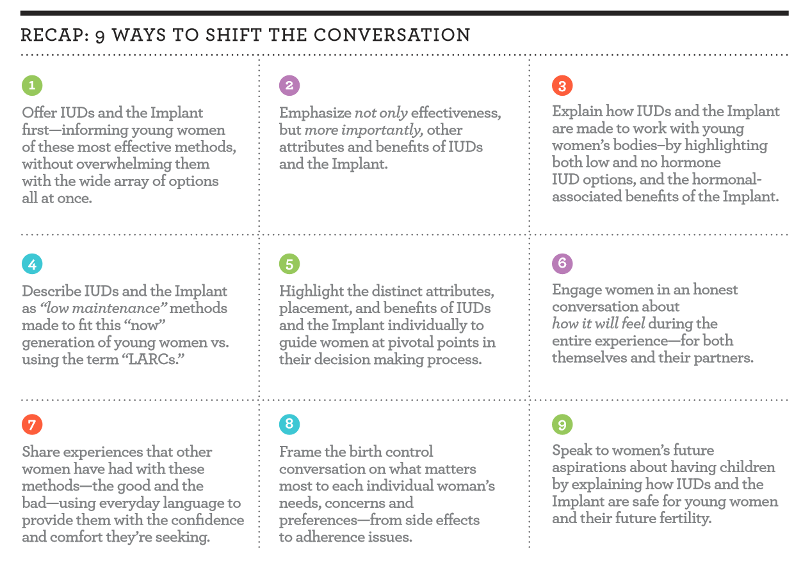

Slide 32
Start contraception or schedule next steps

Slide 33
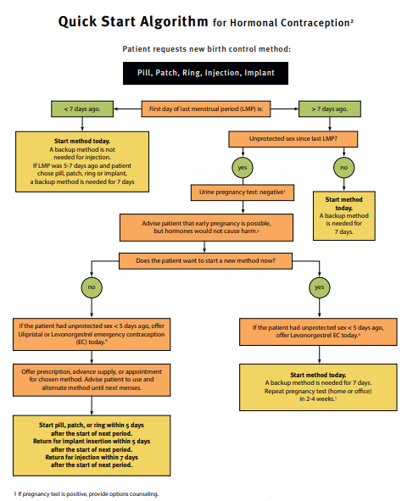
Reproductive Health Access Project | (reproductiveaccess.org)

Slide 34
Reproductive Health Access Project | (reproductiveaccess.org)

Slide 35
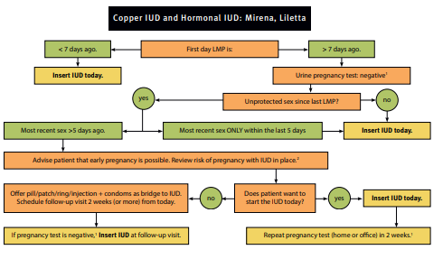
Reproductive Health Access Project | (reproductiveaccess.org)

Slide 36
How to ensure access – have a plan in place:
Some centers have providers trained to place long-acting reversible contraceptives
Build relationship with community providers who can place long-acting reversible contraceptives
Assistance programs:
ARCH Patient Assistance Program: http://www.archpatientassistance.com/eligibility/ (Skyla and Mirena)
Paragard http://paragard.com/What-it-costs.aspx Patient direct

Slide 37
Questions?

