Slide 1
Job Stress! Teaching Students Coping Strategies
María M. Acevedo, PhD, LP – PR Region I Regional Mental Health Specialist
Helena Mackenzie, PhD, LP – Region 5 Regional Mental Health Specialist
Notes:
Welcome! We’re excited to share today’s presentation, which comes out of Dr. Acevedo’s many years of work in vocational rehab.

Slide 2
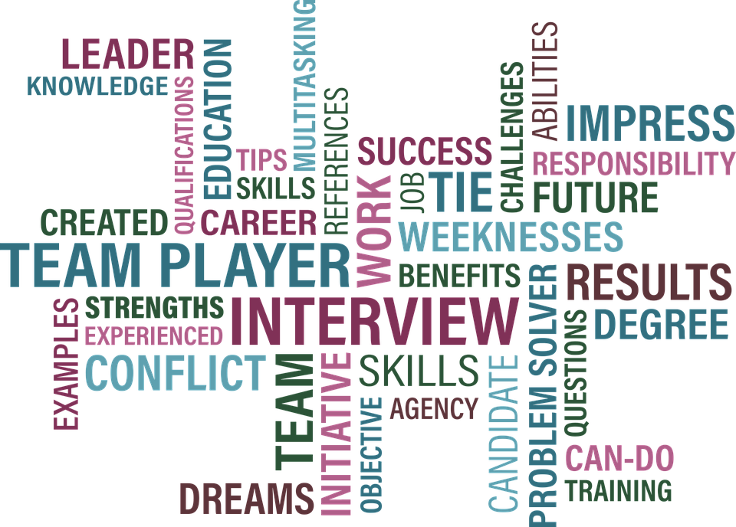
Objectives
Identify two common workplace struggles that result in stress
Recognize how thoughts and interpretations impact emotions
Practice one skill to manage strong physiological reactions
Recognize how practicing interpersonal assertiveness skills can reduce job stress
The idea is to present a non-detailed instruction to provoke students to ask for more detail instructions.
Notes:
[H] Our hope is that this webinar will help you better support Job Corps students' success in the workplace by first identifying potential work-related stressors and then helping students build skills to better manage. You can see the objectives on the slide--
Identify common workplace stressors
Recognize how thoughts and interpretations impact emotions
Practice ways to manage strong physiological reactions, and
Identify different communication styles and practice assertiveness skills

Slide 3
Introduction
Notes:
[M]
Good morning / Good afternoon
I am a clinical psychologist that has been working with Puerto Rico Vocational Rehabilitation Administration for 23 years as a member of an interdisciplinary team that offers direct services to people with significant mental health or dual diagnosis mental/physical or substance use disabilities.
As a psychologist, I perform mental health-vocational assessments to determine strengths, weaknesses, coping skills, treatment adherence, and needs of referred participants.
I recommend a skill training program for those participants that are emotionally stable, have good independent living skills but have work-related problem-solving and decision-making difficulties, and/or social-interpersonal skill limitations for employment settings.
Strengthening and/or developing these skills are primary goals to overcome barriers to obtain and retain employment.
I have developed a skills training program, which is broken into 4 modules, which we’re going to share on today’s webinar.
Before we do that, let me share a few details related to the structure of the training program and the population served.

Slide 4
Training Module Structure & Participants
Participants
Individuals from 18 to 23
Some have previous work experience, some have none
Group interventions
3 or 5 participants
Duration
About 3 months of weekly interventions
Time
An hour and a half
Notes:
[M] The participants I work with in Vocational Rehab are 16 and older – however most of those who participate in the training are between 18 to 23 years old.
Some have previous work experience, some have no experience at all.
As you can see the age and work experience of the population I work with is pretty similar to Job Corps population.
I have found group interventions are preferable since they are dynamic. I form, in most cases, groups of 3 to 5 participants.
Group interventions allow students to practice teamwork, interpersonal skills, and communication/assertive skills.
Also, offer opportunities to learn and receive support from peers that are working to overcome similar needs/challenges.
The Duration and time - Approximately 3 months of weekly interventions of an hour and a half.
For the remainder of the webinar, I will refer to Vocational Rehab participants as students.

Slide 5
Tech savvy
Cooperative & social
Prefer in-person communication
Value self-care & balance
Prefer short time &
interactive activities
Value flexibility, relevance
& authenticity
Factors for group interventions
Create cohesive groups
Emphazise confidentiality
Utilize different means to share information - specially digital information
Share real-life anecdotes/ experiences
Engage students in learning activities
Notes:
[M] Most of vocational rehab students, similar to our JC students, are part of Gen Z, which includes youth who are currently 11 to 26 years old.
Gen Z is the first generation born after the mass-adoption of the internet and smart phones – they are:
Tech savvy
Cooperative, and social,
Interestingly, tend to prefer in-person communication,
Value self-care and balance,
Prefer activities that engage their attention for shorter periods of time, and are interactive,
Value flexibility, relevance, and authenticity.
With COVID limiting social interactions, many of these students yearn to be part of a group and seek connection.
When working with Gen Z students I have learn that it is best to:
1. Create cohesive groups – Define goals with the flexibility to restate them as new needs are observed or are stated by students.
2. Emphasize confidentiality, as you all know, is an important rule of group interventions. This promotes a save and cooperative environment that encourage honest, authentic and direct communication/feedback.
3. Use different means to communicate the intended information – specially digital information. I have resources in English and Spanish – and I will be sharing some of them with you all in the resources section at the end of the webinar. I use
* Traditional or digital newspaper clips
* Digital images/diagrams
* Digital videos on different topics – videos do engage student’s attention.
4. Share real-life anecdotes/experiences – This is crucial to make the information relevant.
5. Engage students in learning activities – I perform role plays of real work stress scenarios for students to continue learning/practice learned skills, and to receive constructive feedback, specially from their peers.

Slide 6
Indentifying Job Stressors
Notes:
[H] Let's imagine a Job Corps student is finishing up their time on center and transitioning to the workplace. What types of stressors might they experience in the workplace and how do we help them prepare for these situations? Maria is going to talk a bit about what she has found to be the biggest job-related stressors in her voc rehab work.

Slide 7
Workplace Stressors
Time pressure
Unsure of job duties/task
Not having what’s needed to do the job
Relational conflicts
Communication
Notes:
[M] The biggest job-related stressors that I have identified are:
Time pressure
Students worry / feel stressed that they would not be able to finish assigned tasks on time.
Some verbalize - “I can’t handle pressure…It frightens me not to be able to perform the tasks on time”.
Not understanding job duties/tasks or not having what’s needed to do the job, but being afraid to ask for what they need to finish the job or for instructions to be clarified:
You can hear them say:
“I get nervous thinking that I will not be able to understand the instructions…of making mistakes…I am afraid to ask ….”.
Relational conflicts – Drama/not getting along with co-workers, supervisors or customers/clients becoming overwhelmed by stress.
You can hear them verbalize:
“I don’t know what to say if someone treats me harshly …if that ever happens to me, I will just leave…walk out …to never return to the job.”
As you can see, student’s difficulties to communicate with others is a present issue in the stressors already mentioned.
I have also notice, more often than not, that students have difficulties communicating to their supervisors that they will be absent or late to work.

Slide 8
Four Modules
Work norms, rules and laws
Helping students learn basic emotion regulation skills
Assertiveness and communication skills
Role plays to allow students to practice skills learned.
C
Notes:
[H] So let’s walk through the four modules of the Training program that Maria has developed:
The first module focuses on what to expect in the workplace: learning about general workplace norms, rules and laws.
The second module focuses on helping students learn basic emotion regulation skills and how doing so can help them respond more effectively to stressful situations. This second module consists of 2 parts:
Part A is a very basic overview of CBT (cognitive behavioral therapy) and skills to assist with identifying thoughts, emotions, body sensations and practicing skills to check-out thoughts and calm the body.
Part B uses videos to help demonstrate and practice these skills.
The third module focuses on assertiveness and communication skills.
The fourth module includes role plays to practice pulling all of it together--emotion regulation, assertiveness, and communication skills.

Slide 9
Module 1 Understand Job Norms/ Rules/Laws
“Almost all fear is fear of the unknown. Therefore, what’s the remedy?
To become acquainted with the things you fear.”
Peace Pilgrim
Notes:
[M]. This first module provides an orientation of general job norms/rules/ laws so that students with no prior work experience know what to expect in the workplace, which will help them feel less stressed.
It also gives students with work experience an opportunity to share any stressors they previously experienced and ask questions.
I share real work anecdotes/experiences and encourage students to also share experiences.
The Job Corps program already emphasizes some of these:
The importance of punctuality.
There is a dress code.
TEAP specialists provide information related to the repercussions of alcohol and drug use in the workplace and explain the zero tolerance policy.
And Sexual Harassment Policy orientations are offered.
To discuss Sexual Harassment I defined the concept, and described different examples of sexual harassment behaviors.
To help students to easily recognize sexual harassment I show them a video that presents some of this behaviors.
To make the information relevant I discuss high-impact media coverage incidents – for example: how the victory of the Spanish women’s team in the World Cup, was marred by Spanish Soccer Federation President Luis Rubiales, when he kissed star player Jenni Hermoso on the mouth without her consent.
I also talk with students about what they should do and say – if they ever experience sexual harassment.

Slide 10
Human Resources
Understanding Job
Norms, Rules, Laws
Probation Period
Cell Phone Policy
Attendace Policy
Notes:
[M] Some other areas that I discuss, which might not be formally done within JC are:
The general functions of Human Resources (HR). They are responsible, among other tasks, of:
Maintaining Employer-Employee Relations
Creating a Safe Work Environment
Handling Disciplinary Actions
Therefore, are responsible for implementing labor standards/norms/rules established by the institution and state/federal laws.
HR usually comes up during our discussions throughout the modules.
Then I proceed to discuss
The Probation period – What is it about and how long the period is according to the Labor Law.
Cell phone policies: Can your employer legally take your cell phone? No. However they can prohibit or ban their use.
Attendance Policy – Students need to know that if they are unable to report to work as scheduled, will be tardy, or are planning to leave early they must contact their supervisor or the designated person as far in advance as possible – and that excuses need to be deemed justifiable.
Students also need to know that there are rules for no calls/no shows – they could be considered job abandonment - resulting in termination of employment.
Again - Discussing real life anecdotes related to these rules/norms/laws is essential.
It has been my experience that most students are not ready to write a text message/email if required or even more to make the call if that is the rule to notify that they will be absent or late.
I decided to write for them scripts to practice the call and guides on how to write a text or email excuses for absenteeism or tardiness.
Remember some of our students do not have functional writing skills – they must practice how to leave a voice message or make the call.
Calling to report that they will be late or absent for work is a source of great stress for the vast majority of students.
I do role plays for them to practice calling their supervisor to excuse themselves.

Slide 11
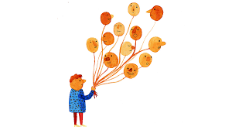
Module 2
Part A:
Basic CBT Skills for Stressful Situations
Notes:
[H] Module 1 helps students better understand the workplace and what to expect; however, as we all know, we can't prepare for every situation that we may encounter. It's natural that students will experience stressful situations, which might trigger strong feelings. The focus of Module 2 is to teach students some very basic CBT (cognitive behavioral therapy) skills and how to use them when facing stressful situations. We’re going to walk through how you might do that.

Slide 12
Skill 1 Practice Identifying & Naming Emotions
Basic Cognitive Behavioral Therapy (CBT) Skills
Notes:
[H]Emotions/Feelings—There is incredible power to teaching students to notice and name their feelings. We know that doing this alone, without any other intervention, often helps decrease overwhelming emotions by getting a bit of space from them. Students (and many of us) try to control or avoid feelings by “stuffing them down;” but we know that the more we avoid or suppress feelings, the more they tend to rear up at unexpected times. While it’s natural that we might not like some emotions (no one likes to feel afraid or depressed), it’s important to remember and help students understand that there aren’t “good” or “bad” emotions. In fact, all emotions are important—they are often like sign posts trying to point things out to us.
One way to teach emotion identification is to first ask students to name as many emotions as they can think of. Often students will only name the very basic ones—happy, sad, angry, so forth. We can then share an emotion wheel like this one, or a list of emotions, to show how many different emotions there are and the subtle differences between them.
An easy way to practice this is to say to students something like, ”Imagine your supervisor tells you that you did an incredible job finishing a project.” How would you feel? Students often say, ”good” or “happy.” We can then encourage them to be more specific by using the feeling wheel or lists of emotions (for instance, instead of “happy” they might realize that they feel proud or self-confident or optimistic). We then might shift to a more challenging situation. NEXT SLIDE

Slide 13
Skill 1
Practice Identifying & Naming Emotions
How would you FEEL?
Notes:
[H] CHAT BOX: Look at this image and imagine you’re the student here and this is your supervisor “giving you feedback”: How would you feel? (CHAT BOX)
If students come up with basic words like ”angry/mad” or "scared," you might ask them to look at the emotion wheel and see if there are any more specific feelings like embarrassed or disrespected or inadequate. It can be even more helpful to then teach students to say something like, “I notice I’m feeling ....embarrassed" or "I notice I'm feeling...disrespected" to help them realize it's a feeling, it's not them, which again can create some space to hold the strong emotion.

Slide 14
Skill 2 Practice Noticing Thoughts
Your New Boss
Notes:
[H} After students are more comfortable identifying feelings, we start having them notice the thoughts or images that go through their mind. Most of us believe that what we think or perceive about things is “reality,” but we know ”reality” is subjective, meaning different people may perceive the same situation or person in very different ways. For instance, if you look at the left image, what do you see? (CHAT BOX).
Some will see a duck (with the bill off to the left) and others will see a bunny (with ears off to the left, facing right).
Now shift your attention to the face on the right side, If I tell you this is your new boss, what thoughts go through your mind? How do you perceive him? Maybe he reminds you of an uncle you liked and you notice generally positive thoughts, “he looks nice.” Or maybe he reminds you of a terrible teacher you had and you find yourself thinking, “he looks mean.” What we think influences how we feel (and vice versa) so it’s helpful for students to understand that sometimes we want to check-out our thoughts/perceptions, not take them as “truth.” Ask ourselves, “Is there a different way to see this or think about this?”

Slide 15
Skill 2
What Would You
Be Thinking?
Notes:
[H] so let’s go back to the supervisor giving feedback situation---
What thoughts would go through your mind? What would you be thinking? (type in CHAT BOX)
I hate her.
I never do anything right
I’m going to get fired
I’m going to quit this job
What’s wrong with her?
I can handle this. I’m not sure what’s up with her today, but this is clearly her issue, not mine. My work is solid.”

Slide 16
Skill 2
Do not go that route!
I can stay calm
Breath!
Thought
Shifting
Breath!
Do not go down that road!
I’ll get through this
Notes:
[H]
It’s not hard to imagine how certain thoughts might trigger strong emotions. For instance, if we thought, “I never do anything right. I’m going to get fired,” we might feel anxious, embarrassed, or defeated. However, if we thought, “I’m not sure what’s up with her today, but my work is solid,” we’d likely feel much differently. So, checking out our thoughts can be really helpful. Asking ourselves, “is there a different way to see this situation or this person?” This is why it’s often helpful to check out our thoughts with others, who might help us see things differently.
However, it’s also important to know that when we are in the middle of a very stressful situation, we’re often not able to check-out our thoughts b/c we’re too activated to think clearly. So, what can we teach students to do in those situations?
It can be helpful to encourage students to have a set phrase, word or mantra to use in intense, emotionally challenging situations, one that can help shift away from a focus on negative interpretations of situations and stay more centered.
For example, if we’re thinking – “I hate my boss. She’s mean…I just want to quit …” --- We might shift to something like, “I can get through this” or ”Stay the course!” or “I’m not going to let someone else’s mood ruin my day.”
Students are often very creative - encourage them to come up with a phrase that works for them.
Remind students that walking away/taking space from a stressful situation, if allowed and appropriate, can also be very helpful in calming down. If a student has a mental health disability, having a pass to go somewhere to take space can actually be a reasonable accommodation. And If a student can’t physically leave a situation, shifting where they’re looking can be helpful—for instance, don’t look at the person/situation that is triggering, look at something or someone who is more calming/neutral.

Slide 17
Skill 3
Notice Body
Sensations
Notes:
[H] The next step, after teaching students to identify their feelings and notice their thoughts, is to help them pay attention to their body and the physical body sensations that they’re experiencing. Only when we recognize that we’re tense, can we practice skills to help our bodies relax. So, imagine you’re in this situation and SCAN your body: what body sensations are there? (CHAT BOX)
Tense, clenched fists, clenched jaw, heart racing, sweating, etc. Likely you will have fight/flight sensations, activated sympathetic nervous system.

Slide 18
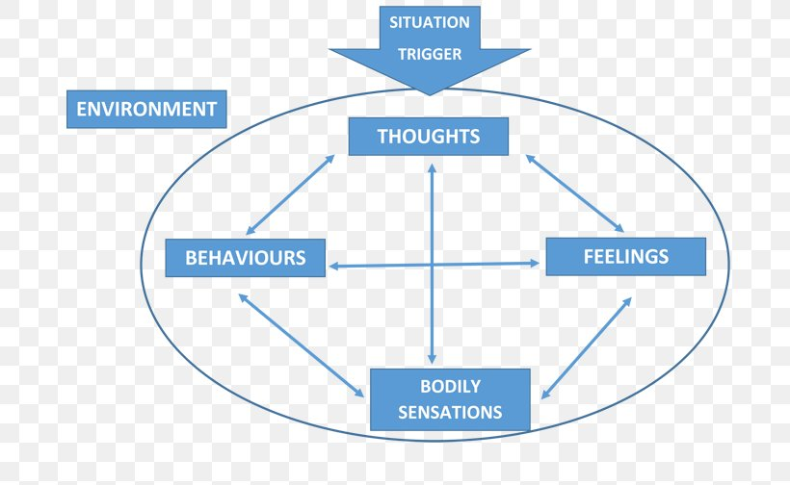
Cognitive Behavioral Therapy Model (CBT)
EXPERIENCE
Notes:
[H] So, here you can see the CBT model and how it all comes together. How situations trigger thoughts, feelings, and body sensations that lead us to behave in certain ways. And that the way we interpret situations is greatly impacted by the environment we’re currently in and our history of learning experiences (including whether we’ve experienced trauma). It’s all interconnected! The good news is this means IF we teach students (and ourselves) how to notice and name feelings, identify and check-out our thoughts, and notice and take care of strong physiological reactions when they occur, we can have a much better sense of freedom—we can understand why we feel and think as we do and we can better choose how we want to respond.
In a few minutes, Maria is going to show videos she uses with students as hands on practice of this CBT model because the best way to help students understand the model is to actually practice it. But, before that, we just wanted to take a few minutes to talk about some strategies to calm the body when activated by a stressful/triggering event.

Slide 19
Skill 3 Calming the Body (Physiological Reactions)
Deep Breathing (next slide)
Drink cold water
Self-hug/self-massage
Repeat mantra or calming phrase “I am safe and will get through this”
Move your body: Stretch in place while taking deep breath
Use a fidget object (will be discussed later)
Stand with arms behind or in front of you, with one hand grabbing the other
Support the body by leaning against a wall—back or side to wall
Look at calming image
Notes:
[H] Once students start noticing their body sensations, particularly when they start being able to notice when they’re tense or in a state of physiological distress, they can learn skills to better regulate and calm down their body. An easy way to introduce self-soothing/calming strategies is to ask students what they do to calm down or cope in the moment when they're feeling stressed or tense. So, [CHAT BOX]: what do you do right in the moment when you notice you’re stressed out or triggered and you want to calm yourself down? On this slide are some SIMPLE Strategies to calm the nervous system. It’s important to encourage students to try out different strategies b/c what is soothing to one person might not be soothing to another.

Slide 20
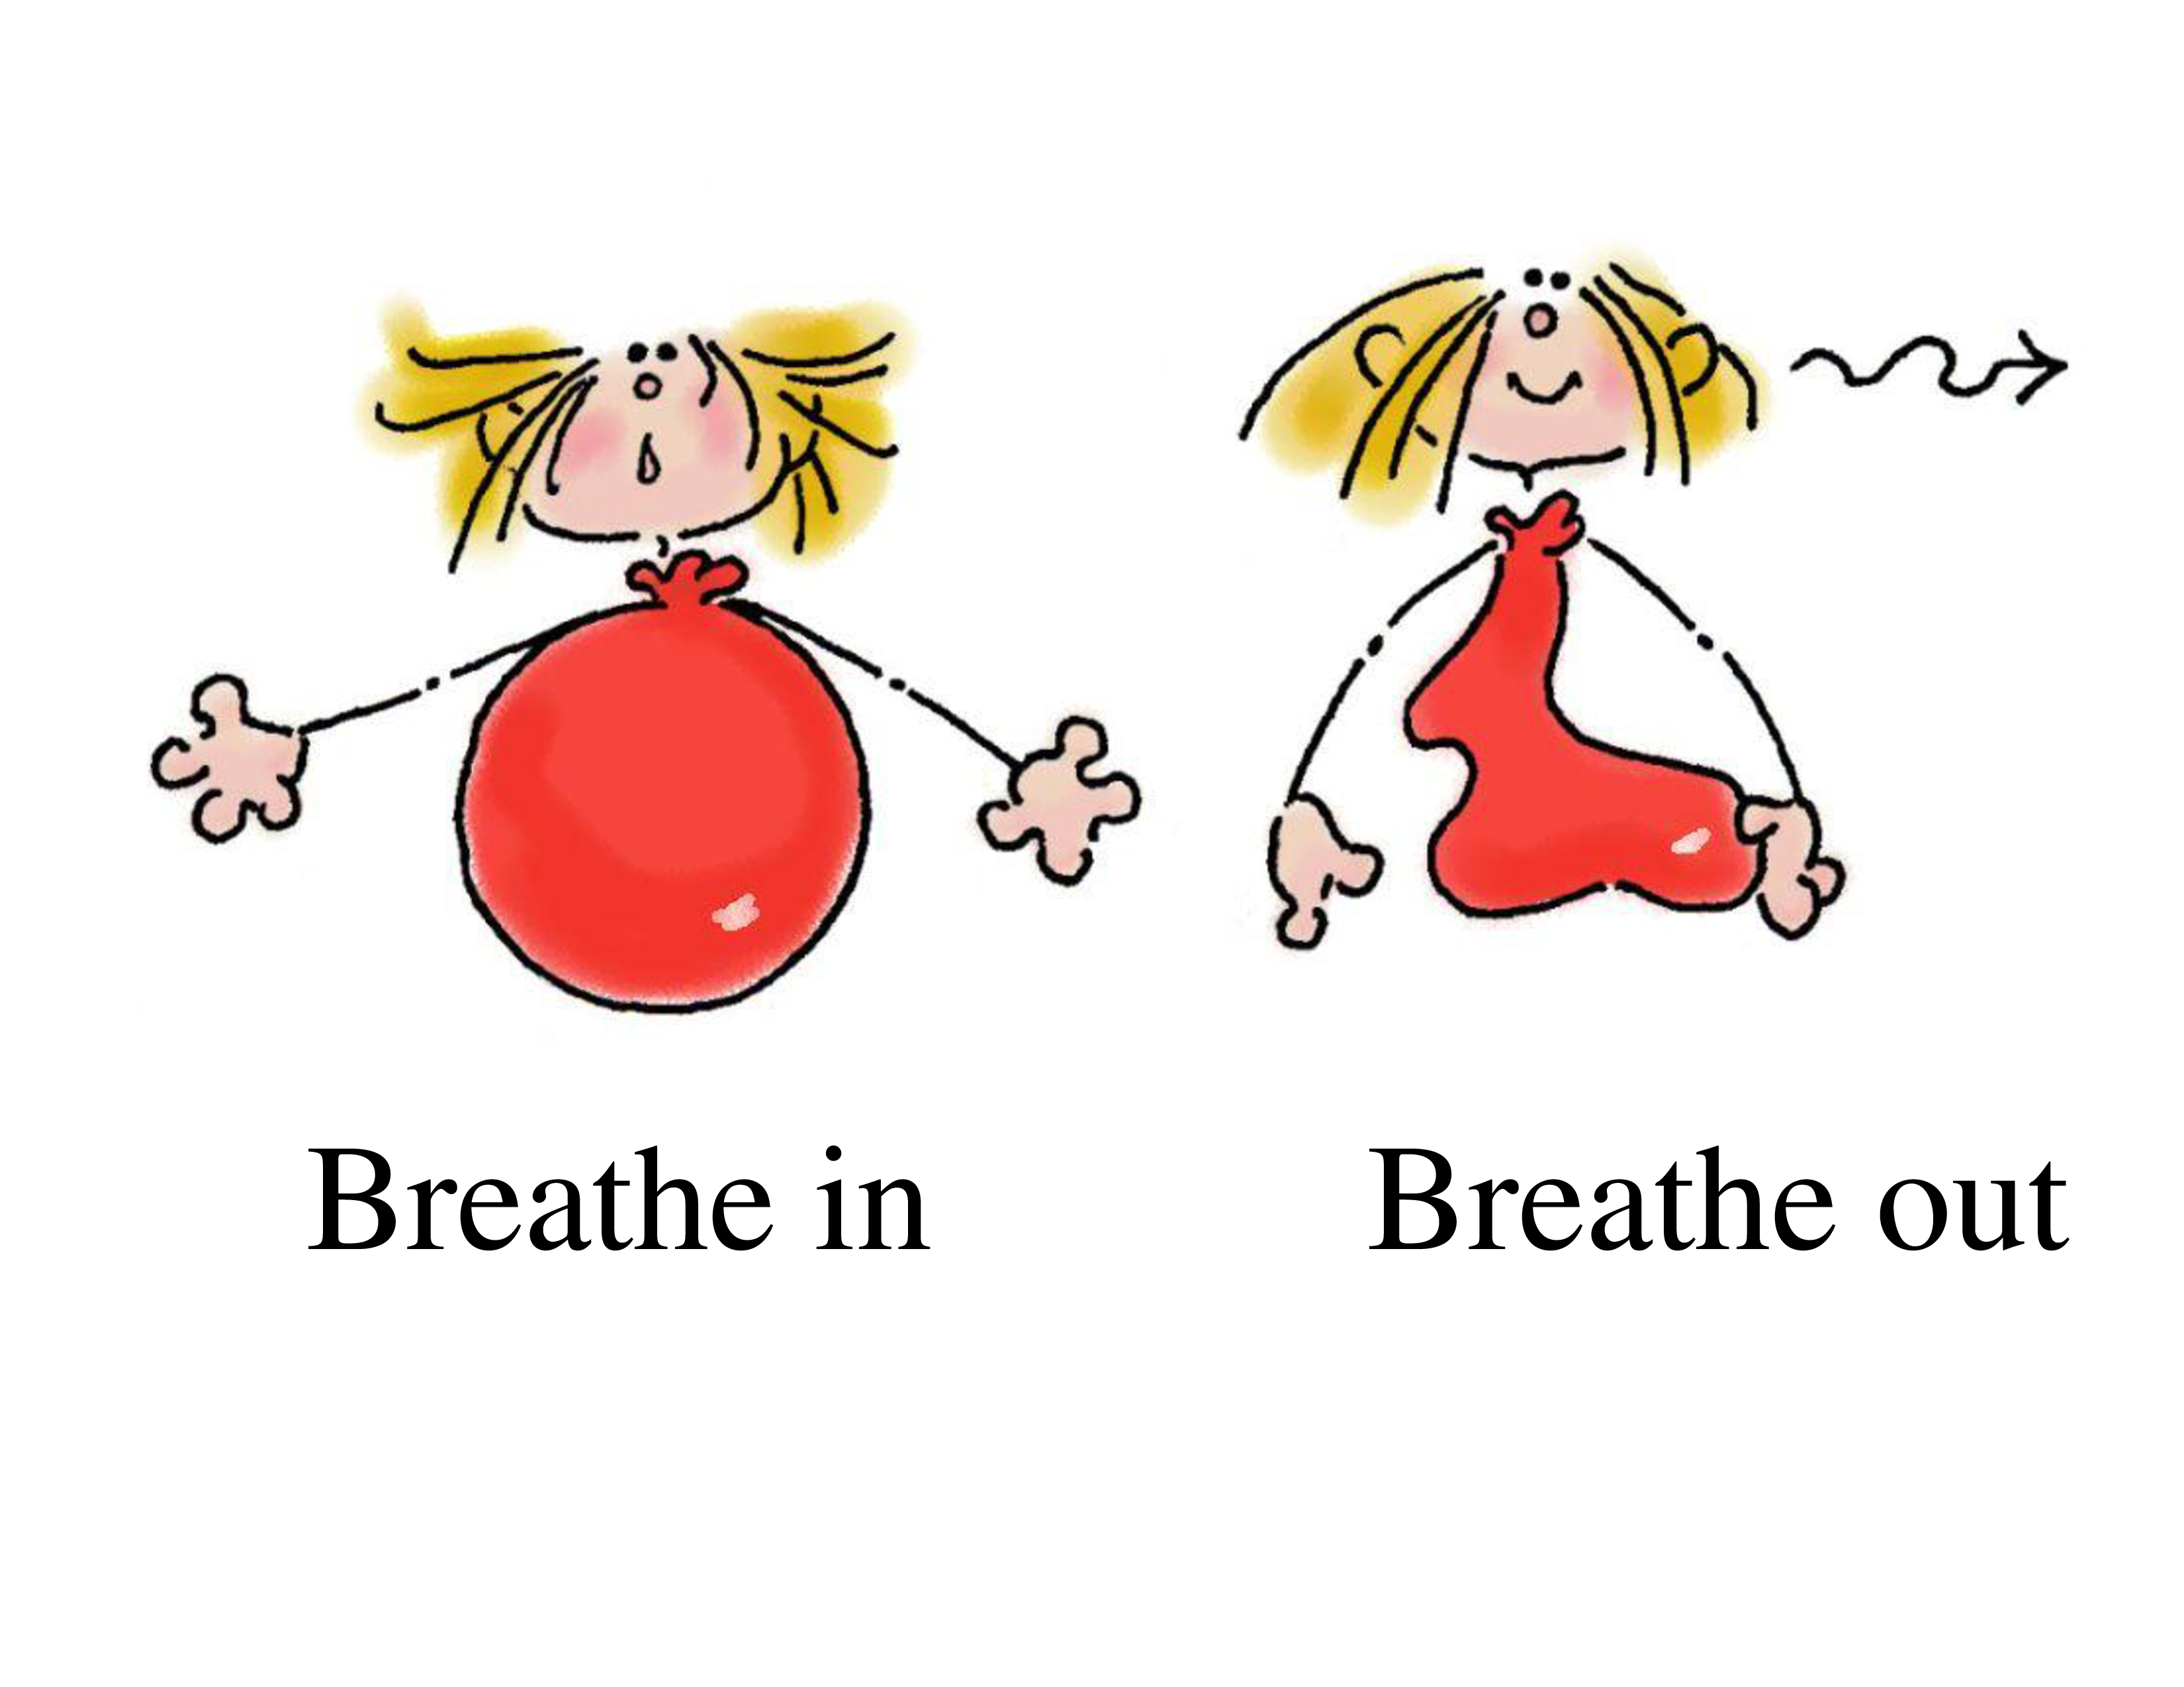
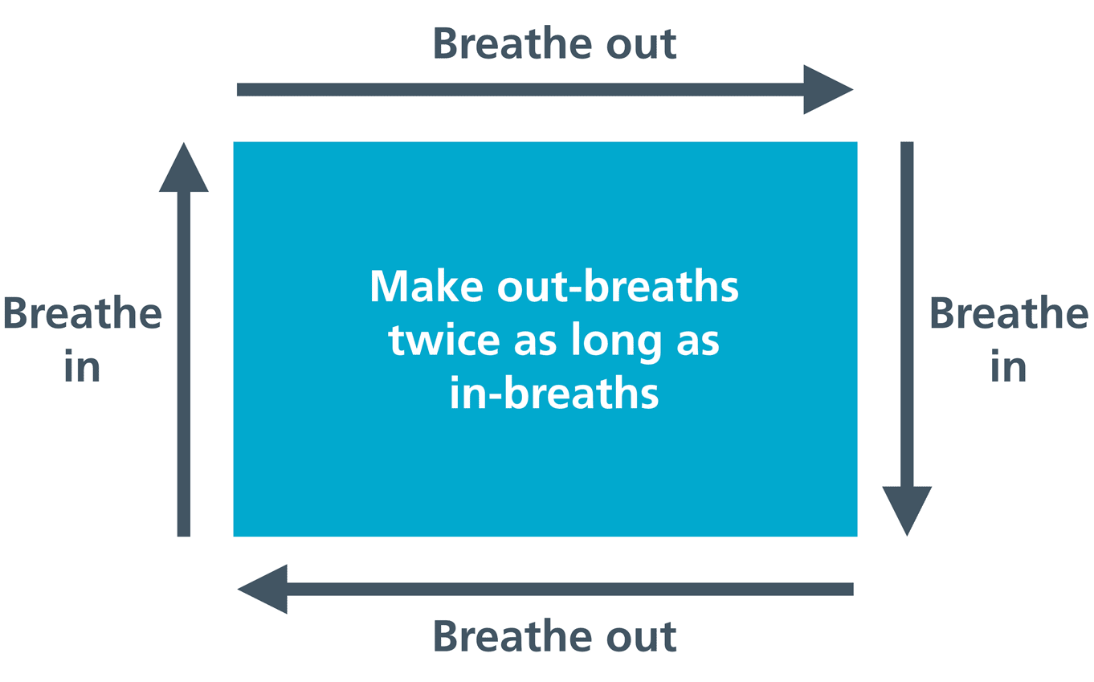
4 x 4 Breathing
Breath In 1-2-3-4 Hold In 1-2-3-4
Breath Out 1-2-3-4 Hold In 1-2-3-4
Rectangle Breathing
Notes:
[M] Deep breathing is probably the fastest way to calm down the nervous system.
We know that breathing gets shallow and faster when we are stressed.
When we take slow, deep breaths we basically send the message to our brain that all is okay.
In my experience, most students have a hard time learning to take a deep breath.
Therefore, it is important to present students different learning methods – diagrams / videos / and/or we modeling step-by-step how to do it.
I have learned with students that holding their breath has help them get through stressful events - specially if they start to feel anger.
Is that the case they can practice the 4 by 4 ratio breathing/box breathing. Inhale in 4, hold in 4, exhale in 4 and hold in 4.
It helps to feel grounded and to monetarily halt body sensations.
The Rectangle breathing is a well known strategy to help manage stress/anxiety.
The most important thing to remember is that your exhale should be longer (ideally twice as long) than your inhale.
Instruct students to inhale through their nose for 4 counts and exhale through their mouth for 6, 7 or 8 counts – in my experience it is initially difficult for students to make it to 7 or 8 counts.
We can teach students to find a rectangle in the room they are in (computer monitor, picture, piece of paper) and instruct them to inhale on the short sides and exhale on the long ones--letting their eyes gaze across the sides as they go.

Slide 21
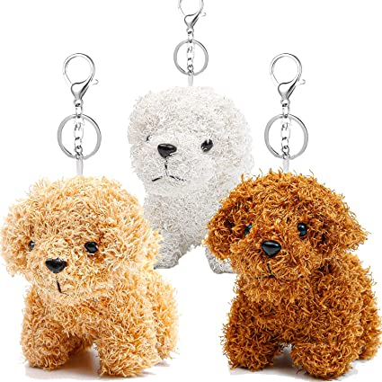
The Fidget Phenomenon
Filled with Squishy Beads
Stress Relief Mindful
Breathing Necklace
Fidget Bolt
Fidget Necklaces
Fidget Rings
Notes:
[M] Some students use fidget objects as means to substitute fidgeting behaviors that appear to regulate the experience of stress.
Before showing students the video titled Best Fidget Toy for the Office Desk I place different fidget objects on the table for students to try.
There is no conclusive scientific evidence about whether fidget objects actually work, and if they do, how. Anecdotical stories advocate the effectiveness of these objects.
The good news is that more researchers are conducting scientific studies to understand the psychology behind fidgeting and fidget objects as instruments to calming fidget behaviors.

Slide 22
Other Strategies to Manage
USE MENTAL HEALTH APPS – HIGHLY RECOMMEND COVID Coach – FREE, OFFERS A VARIETY OF SHORT EVIDENCED-BASED EXERCISES (SPANISH / ENGLISH)
BODY SCAN
OBSERVE THOUGHTS/ THOUGHT SHIFTING
DEEP BREATHING
GROUNDING
MINDFULNESS EXERCISES
MUSCLE RELAXATION
POSITIVE IMAGERY & OTHERS
WITHDRAW TO A CALM PLACE/AREA
SPLASH WATER ON YOUR FACE
STRETCH THE MUSCLE (Videos)
SING – HUM
DRAW
LISTEN TO MUSIC/SEE MUSIC VIDEOS
LAUGH/REMEMBER SOME EVENT WHICH MADE YOU LAUGH OUT LOUD
THINK OF SOMETHING FUNNY/SEE FUNNY VIDEOS OR IMAGES
PLAY VIDEO GAMES
Notes:
[M] In this slide the left column presents the strategy of using Mental Health Apps. I present student COVID Coach–is FREE, OFFERS A VARIETY OF SHORT EVIDENCED-BASED EXERCISES that can be use during breaks and lunch time and is available in SPANISH & ENGLISH.
In the right column are some of the other strategies to manage stress that are discuss with students – there is a more extensive list in the resources section.
Make students aware of the strategies that are appropriate to be used during work hours, breaks, and lunch time.
When selecting strategies remind students to be mindful of others.
Encourage them to be prepare - e. g. to have in their backpack the drawing notebook/drawing pencil or having selected in advanced the songs/music videos that will effectively help them manage different emotions.
Finally, advise students to set their cell phone alarms a few minutes before they need to return to work after breaks / lunch time, if using any of these strategies can cause them to lose track of time.

Slide 23
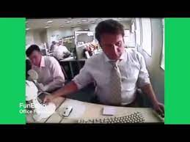
Module 2 Part B Practice!
Office Freakouts Compilation Videos
Notes:
[M] For Module 2 Part B I explain students that to continue to emphasize the importance of us noticing/identifying our emotions –thoughts and body sensations –
I will be showing them some videos that I found in YouTube where they are going to see some employees facing a stressful/uncomfortable situation at work.
Before playing the videos I:
Display the CBT diagram for students to see/refer to.
Hand out copies of the lists of emotions and the Wheel of emotions for students to use.
I will play the video to show the stressful situation and then pause it. Here is one of the videos.
Once in pause I ask students to describe the situation, and then ask them –
What thoughts would you have if you were the ones facing the situation – what emotions – specific emotions, and what physiological reactions you might have.
They often have difficulty identifying their thoughts. I provide support throughout this process.
Then we see the rest of the video – let us see the conclusion of this video.
Once students see the conclusion of the video, I ask –
What thoughts could the employee who assaulted his coworker may have had?
What emotions and body sensations they might had experienced?
This will show them how different thoughts are different interpretations for the situation and how different interpretations elicit different emotions and physiological reactions, and consequently, different behaviors.
Finally, I discuss with students whether the situation was handled appropriately.
What could be the consequences of aggressively handling the situation?
How would they have managed the situation?
This allows students to assess their decision-making process and provide feedback to each other.
Let us now see the first part of the next video - Pause
Again, I would ask students to describe the situation and what thoughts they would have if they were the ones facing the situation – what specific emotions, and physiological reactions they might have.
So, I ask the audience what thoughts you might have if you were the one finding a coworker smoking in the bathroom?
What emotions and physiological reactions you might have.
Please write the answer in the chat box.
Different reactions to the same situation.
Here is the rest of the video!
Again, once the video concludes the discussion will revolve around the aggressive behavior displayed by the employee and the consequences of the response to the situation.
I will be sharing with you all 7 edited videos & an 1 unedited video for you to use if you are interested.
When using the videos
Be creative - Some videos will allow us to complicate the situation – for example - what if these is the third time you see the same coworker smoking in the bathroom and you had previously told him that you are asthmatic and the smoke really affects your capacity to breath.
Also, take these opportunities to educate students on when and how to use proper channels to lodge complaints.

Slide 24
Match the Communication Style
Module 3 Assertiveness
& Communication Skills
“I’m okay with whatever you want to do.”
“You’re stupid if you think that will work.”
“It’s fine if you can’t help with the project. I’m used to doing everything myself.”
I’m finishing an urgent project today. I’m happy to help tomorrow. Will that work?”
4 Styles of Communication
Assertive
Passive
Passive-Aggressive
Aggressive
Notes:
(H): Now we’re going to shift to the third module, which focuses on communication styles and Assertive communication skills, as workplace problems often arise from ineffective communication.
MIX AND MATCH: There are four general styles of communication, which are listed on the right-hand side. Let’s see if we can match the statements to the communication style…
1) “I’m okay with whatever you want to do” is (B) PASSIVE (Passive communicators tend to avoid expressing opinions, they have difficulty identifying their needs, and they tend not to stand up for their rights)
2) “You’re stupid if you think that will work” is (D) an example of an AGGRESSIVE communication style (Aggressive communicators tend to stand up for their own rights/needs in demanding, abrasive way without regard for others opinions or rights)
3) “It’s fine if you can’t help with the project. I’m used to doing everything myself” is an example of a (C) PASSIVE AGGRESSIVE style (Passive aggressive communicators act out angry/aggressive feelings in passive ways—through manipulation, sarcasm, snide comments)
4) “I’m finishing an urgent project today. I’m happy to help tomorrow. Will that work?” is an example of (A) an ASSERTIVE communication style (Assertive communicators directly express their feelings, opinions and needs while also respecting the other person might not hold the same feelings as they do)
Which styles of communication do you think we see the most often with Job Corps students? (CHAT BOX)
There is an excellent Job Corps training, called the Curriculum of Emotional and Social Well Being, Module 6: Assertiveness that can be found in the H&W support webpage, which can be used to teach about communication styles and build assertiveness skills. Maria also shows a video on assertiveness skills, which we have a link to in the resources.

Slide 25
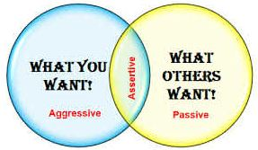
Body language
Stand tall, shoulders back
Directly face person
Maintain eye contact
Speak in a clear, loud enough to be heard and confident voice
Ask for Time
Don’t communicate when experiencing strong emotions!
“You caught me off guard. Let me think about this and I’ll get back to you tomorrow.”
Assertiveness
Skills
Use “I” statements
I want…I need…I feel..
Say “I disagree” instead of “you’re wrong”
Recognize the other person’s point of view
“I understand what you’re saying…”
This Photo by Unknown Author is licensed under CC BY-NC
This Photo by Unknown Author is licensed under CC BY-NC-ND
Notes:
(H): Research indicates that assertive communication is the healthiest style b/c it allows the person to express what they need, while also respecting the other person’s rights and opinions. It has been shown to boost confidence and leads to collaborative and trusting relationships and more job satisfaction.
Some basic assertive communication skills are shown here (read a few). We'll now shift to the final module, Module 4, where Maria helps students practice all of these skills together in a group setting.

Slide 26
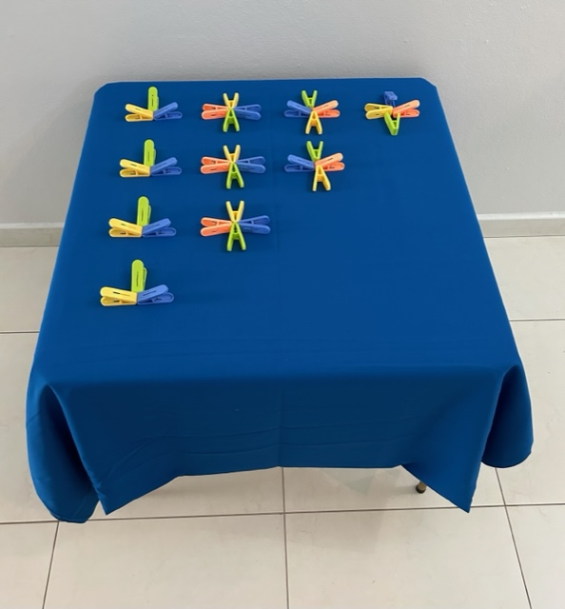
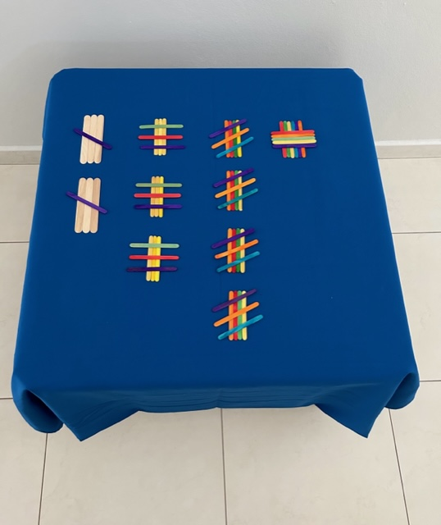
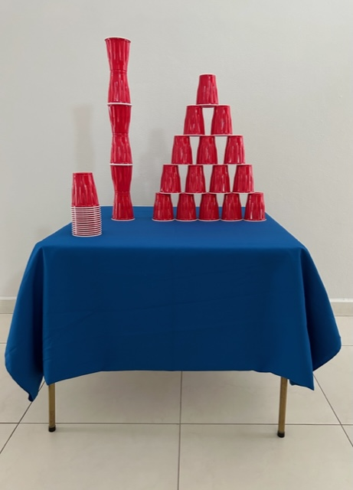
Module 4
Role Plays
Notes:
(M) During this module I role-play different stressful work incidents related to Time pressure, Unsure of Job Tasks, Not Having What is Needed for the Job, and Relational Conflict stressors.
Once the role play is over, students reflect on what they have experienced by referring to CBT cycle.
If they managed the situation assertively – they will be congratulated.
If they were not assertive I invite the group to brainstorm different assertive behaviors / communications.
When preparing for role-plays be ready to assign different tasks to students.
Inform students that tasks will increase in complexity, as will stressful situations in intensity.
Be creative – I have used color popsicle sticks, and color clothespins to form patterns for students to make exact copies.
I also give students a pack of plastic cups and ask them to build towers and/or pyramids.
Here at Voc. Rehab there are work stations that I am allowed to use to perform role plays.
Start with you acting as the supervisor or coworker and students acting as employees.
Then when students get a good sense on how role-plays work allow students to take turns on acting different stressfull situations for other students/employees to manage.
Consider safety precautions – At Voc Rehab all work spaces have doors with integrated vertical windows – which allows me to see what is happening if I leave the room.

Slide 27
Role Plays
Notes:
[M] Role Plays
The first role play that I always start with addresses the stressor of Not understanding the task. Helena and I will actually do a role play. I will be the supervisor and Helena the student/employee.
Ready – let’s start the role play. Welcome, Helena to M & A Inc. I am María Acevedo and I will be your supervisor. Here is the fisrt task that I will assign you. You see this pack of plastic cups I want you to use them to build a tower – the tallest tower you can built. I want to see how creative you can be. Go ahead and Start. I need to go out for a few minutes – I will be back soon.
[Helena builds a pyramid]
Hey Helena – are you done? Let me see! I did not asked for a pyramind, I clearly asked for a tower, take the pyramid down and then build a tower. I need to go out again for a few mins. and will be back.
What about Role plays to address the stressor of Time pressure
The supervisor assign students/employees different tasks to do - goes in and out of the work-area – each time the supervisor returns verbally pressures students/employees to speed up their work execution; raises the tone of voice.
The supervisor sets a time limit for the group to do the tasks. Using a stopwatch, the supervisor pressures the group by letting them know how much time has passed or how much time they have left to finish the tasks. Can go out and in of the room.

Slide 28
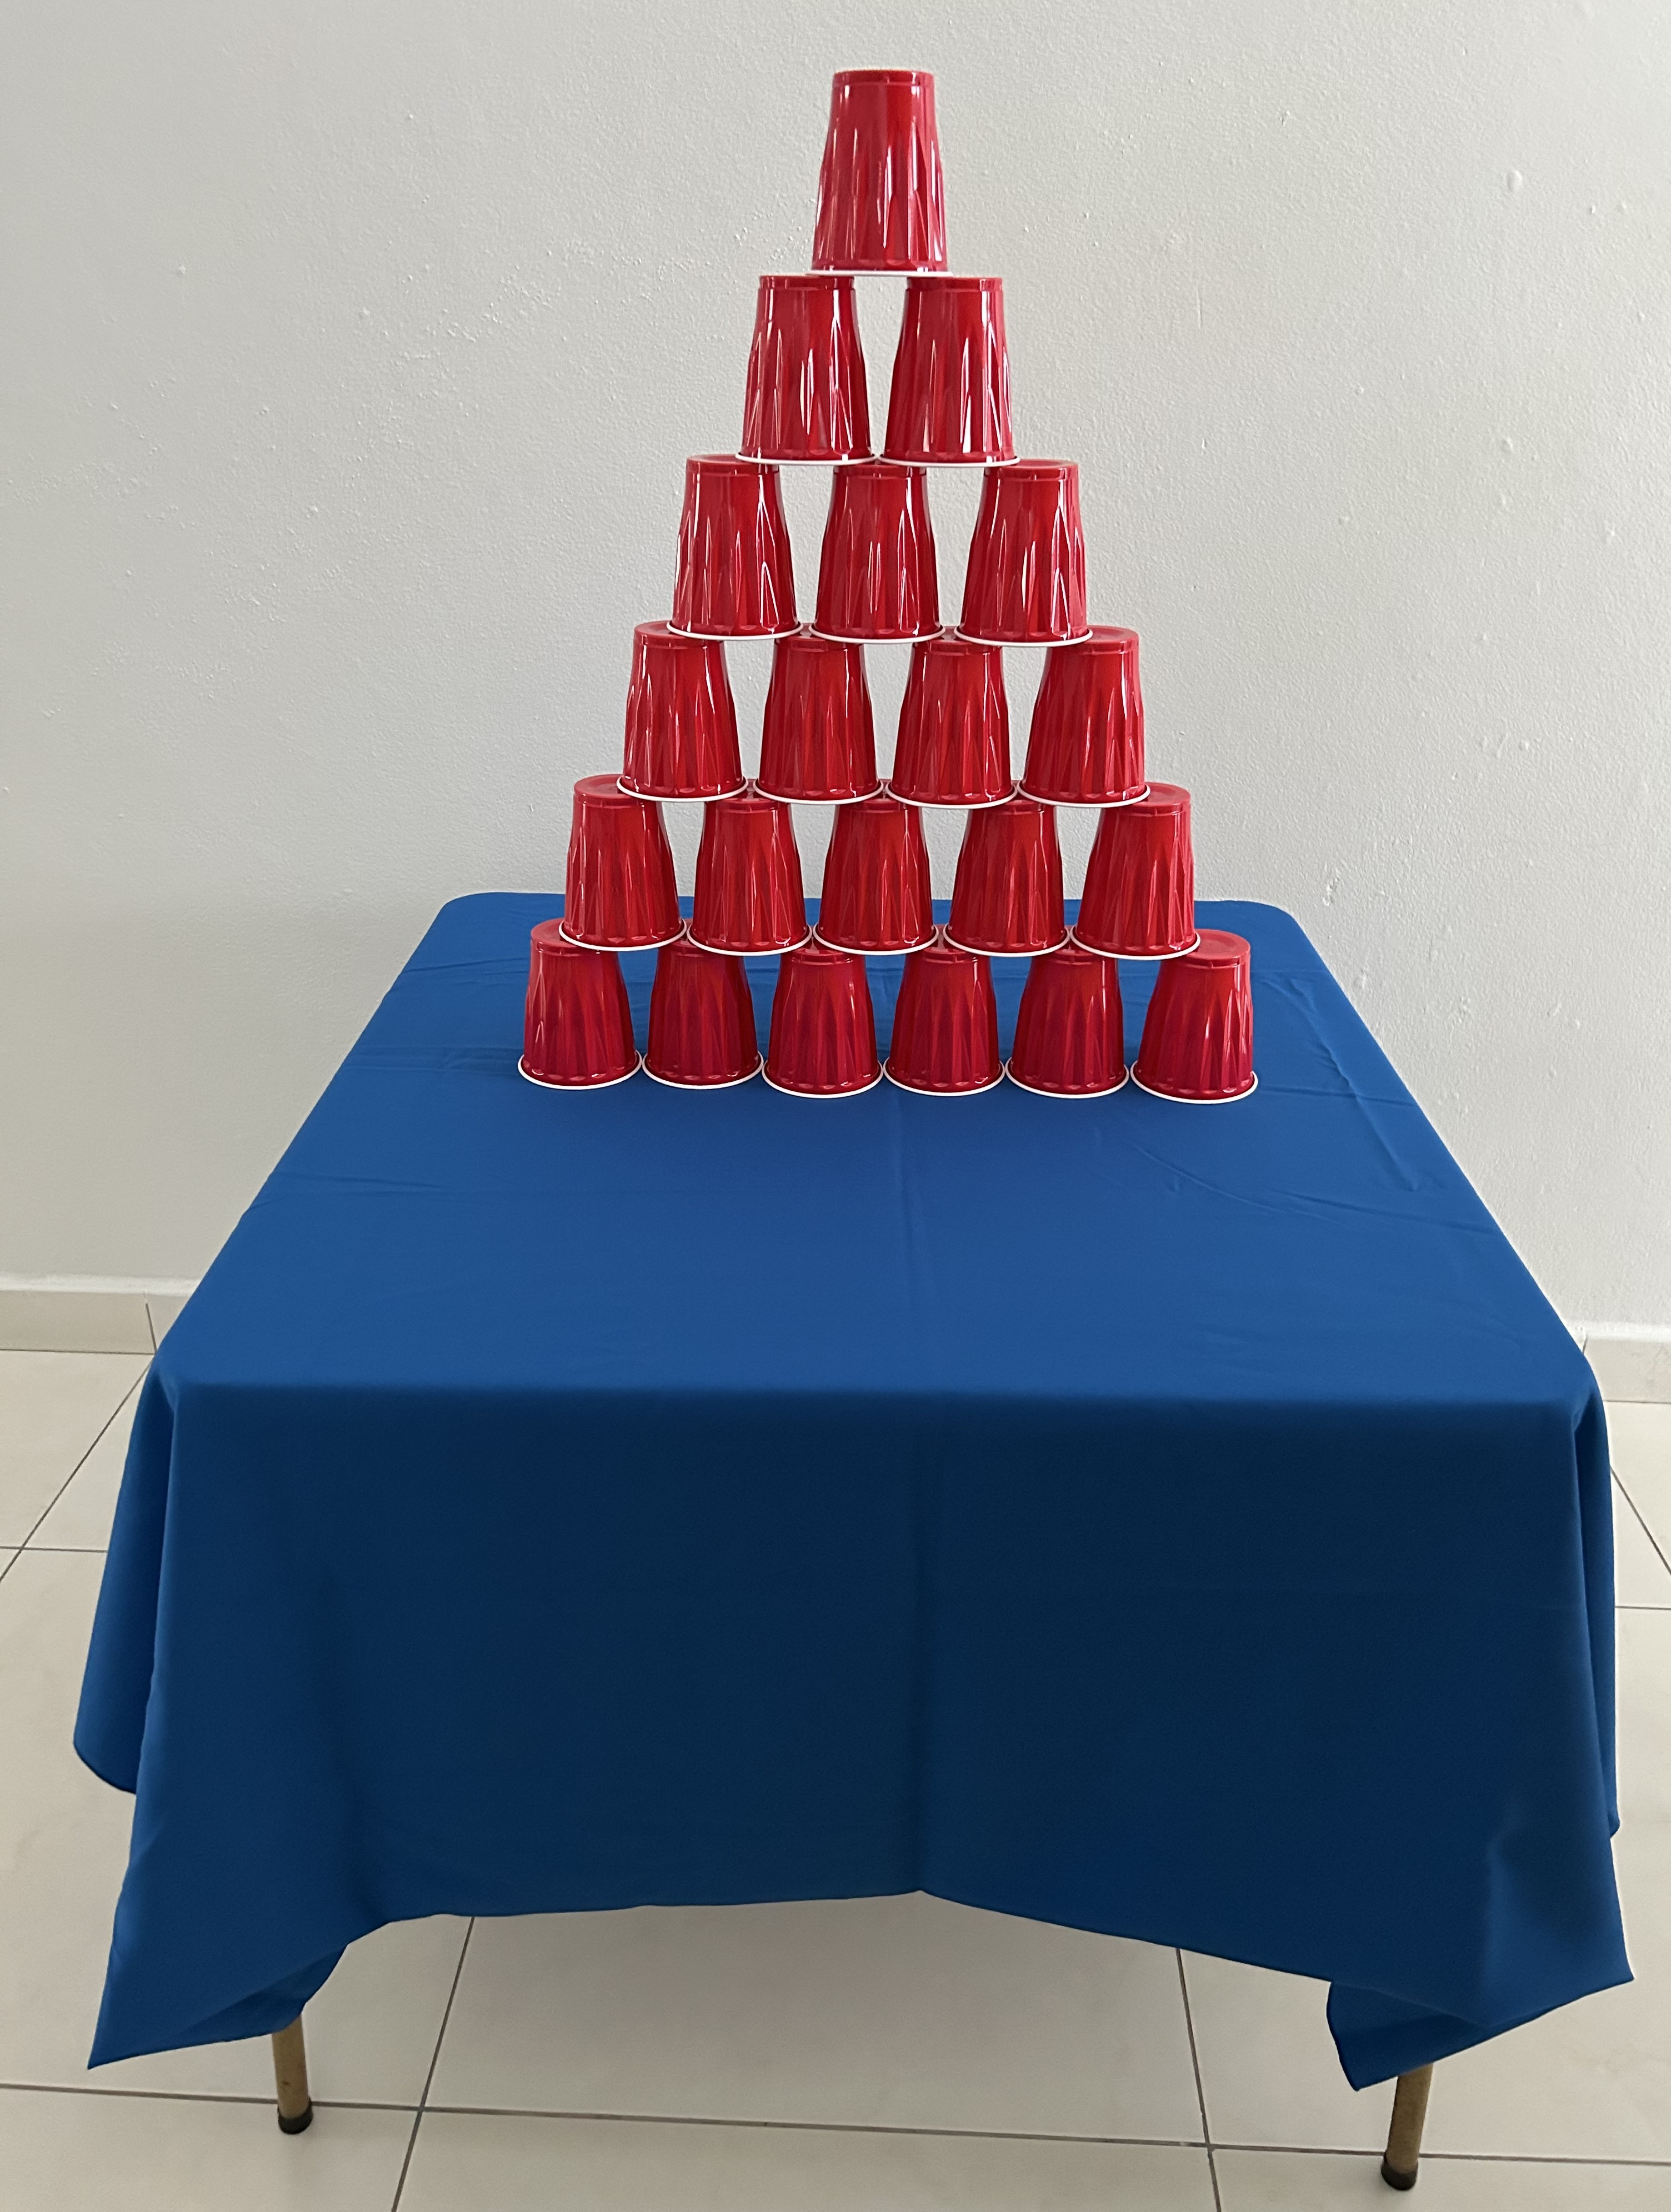

Slide 29
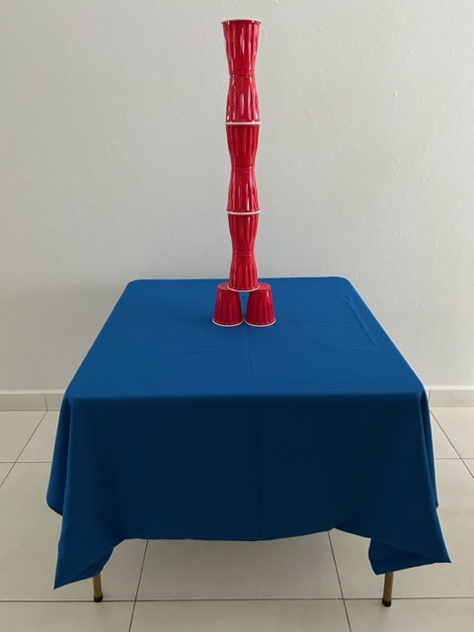

Slide 30
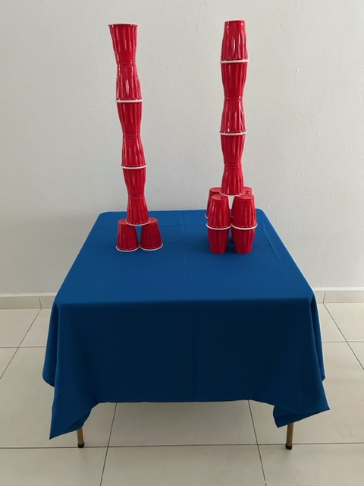

Slide 31
Dealing with Difficult Customers
1) Actively Listen
3) Ask questions to understand the problem
4) Tell the client what you will do to solve the issue
2) Show Empathy
Notes:
This last role-play adresses Relational Conflicts
It has to do with students facing a hostile client. I remaind students, in advance, that this will be the last role play.
I first show them a video of a real incident where a hostile client verbally and physically attacked a manager that became viral here in PR, then I show them a video on How to effectively manage hostile clients and discuss it using the viral video as a starting point.
When dealing with hostile customers first actively listen to their complaint – let them vent. Then show empathy. Thirdly, ask questions to be certain you understand the problem and finally, offer a solution.
My goal is for students to learn how to implement the first 2 steps, given that most students will not have the responsability to directly handle the whole situation.
After they actively listen, are empathic, they should tell the client that they will go find the supervisor for them to take care of the situation.
Helena ready for the last role play: You will be the waitress and I will be the client. Let’s start the role play – Excuse me…Excuse me, server.
I ordered the Prime Rib well done and it is rare…look at all the blood! Disgusting!! I waited almost 45 mins for the food to be served and when it finally arrives …look at it …what a disappointment….and the Prime Rib is an expensive cut! I was starving when I walk in… and now I lost my appetite …I am not paying for this…get me the check for what I did comsume. I want to leave!

Slide 32
Resources

Slide 33
Suggested
Role Plays
Notes:
[M] Other suggested role plays for:
Not understanding job tasks/duties or having what’s needed to do the job
The supervisor ask students/employees to build one tower using the plastic cups provided- goes in and out of the work area. If the students build a tower each the supervisor specifies that the instruction was to build 1 tower between the 2 or 3 students, etc. On the other hand, if they build one tower between them the supervisor tells them that they wanted them to build a tower each.
If they build a pyramind make them start all over again because you ask for a tower not a pyramind.
The idea is to present a non-detailed instruction to provoke students to ask for more detail instructions.
Teach them that if they have doudts it is essential for them to ak and to learm to corrobarate with their supervisor if they correctlly understood the instructions.
The supervisor assigns a task to the group – does not supply all the materials needed to complete the task – and informs the group that they need to leave to take care of another matter – before leaving verbally pressures the group to work fast.
The supervisor assigns tasks for the group to work on and leaves the area. After several minutes have pass by, another supervisor (ask a center employee to participate in the role play) enters the area and asks the group for help moving some merchandise (that is located in another area) due to being understaff. This other supervisor has not spoken with the group supervisor. If students decide to leave the work-area without previously informing their supervisor once they leave the area their supervisor meets them halfway and asks - “What is happening here!...where are you going? After the role-play have a discuss about the consquences of abondoning there working site – leaving merchandize / work materials unattended - and consequences if they are ask to go to a high risk area.
Time pressure
The supervisor assign students/employees different tasks to do - goes in and out of the work-area – each time the supervisor returns verbally pressures students/employees to speed up their work execution; raises the tone of voice.
The supervisor sets a time limit for the group to do the tasks. Using a stopwatch, the supervisor pressures the group by letting them know how much time has passed using and using a loud tone of voice.
The supervisor assign tasks to the group - remains in the work area and, using in loud tone of voice, verbally pressures the group, while simultanately, strongly tapps the work-table with a pencil/pen to mark the desired pace of execution. When taking a break from tapping the table the supervisor can look over the employees shoulders to look at the work done.
Team Work
The supervisor lists the tasks that the students must carry out – suddenly a person enters the room and informs the supervisor that the Human Resources Manager is requesting their presence right now – the supervisor tells the group – “As you heard I have to go…you all know how to do the tasks, so go ahead and start”! (no details are given on how to divide the task between employees).
Relational conflicts
The supervisor assigns various tasks to students/employees – making sure to include building a pyramind and/or tower using the plastic cups - and leaves the room – after a few minutes returns stressed out – walks towards the work table and bumps into it causing the work done by students/employees to collapse. Bump into the the table several times.
Another version of this role-play is for a student actor/co-worker to leave the area to go to the bathroom - on their return loses their balance and bumps into the table causing the
work done by their co-workers to collapse. Then, once the tasks are completed again, the student/actor will sit leaning on the table causing the plastic cups to fall again.
Mini- supermarket – The supervisor tells students/coworkers how they want Capri Sun juice boxes displayed by colors. Once the students/employees have finished arranging the boxes, the supervisor tells them they do not like the way they look and instructs them to rearrange the boxes again. The supervisor keeps asking for the boxes to be rearranged until students/coworkers are assertive.
The supervisor assigns the tasks and leaves – the student actor/co-worker after working for a few minutes tells others that they needs to go the bathroom and will be back soon – instead takes 25/30 minutes to return.
The supervisor assigns the tasks and leaves – the student actor/co-worker will work very slowly, very slowly and all of the sudden will stop working when they are distracted by their own thoughts. Instruct the actor/co-worker that if coworkers help they to refocus– to start working and after a few minutes to again start to work very slowly, very slowly and after a few minutes to starts daydreaming.
The supervisor assigns the tasks and leaves– the student actor/co-worker will begin to yawn, will work slowly…will yawn several more times...will nod sleep until nodding off. If coworkers wake the student/actor - instruct the student actor/coworker to act out the situation again.
Mini clothing store – The supervisor assigns the task of folding garments to be placed on shelves according to size and holds coworkers/employees accountable for working with a specific size (small, medium, large, etc.). The student actor/coworker will throw to their co-workers the garments with a different size than the one assigned to they - making sure that the garments fall on the floor.
Let students know a week in advance that you will be performing a role-play where they could be offended. The supervisor, when assigning the tasks, criticizes the generation of students/employess for being lazy, only looking out for their own interest…. That the only thing they know how to do well is write text messages, etc. (Should be one of the last role-plays)
Anticipate students that you will offend them. The supervisor, when assigning the tasks, will address employees using offensive nicknames. “Hey, you lanky young man…”, “You chubby cabagge patch Carmen…doesn’t she looks like a cabagge patch?” “Are you guys stupid”. (Should be one of the last role-plays)
The last role - play is for students to face a hostile client. Remaind them, in advance, that the last role-play will be about them facing a hostile client.
I show them a video of a real incident where a hostile client verbally and physically attack a manager that became viral here in PR, then I show them a video on How to
deal with difficult clients and discuss it using the viral video as a starting point.
Role –play - Assign students/employees a task – while they are working suddenly appear and ask them if they are store employees and when they say Yes
start complaining - screaming at them – that the merchandise purchased is damaged – “I bought this item yesterday and it does not work.. it did not cost $3.00 dollars …this is
an expensive item… It took me months to save up the money to buy it… I want my money back…I want my money, today.”

Slide 34
Documents
Find these resources and this presentation on the Job Corps Health Support Services Website
Diagrams
(Examples) .

Slide 35
Video Resources
Topic | English | Spanish
Sexual Harassment | Sexual Harassment Training / Sexual Harassment Defined https://youtu.be/ycK7fli2ZUY | Acoso sexual: ¡Que no te pase esto en el trabajo! https://youtu.be/z8_1QtEuhko
Mindfulness | What is mindfulness? https://youtu.be/7-1Y6IbAxdM | ¿Qué es mindfulness? https://youtu.be/_GK6287qvVQ
Assertiveness | How to be assertive: Assertive communication & DBT interpersonal effectiveness skills https://youtu.be/TQ33fPD7ntA | 11 Técnicas de comunicación asertiva y efectiva con ejemplos y pasos https://youtu.be/g2mABsI-MZQ
Assertiveness | How to Be Assertive https://youtu.be/930gSO6DFA4\ | 8 Técnicas avanzadas de comunicación asertiva https://youtu.be/6B2UR4WYs0c
Fidget Toys | Best Fidget Toy for the Office Desk 2020 – 16 Ranked Fidget Toys https://youtu.be/rCttGH4K3eg | 15 Juguetes Antiestrés que vale la pena comprar https://youtu.be/v2pv1i9bFVY
Stretches | Quick and Easy Stretches to Do While Sitting at Your Desk https://youtu.be/BdfTuxdfIE8 | Ejercicios para hacer en el trabajo https://youtu.be/f6-9l3VYzRw?si=iM0FLqhiCIQBCDOJ Ejercicios de estiramiento en oficina https://youtu.be/H0pbvdIcHOY?si=6tIRsV7FjkO-wgxq

Slide 36
Video Resources
Topic | English | Spanish
Diaphragmatic Breathing | Anxiety & Stress Relief with Diaphragmatic Breathing https://youtu.be/pKZCGVSxmas | Respiración diafragmática paso a paso https://youtu.be/bL3SBo5ZSUU
Box or Square Breathing Visual | Square Breathing Visual https://youtu.be/bF_1ZiFta-E Box Breathing – 1 minute in length https://youtu.be/n6RbW2LtdFs
Deep Breathing – Visual | take a deep breath – Calm https://youtu.be/92xTPH7OtLs
Breathing to Stop Panic Attack Visual | Breathing Exercises to Stop a Panic Attack Now https://youtu.be/8vkYJf8DOsc
Hostile Client | Crazy Customer And Angry Employees #4 https://youtu.be/OBVdLdEqiYY | Clienta amenaza a empleado de Burger King https://youtu.be/KpwIR3OBFds
How to Handle Difficult Clients | How to handle an angry customer https://youtu.be/9gyp1Ac7I0I?si=6MaWkybXsPaNHwxn | Cómo contentar a un cliente molesto https://youtu.be/1vPCo6GI9N4

Slide 37
Gen Z https://news.stanford.edu/2022/01/03/know-gen-z/
Gen Z, Explained: The Art of Living in a Digital Age (University of Chicago Press, 2021).
For a copy of a Spanish / English Emotions Wheel you can contact Lindsay Braman MACP, LMHCA starthere@lindsaybraman.com www.lindsaybraman.com
English feelings wheel. https://www.radiusecd.com/news/leading-through-crisis
Dr. Arlene Chung, 4-4-4-4 Breathing Technique
https://www.maimonidesem.org/blog/box-breathing-technique-nbspnbsp
App COVID Coach for iOS/Android https://mobile.va.gov/app/covid-coach#AppFAQ
How Posture Influences Your Physical and Mental Health
https://news.sfsu.edu/news-story/good-posture-important-physical-and-mental-health
https://www.health.harvard.edu/staying-healthy/in-a-slump-fix-your-posture

Slide 39
María Acevedo, Ph.D. macevedo.correa@gmail.com acevedo.maria@jobcorps.org

