Slide 1
The Link Between Oral Health and Chronic Conditions
Mendee B Ligon, DDS
Center Dentist
Pinellas JCC
This Photo by Unknown Author is licensed under CC BY-NC

Slide 2
Learning Objectives
Describe
Describe the three most common oral diseases.
Discuss
Discuss the link between oral health and the risk, prevalence, and management of at least three chronic medical conditions.
Utilize
Utilize strategies to incorporate oral care and maintenance as part of the patient/client Plan of Care.

Slide 3
Oral Health…
…is the health of your mouth (oral cavity)
Hard tissue: teeth & bone
Soft tissue: gums, cheeks, tongue, the floor of the mouth, lips, palate, & throat
…affects our ability to eat, speak, smile, and show emotions
….affects a person’s self-esteem, school performance, and attendance at work or school
Source: CDC
Notes:
Oral diseases—which range from cavities and gum disease to oral cancer—cause pain and disability for millions of Americans and cost taxpayers billions of dollars each year.

Slide 4
Prevalence
More than 40% of adults report having felt pain in their mouth within the last year
More than 80% of people will have had at least one cavity by age 34
The nation spends more than $124 billion on costs related to dental care each year
On average, over 34 million school hours and more than $45 billion in productivity are lost each year as a result of dental emergencies requiring unplanned care
Notes:
This shows us that the impact of oral health in all aspect of our lives is critical.

Slide 5
Social Determinants of Oral Health
Notes:
The Individual, family, and community all influence the oral health outcomes of children and adults
Oral health inequities are largely influenced by community level rather than individual factors
Integrated approach of policy and individual influences promote the greatest impact on health inequities, including oral health
Health care teams have a critical role in promoting oral health equity for patients and communities. Primary care teams are well positioned to promote oral health during routine well child visits, but also medical-dental integration within the wider community.
Child level influences include:
Physical attributes, biologic and genetic characteristics
Health behavior and practices
Dental insurances and use of dental care
Family level influences include:
Family culture, function, and composition
Socioeconomic status, social supports, safety
Health behaviors, practices, and coping skills; parent health status
Community level influences include:
Social environment and social capital
Characteristics of the dental and health care systems
General culture and oral health environment
Physical environment and safety

Slide 6
Disparities in Oral Health
Some racial/ethnic and socioeconomic groups have worse oral health as a result of the social determinants of health—(conditions in the places where people are born, live, learn, work, and play), primarily because:
Can’t afford to pay out of pocket for dental care, do not have private or public dental insurance, or can’t get time off from work to get to dental care.
Live in communities where they don’t have access to fluoridated water and school sealant programs, healthy foods, and public transportation to get to dental appointments.

Slide 7
We the People……
Integrated approach of policy and individual influences promote the greatest impact on health inequities, including oral health
Health care teams have a critical role in promoting oral health equity for patients and communities. Primary care teams are well positioned to promote oral health during routine well-child visits, but also medical-dental integration within the wider community.

Slide 8
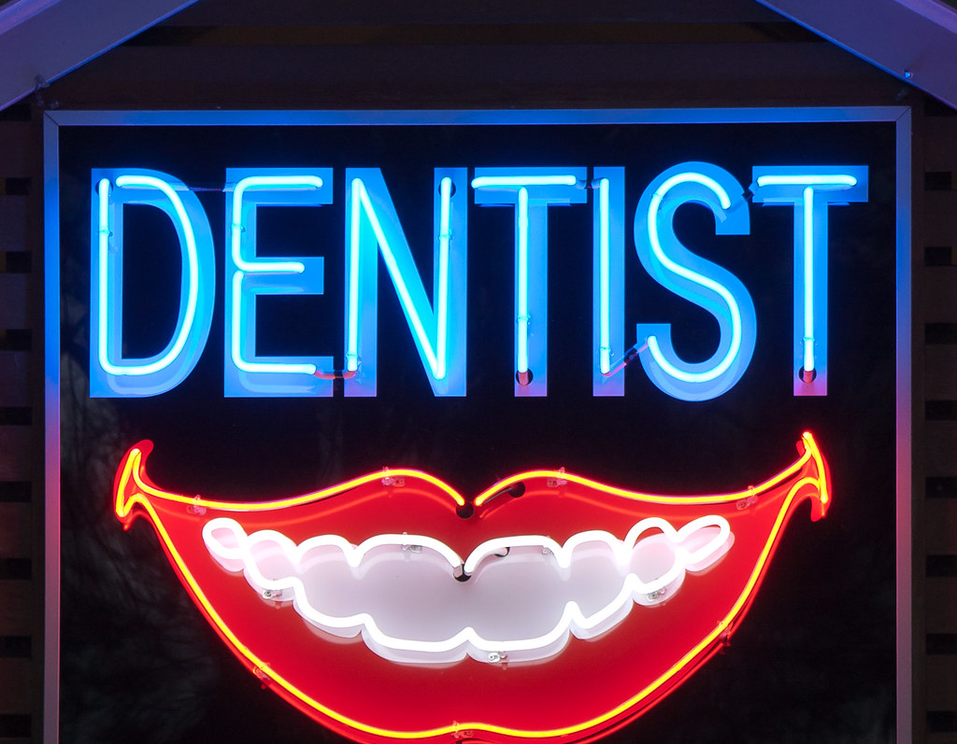
Common Oral Diseases
Cavities (Tooth Decay)
Gum (Periodontal) Disease
Oral Cancer
This Photo by Unknown Author is licensed under CC BY-SA
Notes:
Some of the most common diseases that impact our oral health include cavities (tooth decay), gum (periodontal) disease, and oral cancer.

Slide 9
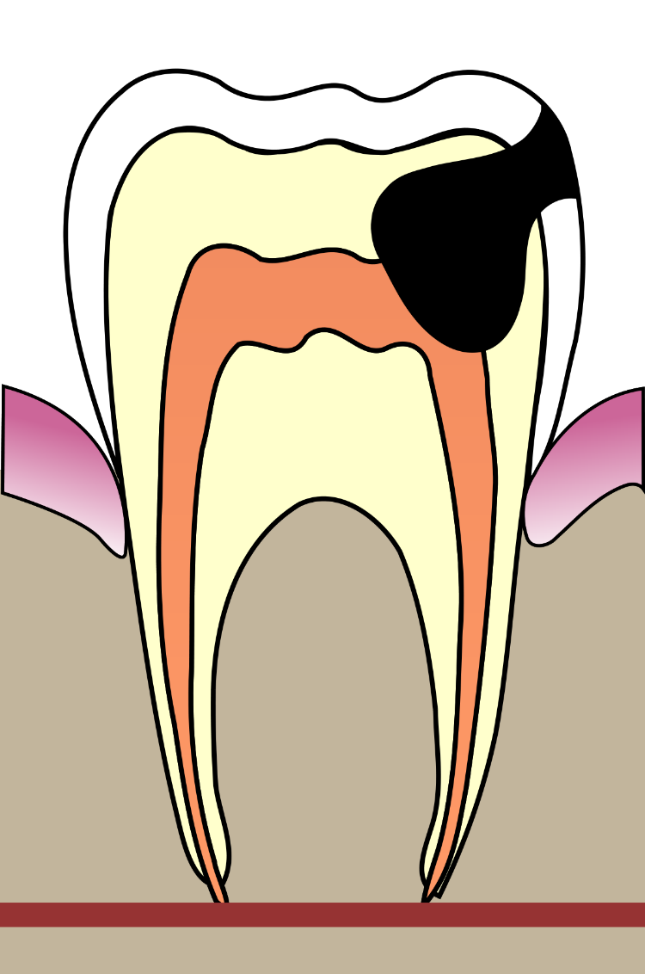
Cavities
Causes
Common
Prevention
Notes:
Cavities are caused by a breakdown of the tooth enamel by acids produced by bacteria located in plaque that collects on teeth, especially along the gumline and in the crevices on the chewing surfaces of the teeth. Eating and drinking foods high in carbohydrates cause this bacteria to produce the acids that can cause the outer coating of the tooth (enamel) or root surface to break down (demineralize).
Although cavities are largely preventable, they are one of the most common chronic diseases throughout the lifespan. About one-fourth of young children, half of adolescents and more than 90% of adults experienced tooth decay. Untreated tooth decay affected 10% of young children to 26% of adults aged 20–64.2 Untreated tooth decay can lead to abscess (a severe infection) under the gums which can spread to other parts of the body and have serious, and in rare cases fatal, results.
Community water fluoridation and school-based dental sealants programs are both cost-saving, proven strategies to prevent tooth decay. Along with oral hygiene consisting of …………….(please explain)………

Slide 10
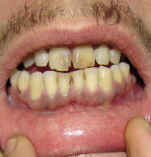
Gum (Periodontal) Disease
Destructive inflammatory disease of the supporting tissues of the teeth
Early stage is called gingivitis
In the serious form, periodontitis, the gums can pull away from the tooth, bone can be lost, and the teeth may loosen or even fall out
This Photo by Unknown Author is licensed under CC BY-NC
Notes:
Periodontitis is a destructive inflammatory disease of the supporting tissues of the teeth. and is one of the most prevalent inflammatory diseases of mankind.
Caused by specific microorganisms or group of specific microorganisms resulting in progressive destruction of periodontal ligament and alveolar bone with periodontal pocket formation, gingival recession or both.
Oral lesions are indicators of disease progression and oral cavity can be a window to overall health.[3] Bacteria are the prime etiological agents in periodontal disease, and it is estimated that more than 500 different bacterial species are capable of colonizing the adult mouth

Slide 11
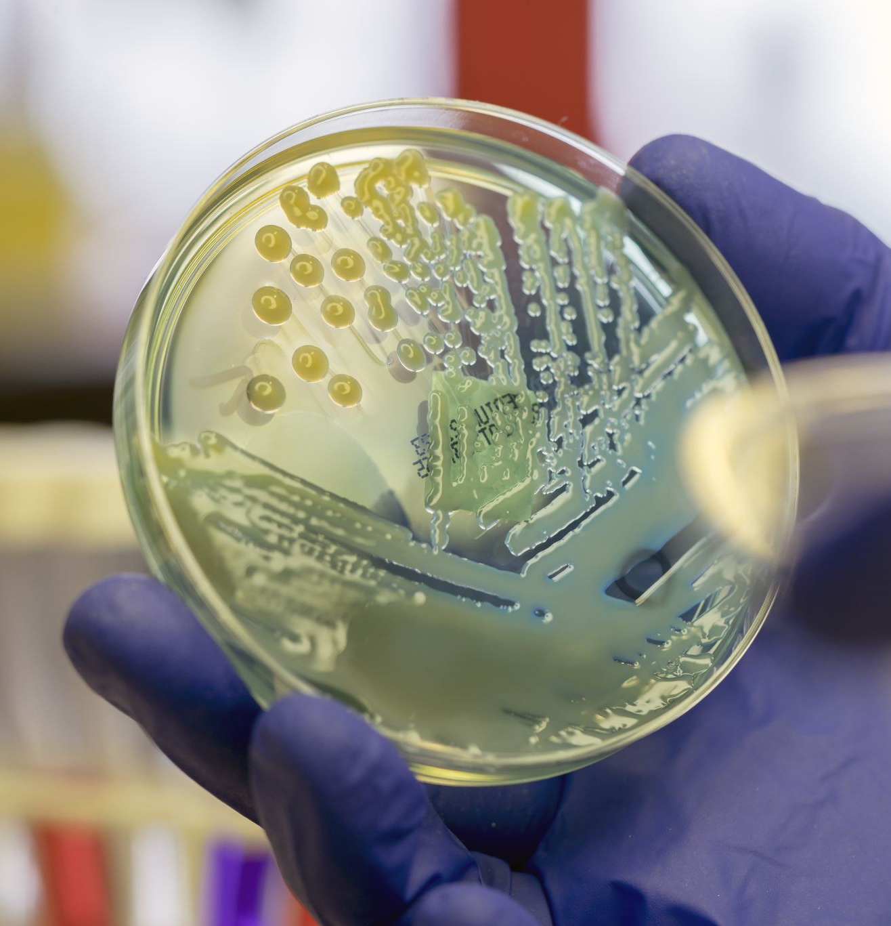
Causes of Periodontal Disease
Specific microorganisms or group of specific microorganisms; bacteria
Bacteria stay on the teeth long enough, they form a film called plaque, which eventually hardens to tartar, also called calculus. Tartar build-up can spread below the gum line

Slide 12
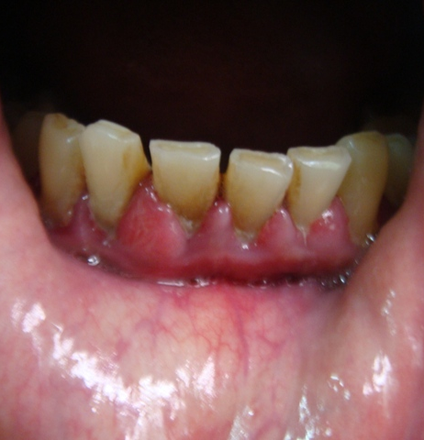
Gum (Periodontal) Disease Warning Signs
Bad breath or bad taste that won’t go away
Red or swollen gums
Tender or bleeding gums
Painful chewing
Loose teeth
Sensitive teeth
Gums that have pulled away from your teeth
Any change in the way your teeth fit together when you bite
Any change in the fit of partial dentures
This Photo by Unknown Author is licensed under CC BY-NC

Slide 13
Risk Factors
Smoking
Diabetes
Poor oral hygiene
Stress
Heredity
Crooked teeth
Underlying immuno-deficiencies—e.g., AIDS
Fillings that have become defective
Taking medications that cause dry mouth
Bridges that no longer fit properly
Female hormonal changes, such as with pregnancy or the use of oral contraceptives

Slide 14
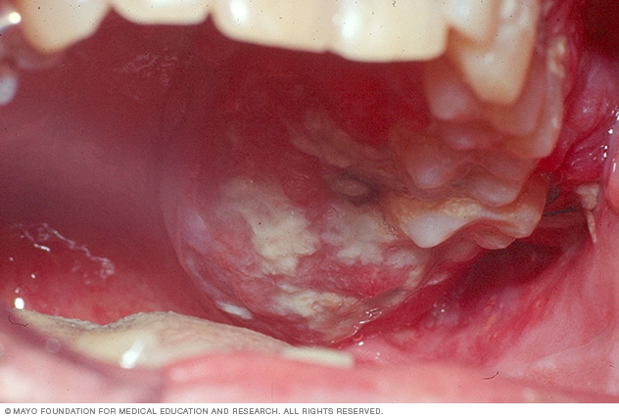
Oral (Mouth) Cancer
What is it?
Risk Factors/Causes
Signs & Symptoms
Diagnosis: Annual Screening/Examination
Notes:
What is it? _______________________________________________________
Risk Factors/Causes
Tobacco and alcohol use.
HPV.
Age.
Sun Exposure.
Betel nut and bedis: chewed or smoked
Signs & Symptoms: If you have any of these symptoms for more than two weeks, see a dentist or a doctor.
A sore, irritation, lump or thick patch in your mouth, lip, or throat.
A white or red patch in your mouth.
A sore throat or a feeling that something is caught in your throat.
Difficulty chewing, swallowing, or speaking.
Difficulty moving your jaw or tongue.
Swelling of your jaw that causes dentures to fit poorly or become uncomfortable.
Numbness in your tongue or other areas of your mouth.
Ear pain.
Please explain the exam/screening process………….

Slide 15
Proper oral care & maintenance is…..
necessary to prevent eating difficulties, digestive problems and infections
essential in the management and prevention of exacerbation of chronic conditions
Notes:
Let explore a few health conditions that are affected by and can be caused by poor oral care & maintenance.

Slide 16
"It is possible that people who are very attentive to their dental health are also very attentive to other aspects of their health."
Cardiologist Dr. Ann Bolger

Slide 17
Oral Health and Crohn’s Disease
This Photo by Unknown Author is licensed under CC BY-NC

Slide 18
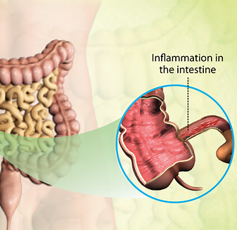
Crohn’s Disease (CD)
Major group of chronic recurrent inflammatory bowel disorders.
Characterized by the diffuse inflammation of the intestinal mucosa, which can affect any part of the digestive tract.
The oral cavity is the gateway through which microorganisms enter the digestive tract.
Therefore, through the human actions of eating and swallowing, oral microorganisms have a high opportunity of entering and colonizing the gastrointestinal tract and interfering with intestinal homeostasis.
Notes:
as part of the digestive tract, the oral cavity is frequently affected in patients with CD). Oral manifestations, such as dental caries and periodontitis, have been reported to occur at a higher rate in patients with inflammatory bowel disease than in healthy individuals

Slide 19
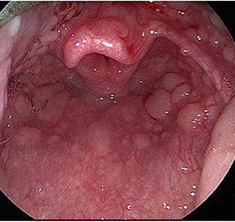
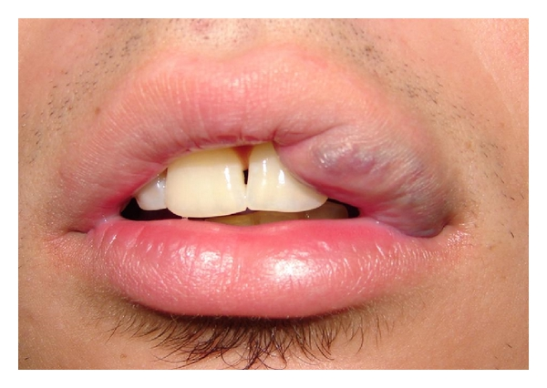
Crohn’s Disease (CD)
CD is characterized by inflammation, muscle layer overgrowth, and collagenous fibrosis of the intestinal tract, with no effective therapy against collagen accumulation (type-III).
Includes perioral erythema with scaling, mucogingivitis, aphthous stomatitis, and cobblestoning
This Photo by Unknown Author is licensed under CC BY
This Photo by Unknown Author is licensed under CC BY
This Photo by Unknown Author is licensed under CC BY-SA

Slide 20
Oral Health and Cardiovascular Disease
This Photo by Unknown Author is licensed under CC BY-NC

Slide 21
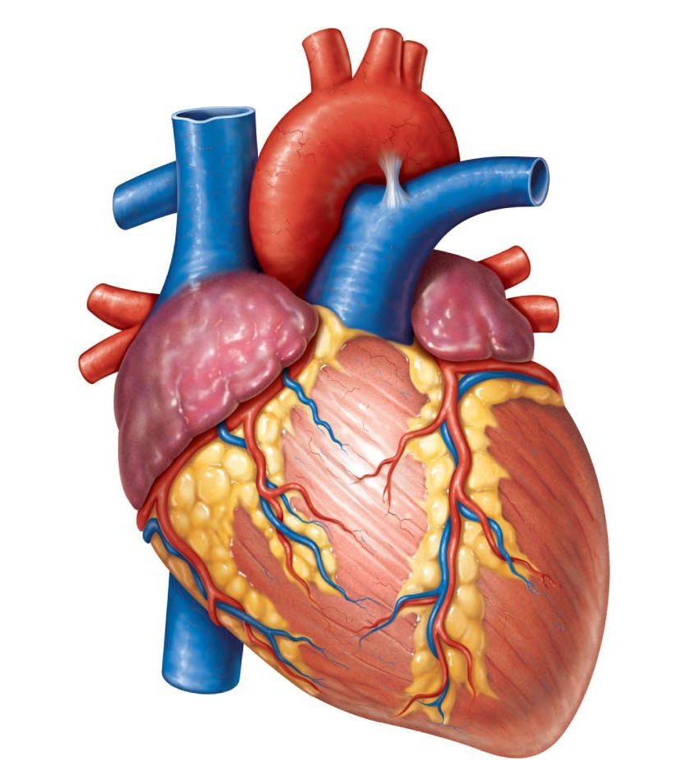
Endocarditis
Infection of the inner lining of your heart chambers or valves (endocardium)
Occurs when bacteria or other germs from another part of your body, such as your mouth, spread through your bloodstream and attach to certain areas in your heart
This Photo by Unknown Author is licensed under CC BY-NC-ND
Notes:
Endocarditis. This infection of the inner lining of your heart chambers or valves (endocardium) typically occurs when bacteria or other germs from another part of your body, such as your mouth, spread through your bloodstream and attach to certain areas in your heart.
Cardiovascular disease. Although the connection is not fully understood, some research suggests that heart disease, clogged arteries and stroke might be linked to the inflammation and infections that oral bacteria can cause.
an association between periodontal (gum) disease and heart disease and stroke. One of the culprits appears to be Porphyromonas gingivalis which is a common strain of bacteria found in periodontal disease. Other bacteria also causes alterations in the inflammatory process which can cause more platelet cells to stick to the inside of blood vessel walls leading to blood clot formation. The risk of heart attack and stroke in people with gum disease is higher than that of people with healthy mouths.

Slide 22
Cardiovascular Disease
Bacteria exacerbates systemic inflammation
Platelet aggregation & endothelial dysfunction
very few people with established CVD seek dental care (38%)
Notes:
Bacteria associated with periodontal disease can attach to atheromatous plaques, causing inflammation and damage, leading to elevated proinflammatory cytokines. This, in turn, can exacerbate systemic inflammation, leading to atheroma formation and ultimate rupture. Periodontal disease has also been linked to platelet aggregation and endothelial dysfunction, with associated elevated biomarkers such as serum C-reactive protein, interleukin-6, and tumor necrosis factor-α, all of which can contribute to increased inflammatory responses.¹⁸ Several clinical studies suggest that the prevalence of
two recent large studies in the United States and Europe also showed that new cases of periodontal disease, not just those preexisting, increase the risk of future cardiovascular events.^{35,36}
It is now recommended that patients at risk should be informed about the association between atherosclerotic CVD and periodontal disease, have early assessment to identify risk factors, and receive early dental and medical evaluations.

Slide 23
Stroke
link between gum infection and stroke, significantly increase the risk of a life-threatening stroke from bleeding in the brain
intracerebral hemorrhages, account for only 10% to 20% of all strokes, they're more deadly than the more common ischemic strokes
gum disease is associated with damage to the brain's tiny blood vessels
Notes:
Published: March 19, 2021 Researchers looked at data from 6,506 people without stroke; people with cavities had 4.5 times higher risk of a stroke from brain bleed than those without cavities, While brain bleeds, also called as intracerebral hemorrhages, account for only 10% to 20% of all strokes, they're more deadly than the more common ischemic strokes, which occur when blood flow through an artery is blocked.

Slide 24
Oral Health and Respiratory Disease
This Photo by Unknown Author is licensed under CC BY-NC

Slide 25
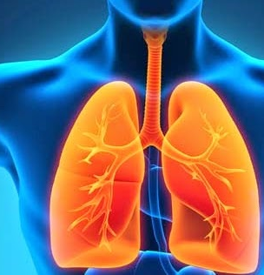
Respiratory Infection
Periodontitis is associated with respiratory diseases due to poor oral hygiene and low immunity state.
Certain bacteria in your mouth can be pulled into your lungs, causing pneumonia and other respiratory diseases. (Aspiration)
Inflammatory process:
Periodontal disease
Emphysema
COPD
This Photo by Unknown Author is licensed under CC BY
Notes:
Respiratory infection is thought to rely in part on the aspiration of oropharyngeal flora into the lower respiratory tract and failure of host defense mechanisms to eliminate the contaminating bacteria, which then multiply to cause infection. Important pre-procedure note: stringent oral care before a procedure
Bacteria in oral plaque can travel from the mouth to the lungs, causing infection or aggravating existing lung conditions.
Notably, the overreaction of the inflammatory process that leads to destruction of connective tissue is present in both periodontal disease and emphysema. This overreaction may explain the association between periodontal disease and chronic obstructive pulmonary disease, the fourth leading cause of death in the United States; these findings underline the necessity for improving oral hygiene among patients who are at risk

Slide 26
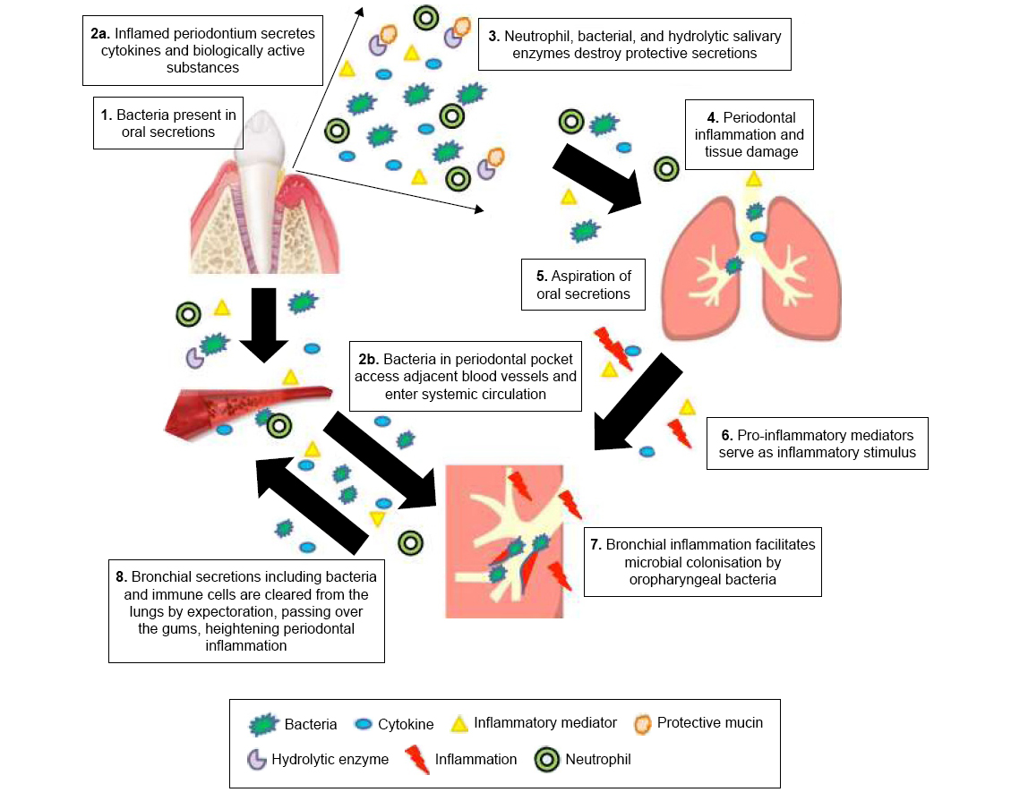
Notes:
Pt position in bed or chair, how awake you are after anesthesia, swallowing issues , the ability to cough and mobilize secretions. Etc
Once again…The oral cavity is a potential reservoir for respiratory pathogens which can predispose patients to bacterial super-infection.

Slide 27
Oral Health and Bone Conditions
This Photo by Unknown Author is licensed under CC BY-NC

Slide 28
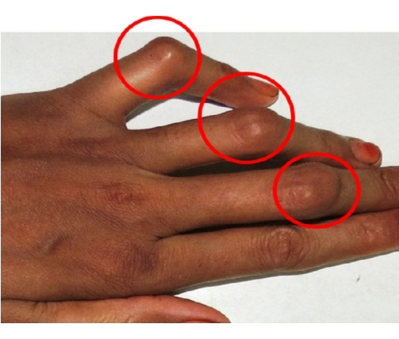
Rheumatoid Arthritis
Autoimmune disease: persistent inflammation
Trigger for RA
Common Oral Manifestations
Sjogren’s Syndrome – dry mouth
Temporomandibular Joint Disease (TMD)
This Photo by Unknown Author is licensed under CC BY
Notes:
The current thinking is that certain bacteria in your mouth that are known to cause periodontal disease may also act as a trigger for RA, Both RA and gum disease are accompanied by severe inflammation, which your body uses to protect you from foreign substances like viruses and bacteria.
RA is an autoimmune disease, inflammation occurs despite the absence of foreign bodies.
According to a study conducted at Johns Hopkins, 70% of RA patients have gum disease. However, only 35% of the general population is affected by gum disease.
Common oral manifestations in rheumatoid arthritis include Sjogren’s (“show gruhnz”) syndrome : dryness in the mouth making it difficult to speak or swallow. Which can lead to an emergency
and Temporomandibular joint disease (TMD) :
Studies have suggested associations with periodontal disease in patients with rheumatoid arthritis.

Slide 29
Osteoporosis
Reduction in the density of the jaw and mandible
Results in
A decrease in the alveolar ridge
Reduced bone density in the jawbone
Loss of teeth
Periodontal problems
Notes:
Osteoporosis is a complex pathology that causes a decrease in bone density. IThe jaw can suffer the same loss of bone substance as the rest of the bones.
This bone-weakening disease is linked with periodontal bone loss and tooth loss. Certain drugs used to treat osteoporosis carry a small risk of damage to the bones of the jaw.
the alveolar ridge (the area of the jaw where the dental roots are located). Nutrition and hormonal imbalance are other determinants of this situation.
Reduced bone density in the jawbone in the case of Osteoporosis increases the porosity and trabecular spaces of the jawbone. This loss of bone mass makes the jaws more fragile. For this reason, the placement of dental implants or prostheses becomes more difficult in these patients, which negatively affects their quality of life.
Loss of teeth
Patients with osteoporosis have a greater predisposition to lose their teeth or suffer edentulism
Periodontal problems
Although osteoporosis isn’t the cause of periodontal disease, the consequences of this pathology. The development of periodontal sacs, the loss of bone insertion and the consequent mobility or loss of teeth is greater in people with osteoporosis.

Slide 30
Oral Health and Diabetes
This Photo by Unknown Author is licensed under CC BY-NC

Slide 31
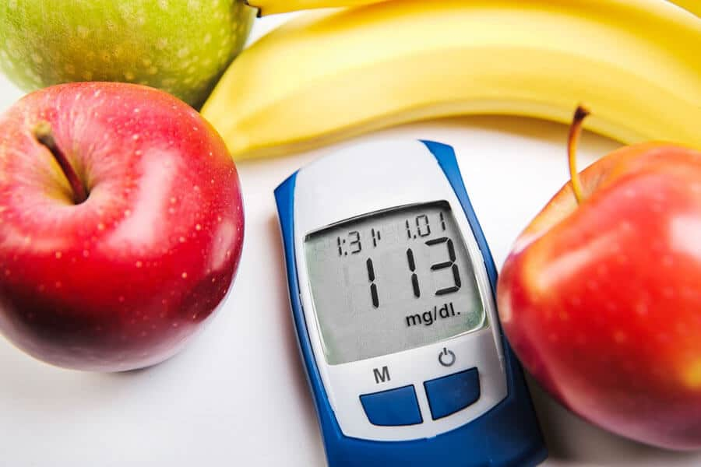
Diabetes
Diminished salivary flow and sensation
Weakened white blood cells
Gum Disease
More Severe
Longer to heal
This Photo by Unknown Author is licensed under CC BY-NC
Notes:
Diabetics may experience diminished salivary flow and a sensation of a burning mouth or tongue, which leads to a higher incidence of tooth decay.
It’s a good idea to make morning appointments because blood glucose levels tend to be under better control at this time of day.
High blood sugar can weaken white blood cells. These are your body’s main way to fight infections that can occur in the mouth.
Gum disease can be more severe and take longer to heal if you have diabetes. If you have gum disease, your diabetes may be harder to manage.

Slide 32
Notes:
1. Noncommunicable diseases (NCDs), also known as chronic diseases, are not passed from person to person. They are of long duration and generally slow progression.
6. In people who do not have diabetes, periodontitis is associated with higher glycated haemoglobin (HbA1c) and fasting blood glucose levels, and severe periodontitis is associated with increased risk of developing diabetes. In people with type 2 diabetes, periodontitis is associated with higher HbA1c levels and worse diabetes complications.

Slide 33
Oral Health and Other Chronic Conditions
This Photo by Unknown Author is licensed under CC BY-NC

Slide 34
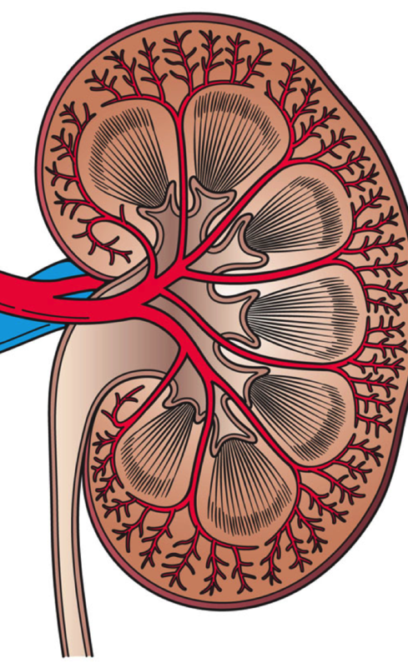
Kidney Disease
Oral Effects
Bad taste, bad breath
Kidneys fail to remove urea from the blood
Bone changes because of calcium malabsorption
Dialysis Patients
Protein food
Bleeding issues
This Photo by Unknown Author is licensed under CC BY-SA-NC
Notes:
germs that cause cavities and gum disease don’t stay put and may spread throughout the body, especially if your immune system is weak.
The kidneys fail to remove urea from the blood. The urea breaks down to form ammonia, which has a foul smell.
Bone changes also can occur because the body cannot absorb calcium properly. Therefore, people with kidney disease are at risk for losing bone from their jaws. Their teeth may become loose and eventually fall out.
A few special considerations: 1. Healthy teeth are important to be able to chew high-quality protein foods such as meat, fish, and poultry. 2. people on dialysis may receive a blood thinning medicine during their dialysis treatments to prevent clotting. Because some dental procedures can cause bleeding, it’s important to schedule dental appointments on non-dialysis days.

Slide 35
Pregnancy & Birth Complications
Factors affecting oral health during pregnancy:
Interest in some foods, e.g., carbohydrates
Bleeding
Vomiting
Decreased saliva flow
More concern about the health of the baby
Dental Care During Pregnancy: ABSOLUTELY!
Assessment of oral health by a dentist
Barriers: inadequate dental insurance, persistent myths about the effects of pregnancy on dental health, and concerns for fetal safety during dental treatment
This Photo by Unknown Author is licensed under CC BY-SA
Notes:
* During the first months of pregnancy some mothers may have extreme interest in some foods, especially carbohydrates, and tooth brushing can be neglected after they eat these kinds of food.
* Pregnant women bleed more readily due to the effect of pregnancy hormones (estrogen, progesterone), and may consequently avoid brushing their teeth. As a result, bacterial plaque increases. Therefore, in pregnancy, the mouth needs more care.
* Vomiting, especially during the first months of pregnancy, increases the acidic environment in the mouth. After vomiting, in the first few months, the mother may not pay enough attention to oral care. If the teeth are not brushed sufficiently, an acidic environment will form in the mouth.
* Saliva flow decreases. For these reasons, the formation of caries increases during this period.
* Mothers can neglect their own oral and dental health care while they are dealing with the health of the baby, which in turn causes a deterioration of oral health.
For these reasons, it is necessary to pay more attention to dental health care during this period

Slide 36
Pregnancy & Periodontitis
Preterm birth
Low birth weight
Cariogenic bacteria lead to dental carries in the infant
This Photo by Unknown Author is licensed under CC BY-NC-ND
Notes:
Periodontitis is associated with preterm birth and low birth weight, and high levels of cariogenic bacteria in mothers can lead to increased dental caries in the infant.
Weeks pregnant Milestone 8 weeks Gum tissue forms in the upper and lower jaw. 9 weeks Tooth buds for each of the 20 baby teeth start to develop; production of enamel and dentin begins.10 weeks Teeth start to harden and connect to the jawbone.
Dental procedures such as diagnostic radiography, periodontal treatment, restorations, and extractions are safe and are best performed during the second trimester. second trimester is the most appropriate period for making many treatments, for those that if postponed until the end of pregnancy would be dangerous, such as tooth extraction, filling, and canal treatment.
The baby has grown considerably in the womb and the delivery is close. It should also be remembered that if a pregnant women, in the last trimester, sits for too long in the dental chair, it may cause vena cava inferior syndrome (supine hypotensive syndrome). In this situation, turning the mother to the left side in a semi-sloping manner will help to relieve the venous circulation

Slide 37
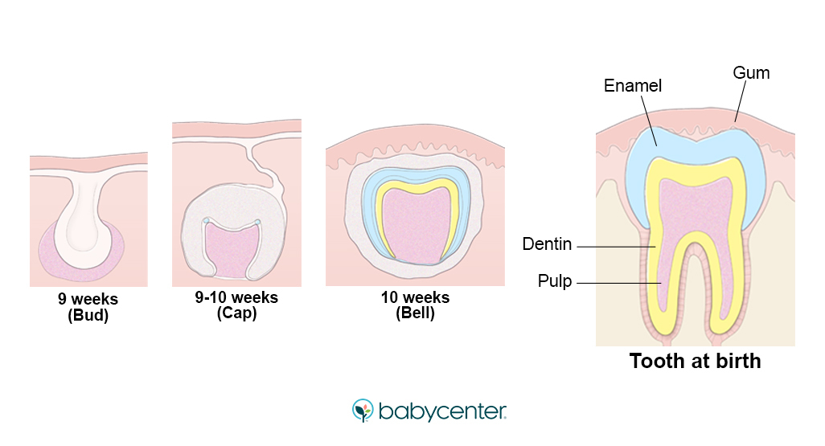
Notes:
Periodontitis is associated with preterm birth and low birth weight, and high levels of cariogenic bacteria in mothers can lead to increased dental caries in the infant.
Weeks pregnant Milestone 8 weeks Gum tissue forms in the upper and lower jaw. 9 weeks Tooth buds for each of the 20 baby teeth start to develop; production of enamel and dentin begins.10 weeks Teeth start to harden and connect to the jawbone.
Dental procedures such as diagnostic radiography, periodontal treatment, restorations, and extractions are safe and are best performed during the second trimester. second trimester is the most appropriate period for making many treatments, for those that if postponed until the end of pregnancy would be dangerous, such as tooth extraction, filling, and canal treatment.
The baby has grown considerably in the womb and the delivery is close. It should also be remembered that if a pregnant women, in the last trimester, sits for too long in the dental chair, it may cause vena cava inferior syndrome (supine hypotensive syndrome). In this situation, turning the mother to the left side in a semi-sloping manner will help to relieve the venous circulation

Slide 38
Pregnancy & Dental Procedures
1st trimester: assessment, EDUCATION, maintenance & prevention
2nd trimester: diagnostic radiography, periodontal treatment, restorations, and extractions
Notes:
Periodontitis is associated with preterm birth and low birth weight, and high levels of cariogenic bacteria in mothers can lead to increased dental caries in the infant.
Weeks pregnant Milestone 8 weeks Gum tissue forms in the upper and lower jaw. 9 weeks Tooth buds for each of the 20 baby teeth start to develop; production of enamel and dentin begins.10 weeks Teeth start to harden and connect to the jawbone.
Dental procedures such as diagnostic radiography, periodontal treatment, restorations, and extractions are safe and are best performed during the second trimester. second trimester is the most appropriate period for making many treatments, for those that if postponed until the end of pregnancy would be dangerous, such as tooth extraction, filling, and canal treatment.
The baby has grown considerably in the womb and the delivery is close. It should also be remembered that if a pregnant women, in the last trimester, sits for too long in the dental chair, it may cause vena cava inferior syndrome (supine hypotensive syndrome). In this situation, turning the mother to the left side in a semi-sloping manner will help to relieve the venous circulation

Slide 39
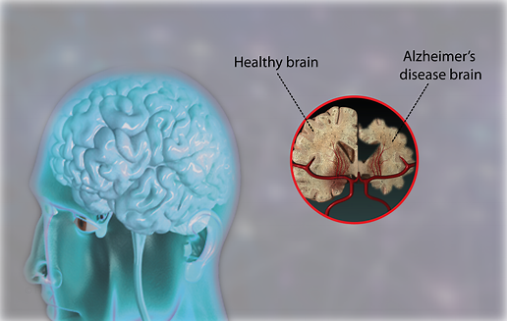
Dementia & Alzheimer's
The bacterium Porphyromonas gingivalis increased the risk of Alzheimer’s and associated Dementias
Migrate from the mouth to the brain
Plaques of beta-amyloid protein
Notes:
A connection discovered between Alzheimer’s and the bacteria that cause gum disease suggests that improved oral hygiene may decrease the risk of developing the disorder
This bacterium is one of the main causes of periodontitis — a disease characterized by inflamed gums.
The research suggests that it can migrate from the mouth to the brain and, once in the brain, secrete toxins that cause damage to brain cells.
Alzheimer's disease. Worsening oral health is seen as Alzheimer's disease progresses. Diseases that affect the brain, like Alzheimer’s or Parkinson’s, can cause coordination problems that also make brushing teeth difficult. And as older adults rely more on caregivers, oral hygiene may fall through the cracks,
In fact, a recent study suggests that plaques of beta-amyloid protein, a major hallmark of Alzheimer’s disease, may be produced as a response to this infection.

Slide 40
Smoking
Tobacco in any form is damaging to your oral health.
Vaping, chewing tobacco, and smoking cigars and pipes all pose similar problems
This Photo by Unknown Author is licensed under CC BY-ND
Notes:
Smoking can cause: Gum disease, which can lead to tooth loss › Oral cancer › Bad breath › Tooth discoloration › Leukoplakia (white patches inside the mouth) › Loss of bone in the jaw It’s not just your liver and lungs that are compromised by alcohol and tobacco.
People with alcohol use disorder are more likely to:*
› Have higher plaque levels
› Experience permanent tooth loss – three times
more likely
› Suffer from oral cancer – alcohol misuse is the
second-leading cause

Slide 41
Alcohol
When you drink alcohol, you make less saliva, which means cavity-causing plaque can stay on your teeth for longer.
This Photo by Unknown Author is licensed under CC BY-SA-NC
Notes:
Smoking can cause: Gum disease, which can lead to tooth loss › Oral cancer › Bad breath › Tooth discoloration › Leukoplakia (white patches inside the mouth) › Loss of bone in the jaw It’s not just your liver and lungs that are compromised by alcohol and tobacco.
People with alcohol use disorder are more likely to:*
› Have higher plaque levels
› Experience permanent tooth loss – three times
more likely
› Suffer from oral cancer – alcohol misuse is the
second-leading cause

Slide 42
COVID-19
A respiratory disease caused by SARS-CoV-2
Spreads mainly from person to person through respiratory droplets produced when an infected person coughs or sneezes
More severe cases seen with >65 and/or underlying medical conditions
PREVENTATIVE STRATEGIES Include:
CDC recommendations
Optimal Health
Oral Health is ESSENTIAL

Slide 43
COVID-19
Impact on oral health – prevention & maintenance
Oral care tips now and post COVID-19

Slide 44
Role of Direct Care Providers in Promoting Oral Health

Slide 45
Patient Care: Oral Care
Assessment
Priority
Contributes to the well-being, recovery, and nutritional needs of the patient
Barriers
Notes:
Assessment will be based on the environment you are in……is it appropriate to do an inspection of the oral cavity or just a probe about pain, description of their oral cavity, nutritional status, oral care practices, mental status, etc.

Slide 46
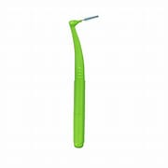
Care Interventions
Dependent Oral Care
Must be a part of the Plan of Care and scheduled to be done and documented
Have available & use alternative items: mouth swabs, sponges, lubricating ointment for lips
Daily Oral Care
Provide short, simple instructions
Use a "watch me" technique
Keep the teeth and mouth clean
Dentures
Try different types of toothbrushes
Floss regularly
Be aware of potential mouth pain
Notes:
Get away from lemon glycerin swabs, no items containing alcohol or hydrogen peroxide
Also strategies for caregivers
Explain dental care by breaking directions into steps. "Brush your teeth" by itself may be too vague. Instead, walk the person through the process. Say: “
Hold your toothbrush." "Put paste on the brush." Then, "Brush your teeth.“
Hold a toothbrush and show the person how to brush his or her teeth. Or, put your hand over the person's hand, gently guiding the brush. If the person seems agitated or uncooperative, postpone brushing until later in the day.
Very gently brush the person’s teeth, gums, tongue and roof of the mouth at least twice a day, with the last brushing after the evening meal and any nighttime liquid medication. Allow plenty of time and find a comfortable position if you must do the brushing yourself. Gently place the toothbrush in the person's mouth at a 45 degree angle so you massage gum tissue as you clean the teeth.
If the person wears dentures, rinse them with plain water after meals and brush them daily to remove food particles. Each night, remove them and soak in a cleanser or mouthwash. Then, use a soft toothbrush or moistened gauze pad to clean the gums, tongue and other soft mouth tissues.
ou may find that a soft bristled children's toothbrush works better than a hard bristled adult's brush. Or that a long handled or angled brush is easier to use than a standard toothbrush. Experiment until you find the best choice. Be aware that electric dental appliances may confuse a person with Alzheimer’s.
investigate any signs of mouth discomfort during mealtime. Refusing to eat or strained facial expressions while eating may indicate mouth pain or dentures that don't fit properly.lossing daily. If using floss is distressing to the person with Alzheimer's, try using a "proxabrush" to clean between teeth instead.

Slide 47
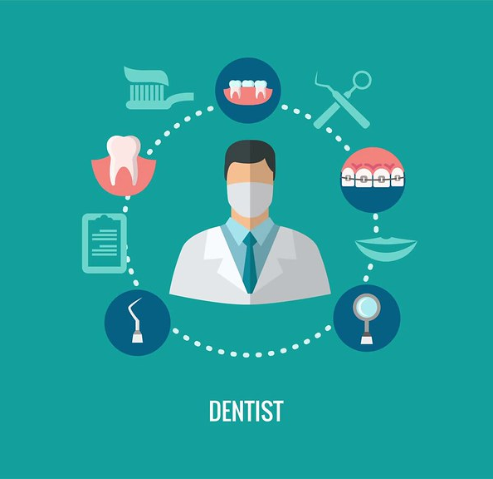
Interventions
Involve the Dietician to adjust foods according to chewing, heat/cold sensitivity, high ca, high protein, etc.
Working with the dentist
Find the right dentist
Coordinate care.***
Keep up with regular dental visits for as long as possible
This Photo by Unknown Author is licensed under CC BY
Notes:
Find the right dentist. Contact your local dental society to find the names of professionals who have experience working with people with dementia or with elderly patients. who specialize in the treatment of people with dementia and other medical problems
Coordinate care. Provide the dentist with a list of all health care providers who are caring for the person with dementia, as well as a list of all medications. Certain medications can contribute to dry mouth and other oral health issues. Before a dental visit, discuss any environmental modifications such as reducing noise or the number of people around, transport issues, sedation or pre medication needs with the dentist and staff.
Keep up with regular dental visits for as long as possible. This will help prevent tooth decay, gum problems, pain and infection.

Slide 48
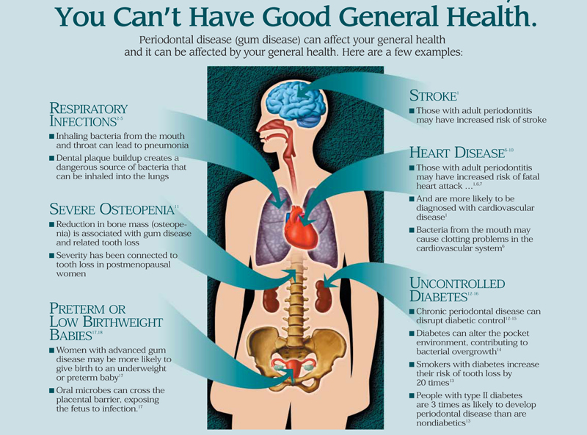
Notes:
To wrap this up and bring the point home how there is a link between oral health and chronic conditions. We only covered a few. As with any health promotion, matintance and prevention strategies in our ministries we may have the opportunity to advocate and empower our clients, patients and faith communities to include the dentist as part of their health care team.

Slide 49
Resources:
The Health Resources and Services Administration supports a network of “safety net” clinics for people who qualify for reduced-cost care, and many have a dental clinic. https://www.hrsa.gov/
Most dental schools have a clinic staffed by professors and students, where care is provided based on your ability to pay.
Your state dental organization may be able to refer you to dentists in your area who provide care at a reduced rate.
Florida-specific resources
Florida Dental Association
Find Help Florida
Notes:
As Faith Community Nurses and Volunteers, we often make referrals…here you go. I have personally check all of these out and they are good sources.

Slide 50
Bibliography
Alzheimer’s Risk Linked to the Presence of Mouth Bacteria, Study Shows
Alzheimer’s Association: Dental Care
CDC: Oral Health Conditions
Oral health may affect your heart brain and risk of death
Rheumatoid arthritis and periodontal disease: What are the similarities and differences?
The Journal of Cardiovascular Nursing: Oral Healthcare and Cardiovascular Disease
Social Determinants of Oral Health

