Slide 1
Mental Health Applicant File Review (AFR) Overview
February 2023
Notes:
Hello, Everyone. Welcome and thank you for joining today’s webinar. This webinar, Mental Health Applicant File Review Overview, is designed for CMHCs but we also wanted to invite Health and Wellness Directors (HWDs) and Disability Coordinators (DC). Whatever your role on center, I hope that this webinar will be helpful to you.! Let me just mention now that this webinar is being recorded. The recording will be available on the Health and Wellness support website home page in a couple of weeks. BUT the presentation slides and other tools we share with you today are already on the Job Corps HW website on the home page under new items. When you download the slides from today, all the hyperlinks that you see will be active.. Also be sure to look at the Speaker’s Notes for information that is not on the slide.
This is a 90-minute webinar with lots of important information so Let’s get started
PUT IN CHAT BOX – “The PowerPoint slides of this webinar are available on the Health and Wellness website under the “New Items” column.
https://supportservices.jobcorps.gov/health/Pages/default.aspx”

Slide 2


NEW AFR Resources
MARCH 1st
CMHC Applicant File Review (AFR) Guide
  Comprehensive compendium of ALL AFR primary guidance documents
CMHC Applicant File Review (AFR) Tools
  Collection of ALL AFR secondary resources (updated)
  Sample Applicant Interview Questions
  Sample Completed Form 2-04 and Form 2-05
  Brief Guide to Reviewing IEPs
  And more!
HCNA in Brief and DTA in Brief
Step-by-step guide for completing Forms
Your RMHS is your best source of guidance for AFR.
Please reach out to us!
Notes:
The first question I know on everyone’s mind is: When do we need to start using the new PRH forms? The answer is” March 1st. The Word document versions of the new Form 2-04 Direct Threat Assessment and Form 2-05 Health Care Needs Assessment that allow you to do the assessments electronically will be uploaded to the HW website mid February.
So, in addition to this webinar, we want to let you know about some brand new AFR resources that the Regional Mental Health Specialist team has been busy putting together for you to guide you through the changes to the Health Care Needs Assessment and Direct Threat Assessments.
CMHC Applicant File Review (AFR) Guide: Comprehensive compendium of ALL AFR primary guidance documents
CMHC Applicant File Review (AFR) Tools: Collection of ALL AFR secondary resources (updated) listed on the slide
HCNA in Brief and DTA in Brief: Step-by-step guide for completing Forms
All of these resources will be available to you by if not before the end of the month.
Now, these guidance documents will not cover every situation you will encounter when doing AFR. Your Regional Mental Health Specialist and Regional Disability Coordinator are always your best source of guidance for AFR. So please reach out to us!

Slide 3
Learning Objectives
1
2
3
4
5
List possible outcomes for a Job Corps application
Describe main AFR process steps - center level
List 2 allowable reasons for recommending denial of an applicant
Understand considerations related to the applicant interview
Describe the 5 primary changes and review
Form 2-05
Notes:
Let’s get right to it. Here are the 5 learning objectives for today’s webinar. By the end of our time together, it is my goal for you to be able to first of all stay awake - then
List possible outcomes for a Job Corps application
Describe main AFR process steps – at the center level
List the only 2 reasons that centers can recommend denial of enrollment for an applicant
Understand considerations related to the applicant interview
Describe the 5 primary changes to Form 2-04 DTA and Form 2-05 HCNA that resulted from PRH Change Notice 22-02 which was released last November

Slide 4
PRH Policies Related to AFR
Center Applicant File Review
Chapter 1.5
Center Applicant File Review and Disability Program
Exhibit 1-1 Job Corps Eligibility Requirements
Form 1-06 Center File Review Forms
Form 2-04 Individualized Assessment of Possible Direct Threat
Form 2-05 Health Care Needs Assessment
Exhibit 2-4 Job Corps Basic Health Care Responsibilities
Appendix 201 Communicating with Individuals with Disabilities
Disability Program
Appendix 201 Communicating with Individuals with Disabilities
Form 2-03 Procedures for Providing Reasonable Accommodation, Reasonable Modification in Policies, Practices, or Procedures, and Auxiliary Aids and Services for Participation in the Job Corps Program
Notes:
Today’s webinar will not cover absolutely everything that you need to know about AFR. This slides shows the key PRH policies related to AFR that you need to be familiar with. And again, when you download the presentation and put in slide show mode - these are live links to take you to these policies for both AFR and the disability program..
.

Slide 5

AFR Outcomes
Learning Objective 1:
What are the possible outcomes after a young person applies to Job Corps?
5
Notes:
The first learning objective today relates to the possible outcomes of a young person’s application after they apply to Job Corp.

Slide 6

Application Outcomes
1. Center Enrollment
Recommendation
of Denial
Eligibility
Issues
Movement of Applicant Files
2.
3.
4.
Even with Admissions assistance
Direct Threat Assessment (DTA)
(Form 2-04)
New Information
Applicant-Initiated Withdrawal
Disability Status
Incomplete Application
Health Care Needs Assessment (HCNA)
(Form 2-05)
NEW
Residential Setting/ Hospitalization
Health Care Needs Assessment (HCNA)
Alternate Center
(Form 2-05)
Error in Initial Eligibility Review
NEW
Notes:
It begins with Admissions - Admission services electronically sends completed applications to the centers via CIS- Job Corps Center Information System-. The role of centers is to review each applicant file before enrollment So What happens after a center has received an applicant file and completed the AFR process? There are 10 different possible outcomes. I will be focusing on the the process for centers to make recommendation of denials. But will briefly touch on the other outcomes and would refer you to your Regional Disability Coordinators for more information.
The first and most common outcome is that the center decides to enroll an applicant in the program. The conditional enrollment now becomes a true enrollment.
A second outcome is a recommendation of denial, which occurs after the center reviews the file, interviews the applicant and submits a recommendation to the Office of Job Cops Regional Office. The 2 types of denial recommendations are:
a Direct Threat Assessment or DTA using Form 2-04
a Health Care Needs Assessment or HCNA using Form 2-05 and the HCNA also has an option to recommend an an alternate center- which is rarely used.
A third set of outcomes relates to eligibility :
The center learns of new information related to eligibility criteria that Admission staff could not have known that triggers a need for the Regional Office to do an eligibility review. This new information is typically discovered during the applicant interview. or
An applicant claims to have a disability in order to be eligible for Job Corps without meeting the age and low income requirements but they do not have documentation of their disability or the documentation is lacking
Number 4 has a few categories - an applicant can request that their application is withdrawn from consideration. An applicant can withdraw their application at any time. Then there are 3 new PRH categories - “incomplete application” – this is when the center cannot reach the applicant to complete the interactive parts of AFR process even after seeking assistance from Admission staff –
Next, the applicant is in a residential setting or hospital and cannot be reached to complete the interactive parts of the AFR process which will result in a withdrawal. If applicant is able to be reached and participate, the AFR process continues
Lastly, the center learns of information that was known to Admission staff, and Admissions staff made an error and deemed the applicant as eligible for the program when they were not. This happens rarely.
Eligibility issues, withdrawals and incomplete applications due to not being able to reach an applicant are complex. I strongly recommend that centers consult with their Regional Disability Coordinator for consultation to make sure you are following PRH policy.

Slide 7

AFR Process Steps: Center Level
Learning Objective 2:
What are steps of the AFR process at the center level?
7
7
Notes:
Now that we have reviewed what can happen to an applicant at the end of the center’s AFR process, let’s go back to the beginning and walk through the center process steps associated with AFR.

Slide 8
AFR Process Steps – Center Level
STEP 1
STEP 2
STEP 3
Records staff logs receipt of applicant file and tracks its movement.
HWD does initial review & approves enrollment or refers file for additional review.
HWD refers the file to one or more qualified health professionals (QHPs) for review.
STEP 6
STEP 5
STEP 4
If applicant is an individual with a disability, the disability accommodation process (DAP) must occur.
If needed, applicant is interviewed, then QHP makes decision: 1) to enroll or 2) recommend denial, or 3) refer file to region for eligibility review.
QHP(s) review file & determine whether applicant interview is needed to make an enrollment decision.
Notes:
There are 8 steps in the AFR process at the center level. Whether an applicant file needs to go through all 8 steps depends on whether the applicant is an individual with a disability. This slide shows the first 6 steps.
In Step 1, the center Records department logs receipt of an applicant file from Admissions and begins tracking it through the AFR process.
In Step 2, the Health and Wellness Director does an initial review of every applicant file. It’s a really big job.
Step 3: The HWD can decide that the file needs no additional review and approve enrollment of the applicant. Or the HWD can decide to refer the file to one or more qualified health professionals (QHPs)- which would typically be our center health staff for additional review.
Step 4: The QHPs review the applicant file and determine whether an interview with the applicant is needed to make an enrollment decision. An applicant can be enrolled without an interview, but if the QHP thinks that a recommendation of denial may be needed, an applicant interview is required.
Step 5: After conducting the applicant interview, the QHP can make a decision to enroll an applicant or recommend denial. If you have decided to recommend denial, this is when you would start to complete Form 2-05 HCNA or Form 2-04 DTA. If the applicant is NOT an individual with a disability, the AFR process stops after Step 5.
If, however, the applicant IS an individual with a disability, then in Step 6 the disability accommodation process or DAP for short must occur. I’ll cover the DAP in more detail later.

Slide 9
AFR Process Steps – Center Level
STEP 7
STEP 8
QHP(s) who recommend denial consider whether accommodations would sufficiently remove or reduce barriers to enrollment.
Recommendation of denial using Form 2-04 or Form 2-05 is forwarded to the Regional Office (RO) for review. RO makes final determination of the applicant’s status.
Notes:
In step 7, you have made a decision to recommend denial, and you consider whether disability accommodations would sufficiently remove or reduce the barriers to enable the applicant to enroll. If this answer is no, the disability accommodations would NOT sufficiently remove or reduce the barriers to enrollment, then you would complete Form 2-05 or Form 2-04 and, in Step 8, submit the recommendation of denial to the Job Corps Regional Office. There the recommendation of denial goes through the 2-step review process -administrative review with the disability team and then a clinical review with the health team. The Regional Office then makes the final determination about the applicant’s status. So, there are many steps involved but it does become easier the more you do it..

Slide 10

File Review Team (FRT)
Health & Wellness Director (HWD)
Initial Review
Disability Coordinator (DC)
IF applicant has a disability
+
QHP
CMHC
QHP
TEAP Specialist
QHP
Center Physician
QHP
Center Dentist
HWD may refer applicant file to more than one center clinician (QHP) for review.
Each QHP reviews file, determines the need for an interview, and makes an independent decision to approve applicant for enrollment or to submit a recommendation of denial.
Notes:
As I mentioned, the first step in the AFR process is an initial review by the Health and Wellness Director (HWD) of every applicant file. If needed, the HWD then determines which center clinicians are the qualified health professionals (QHP) that need to review of the file based on their area of expertise and licensure. The HWD, the Disability Coordinator (if the applicant is an individual with a disability).and all the center clinicians who are asked to review the file comprise the File Review Team (FRT).
The FRT may include more than one clinician depending on whether there are concerns related to the items endorsed on the ETA 653 Job Corps Health Questionnaire or in medical or other records. For example, if there are concerns related to both mental health and substance use, then both the CMHC and the TEAP Specialist will both be part of the FRT. Each center clinician will review the file, determine the need for an interview and make an independent decision to approve the applicant for enrollment or recommend for denial. If any member of the File Review Team recommends denial, then the review of all clinician on the FRT must be documented on the DT or HCN assessment. One assessment with both clinicians’ summaries and recommendations

Slide 11
Review all relevant documents in the applicant’s e-Folder
Is an interview needed to make an enrollment decision?
Yes
No
Conduct Applicant Interview*
Does the applicant have mental health care needs that exceed basic health care at JC?
Does the applicant’s condition/disability pose a direct threat to others?
No
Yes
Yes
No
Recommend denial or alternate center using Form 2-05
Recommend denial
using Form 2-04
Recommend
enrollment
AFR Process Flowchart
For QHP (after HWD initial review)
Is the applicant an
individual with a disability?
Is the applicant an
individual with a disability?
No
Yes
Yes
No
DAP
Identify & discuss potential disability accommodations with applicant and others working on applicant’s behalf
DAP
Identify & discuss potential disability accommodations with applicant and others working on applicant’s behalf
Do disability accommodations reduce or remove barriers to enrollment?
Applicant is assigned a start date to enroll
No
Yes
Submit recommendation of denial or alternate center to the Regional Office for review
11
Notes:
This flowchart outlines the decision-making process for CMHCs after the HWD has referred a file for additional review. It may look complicated, but there are really only 5 decision points represented by the white bubbles:
Is an interview needed to make an enrollment decision?
Does the applicant have mental health care needs that exceed basic health care at JC?
Does the applicant’s condition or disability pose a direct threat to others?
Is the applicant an individual with a disability?
If so, do disability accommodations reduce or remove the barriers to enrollment?
Hopefully, this will be helpful to you when you get a chance to look at it in more detail on your own. _____________Can you please put the link in the chat box to the flow chart

Slide 12
Who is a Qualified Health Professional (QHP)?
Licensed/certified health professionals who have current, documented expertise in the medical condition(s) or disability or disabilities involved in a particular case.
A center may need to consult with the individual’s treating provider or may need to retain an outside provider with the necessary current expertise in the particular medical condition or disability and its effects, to conduct a direct threat or health care needs assessment in a given case.
Notes:
Now I’ve mentioned the term “qualified health professional” or QHP a few times. This is a new term with the PRH changes. What is a QHP?
A QHP is a licensed/certified health professional who has current, documented expertise in the medical condition(s) or disability or disabilities involved in a particular case. In most cases, it is expected that center health and wellness staff – CMHCs, TEAP specialists, Center Physicians and Center Dentists – will serve in the role of the QHP.
However, there may be specific cases when a center may need to consult with the applicant's treating provider or may need to retain an outside provider with the necessary current expertise in a particular medical condition or disability, to conduct a direct threat or health care needs assessment.

Slide 13

QHP Responsibilities
Review relevant parts of the applicant’s file based upon the HWD’s initial triage of the file and based upon a “need to know.”
Contact applicants and conduct clinical interviews.
Contact outside treating providers as necessary to discuss an applicant’s health care needs.
Complete health care needs or direct threat assessments, if indicated.
Identify potential disability accommodations if the applicant is an individual with a disability.
13
Notes:
What is the QHP expected to do as part of AFR? There are 5 primary tasks:
Review relevant parts of the applicant’s file based upon the HWD’s initial triage of the file and based upon a “need to know.”
Contact applicants and complete clinical interviews.
Contact outside treating providers as necessary to discuss an applicant’s health care needs.
Complete health care needs or direct threat assessments, if indicated.
Identify potential disability accommodations in collaboration with the disability coordinator if the applicant is an individual with a disability.

Slide 14

2 AFR Timelines
  Centers have 30 calendar days to complete the AFR process.
  CMHCs should be assigned the file no later than 3-4 days after it is made available to the center.
Regional Disability Coordinator
Regional Mental Health Specialist
While a recommendation of denial is in Regional Review, Centers have 10 business days to provide additional information or make corrections as requested by email from the RDIC or RMHS.
Administrative
Review
Clinical
Review
  An extension can be requested from the Regional Office.
  Check with your HWD about your center contractor’s policies.
  Waiting for records is typically not justification enough for an extension, unless deemed critical for the review. Per policy, you must make a decision based on information you have.
Notes:
There are 2 timelines associated with AFR that you need to be aware of. After a center has been notified that an applicant e-Folder has been assigned to the center, the file must be processed within 30 calendar days. That can come quickly I know.
You should be assigned the file and start your review no later than 3 to 4 days after it is made available to the center because of the time it takes to go through all of the steps involved in making a recommendation of denial– that’s if you decide to go that route. (JUST A NOTE: Just because you are assigned to review a file does NOT mean that you have to do a recommendation of denial; but you’re being given the file because the applicant has disclosed mental health information that needs your review).
Now an extension can be requested from the center’s Regional Program Manager. Most of the time extensions are requested because you are still waiting to get outside records, but this alone is often no justification for requesting an extension unless it is a critical piece of information, and you think it is forthcoming within a reasonable amount of time. For example, applicant reports a recent hospitalization since applying to the program and you want those records. Now Per policy, you must make a decision to approve admission or submit a recommendation of denial based on the information you have. If you are ever in this situation, I strongly suggest that you reach out to your Regional Mental Health Specialist to discuss the file.
There is another timeframe to be aware of - while a recommendation of denial is in Regional Review you may be contacted by email by the Regional Disability Coordinator or the the Regional Mental Health Specialist for more information or to make corrections? You have 10 business days to address the issues and respond to the email. When you get an email from the Regional Mental Health Specialist, unless it is something you can’t finish quickly, just pick up the phone and call your RMHS to discuss the issues.

Slide 15

Making a Recommendation of Denial
Learning Objective 3:
What are the 2 reasons that a center can recommend denial of an applicant’s enrollment in Job Corps?
15
Notes:
Now on to the 3rd learning objective: What are the only 2 reasons that a center can recommend denial of an applicant’s enrollment to Job Corps?

Slide 16
2 Reasons to Recommend Denial
Direct Threat To Others
Health Care Needs
Job Corps requires, as a qualification standard, that an applicant or student not pose a direct threat to the health or safety of others, including students and staff
The applicant has mental health care needs that exceed what can be provided at Job Corps as part of the Basic Health Care Responsibilities.
Use Form 2-04 Individualized Assessment of Possible Direct Threat
Use Form 2-05 Health Care Needs Assessment
Notes:
I alluded to the 2 reasons when briefly reviewing the flowchart earlier. The only 2 -- reasons to recommend denial are:
If the applicant’s condition or disability poses a direct threat to others. Job Corps requires, as a qualification standard, that an applicant or student with or without disabilities not pose a direct threat to the health or safety of others, including students and staff. Form 2-04 Individualized Assessment of Possible Direct Threat is used to make a recommendation of denial based on direct threat to others.
The other reason to recommend denial of enrollment for an applicant is if f the applicant has mental health needs that exceed what can be provided at Job Corps as part of the Basic Health Care Responsibilities as outlined in Exhibit 2-4 . Form 2-05 Health Care Needs Assessment is used to make a recommendation of denial based on health care needs this included danger or threat to self.
Let’s look at these two scenarios in more detail.

Slide 17

Direct Threat to OTHERS
Federal disability nondiscrimination laws define a “direct threat” as a significant risk of substantial harm to the health and safety of others that cannot be eliminated or reduced by reasonable accommodation, reasonable modification in policies, practices, or procedures, and auxiliary aids and services.
RA/RM/AAS = reasonable accommodation; reasonable modification in policies, practices, or procedures, and auxiliary aids and services. Collectively referred to as “disability accommodations.”
17
17
Notes:
First let’s look at the criteria for direct threat to others
In 2017, the definition of “direct threat” in federal disability nondiscrimination laws was changed to remove threat to self. Direct threat is now defined exclusively as a direct threat to others.
Direct threat is defined as a significant risk of substantial harm to the health and safety of others that cannot be eliminated or reduced by reasonable accommodation, reasonable modification in policies, practices, or procedures, and auxiliary aids and services which is abbreviated as RA/RM/AAS or referred to as disability accommodations which I will use for the rest of the training today. You will see these terms frequently on the updated Forms 2-04 and 2-05.
. Now back to Direct Threat!

Slide 18
Direct Threat – High Standard
Direct Threat Standards
“A significant risk of substantial harm”
indicates a high standard of harm to others
X Not a perception of harm
X Not a slight probability of risk
X Not a speculative or remote risk
18
Notes:
The standard for making a recommendation based on a direct threat is high because it involves “an actual significant risk of substantial harm”
A “significant risk” means that it cannot be:
a perception of harm or
a slight probability of risk.
And it cannot be a speculative or remote risk. All of those are insufficient to considered a direct threat.

Slide 19
Direct Threat – High Standard
Direct Threat Standards
The risk of harm must be:
Current (present at the time of the assessment)
Imminent (likely to occur soon)
The direct threat cannot be based solely on history.
More detailed training on DTA will be coming soon!
19
Notes:
Another reason that the the standard for making a recommendation based on a direct threat is high because the risk of harm must be:
Current: present at the time of the assessment AND
Imminent meaning likely to occur soon
In the other words, the direct threat cannot be based solely on history. For example, if an applicant has:
a history of assaultive behavior at school 2 years ago – they got into fights and were suspended several times AND
a history nonadherence with psychotropic medications for ADHD, aggression, and anger outbursts in the last year.
AND the applicant is irritable and not forthcoming during the interview
You might suspect this applicant COULD pose a direct threat, but without current evidence of an imminent threat as in recent assaultive behavior or they make statements during the interview indicating on-going problems with impulse control, can’t regulate anger towards others, The applicant’s condition or disability may not rise to a level of a direct threat. However, you may be able to consider a health care needs assessment due to the need for supervision and behavior management with current uncontrolled symptoms.
We will be doing more training on completing a direct threat assessment soon where we will discuss these types of issues with examples in more detail.

Slide 20

Health Care Needs Assessment (HCNA)
Mental Health and Wellness Program direct services in PRH Exhibit 2-4 Job Corps Basic Health Care Responsibilities:
Mental Health Assessments
Short Term Counseling
Crisis Intervention
Referral to off-center providers
Medical: Access to prescription medications
Notes:
Now let’s turn to the second and much more common reason that a recommendation of denial can be made – if an applicant currently has mental health treatment or management needs that exceed what can be provided at Job Corps. Well, to make that assessment, you first have to understand what Job Corps is required and can provide as described in PRH Exhibit 2-4 Job Corps Basic Health Care Responsibilities. Please familiarize yourself with this document.
The Job Corps Mental Health and Wellness program essentially states that in terms of direct care, CMHC’s provide:
Mental Health Assessments
Short Term Counseling
Crisis Intervention
Referral to off-center providers
In the medical section of Exhibit 2-4, one of Job Corps basic health care responsibilities is access to prescription medications. This is an important factor to keep in mind for an applicant who may be taking or may need psychotropic medications. It is considered part of Job Corps basic health care services.

Slide 21
Health Care Needs Assessment (HCNA)
Denial of Enrollment
Recommend an Alternate Center
In my professional judgment, the individual’s health care needs exceed the Job Corps Basic Health Care Responsibilities in Exhibit 2-4.
In my professional judgment, the individual’s health care needs do not exceed the Job Corps Basic Health Care Responsibilities in Exhibit 2-4, but they do require community support services which are not available near center. Applicant should be considered for center closer to home where health support and insurance coverage are available.
Most common > 99%
of HCNAs
Notes:
There are 2 types of recommendations on the HCNA. The most common recommendation in about 99% of all HCNA is for denial of enrollment because the applicant health care care needs exceed what Job Corps can provide.
The other recommendation is for an alternate center. You are not recommending denial because you do NOT think the applicant’s health care needs exceed what Job Corps can provide, but they DO EXCEED what can be provided at YOUR CENTER. Centers vary in the availability of community mental health resources for referrals to off-center providers based on a number of factors including
the location of a center (how rural it is) and access to specific resources
the availability of health insurance coverage for Job Corps students
So, when conducting an assessment of an applicant file, the two questions you should ask are:
Does the applicant’s condition or disability currently pose a direct to others at this time? OR
Based on current symptoms, behaviors, and functional limitations, does the applicant currently have mental health care management needs that exceed what can be provided at Job Corps?
Let me ask you a question - When conducting an assessment should you ask yourself:
Will this applicant be able to complete the program successfully (for example, TABE up)? – The answer is NO
Questions about “good “fit” and ability to finish the program are the kinds of questions that colleges may ask, but they are the questions that center health staff are not charged to answer. If an applicant is eligible for Job Corps, then there are only 2 questions as a CMHC you need ask - DT or HCN.
And remember that Applicants to Job Corps are never recommended for denial based on their need for accommodations. They would be considered discriminatory against individuals with disabilities.

Slide 22


Individualized Assessment
Review of each applicant must be an individualized assessment.
Avoid making assumptions about an applicant’s ability, behavior, or functioning based on any single factor such as:
  A diagnosis, including serious mental illness (SMI)
  Special education placement
  A single hospitalization
Generalizations, stereotypes, and subjective perceptions related to a medical condition or disability are inappropriate in the AFR process.
There are no “automatic reasons”
for a recommendation of denial in the Job Corps program.
Notes:
Okay one final and very important point to make about AFR is that the review of each applicant must be an INDIVIDUALIZED ASSESSMENT that takes into account an applicant’s strengths and challenges in various domains of functioning.
There are no “automatic” reasons that you should make a recommendation of denial. You may hear rumors that if an applicant has or did X or Y -- such as have a hospitalization for a suicide attempt in the past 6 months -- that the applicant is “automatically” considered for denial. That is simply not true. Each applicant must be assessed on an individual basis and not any single factor.
The bottom line – and I don’t need to say it to this group -- is that generalizations, stereotypes, and subjective perceptions related to a medical condition or disability are inappropriate in the AFR process. For example: On your centers you have had students with diagnoses of schizophrenia and intellectual disabilities who have successfully completed the program.

Slide 23

Considerations for the Applicant Interview
Learning Objective 4:
What are some things to consider when preparing for, scheduling, and conducting an applicant interview?
23
Notes:
Learning objective 4 - The interview of applicants is one of the most important parts of the AFR process and is required if a center wants to make a recommendation of denial. So, let’s spend time discussing some considerations about how to prepare for, schedule and conduct an applicant interview.

Slide 24

Purpose of the AFR Interview
To obtain current information about disclosed mental health
Conditions
Symptoms
Behaviors
Functional limitations
To determine if an applicant:
Has a condition or disability that currently poses a direct threat to others or
Currently has mental health care management needs that exceed what can be provided at Job Corps
24
Notes:
The interview is where you are able to obtain current information about disclosed:
Mental health conditions
Symptoms
Behaviors
As some of you may have noticed, sometimes it takes quite a while for an application to be completed. An applicant’s ETA 653 Job Corps Health Questionnaire may be few months old by the time a completed application is assigned to a center. So you want to be sure to have current information for your assessment.
And as stated before to determine if an applicant:
Has a condition or disability that currently poses a direct threat to others or
Currently has mental health care management needs that exceed what can be provided at Job Corps

Slide 25
Applicant Interview Considerations
  Single most important part of your applicant assessment
  particularly if there are no records or other documents to review.
The interactive applicant interview
REQUIRED for all recommendations of denial.
A decision to enroll an applicant can be made without conducting an interview.
Must be conducted by the CMHC for recommendations of denial related to mental health and/or behavioral difficulties.
Should NOT be conducted as part of the Disability Accommodation Process (DAP) for legal reasons.
Notes:
The applicant interview is ESSENTIAL for putting all of the information from file review into current context and make a determination about the need for a recommendation of denial. It is the single most important part of your clinical assessment, particularly if there are no records or other documents to review in the applicant file. In that case, the basis for and the strength of the recommendation of denial will rest solely on the quality of the interview.
3 things that you should know about the interactive clinical interview are that
A decision to enroll an applicant can be made without conducting an interview,. However, it is required if you want to make a recommendation of denial. However, If, after reviewing the file, you are unsure about whether to recommend enrollment or recommend denial, it is always a good idea to interview the applicant before making your decision. You can also consult with your RMHS to discuss the case.
If a recommendation of denial is being made to due to health care needs related to mental health and/or behavioral difficulties, the health care needs assessment including the applicant interview must be conducted by the CMHC.
Applicant interviews should NOT be completed as part of the Disability Accommodation Process (DAP). The applicant assessment and DAP or consideration of disability accommodations are two separate processes and must be so for legal reasons. BUT, it is often helpful to schedule the DAP immediately following the applicant interview to minimize difficulties with scheduling both and to reduce the burden on the applicant.

Slide 26

Applicant Interview Considerations
In person
Videoconference
Telephone
Consider doing a video-based or in person interview if you anticipate that an applicant may have communication difficulties due to a cognitive limitations and/or speech or language problems.
More complete assessment
More options for providing communication accommodations
Notes:
Applicant interviews can be conducted in person, by videoconference, or by telephone. Prior to the COVID pandemic, most applicant interviews were conducted by phone. Now with with WebEx and other secure platforms, CMHCs can conduct a video-based interview if an applicant has access to the Internet and a telephone, tablet or computer.
Videoconference and in-person interviews are encouraged, so that you make direct observations of the applicant’s appearance and behavior and get a more complete picture of the applicant and how they are functioning. A video-based or in person should be considered if you anticipate that an applicant may have communication difficulties due to a cognitive limitations and/or speech or language problems. Why? So you can do a more complete assessment and it gives you more options in terms of providing communication accommodations such as writing down questions or allowing the applicant to respond by writing. We’ll talk more about communication accommodations in a few minutes.

Slide 27
Scheduling Applicant Interviews
Make at least 2 attempts to schedule an interview with an applicant.
Unable to reach an applicant? Contact the applicant’s Admissions staff person for assistance.
  Try all the telephone numbers provided on the ETA 652 Job Corps Applicant Data Sheet.
  Leave messages with specific timeframes and a deadline to return your call.
Found at the top of the ETA 652 Job Corps Applicant Data Sheet.
Email is recommended for ease of documentation.
Provide Admissions staff with specific days/times when you are available to interview the applicant.
Document your efforts to reach the applicant & your contacts with Admissions staff.
Ask your HWD about how to document AFR activities at your center.
Notes:
Now let’s talk about some of the logistics with scheduling applicant interviews.
First, you must make at least 2 attempts to schedule an interview with an applicant.
Be sure to try all of the telephone numbers provided on the ETA 652 Job Corps Applicant Data Sheet.
When leaving messages for applicants, provide specific timeframes a deadline for returning your call (example: “Please call on Mondays and Wednesdays. Please return my call within 3 days.”)
If you are unable to reach the applicant to schedule an interview – if, for example, none of the numbers on the ETA 652 work or the applicant has not returned messages -- contact the applicant’s Admissions staff person for assistance. The name and phone number for the Admissions staff person can be found at the top of the ETA 652. Using email is recommended for contacting Admission staff. Email addresses can be found in Outlook in the email directory. In your message to Admissions staff, provide specific days/times when you are available to interview the applicant.
Document your efforts to reach the applicant and any contacts that you have with Admissions staff. Ask your HWD about documenting AFR activities at your center – it could be on a SF-600 Form, a center-specific tracking log, or in some other way.

Slide 28
Interviewing Minors
Applicants and the parents/guardians of minor applicants sign a consent for a pre-enrollment interview as part of the application process, so there is no need to obtain additional consent.
Scheduling an interview: invite a minor’s parent/guardian to participate, but their participation is not required.
  Also applies to applicants with cognitive and/or language difficulties.
Politely ask the parent/guardian to wait to provide their input AFTER the applicant has an opportunity to respond to each question. Do this at the very beginning before the interview starts. Provide reminders as needed.
Notes:
Here are also a few considerations when it comes to interviewing minor applicants.
Applicants and the parents/guardians of minor applicants sign a consent for a pre-enrollment interview as part of the application process, so there is no need to obtain additional consent.
When scheduling an interview with a minor applicant, the parent/guardian should be invited to participate, but the participation of the parent/guardian is not required.
If the parent/guardian chooses to be on the phone or in the room during the interview, politely ask the parent/guardian to wait to provide their input AFTER the applicant has an opportunity to respond to each question. Explain that this is important so that you can see how well the applicant functions independently since they will be expected to function independently at Job Corps.

Slide 29
Preparing for an Applicant Interview
You can only ask an applicant about
DISCLOSED
mental health diagnoses, conditions, symptoms, and behaviors
Asking about non-disclosed information constitutes unauthorized collection of data, potentially resulting in an admissions process that is biased and unfair
(Program Instruction 14-24).
You need to prepare for the applicant interview by carefully reviewing all the relevant information in the applicant’s e-Folder so you know what to ask about during the interview.
Notes:
When conducting an applicant interview, you can only ask an applicant about DISCLOSED diagnoses, conditions, symptoms, and behaviors on the ETA 653 and any other records in the applicant e-Folder including medical/mental health records, school disability document, Chronic Care Management Plans and so on. Asking about undisclosed information can potentially be seen as making the process biased and unfair.
You need to prepare for the applicant interview by carefully reviewing all the relevant information in the applicant’s e-Folder, so you know what to ask about during the interview.
So, let’s turn now to documents you will encounter and need to review information in the applicant e-Folder.

Slide 30
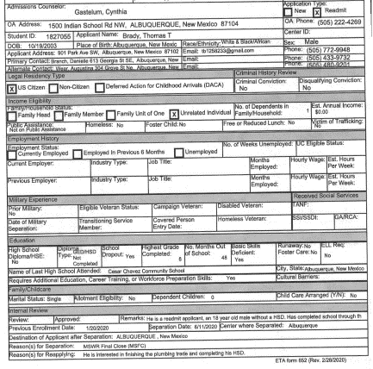
SOURCES OF INFORMATION
Where to look
Reviewing Documents in the Applicant e-Folder
1
Start with 2 Required Documents
2
3
ETA 652 Job Corps Applicant Data Sheet
  Contact phone numbers
  Address: How far from center? Out of state?
  Date of birth: minor or adult
  New application or readmit
  Homeless
ETA 653 Job Corps Health Questionnaire
4
5
6
Notes:
After you have logged into CIS and located the applicant’s e-Folder, you will find two documents in every applicant folder because they are a required part of the application.
The first is the ETA 652 the Job Corps Applicant Data Sheet. There is a screenshot on the slide.
The Job Corps Data Sheet (ETA-652) provides demographic information about the applicant including the information you see on the slide.

Slide 31
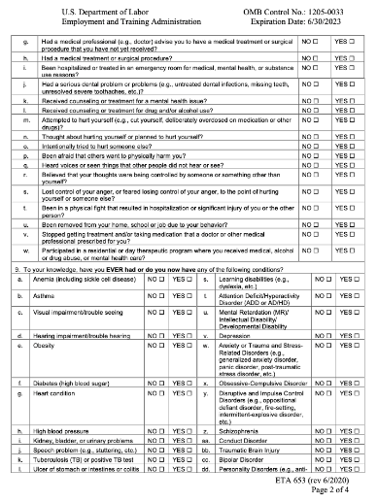
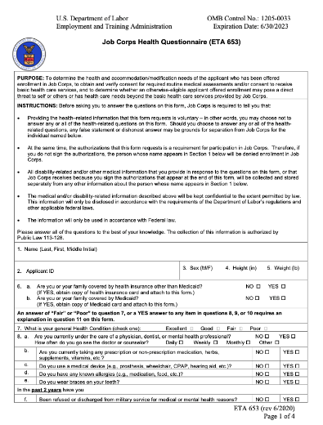
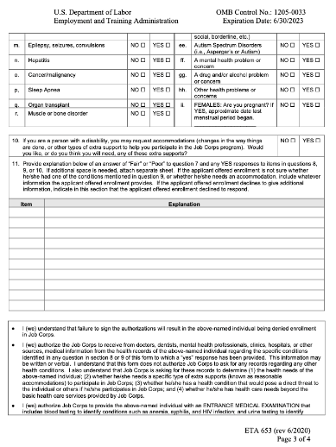
ETA 6-53 Job Corps Health Questionnaire
Questions 9
9ee-9ii
Question 8
8g-8w
Question 10
Disability
Question 9
Diagnoses
9a-9dd
Admissions comments
Question 8
Current health
Behaviors & events in the past 2 years
8a-8f
31
Notes:
The 2nd document is The ETA 653 Job Corps Health Questionnaire is a 4-page document included in every applicant file. While it is a required document, it is important to know that applicants to Job Corps, like applicants to a job, are not required to disclose health information. We hope that they do, but they are not legally required to do so.
You will want to review the items that are were endorsed or marked “yes” by the applicant of the 6-53
then look in the comments section after question 10 . For any item that is marked ”yes,” Admissions is to make notes with additional information including whether any documentation related to the condition is included in the e-Folder.

Slide 32
Reviewing the Applicant e-Folder
Wellness and Accommodation
Health e-Folder
Health and medical documents
Disability e-Folder
School-related and other disability documents
Chronic Care Management Plans
Medical records
Mental Health and Counseling records
Other
Psychological, Neuropsychological and Psychiatric Evaluations
Substance Abuse records
Supplemental Health and Wellness Documentation
504 Plans
Behavior Intervention or Support Plan
Individualized Education Program (IEP)
Other
Other miscellaneous non-medical documentation
Previous School Records
Vocational Rehab or other community resource
Autism Spectrum Disorder
Intellectual Disability
Emotional Disturbance
Notes:
After reviewing the ETA 652 Job Corps Applicant Data Sheet and ETA 653 Job Corps Health Questionnaire, you then go to the Wellness and Accommodation folder where you will find the Health e-Folder and the Disability e-Folder. Now this assumes that you are doing your applicant file review electronically in CIS, which I would highly recommend
At any rate, the lists of possible documents that you see on the slide is how they appear in the e-Folder. As you review documents, be sure to make notes about the information disclosed so that you can ask about them during the applicant interview, if you decide you need to do one.
As a “best practice,” CMHCs should review the school disability documents (IEPs, 504 Plans, etc.) in the Disability e-Folder because these documents often contain important information related to behavior, social skills, communication and activities of daily living, especially for applicants identified as having Autism Spectrum Disorder, Intellectual Disability and Emotional Disturbance due to the frequency of some of the challenges that are associated with these conditions.
There have also been instances where an IEP was the only place where it was mentioned that an applicant had an ankle bracelet for monitoring during probation or that a student frequently misses school due to repeated psychiatric hospitalizations.
If you do not have access to the Disability e-folder. You should have access to this folder so if you do not, please check with your HWD or IT person on center about getting access to the Disability e-Folder.

Slide 33
Resource:
Sample Applicant Interview Questions
Conducting an Applicant Interview
Notes:
Before we start on the section about actually conducting an application interview, I want to call your attention to an important resource to help you when conducting applicant interviews: the Sample Applicant Clinical Interview Questions. For those of you who are already familiar with it, we have updated it, so it is “new and improved.”
The Sample Applicant Interview Questions were designed with the direct threat and health care needs assessments in mind – to help you capture the information needed to write a strong assessment to support a recommendation of denial. You do not have the use all of the questions because all of the questions won’t be appropriate. For example, there are specific sets of questions for particular situations, such as when an applicant has a cognitive disability and you need to assess adaptive functioning.

Slide 34

Conducting an Applicant Interview
Communication Accommodations
Determine if the applicant or parent/guardian may need communication accommodations, including translation services.
As part of nondiscrimination regulations, centers are required to communicate effectively with applicants with disabilities during the application process.
The burden is on Job Corps centers to provide auxiliary aids and services (communication aids) to enable individuals with disabilities to communicate effectively and have an equal opportunity to participate in the AFR process.
Notes:
While scheduling the interview and during the first few minutes of the interview, try to determine parent/guardian of the applicant may need communication accommodations, including translation services.
Listen carefully to the applicant’s speech and language – how they express themselves and how well they seem to understand and respond to the questions.
This is important because as part of nondiscrimination regulations, centers are required to communicate effectively with applicants with disabilities during the application process so that an applicant can participate in the process to the maximum extent possible.
Under the law, the burden is on Job Corps centers, not the applicants, to provide appropriate auxiliary aids and services (communication aids) that are needed for effective communication for an individual with a disability.
Communications difficulties can present in many ways. Problems with speech –. Examples include articulation, stammering, and stuttering, Problems with comprehension or receptive language which may manifest as trouble understanding questions Problems with expressive language which may manifest with long pauses before providing responses, and word-finding problems
Clues that an applicant may need communication accommodations is if you see the item “speech problems” checked on the ETA 653 Job Corps Health Questionnaire or if they have an IEP that included speech or language therapy. Communication accommodations may be needed by applicants with a wide range of disorders including individuals with autism spectrum disorders, intellectual disabilities, processing problems or sensory impairments (blindness, deafness, etc.) but also an applicant with a severe anxiety-related disorder.

Slide 35

Communication Accommodations
Simplify language/rephrase question
Give extra processing time to both absorb info & respond to questions
Use slower rate of speech
Ask the applicant to repeat back information to confirm understanding
Provide handouts of questions and information
Allow written communication/responses
Interview face-to-face in lieu of phone
Use pictures or other symbols to convey meaning
Use interpreters, hearing assisted devices, text-to-speech technology
Notes:
This slide lists several types of communication accommodations that you can read. I will just mention a few. They can include a wide variety of interventions, some of which you may do naturally like
Simplifying language or rephrasing statement or question
Giving extra processing time to both absorb information and respond to questions
But it can also include more active interventions such as:
Using picture-related supports
Providing handouts of questions and/or necessary information
Providing more specialized accommodations, as needed, such as a sign-language interpreter or a language translator (e.g., Spanish speaking, Vietnamese, etc.
Whatever accommodations are used should be used for both the applicant interview as well as the disability accommodations discussion. All communication accommodations will need to be documented in the assessment as we’ll discuss shortly.

Slide 36

Conducting an Applicant Interview
  Focus on CURRENT*
  symptoms, behaviors and functioning
  Frequency severity, and chronicity
  Whether/how symptoms interfere with functioning
  Current treatments and adherence
  Coping strategies
  A recommendation of denial cannot be based on historical information.
  The applicant must have current symptoms and behaviors that require treatment now.
* past 6 to 12 months
36
Notes:
During the interview, ask about all disclosed behaviors and conditions that may be relevant in evaluating whether the applicant poses a direct threat to others or has health care needs that exceed what Job Corps can provide This includes asking about sensitive information such as involvement with the criminal justice system and inappropriate sexual behaviors, so consider in advance how you approach sensitive topics.
If new mental health/disability information or legal involvement is disclosed, then you can and should ask follow-up questions about the newly disclosed information.
Now, the Applicant Interview should mainly focus on applicant’s CURRENT FUNCTIONING looking at symptoms and behaviors - What do we mean by current – generally the past 6 to 12 months, but the closer to the time of the interview, the better.
– specifically:
How frequently do symptoms occur, how severe are the symptoms?
Whether/how current symptoms and behaviors are interfering with current functioning ( such as difficulty with social behavior, managing stress, regulating emotions,
Current treatment and How adherent are they (meds, appts)?
Coping strategies: How does the applicant manage his/her symptoms. Not everyone who is experiencing symptoms requires ongoing treatment.
The reason it is so important to focus on specific symptoms and behaviors that the applicant is CURRENTLY experiencing is because a
a recommendations of denial cannot be based on historical information alone.

Slide 37

Mental Status Exam (MSE)
  The MSE consists of behavioral observations about the applicant during the course of interview and provide critical information that cannot be obtained from any other source.
  It provides a detailed portrait of how the applicant spoke, thought, behaved, and interacted with you during the interview.
  In some cases, the MSE will provide information that contradicts statements made by the applicant about their mood, need for treatment, etc. and will be the most compelling evidence supporting a recommendation of denial.
Notes:
The Mental Status Exam or MSE is also part of the applicant interview and your written summary in the DTA or HCNA.
It provides a detailed portrait of how the applicant spoke, thought, behaved, and interacted with you during the interview on the phone -- of what it was like to be in the room with that applicant if in person or via video. Things like:
appearance – appropriate with good hygiene or disheveled with poor hygiene?
eye contact?
speech and language
thought process and content
In some cases, the MSE will provide information that contradicts statements made by the applicant about their mood, need for treatment, etc. and will be the most compelling evidence supporting a recommendation of denial.
For example, an applicant may deny all symptoms, but their behavior – being fidgety, restless or anxious or exhibiting a thought process that is non–linear and tangential and requires frequent redirection – indicates that they are, in fact, symptomatic.

Slide 38
Mental Status Exam
(MSE)
Appearance* | Rapport | Behavior* | Mood | Affect*
☐ Appropriate hygiene & dress ☐ Poor hygiene ☐ Unkempt ☐ Disheveled ☐ Inappropriate dress ☐ Unusual hairstyle or color ☐ Body art/tattoos ☐ Eccentric ☐ Seductive ☐ Unable to assess | ☐ Cooperative ☐ Engaged ☐ Resistant ☐ Avoidant ☐ Apathetic ☐ Dismissive ☐ Distant ☐ Evasive ☐ Mistrustful ☐ Guarded ☐ Hostile | ☐ Appropriate/WFL ☐ Anxious/Tense ☐ Restless ☐ Impulsive ☐ Hyperactive/fidgety ☐ Agitated ☐ Aggressive ☐ Withdrawn ☐ Lethargic ☐ Yawning ☐ Hair twirling ☐ Nail biting ☐ Picking ☐ Histrionic ☐ Bizarre ☐ Tics ☐ Tardive dyskinesia ☐ Unable to assess | ☐ Euthymic ☐ Cheerful/positive ☐ Euphoric ☐ Elevated ☐ Depressed ☐ Anxious ☐ Irritable ☐ Angry ☐ Labile | ☐ Full range ☐ Congruent with mood/content ☐ Expansive ☐ Constricted ☐ Blunted ☐ Flat ☐ Labile ☐ Incongruent with mood/content ☐ Unable to assess
Eye Contact* | Alertness/Orientation |  | Ideation | Insight
☐ Good ☐ Intermittent ☐ Poor ☐ Avoidant ☐ Intense ☐ Unable to assess | ☐ Alert & oriented x 4 ☐ Drowsy ☐ Sedated ☐ Not fully oriented ☐ Not assessed |  | ☐ Suicidal ideation ☐ with plan ☐ with intent ☐ Homicidal ideation ☐ with plan ☐ with intent | ☐ WFL/age-appropriate ☐ Fair ☐ Lacking ☐ Poor ☐ Unable to assess
Speech | Language | Cognition | Thought Content | Perceptual
☐ Clear ☐ Rate, prosody & volume WFL ☐ Mumbled ☐ Pressured ☐ Rapid rate ☐ Slow rate ☐ Slurred ☐ Halting ☐ Stammering ☐ Stuttering ☐ Soft volume ☐ Loud volume ☐ Lack of prosody | ☐ Receptive/ comprehension WFL ☐ Expressive WFL ☐ Required repetition ☐ Required rephrasing ☐ Delayed responses ☐ Word-finding problems ☐ Limited vocabulary ☐ Circumlocution ☐ Rambling ☐ Excessive ☐ Word salad | ☐ WFL ☐ Impaired: Attention/distractibility ☐ Concentration ☐ Abstract thinking ☐ Judgment ☐ Recent memory ☐ Remote memory Est. intelligence: ☐ Above average ☐ Average ☐ Below average ☐ Well below average | ☐ Logical, coherent & goal-directed ☐ Concrete ☐ Disorganized ☐ Tangential ☐ Incoherent ☐ Perseverative ☐ Flight of ideas ☐ Loose associations ☐ Paranoia ☐ Ideas of reference ☐ Bizarre ☐ Delusional ☐ Depersonalization ☐ Derealization | ☐ WFL Hallucinations ☐ Auditory ☐ Visual ☐ Other ☐ Unable to be assessed
 |  |  |  | Sensory/Physical*
 |  |  |  | ☐ No limitations noted ☐ Visual ☐ Hearing ☐ Physical ☐ Speech ☐ Self-reported ☐ Unable to assess
Document specific behaviors and clinical observations that you made during your time with the applicant.
Yellow highlighting indicates which areas can be “observed” during a telephone interview.
In Sample Applicant Interview.
Notes:
This MSE checklist is included in the Sample Applicant Interview Questions document. I sometimes hear CMHCs tell me that they cannot do a mental status exam because the applicant was interviewed by telephone. The areas highlighted in yellow are domains that can be assessed during a telephone interview. Speech, thought content, etc.

Slide 39

5 Main Changes and Updated Form 2-05
Learning Objective 5:
What are the main changes from the previous versions of the Direct Threat and Health Care Needs Assessments?
Notes:
Now for the good stuff

Slide 40
Primary Changes
Documentation of Communication Accommodations
Clinical Decision made before Disability Accommodation Process (DAP)
Role of CMHC in the (DAP) and Documentation of DAP
Clinical Summary and DAP Summary
Signature box with attestation
Notes:
There are 5 primary changes to Form 2-04 and Form 2-05.
Documentation of Communication Accommodations
Clinical Decision made before Disability Accommodation Process (DAP)
Role of CMHC in the (DAP) and Documentation of DAP
Clinical Summary and DAP Summary
Signature box with attestation
We will go over them as we review the updated version of Form 2-05

Slide 41
Updated Form 2-05 Health Care Needs Assessment
Document Communication Accommodations
Document Review of Clinical Data & Applicant Interview
Question 1A
Identify Current Barriers to Enrollment
Question 2
How symptoms &
behaviors interfere
Identify Health Care Needs/Barriers
Question 3
What is needed to treat or manage symptoms/behaviors
Make Clinical Decision/Recommendation
Question 4
Recommend denial of enrollment, or
Recommend an alternate center, or
Approve admission: health care needs do not exceed JC Basic Health Care Responsibilities
If applicant is a person with a disability:
Question 5
Conduct
Disability Accommodation Process (DAP)
Post-Assessment Reasonable Accommodation Review
Complete Clinical Summary and DAP Summary - Question 6 or Question 7
Notes:
The HCNA is comprised of six (6) questions. As the QHP conducting the assessment, the CMHC is responsible for completing the sections of the assessment. The following diagram provides a snapshot of the steps to complete an HCNA using Form 2-05.
The structure of the HCNA follows the steps of the AFR process.
First you document communication accommodations
In Question 1 you document your review of clinical data and the applicant interview
In Question 2 you identify the current barriers to enrollment – the functional limitations, symptoms and behaviors that are currently interfering with functioning
In Question 3 you identify the health care needs and barriers – what is needed to treat or manage the symptoms and behaviors identified in question 2.
In Question 4 you make you clinical decision in term of recommending denial of enrollment, recommending an alternative center or approving admission.
In Question 5, you indicate whether the applicant is an individual with a disability.
If yes, then you go through the Disability Accommodation Process and do the Post-Assessment Reasonable Accommodation Review
If no, the applicant is not an individual with a disability, you skip the large blue box because no DAP or Post-Assessment Reasonable Accommodation Review is needed.
The final step is going to Question 6 or 7 and completing a clinical summary and a DAP summary.
Now let’s briefly go step-by-step through each question of Form 2-05. for each question or section, For each question, I will show you an example taken from our sample completed form that you can use for future reference. Also, in the chat box you will find a link for an example of a completed Form 2-05- Health Care Needs Assessment

Slide 42
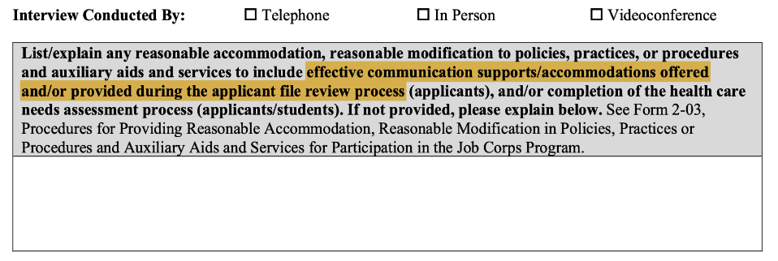
Documentation of Communication Accommodations
Change #1
The first item is not numbered. It is a box that must be completed to document any communication supports or accommodations that were offered or provided during the AFR process.
DO NOT LEAVE THIS BOX BLANK!
Notes:
First, you check one of the boxes to indicate how the interview was conducted – by phone, in person, or via video conference
The first box on both the HCNA and DTA is not numbered. It must be completed to document any communication supports or accommodations (RA/RM/AAS) that were offered or provided during the AFR process or why they were not provided. DO NOT LEAVE THIS BOX BLANK.
.

Slide 43
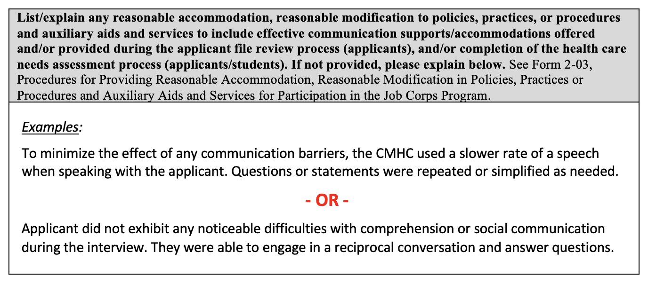
HCNA – Communication Accommodations Box Example
Notes:
For your future reference, here is an example with a statement where the applicant needed communication accommodations and a statement where the applicant did not need communication accommodations. This is also on the example of a completed HCNA available to you.

Slide 44
HCNA Question 1A
Summarize the Clinical Information that forms the basis for your recommendation of denial.
4 Sources of Clinical Information:
ETA 653 Job Corps Health Questionnaire items
Applicant File Review Summary
Chronic Care Management Plan (CCMP) Provider Form
Applicant Interview Summary
Notes:
The HCNA can now be used for applicants and students. We will focus on it’s use for applicants. Question 1A is the question applicants.
For those of you familiar with old version, there is no longer a question that asks about the factors that triggered that review.
Question 1A is where you summarize all the information in the file and the applicant interview that serves as the basis for your recommendation of denial. There are 4 sources of clinical information that are summarized in Question 1A
the ETA 653 Job Corps Health Questionnaire
the summary of your review of all the applicant’s records
the summary of the content of the Chronic Care Management Plan or CCMP, if any
and the summary of your applicant interview.
In many cases, you will not have all 4 pieces of information. Some files will not include health/mental health or disability documents. Some files will not include CCMPs, particularly if the applicant is not currently receiving treatment from any providers. In the cases where there are no records or CCMPs, your applicant interview summary needs to be particularly strong.

Slide 45
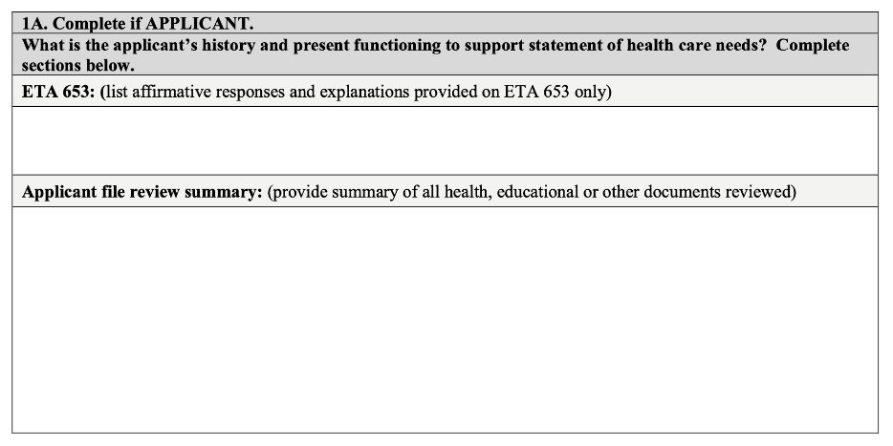
HCNA Question 1A
Notes:
Here is the screenshot of the first part of Question 1A that shows where to summarize the ETA 653 and your record review. For each section, there are instructions listed on the form.

Slide 46

Question 1A: ETA 653 Health Questionnaire
Just list the items as they are with or without the actual question #.
Do include information from the Admissions comments section in parentheses after the item (if significant additional information is provided).
Do NOT add to or embellish the items in any way, such as including information from the records.
Notes:
The ETA 653 subsection is the easiest to complete. All you need to do is list ALL the items that the applicant endorsed (marked “yes”) on the ETA 653. In the past, only the items relevant to mental health were endorsed. Now because so many files require review by more than one center clinician, ALL items need to be listed.
When completing the ETA 653 section, keep it simple. Just list the items as they are with or without the question number.
Do include information from Admissions comments in parentheses after the item (if significant additional information is provided).
Do NOT add to or embellish the items in any way, such as including information from the records.

Slide 47
ETA 653 Example
1A. Complete if APPLICANT.
What is the applicant’s history and present functioning to support statement of health care needs? Complete sections below.
ETA 653: (list affirmative responses and explanations provided on ETA 653 only)
8b. Taking prescription(s) (AC comments: Zyprexa 2.5 mg twice daily, hydroxyzine 50 mg as needed every 6 hours, trazodone 100 mg at bedtime) 8k. Received counseling/treatment for mental health (sees counselor “Jackie” at Meridian Behavioral Health every 2-3 weeks) 9t. Attention Deficit/Hyperactivity Disorder (diagnosed in elementary school, does not take any medication) 9w. Anxiety or Trauma and Stress-Related Disorders (diagnosed during hospitalization in 2021, see records) 9cc. Bipolar Disorder (diagnosed during hospitalization in 2021, see records)
Just list the items as they are with AC comments as needed.
Notes:
Here is an example with the ETA 653 section completed for later reference.

Slide 48
Applicant File Review Summary aka “record review”
  Summarize all records relevant to the recommendation of denial including:
Medical records
Mental health records
School disability documents (IEP, 504 Plan, Behavior Intervention Plans, etc.)
Do NOT write “See enclosed.” You must summarize all relevant information without reference to any other documents.
Do NOT include information that belongs in other sections.
If a document was reviewed but did NOT contain information relevant to the recommendation for denial, list the document with a header and write a notation such as:
“No mental health information was found.” or
“Records only contained office visits for medical problems.”
Notes:
The Applicant File Review Summary (as known as the “record review). In this section, you provide a summary all records relevant to the recommendation of denial including
Medical/mental health records
School disability documents (IEP, 504 Plan, Behavior Intervention Plans, psychoeducational evaluations, etc.)
Memo from Admissions staff to Health and Wellness
Here are a couple common mistakes to avoid when completing this section:
Do not write “See enclosed.” You must summarize all relevant information in the File Review Summary itself. The HCNA must be able to stand on its own without reference to any other documents. Think of it this way: if an applicant wanted to appeal his/her denial, the HCNA is going to be the primary document used to defend the recommendation of denial.
Also, Do not include information that belongs in other sections. Only the summary of your records review should be included here. Do not include information from the CCMP, the clinical interview, or the DAP meeting. There are other specific places where those pieces of information belong.
If a document was reviewed but did NOT contain information relevant to the recommendation for denial, list the document with a header and write a notation such as:
“No mental health information was found.” or
“Records only contained office visits for medical problems.”

Slide 49
Recommendations for Summarizing Records
Use bullets to summarize information. Create a header for each document with dates, type of document, and name of the facility/provider. List documents in reverse chronological order (most recent document first). For medical/mental health records, include: Significant history (usually in the ““Presenting Problem,” “Chief Complaint,” or “History of Present Illness (HPI)” section) Diagnoses Current medications and adherence Hospitalizations/self-harm behaviors Assessment/Plan (follow-up, medication changes, referrals) | Don’t recreate entire medical records. Summarize the most relevant information only. Don’t write “See enclosed.” All relevant information must be summarized on the form. Don’t include any information about CCMP(s). There is a separate section for CCMPs. Detailed summaries are generally not needed for records older than 2 years General summaries are sufficient for records older than 2 years.
Notes:
Here are some recommendations from the forthcoming AFR Guide about how to summarize records. In the interest of time, I am not going to read all of this, but I do want to highlight a couple of things
We recommend using bullets
Don’t recreate entire medical records. Summarize the most relevant information only
Detailed summarizes are generally not needed for records older than 2 years

Slide 50
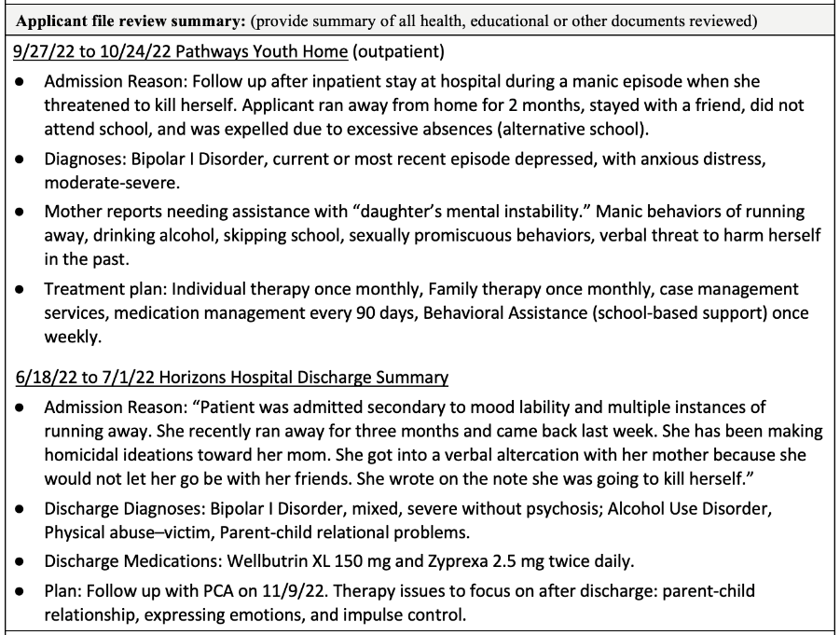
Applicant File Review Example
Notes:
Here is an example of an applicant file review section with our recommended formatting (bullets, header with dates and document description in chronological order). You want to highlight just the most relevant information from the documents. For example, reason for admission or reason for referral to outpatient, specific behaviors,- discharge plan

Slide 51
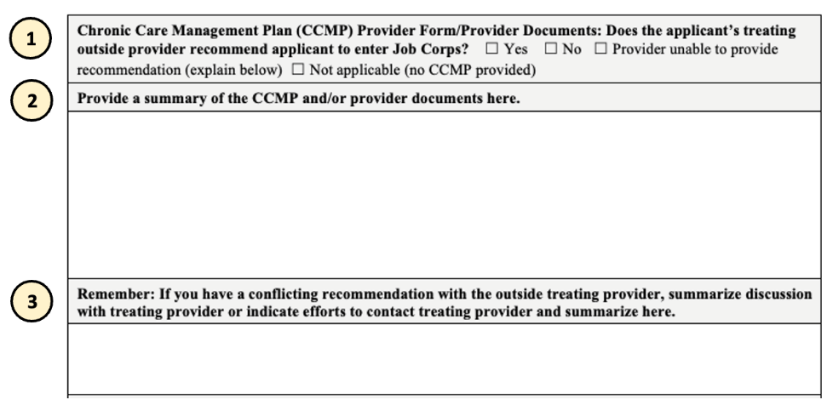
Question 1A: Chronic Care Management Plan (CCMP)
The CCMP section has 3 sections.
Notes:
The section for summarizing Chronic Care Management Plans or CCMPs has 3 sections. I like this change because it spells out the type of information needed for this section.
Let’s look at each section.

Slide 52
CCMP - Section 1
Chronic Care Management Plan (CCMP) Provider Form/Provider Documents: Does the applicant’s treating outside provider recommend applicant to enter Job Corps? ☐ Yes ☐ No ☐ Provider unable to provide recommendation (explain below) ☐ Not applicable (no CCMP provided)
Check one of the boxes to indicate whether the applicant’s provider recommended the applicant to enter Job Corps in the last question of the CCMP.
Yes = Provider recommended applicant
No = Provider did not recommend
Provider unable to provide recommendation (explain below)
Not applicable = No CCMP provided
A box must be checked even if there is no CCMP.
Notes:
For the first section, the instructions state: Does the applicant’s treating outside provider recommend applicant to enter Job Corps?
This question refers to the last question of every CCMP, which asks the provider to indicate whether they recommend the applicant for Job Corps. There are 4 checkboxes to choose from.
There are 4 choices:
Yes = Provider recommended applicant
No = Provider did not recommend
Provider unable to provide recommendation (explain below)
Not applicable = No CCMP provided
Note that a box must be checked even if there is no CCMP in the e-Folder.

Slide 53
CCMP – Section 1
Chronic Care Management Plan (CCMP) Provider Form/Provider Documents: Does the applicant’s treating outside provider recommend applicant to enter Job Corps? ☐ Yes ☐ No ☐ Provider unable to provide recommendation (explain below) ☐ Not applicable (no CCMP provided)
Provider unable to provide recommendation (explain below)
There is no response to the last question of the CCMP (left blank or omitted).
Provide writes in a response like “unsure.”
The provider sent a letter or memo rather than a CCMP.
For the explanation, write something like:
“Recommendation question was left blank.”
“Provider did not check a box and wrote in ‘unsure’.”
”Provider provided a letter than a CCMP.”
Notes:
You may be wondering when you would check the box for “provider unable to provide recommendation”?
There are at least 3 situations when you would check “provider unable to provide recommendation:”
There is no response to the last question (left blank or omitted).
Provide writes in a response like “unsure.”
The provider sent a letter or memo rather than a CCMP.
For the explanation, write something like:
“Recommendation question was left blank.”
“Provider did not check a box and wrote in ‘unsure’.”
”Provider provided a letter than a CCMP.”
A letter or memo from a provider should be treated like a CCMP.

Slide 54
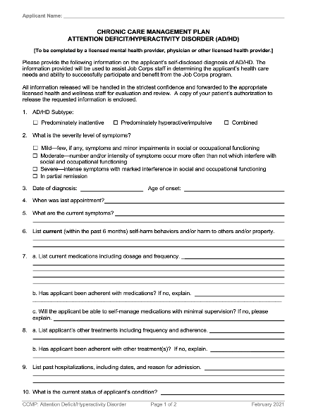
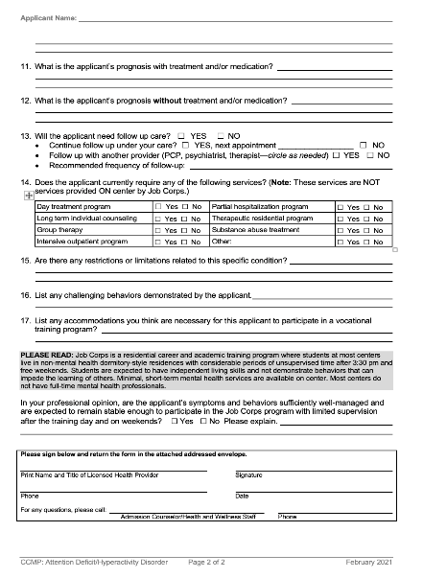
CCMP
Revised
February 2021
Notes:
Here is a screen shot of the CCMP for AD/HD. Updated versions of CCMP forms were released in February 2021. The last question on the bottom of the 2nd page, highlighted by the red box is the question about whether or not the provider recommends Job Corps. Specifically it states:
In your professional opinion, are the applicant’s symptoms and behaviors sufficiently well-managed and are expected to remain stable enough to participate in the Job Corps program with limited supervision after the training day and on weekends? ☐ Yes ☐ No Please explain.
Just above the question shaded in gray is a brief description of Job Corps to provide some context for the question because there are a lot of misconceptions among providers and others about what Job Corps is.

Slide 55
CCMP - Section 2
Provide a summary of the CCMP and/or provider documents here.
Provide a summary of the CCMP or another provider document
Use bullets to summarize the most relevant information in the CCMP
A letter from a provider should be treated the same as a CCMP.
Notes:
In the second section of the CCMP is where you provide a summary of CCMP/Provider Document
Use bullets to summarize the relevant information in the CCMP. I’ll show you an example in a moment.
What is an “other provider document?” A letter, memo or any other kind of narrative document from a provider should be treated the same as a CCMP.

Slide 56
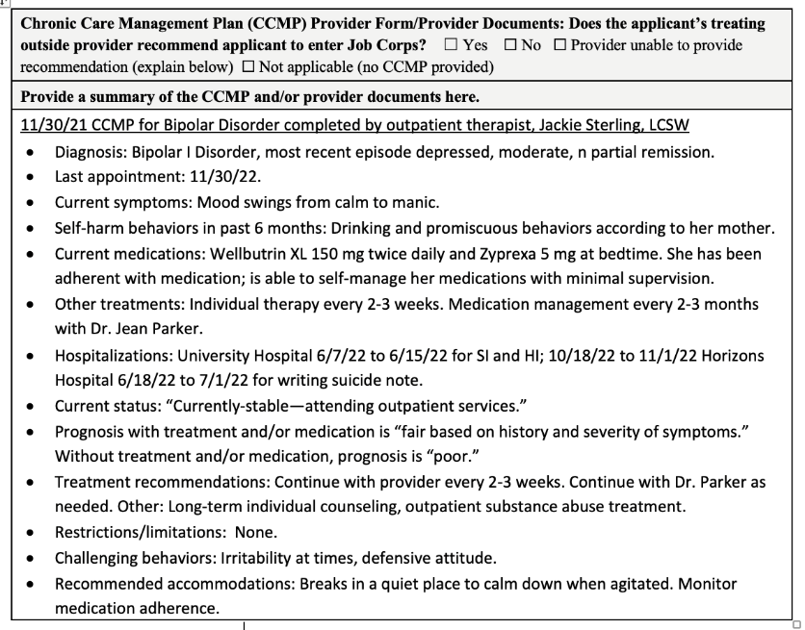
CCMP Summary Example
Notes:
Here’s an example of a CCMP Summary. It is easy to add the stems from the CCMP like “diagnosis,” “last appointment,” “current symptoms” and so on into a template so you don’t have to type in this information every time.

Slide 57
CCMP - Section 3
Remember: If you have a conflicting recommendation with the outside treating provider, summarize discussion with treating provider or indicate efforts to contact treating provider and summarize here.
If the provider recommends the applicant for Job Corps (marks the “yes” box for the last question of the CCMP), contacting the CCMP provider to discuss their recommendation is required.
Why? Because the provider’s recommendation differs from yours, and presumably the provider knows the applicant better than you as the CMHC (but, of course, the provider does not know Job Corps as well as you do).
You must make at least 2 efforts to contact provider.
Summarize your discussion with provider (including the date and name of the provider) OR document at least 2 efforts to reach provider.
Notes:
The third section of the CCMP section instructs, “If the provider recommends the applicant for Job Corps (marks the “yes” box for the last question of the CCMP), then contacting the CCMP provider to discuss their recommendation is required.
Why? Because the provider’s recommendation differs from yours, and presumably the provider knows the applicant better than you as the CMHC (but, of course, the provider does not know Job Corps as well as you do).
You must make at least 2 efforts to contact provider.
Summarize your discussion with provider (including the date and name of the provider) or document at least 2 efforts to reach provider.

Slide 58
CCMP Provider Contact Examples
Remember: If you have a conflicting recommendation with the outside treating provider, summarize discussion with treating provider or indicate efforts to contact treating provider and summarize here.
CMHC contacted the applicant’s provider (therapist) on 1/27/22. Provider indicated that applicant still has a “’I-can-do-whatever-I-want-to-do-when-I-want-to-do-it’ attitude.” Provider also stated that applicant is drinking alcohol to cope with life. The provider thought that the change in environment that Job Corps would provide would be good for the applicant because the applicant’s relationship with her mother is not good.
Remember: If you have a conflicting recommendation with the outside treating provider, summarize discussion with treating provider or indicate efforts to contact treating provider and summarize here.
CMHC attempted to contact the applicant’s provider. Messages were left for Dr. Chan on 11/17/22 at and on 11/20/22. Dr. Chan did not return any messages.”
Notes:
Here are 2 examples -- one in which the CMHC was able to reach the provider and have a conversation and one in which the CMHC documented 2 attempts to reach the provider.

Slide 59
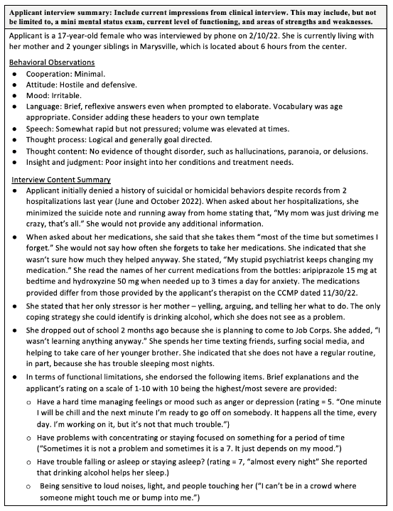
Applicant Interview Summary Example
Starts with demographic information: age, date of interview, current living situation.
Functional limitations, symptoms and behaviors were assessed using table from Sample Applicant Interview (table on page 13).
Notes:
The 4th and final section of Question 1A is the Applicant Interview Summary. The instructions state: Please include current impressions from clinical interview. This may include, but not be limited to, a mini mental status exam, current level of functioning, and areas of strengths and weaknesses.
This is an example of an Applicant Interview Summary for you to look closer at later. I will point out just a few things:
There are a couple of introductory sentences with basic demographic information. “Applicant is a 17-year-old female who was interviewed by phone on 2/10/22. She is currently living with her mother and 2 younger siblings in Marysville, which is located about 6 hours from the center.”
Headers are provided for the two sections – one for Behavioral Observations/MSE and another for Interview Content Summary to help organize the information, and bullets are used to summarize the information.
The table on page 13 of The Sample Applicant Interview document I mentioned at the beginning of the training provided table on page 13 that was used to assess functional limitations, symptoms and behaviors using a scale of 1 to 10 with 10 being the highest/most severe. It is strongly recommended that you use the table of page 13 if you don’t use anything else for 2 reasons:
Asking applicant specific questions tends to elicit more information than asking them about general symptoms associated with a condition. I have seen HCNAs where the applicant denied all symptoms, but then provided answers to these questions that indicated a high level of symptoms that were occurring frequently.
These questions were designed to help you answer question 2, which we will go to next.

Slide 60
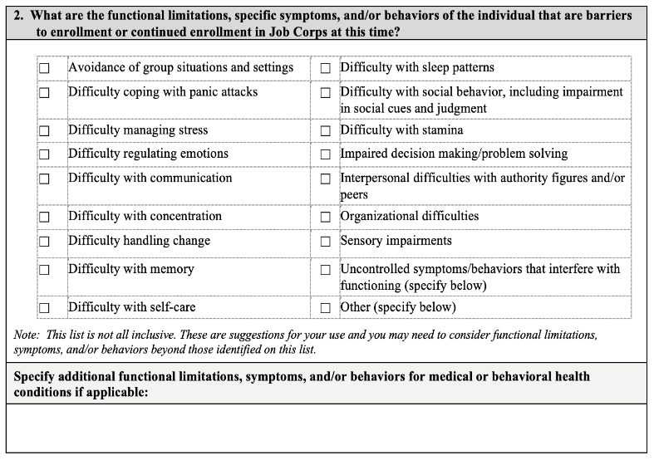
Question 2: Barriers to Enrollment
Functional limitations
Symptoms
Behaviors
that applicant is currently experiencing or exhibiting.
Support for each checkbox should be found in Question 1A.
Add symptoms and behaviors that don’t fit in categories above.
Notes:
Question 2 you check the boxes that correspond to functional limitations, symptoms or behaviors that the applicant is currently experiencing or exhibiting that are barriers to enrollment.
For each identified functional limitation, symptom, or behavior, there must be evidence to support it in Question 1A – which includes the clinical interview summary, a CCMP, a conversation with a provider or in and recent records (medical/mental health, IEP, 504 Plan, etc.).
Using information about behavior problems reported in an IEP that is 2 years old is not considered “recent.:
If the applicant reports symptoms or behaviors that do not fit into any of these categories provided, you should check the other box then write in the symptoms or behaviors in space provided below the table.

Slide 61
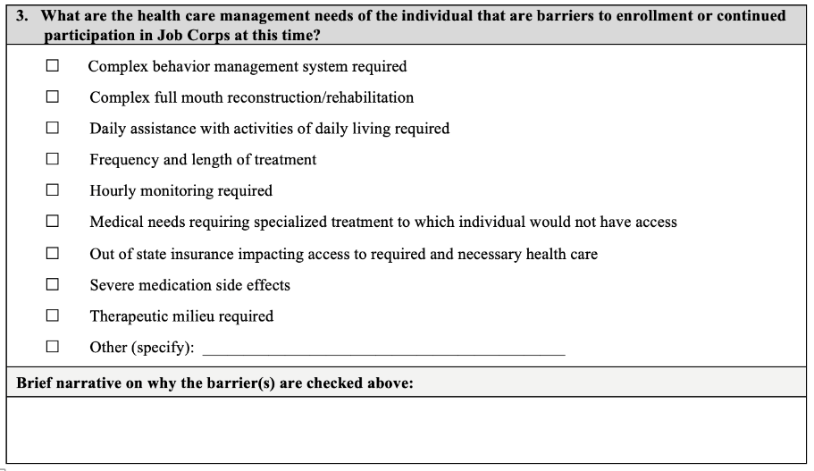
Question 3: Health Care Management Needs
In the Brief Narrative, describe the specific treatments you are recommending for the applicant (that correspond to the checkboxes you selected) and why.
Notes:
Question 3 asks, ”What are the health care management needs of the individual that are barriers to enrollment or continued participation in Job Corps at this time?”
This is the same list of health care management needs as on the previous version of Form 2-05. They are just formatted a little differently.
As before, you check the appropriate boxes that correspond to the general category of health care management needs.
The choices represent your recommendation(s) about the applicant’s current treatment needs. What treatment would you recommend for this applicant if they were your client in another setting?
The checkboxes are just general categories of treatment. For each checkbox, you will need to describe the treatment need more specifically in the Brief Narrative section. The next slide has a couple of examples of specific treatments that correspond with specific checkboxes.

Slide 62
Question 3: Brief Narrative
  Checkbox (as many as applicable)
  Narrative Examples
  Frequency and length of treatment
  Psychotherapy – Weekly? Biweekly?
  Medication mgmt. – monthly (more often due to nonadherence with symptoms)?
  or 3 months (until new regimen is stable)?
  Intensive outpatient program (IOP)
  Therapeutic milieu required
  Inpatient for symptom stabilization
  Partial Hospitalization Program (PHP)
  Residential Treatment
  Dual Diagnosis Program
  Complex behavior management system beyond Job Corps current system
  Hourly monitoring (elopement risk, unpredictable symptoms)
  Frequent redirection/prompting
  Interventions from Behavior Intervention Plan in IEP
Notes:
So here are some examples of a box you might check and what you might write in the brief narrative section. The most commonly checked box is “Frequency and length of treatment.” This choice makes sense given that many applicants have a chronic history of mental health problems.
In the narrative section, you explain what you mean by “frequency and length of treatment.” It could be that you would recommend psychotherapy – you don’t have to specify how often but you could. It could mean therapy plus continued medication management. It could mean intensive outpatient services
The same goes with ”therapeutic milieu required,” which is probably the 2nd most common box checked. A therapeutic milieu could refer to inpatient hospitalization for symptoms stabilization. It could mean a partial hospitalization program or residential treatment or a dual-diagnosis program. These are all just examples.
Do not put your recommendation of denial summary in this section – just focus on the health care needs.

Slide 63
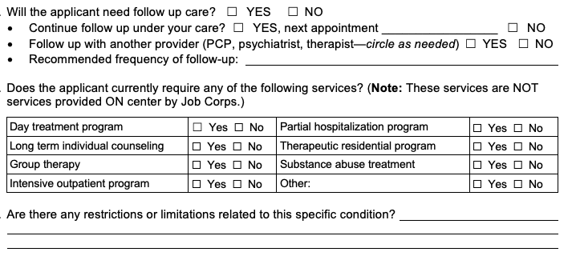
Question 3: Brief Narrative
The Brief Narrative section that should be completed using complete sentences rather than bullets.
Always include the CCMP provider’s recommendations for follow-up care and additional services
Include restrictions and limitations (if relevant).
CCMP Follow-Up Treatment Questions
Notes:
A few final tips about the Brief Narrative section:
It should be completed using complete sentences rather than bullets.
If there is a CCMP in the e-Folder, always include the provider’s recommendations for follow-up care and additional services. See blue arrow
Just below the treatment recommendations, there is a question about whether there are any restrictions and limitations related to the applicant’s conditions. Include these if relevant.
The screenshot shows the CCMP follow-up treatment questions and the question about any recommended restrictions/limitations.

Slide 64
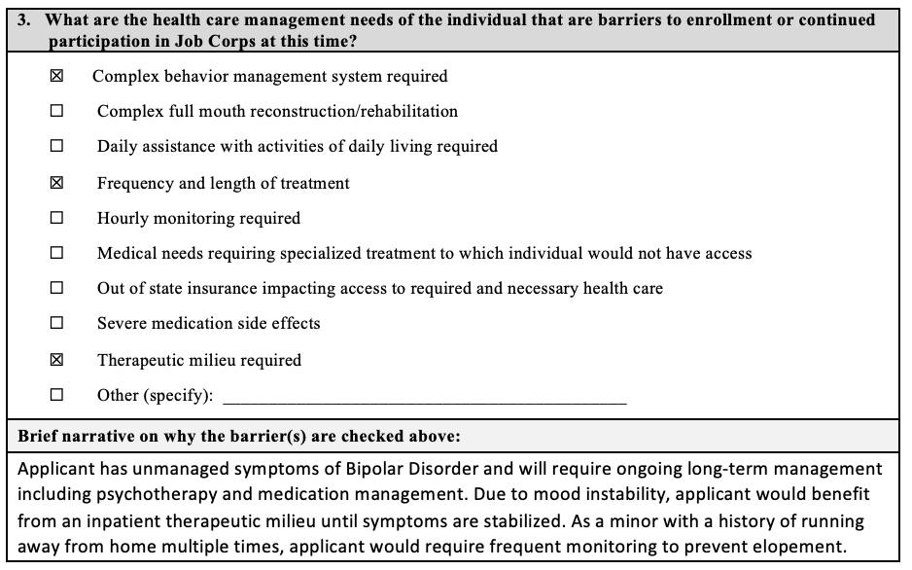
Question 3: Health Care Needs/Barriers Example
To determine treatment needs, consider:
Severity and chronicity of condition(s)
Treatment history: no treatment, poor response, poor or inconsistent adherence
Behavior Intervention Plan in IEP/Section 504 Plan
Notes:
Here is an example of question 3 for you to review .
Remember - The severity and chronicity of the conditions – those are good words to use in the narrative section, particularly in the case of serious mental illness such as schizophrenia or recurrent depression.
You may also want to consider the applicant’s treatment history: whether the applicant has had no treatment or a poor response to treatment or inconsistent adherence with current symptoms.
Finally, if the applicant has an IEP or Section 504 Plan that includes a Behavior Intervention Plan, consider which aspects of that plan may need to implemented in the Job Corps setting.

Slide 65
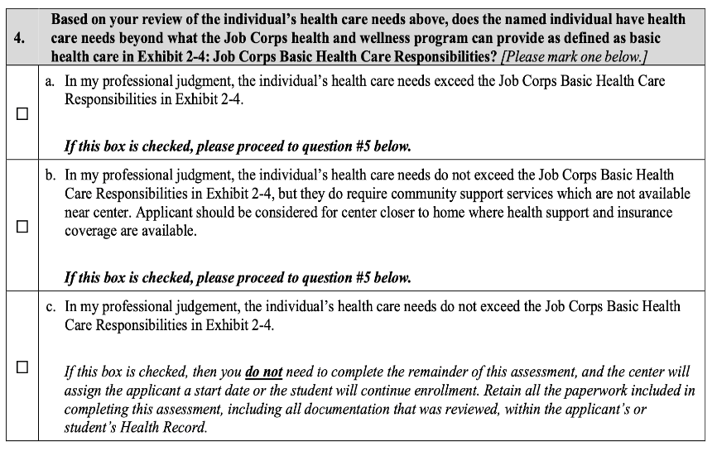
Change #2: Clinical recommendation is made BEFORE the DAP.
Question 4: Make Your Clinical Decision
If “b” is checked for alternate center, question 7 must also be completed.
Notes:
In Question 4, you indicate your recommendation based on your clinical assessment of the applicant’s health care needs. Unlike on the previous version of Form 2-05, the clinician makes their recommendation BEFORE rather than AFTER considering disability accommodations (RA/RM/AAS). This is the 2nd major change from the previous version.
For the HCNA, there are 3 choices:
The applicant’s health care needs exceed the Job Corps Basic Health Care Responsibilities in Exhibit 2-4 (first checkbox)
The applicant’s health care need do not exceed the Job Corps Basic Health Care Responsibilities in Exhibit 2-4 but they do require community support services whare are not available near center. This is the second checkbox and is referred to as the “alternate center recommendation”, or
The applicant’s health care needs do not exceed the Job Corps Basic Health Care Responsibilities in Exhibit 2-4 (third checkbox)
If “b” is checked for alternate center, question 7 must also be completed.

Slide 66
Question 5: Applicant’s Disability Status
5. | Consideration of Reasonable Accommodation, Reasonable Modification in Policies, Practices or Procedures, and Auxiliary Aids and Services
Is the applicant or student a person with a disability (a physical or mental impairment that substantially limits one or more of their major life activities)? If no, skip to #6 to recommend denial for an applicant or MSWR for a student. If no and recommending an alternate center for an applicant go to #7(a and c). If yes, then continue to Post-Health Care Needs Assessment Disability Accommodation Review. |  | Yes | ☐ | No | ☐
Notes:
Question 5 has a “Yes/No” checkbox to identify whether the applicant is an individual with a disability.
If “Yes,” proceed to Post-Health Care Needs Assessment Reasonable Accommodation Review.-If the applicant is an individual with a disability, then the DAP must take place to consider RM/RA/AAS that may reduce or remove the barriers to enrollment. The outcome of this process is documented in a new section called Post-Health Care Assessment Reasonable Accommodation Review
If “No,” the applicant is not an individual with a disability, and you skip the Post-Health Care Needs Assessment Reasonable Accommodation Review
.

Slide 67
Post Health Care Needs
Disability Accommodation Review
NEW SECTION
Notes:
Lets talk about this new Post HCN Disability Accommodation Review

Slide 68

Disability
Accommodation Process (DAP)
If an applicant is an individual with a disability, Job Corps must consider:
  reasonable accommodation (RA)
  reasonable modification (RM) in policies, practices, or procedures, and
  auxiliary aids and services (AAS) including effective communications
  that may reduce or remove the barriers to enrollment in the program.
RA/RM/AAS
68
Notes:
Disability Accommodations
Job Corps must consider disability to include equally effective communication that may reduce or remove the barriers to enrollment in the program. This is referred to as the Disability Accommodation Process or DAP. The acronym RA/RM/AAS refers to the 3 different types of disability accommodations listed on the slide. We will just use the term “disability accommodations” to refer to all 3.

Slide 69
Change #3: Greater role of the QHP (CMHC) in the DAP
DAP – 2 Step Process
The Disability Accommodation Process (DAP) is a 2-step process to identify and discuss possible RA/RM/AAS that may remove of reduce the direct threat or health care barriers to enrollment.
Step 1
Step 2
The QHP, in collaboration with the Disability Coordinator (DC) must identify possible RA/RM/AAS that may reduce or remove the barriers to enrollment
QHP or DC engage in an interactive Discussion of the RA/RM/AAS and document whether the applicant accepted or declined each of the offered supports.
Notes:
The Disability Accommodation Process (DAP) is a 2-step process to identify and discuss possible RA/RM/AAS that may remove or reduce the direct threat to others or health care barriers to enrollment
In Step 1, the QHP, in collaboration with the Disability Coordinator (DC)- together must identify possible RA/RM/AAS that may reduce or remove the barriers to enrollment.
In Step 2, the QHP or DC engage in an interactive Discussion with the applicant on the RA/RM/AAS identified and document whether the applicant accepted or declined each of the offered supports.

Slide 70

Preparing for the DAP Discussion
Sources of Potential Accommodations
Functional Limitations
Identified in HCNA Question #2
School Disability documents for previous accommodations
IEP, 504 Plan, Behavior Intervention Plan, psychological evaluations
    Only discuss accommodations relevant to the symptoms, behaviors and functional limitations that are the basis of the HCNA.
CCMP(s) – look for:
Restrictions/Limitations: CCMP notes that noise and crowded spaces can trigger panic attacks
Accommodations: Last question on every CCMP
RA/RM that you propose
What has worked for students with disabilities on your center
Research on the Job Corps Disability website or the Job Accommodation Network at https://askjan.org/
Consultation with the RDIC
Applicant mentions/requests
Single dorm room or emotional support animal due to anxiety
Notes:
In preparation for the CMHC discussion with DC to identify potential accommodations, several sources outside of the HCNA should be considered as outlined on this slide
Check the CCMP
Any accommodations that the applicant mentions or requests
School disability documents
Any accommodations that you propose or identify based on consultation with your regional disability coordinator
When you are considering all these sources, it is important to remember that you only need to discuss accommodations relevant to the symptoms, behaviors and functional limitations that are the basis of the HCNA. So academic accommodations in an IEP such as extended time on tests do not need to be discussed because they are not relevant to the reason you are making a recommendation of denial. What does this look like on the form? There is a new and improved version of the table of functional limitations and possible accommodations, and I think you will find the changes very helpful..

Slide 71
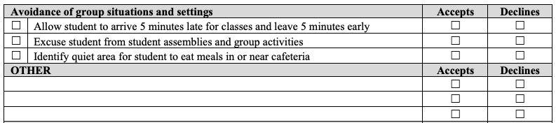
Completing the DAP Table
2
1
Add other suggestions for this functional limitation here.
Step 1
Step 2
For each functional limitation checked in Question 2, you identify the RA/RM/AAS to be discussed by checking the box(es) in the first column of the left of the table and/or adding suggestions in the Other section.
After discussing the RA/RM/AAS, documenting whether the applicant accepted or declined each of the offered supports is done by checking either “Accepts” or “Declines” in the columns on the right side of the table.
Notes:
Here is an example of the first functional limitation on the Post assessment – avoidance of group situation and settings.
Step 1: For each functional limitation identified in Question 2 of the HCNA, identify the disability accommodations to be discussed by you as the CMHC and the DC and check the box(es) in the first column of the left of the table and/or adding suggestions in the Other section located below the list of suggested accommodations. Having checkboxes makes it much clearer which accommodations were discussed with the applicant and which ones were not.
After you and the DC discuss the disability accommodations, then an interactive interview is held with the applicant and then whether the applicant accepted or declined each of the offered supports is done by checking either “Accepts” or “Declines” in the columns on the right side of the table. The column headings “accepts” and “declines” are much clearer than the “yes” and “no” on the previous version, which caused a lot of confusion and mistakes.

Slide 72
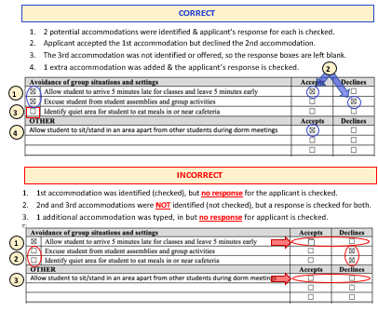
Avoid Common Mistakes
Be sure to consider RA/RM/AAS for every functional limitation identified in Question 2.
Do not consider RA/RM/AAS for functional limitations that were not identified in Question 2.
If a box is checked on the left, then a box must be checked on the right.
If an RA/RM/AAS is written in the OTHER section, a box must be checked on the right.
Document whether the applicant accepts, declines, or if there is agreement to modify a proposed RA or RM.
Notes:
Even with the clearer format of the table, there are some common mistakes to avoid. This screenshot shows examples in the AFR Guide about the correct and incorrect ways to complete the table. There are basically at least 4 different kinds of mistakes that can be made. I am not going to review them all here. The information is the on the slide for later review and is explained in the AFR Guide.

Slide 73
DAP – Unable to Identify RA/RM/AAS
Complete this section if the qualified health professional, in collaboration with the Disability Coordinator, has been unable to identify any RA/RM/AAS appropriate to support this applicant/student to sufficiently reduce or remove the barriers to enrollment or to remaining in the Job Corps program. Provide explanation/justification below. For example, the applicant has a current and/or extensive history of aggression and violence that is escalating in frequency and severity.
Fairly rare cases: the symptoms or behaviors associated with a condition are so frequent or severe that you, as the QHP, in collaboration with the DC, are unable to identify any disability accommodations appropriate to support the applicant. If so, an explanation must be provided in this box.
This may be true for all the symptoms/behaviors identified in Question 2 or for only one or more of them. In either case, an explanation must be provided.
Notes:
As in the previous version, there are spaces to document 2 sets of situations that may come up during the DAP. Each situation now has a separate box to document these situations.
There will be some fairly rare cases where the symptoms or behaviors associated with a condition are so frequent or severe that you as the QHP, in collaboration with the DC, are unable to identify any disability accommodations appropriate to support the applicant / to sufficiently reduce or remove the barriers to enrollment. If so, an explanation must be provided in this box.
An example is provided in the box: “The applicant has a current and/or extensive history of aggression and violence that is escalating in frequency and severity..”

Slide 74
DAP – Special Considerations & Applicant Input
Summarize any special considerations and findings as well as the applicant’s or student’s input related to RA/RM/AAS ONLY. For example, if the applicant/student does not wish to discuss RA/RM/AAS, document that information below.
Special Considerations: Used to document specific accommodation requests by the applicant such as a single dorm room or an emotional support animal.
Applicant’s Input: Used to document situations such as unusual responses such as when an applicant does not want or is unable to discuss accommodations or when applicant refuses all supports offered
Notes:
This box is used to document special Considerations and Applicant Input:
Special Considerations would include specific accommodation requests by the applicant such as a single dorm room or an emotional support animal – such as whether a single room was offered or , if single rooms are not available, whether the applicant was willing to accept a room with 2 roommates.
In terms of applicant’s input: if the applicant does not want or is unable to discuss accommodations or if an applicant refuses all supports offered, those types of unusual responses should be documented here.

Slide 75
DAP - Applicant Input Example
Summarize any special considerations and findings as well as the applicant’s or student’s input related to RA/RM/AAS ONLY. For example, if the applicant/student does not wish to discuss RA/RM/AAS, document that information below.
When the DC called the applicant, they did not want to participate in discussion about accommodations. Applicant was short and hostile on the phone, stating, “I’ve only got a few minutes for this.” Applicant refused all accommodations offered.
Notes:
Here is an example of documenting applicant input when the applicant refused all accommodations offered. As you can see, it is very short and sweet. The explanation does not need to be extensive.

Slide 76
Question 6: Clinical and Disability Accommodation Process (DAP) Summary
8. | Clinical and Disability Accommodation Process (DAP) Summary
a. | Clinical Summary: Summarize information from the file, clinical interview and/or discussions with providers to support the direct threat assessment.
b. | Disability Accommodation Process (DAP) Summary: If RA/RM/AAS were identified above, include a detailed explanation for why these supports would not sufficiently reduce the risk to allow for enrollment.
Change #4
Notes:
Question 6 is the final question unless you are recommending an alternate center. Question 6 requires 2 brief summaries: a Clinical Summary and a DAP Summary.
The clinical summary should provide a general recap of the information used to support your assessment that the applicant currently has health care needs that exceed what can be provided at Job Corps. It should be no longer than a paragraph or two. There is no need to summarize all the clinical information from Question 1A. You can think of the clinical summary as the “big picture” or the “bottom line” about why you are recommending denial of enrollment for the applicant.
The DAP summary provides a statement explaining why the disability accommodations are not sufficient to reduce or remove the barriers to enrollment. It, too, should be very general without getting into specifics.

Slide 77
Clinical Summary Example
6. | Clinical and Disability Accommodation Process (DAP) Summary
Clinical Summary: Summarize information from the file, clinical interview and/or discussions with providers to support the health care needs assessment.
The applicant currently has a number of unmanaged symptoms including mood instability, impulsivity, risky behaviors, irritability, and running away from home. Applicant has had two psychiatric hospitalizations in the past year as well as outpatient treatment without significant improvement in symptoms. This is a safety concern. During the interview, applicant minimized recent suicidal and homicidal behaviors. Applicant will require long-term ongoing mental health treatment for serious mental illness. Applicant has poor insight into their condition and refused all accommodations that would help to mitigate the barriers to enrollment.
Notes:
Here is an example of a Clinical Summary. In the chat box there is a link to a sample of this new section with clinical and DAP Summaries for DTA and HCNA..

Slide 78
DAP Summary Example
Notes:
Here is an example of a DAP Summary. This can be a brief narrative or a bullet point summary of why the disability accommodations/supports were not sufficient to reduce barriers to enrollment. There will be several examples of this new summary section in the AFR Guide to be available at the end of the month.

Slide 79
Question 7: Recommend Alternate Center
7. | APPLICANT ONLY- IF RECOMMENDING AN ALTERNATE CENTER (if selected “b” in item 4)
Clinical and Disability Accommodation Process (DAP) Summary
Clinical Summary: Summarize information from the file, clinical interview and/or discussions with providers to support the health care needs assessment.
Disability Accommodation Process (DAP) Summary: If RA/RM/AAS were identified above, include a detailed explanation for why these supports would NOT sufficiently reduce the barriers to allow for enrollment to YOUR center.
Document efforts to secure community support near center in the space below. (Include name of organizations/facilities and specific individuals contacted and why access is not available near center.)
Notes:
In order to make an alternative center recommendation as part of a HCNA, you must document why the health care needs of the applicant/student cannot be met in the community where your center is located including information on resources contacted.

Slide 80
Signature Box with Attestation
Change #5
If revisions are required during the Regional Review process, the updated version must also be signed.
Notes:
The last box on the both the DTA and the HCNA is a signature box that must be signed by the QHP(s) who completed the assessment and recommended denial. If more than one QHP completed and assessment, all QHPs who are recommending denial must sign the assessment.
In the new signature section, the QHP(s) attest to having the necessary licensure, training, and clinical experience to complete the assessment. This attestation is the 5th primary change to the AFR process and forms.

Slide 81
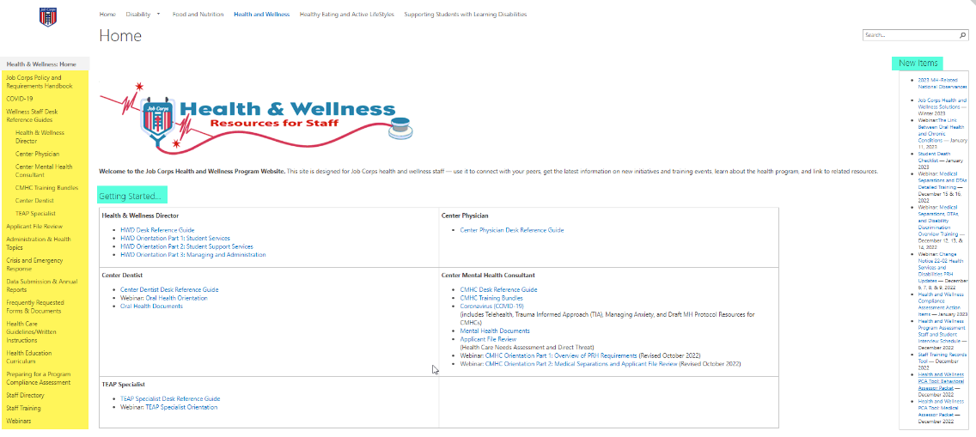
Job Corps Health and Wellness Website https://supportservices.jobcorps.gov/health/Pages/default.aspx
Notes:
Whew- we made it…2 important websites where you will find new tools and resources to help you prepare for using the updated Forms 2-04 and 2-05/ The Job Corps Health and Wellness website . Always look on the right hand side under new items. If you go to the website after this webinar- you will find the slides for this presentation, all the documents we provided links to in the chat box today and in a couple of weeks the recorded version of this webinar and additional tools will be posted.

Slide 82
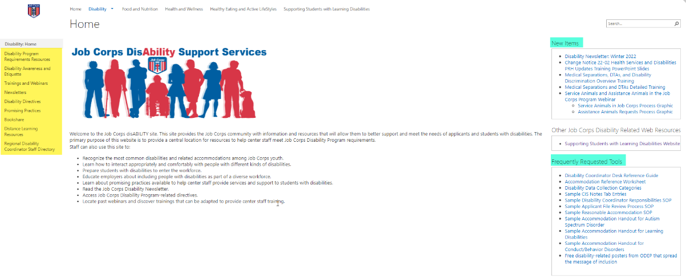
Job Corps Disability Support Services Website https://supportservices.jobcorps.gov/disability/Pages/default.aspx
Notes:
The same for the Job Corps disability support website. You will find trainings, resources and tools listed under new items.

Slide 83


Thank you for attending.
Notes:
We have come to the end of our whirlwind tour of the AFR process, highlights of the changes to the forms and an overview of the Health Care Needs Assessment. Thank you for attending. We will put together a FAQ document of all questions we receive from this training. Know that your regional health and disability coordinators are available to assist you – reach out so we can help you understand the changes.

