Slide 1
Preventing Medication Errors Jason Young Nurse assessor

Slide 2
Objectives
The Participant will be able to:
Verbalize the 5+ Rights of Medication Administration
Identify 3 Effects of Medication Errors
Identify 3 Ways to Administer Medications Safely

Slide 3
PRH Chapter 2
2.3 R14 Medication Management
a. Centers must comply with all state and federal regulations regarding prescribed non-controlled medications, prescribed controlled substances, and over-the-counter medications.
b. Centers must follow medication management guidelines as specified in Appendix 203.

Slide 4
Appendix 203 Medication Errors
Ensure that all prescribed non-controlled medications are given to the correct student in the right dose and by the proper route. In cases of a medication error, the center medical provider/center dentist/center psychiatrist (if applicable), HWM, and center director must be notified. Document in the SHR. All medication errors will be immediately reported to the Regional Office and the regional nurse specialist.
Any miscounts or missing medications identified during the inventory shall be immediately reported to the Regional Office and regional nurse specialist by the Center Director.
Follow Centers Approved SOPs/COPs
Notes:
Appendix 203
Prescribed Non-Control #5 and
Prescribed Control #7

Slide 5
5+ Rights of Medication Administration
Right Patient (Student)
Right Medication
Right Route
Right Dose
Right Time
DOCUMENT, DOCUMENT, DOCUMENT
This Photo by Unknown Author is licensed under CC BY-NC-ND
Notes:
The SHR is a legal document. The SHR can be subpoenaed by an attorney

Slide 6
Case Example One
Nathaniel L. Green is a 20-year-old,
DOB: 1/21/2000 DOE 2/10/2020
Allergies: Penicillin HX: HTN on medications.
Nathan L. Green is a 21-year-old
DOB: 2/1/1999 DOE: 10/1/2019
Allergies NKMA Refer to CMHC for anxiety
**You alert your staff that there are 2 students with similar names.
Notes:
Over the next few slides we will go over what can be done to help prevent medication errors
Make sure to alert your CMHC, Dentist, RDH, physician of the 2 students with similar names

Slide 7
Case Example (continued)
Nathaniel Green saw the center physician today for his entrance physical and requested a reorder of his Lisinopril.
Nathan L. Green saw the center physician today for Bronchitis and ear infection. Treatment: Amoxicillin. And a referral to the CMHC for anxiety.

Slide 8
Steps of Safe Medication Administration
1. Complete prescription
2. Accurate transcription
3. Correct administration

Slide 9
1) Complete Prescription
Nurses play important role in preventing errors at the prescription step
Practitioner who administers drug shares liability for injury
Even if medical order was incorrect
Protect your patient and your license always verify safety of drug order by checking reliable drug reference
Notes:
Make sure you notate all physician orders with date, time and signature of person taking the order off.

Slide 10
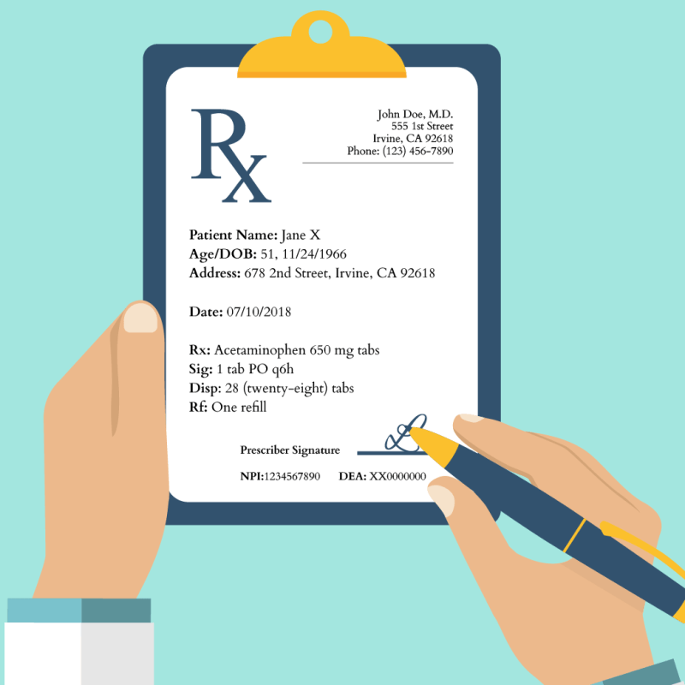
Doctors Order
Important to NOTE there are 2 students with similar names and 1 has a PCN allergy.
Ensure all referrals are properly notated and arranged timely.
Make sure notating correct SHR and 1 student has an allergy.
Physician Order on Nathaniel L Green Reads
Amoxicillin 500 mg TID for 7 days

Slide 11
What is your Role
When taking off the order you note Nathaniel L Green has a PCN Allergy. What should you do?
A. Call the doctor and remind them Nathaniel is a new student and has a PCN allergy.
B. Give the medication you are sure the doctor knew which patient student he wrote the order for.
C. Remind the physician both Nathaniel L Green was seen for entrance physical and Nathan L Greene for bronchitis, was the order meant for Nathan L. Greene?
You are sure the physician put the order in the wrong SHR and just switch the orders.
Notes:
Answer C, but A can also be correct.

Slide 12
2) Accurate Transcription
In order to prevent medication errors, do not use abbreviations, acronyms, symbols. For example DO NOT USE the following:
U (unit)
IU (international unit)
Q.D., QD, q.d., or qd (daily)
Q.O.D., QOD, q.o.d., or qod (every other day)
Trailing zero (X.0 mg)
Lack of leading zero (.X mg)
MS or MSO4 (morphine sulfate)
MgSO4 (magnesium sulfate)

Slide 13
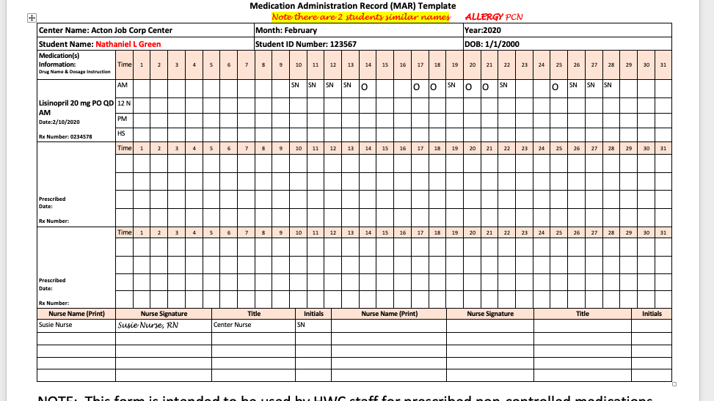
Notes:
SN = Susie Nurse
O = Dose not given
MARs should be filled out consistently in the same format by all of the wellness staff administering medications.

Slide 14
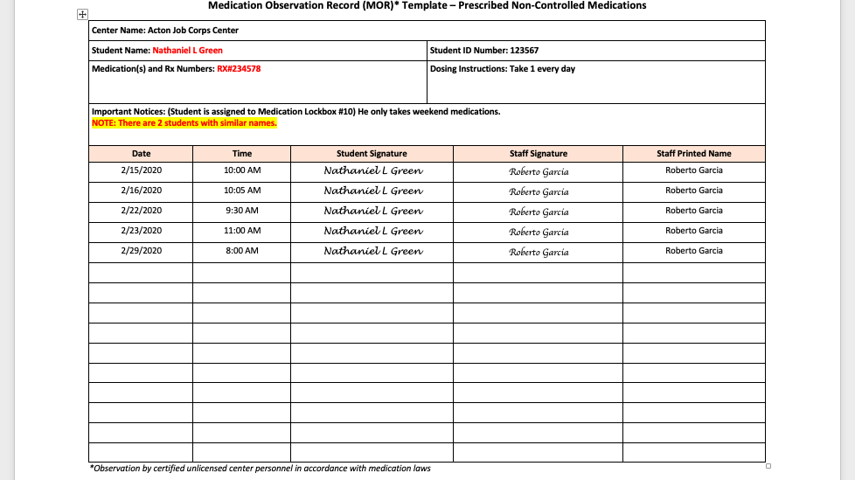
Notes:
Residential staff need to be properly trained in properly completing the MOR. The MOR should be returned to the wellness center at least weekly or more often if requested by wellness.
The MOR is a Legal Document

Slide 15
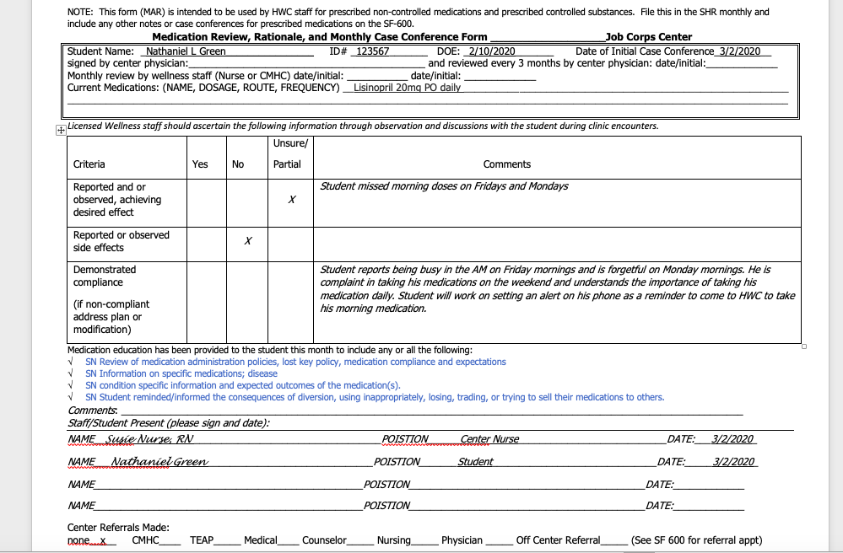
Notes:
Medication Case Management is required at least monthly and should be documented.

Slide 16
Preventing Errors with Verbal Orders
Write or enter verbal or telephone order into patient’s medical record
Read order back to prescriber to ensure clarity
Receive confirmation that order is correct
Notes:
Make sure to document correctly all verbal orders.

Slide 17
7 Parts to a Verbal Order
When receiving a verbal order, check to see if order is complete by counting the 7 parts of the order:
Patient’s name
Date and time of order
Name of medication
Dosage of medication
Route of medication
Frequency or administration schedule
Prescriber’s name and licensure

Slide 18
Which one is complete?
Option 1
Nathan L. Green
2/10/2020 1 PM
Amoxicillin 500 Mg three times a day for 7 days for Bronchitis
John Doe, MD/Susie Nurse RN
Option 2
N Green
2/10/20 1 pm
Amox 500 mg 3x/D x7
JD, MD/SN RN
Notes:
Option 1 has all the components
Student Name
Date and time
Name of drug, dosage, route, frequency
Complete legible Physician signature

Slide 19
3) Correct Administration
ALWAYS USE THE 5 RIGHTS OF MEDICATION ADMINISTRATION
The 5 rights was created to help prevent medication errors
It helps to protect the student and you
THERE IS NO EXCUSE TO NOT USE THE 5 CHECKS
There is no excuse not to document at the time.

Slide 20
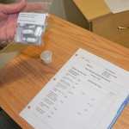
Right Drug
ALWAYS use the 3 checks system to ensure right drug is being administered.
This gives you 3 opportunities to ensure right medication is going to be administered
Check medication label against MAR three times:
1. On first contact with drug
2. Prior to measuring Pouring, counting, or withdrawing
3. After preparing drug just prior to administration

Slide 21
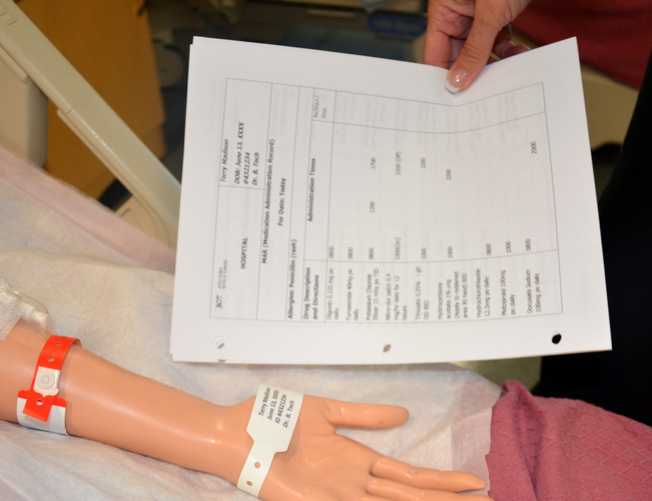
Right Patient/Student
Correctly identify patient using two identifiers prior to medication administration
Compare students ID with label on medication bottle
Ask patient to state name and birthdate
Compare picture to student
This Photo by Unknown author is licensed under CC BY.

Slide 22
Preventing Errors
Be aware of distractions
Do not multitask during administration
Be knowledgeable about drug’s actions, indications, and contraindications

Slide 23
Back to Case Example
At 3:45 PM Nathan L Green comes to pick up his Rx he does not have his ID
You ask him his name he says Nathan L Green
You give him a packet for Nathaniel Green his packet of medications and ask if he has any questions.
At 4:00 PM Nathaniel Green comes to pick up his medication he shows you his ID
You give him a packet of medication for Nathan L Green – he reminds you his name is Nathaniel Green.
Notes:
Were the 5 Rights observed?
What should you do now??

Slide 24
Medication Errors
Both students were given the wrong medications
Nathan was Lisinopril and has a normal blood pressure and Nathaniel was given Amoxicillin and he has a PCN allergy.
What should you do:
Try to locate Nathan to inform him of the medication mix up
Give Nathaniel his Lisinopril
Let the center director know about the medication error (per Appendix 203)
Write an SIR and work on a corrective action plan so this does not happen again.
Report immediately to RO and Nurse Specialist

Slide 25
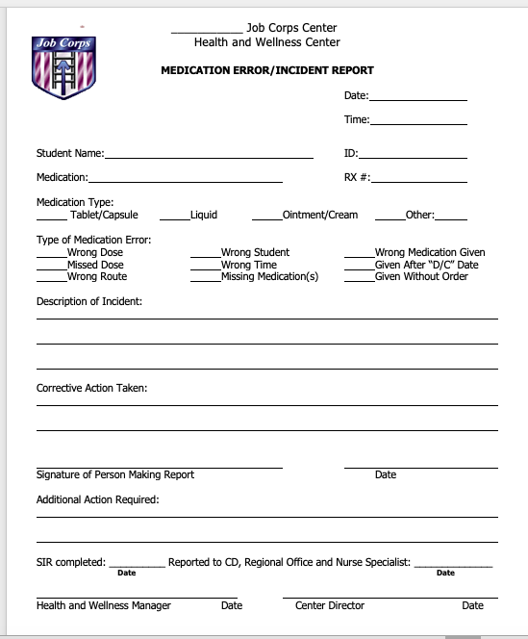
Notes:
Here is a sample Medication Error form to complete when there is a medication error. This can be found on the Health and Wellness website

Slide 26
Effects of Medication Errors
Effects:
Hospitalization or Increased length of stay (hospital setting)
Increased cost
Patient disability
Death
Harm to nurse’s personal and professional status, confidence, and practice
Notes:
Nathaniel is allergic to PCN
Nathan does not regularly take any medications and has a normal BP
In both cases there could be harm to the students.

Slide 27
Right Dose
Carefully read and clarify drug orders
Recheck labels
Have two nurses double-check potent medications
**ALWAYS have 2 nurses verify dose prior to administering controlled medications
Consult drug references
Conduct accurate dosage calculations (double check calculations)

Slide 28
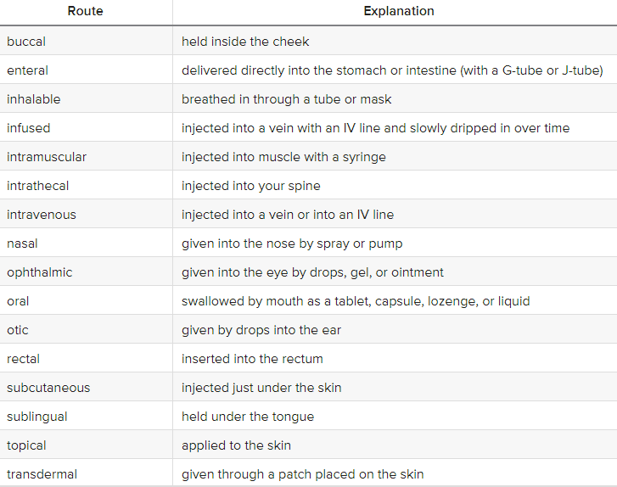
Right Route
Check prescribed Route:

Slide 29
Right Route
Change or clarify
May need to change or clarify forms or routes of a prescription for safe medication administration
Consult
Always consult a Drug Reference Guide
Guess
Never guess, when in doubt always ask for clarification!
Change
Only prescriber can change route

Slide 30
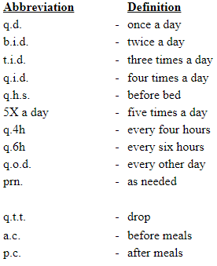
Right Time
Order should always include a frequency of administration

Slide 31
Documentation
Document as soon as possible after administration
Omitting documentation can result in over- or under-medication
Reminder the SHR is a Legal Document
Notes:
SHR is a legal document and if you do not document, it was not done.

Slide 32
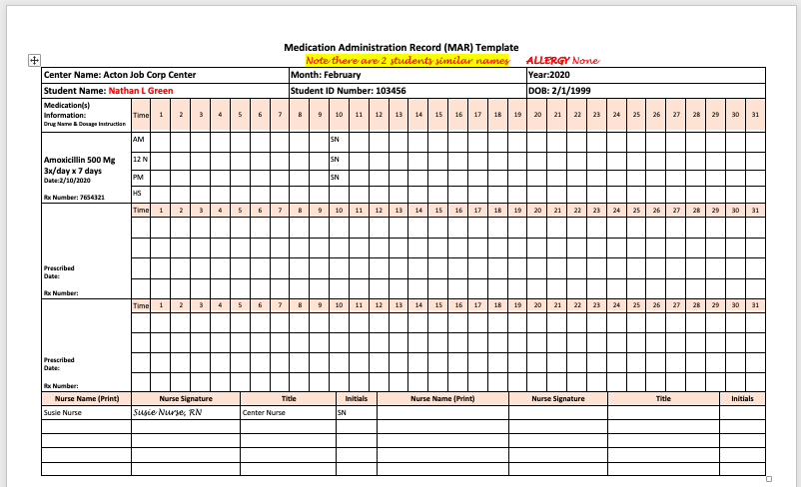
Notes:
Based on the information from the MAR and the MOR can you tell how many doses were given to Nathan?
Is this good documentation?

Slide 33
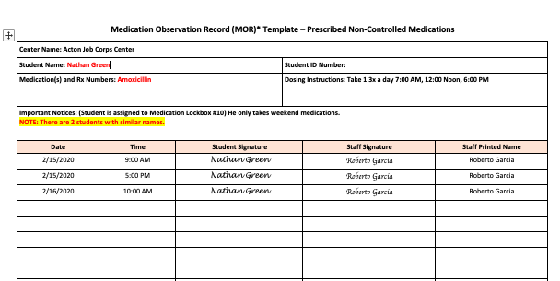
Notes:
Based on the past 2 slides is it clear if Nathan was provided his medication as ordered?
Did Nathan complete the course of Antibiotics?

Slide 34
Case Example Two
Roberta Marsh is a 20 year old female with Sickle Cell Disease. Roberta was hospitalized 4 months ago for a sickle cell crisis. She takes 1-2 Norco 7.5mg/500 every 6 hours as needed for pain control. When she has a crisis it is usually in the evening or at night when wellness is closed.
You explain the medication policy to Roberta and assign her a lockbox.

Slide 35
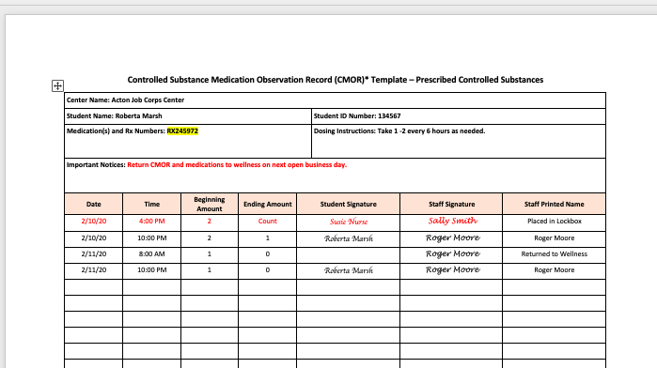

Slide 36
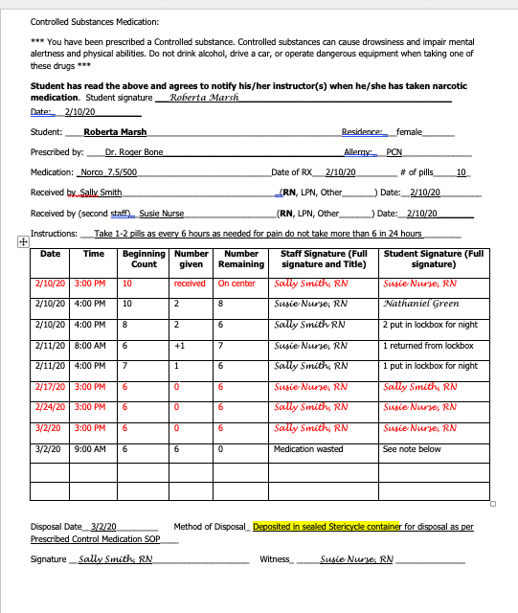
Notes:
Here is an example of a well documented controlled substance log. Red font is when the nurses did the weekly count.

Slide 37
Common Concerns

Slide 38
Common Concern 1
Documentation of a monthly case conference with the HWM (or designee) and the prescribing health professional was not found in the SHRs
Notes:
Ideally the meeting should be in person together, however if not able to be in person the case management form should be documented and placed in the SHR. THis allows each provider to participate and gives a clear and current picture of the student.

Slide 39
What the PRH says:
PRH-2: 2.3, R14(b); Appendix 203-Prescribed Non-Controlled Medications #2 & Prescribed Controlled Substances #4
Confirm the rationale for long-term prescribed medications at least monthly with case conferences between the HWM (or designee) and the CP/NP/PA
Must be documented in the SHR
Must include student adherence to the medication prescribed
Must include any side effects the student reports
Document-is the medication providing to the student the desired effect.

Slide 40
Concern 2
Medication Administration Records (MARs) are not filed in the SHRs monthly
Students on prescribed medications do not have monthly MARs filed in the SHRs. Prescription orders should be transcribed to a MAR exactly as the order reads

Slide 41
What the PRH Says:
PRH-2: 2.3, R14(b; Appendix 203-Prescribed Non-Controlled Medication #3 & Prescribed Controlled Substances #9
Document prescription orders and the administration of doses in the SHR.
Monthly medication Administration Records (MARs) must be filed in the SHR
Prescription orders should be transcribed to a MAR exactly as the order reads.
This Photo by Unknown author is licensed under CC BY-SA.

Slide 42
REMINDERS
Check
Check labels carefully
Follow
ALWAYS Follow five Rights of medication administration
Check
ALWAYS Check medication three times before administering
Identify
Identify if form is appropriate for route
Clarify
If unsure of order, clarify prior to administration
Notes:
Report any Errors Timely

Slide 43
DOCUMENT
Report Errors Timely
DOCUMENT, DOCUMENT, DOCUMENT

Slide 44
Resources
PRH Chapter 2, 2.3 R14
Appendix 203
Health and Wellness Website for sample SOPs https://supportservices.jobcorps.gov/health/Pages/Documents.aspx

