Slide 1
Relapse Prevention
Christy Hicks, LCADC/CSW/CSS
Atlanta, Chicago, and Dallas Regional TEAP Specialist
This Photo by Unknown Author is licensed under CC BY-NC-ND

Slide 2
Relapse Prevention Objectives:
Define “relapse prevention”
List three relapse-prevention activities that are suitable for adolescents
List three items to include in a relapse-prevention plan

Slide 3
What is Relapse?
Relapse is when someone begins using a substance again after a period of sobriety.

Slide 4
What is Relapse Prevention (RP)?
Relapse prevention is one of the main goals of all drug or alcohol treatment.
RP is an umbrella term that refers to strategies that help reduce the likelihood and severity of relapse when someone is trying to remain sober.
Most RP strategies focus on building Cognitive-Behavioral Therapy (CBT) skills and coping responses.
CBT skills refer to a person’s ability to recognize their thought patterns, which influence their emotions, which determine their behavior.
Coping responses are behavioral responses to stressful situations.
When a person becomes addicted to a substance, their brain functions change. These changes make it very difficult for them to overcome their disorder.
Because everyday life contains many triggers, relapse is not uncommon among people trying to get over their disorder.

Slide 5
Statistics
165 million people in the US are past-month substance users
20 million people in the US have a substance use disorder
60 percent of drug or alcohol treatment patients are expected to relapse at some point
62 percent of high school seniors have used alcohol
50 percent of teenagers have misused some type of drug

Slide 6
The three stages of relapse:
Emotional Relapse
Not thinking of using yet but setting yourself up for relapse.
You may be feeling negative emotions like anger, anxiety, or restlessness. Self-isolation mood swings, missing meetings, and poor eating or sleeping habits are signs of emotional relapse.
Mental Relapse
There is a battle going on inside of you. Part of you wants to use it and part of you doesn’t.
You are thinking about people and places you used, glamorizing their past, fantasizing about using, lying, and hanging out with old friends.

Slide 7
Continued:
Physical Relapse
Finally give in and go through the motions of using again (e.g., driving to the bar or liquor store, calling your dealer, or finding your old stash).
RP focuses on building the awareness necessary to recognize the early stages of relapse and providing you with the skills to change your behavior and avoid using again.

Slide 8
Relapse Prevention Skills and Techniques
Identifying Triggers
Self-care
Emotional Awareness (HALT)
Mindfulness
Grounding Techniques
Play the Tape Through
Finding Support
Accepting Help
Notes:
Identifying Triggers- Triggers may be internal or external. Knowing what emotions, people places and things lead you to relapse can help you avoid then or take an alternative course of action when confronted by a trigger.
Self-Care- A healthy diet, sleeping pattern, and exercise routine can help train your body to reduce post-acute withdrawal symptoms in the weeks or months after stopping use.
Emotional Awareness (HALT)- HALT stands for Hungry, Angry, Lonely, Tired. These emotions are some of the most common triggers for people in recovery. Learning to identify these emotions can help you reduce the chances of relapse.
Mindfulness- Meditation, breathing techniques, yoga, and other mindfulness practices help increase self-awareness and provide healthy alternative courses of action.
Grounding Techniques- Grounding techniques can help you destress and reduce anxiety.
Play the Tape Through- If you find a student wanting to use again, a good techniques is to “play the tape through” This involves playing out the scenario of using and visualizing the negative consequences that will come after relapse.
Finding Support- Joining a support group such as AA, NA< SMART Recovery, or any other local organization can provide you with a network of people in similar situations. (they will meet people further along in recovery to befriend) Accepting Help- Making sure there is a peer group and support system of friends and family, will give you plenty of options if you feel a relapse coming.

Slide 9
What exactly is grounding?
The 5-4-3-2-1 coping technique is one of the most helpful grounding methods.
Identify 5 things you can see around you
Identify 4 things you can touch around you
Identify 3 things you can hear around you
Identify 2 things you can smell around you
Identify 1 thing you can taste around you
This Photo by Unknown Author is licensed under CC BY-NC-ND

Slide 10
A Relapse Prevention Plan
Helps recognize your warning signs and outlines ways to change your behaviors and remain drug-free.

Slide 11
Three steps to take when creating a RP Plan:
Record and assess
Record and assess your history of substance use
Create
Create a list of warning signs that could lead to relapse
Establish
Establish a plan of action for each warning sign

Slide 12
The Plan Should Include
A list of triggers
Techniques for managing triggers and cravings
Preventative tools you can utilize
Available support groups and programs
Lifestyle changes you should make

Slide 13
Common Relapse Triggers
Depression
Chronic Pain
HALT (hungry, angry, lonely, tired)
Negative mindset
Lack of support or aftercare
Undiagnosed or untreated mental illness
Isolation
Notes:
Many triggers can cause people to relapse. These triggers are environmental, mental, and emotional. Knowing and understanding these triggers can help avoid relapses during recovery.
Some questions we may ask:
Who could I see that would remind me of drug use?
What places did I use drugs that could trigger me to use?
What addictive thoughts could make me relapse?
What can I do if I can not avoid things that trigger me?
Do anniversaries or times of the year trigger relapse?
What feelings are linked to relapse?

Slide 14
How to Manage Cravings
The feelings someone has when they wish to use again. Cravings can sometimes lead to a relapse.
Compile a list of people you can call if you experience cravings, what you can do to distract yourself from cravings, and how you can stop a craving altogether.
Substance use is a negative coping skill, so healthy coping skills will prevent relapse and result in positive outcomes in the long term.

Slide 15
Preventative Tools
Compile a list of relapse prevention tools that have been helpful in your recovery.
Think about what you can do instead of use, and such activities can point you back on the right track.
Counseling
Writing a list of consequences should you relapse
Attending support meetings
Exercising
Journaling
Writing a gratitude list
What else????
This Photo by Unknown Author is licensed under CC BY
Notes:
People can be preventative tools as well. Contacting the supportive people in your life can have a tremendous impact on cravings and relapse.

Slide 16
Support Groups and Programs
Alcoholics Anonymous (AA)
Narcotics Anonymous (NA)
SMART Recovery
Cocaine Anonymous (CA)
Marijuana Anonymous (MA)
Teletherapy
Relapse Prevention Groups on center

Slide 17
Amending Damages
Relationships
Legal issues
Financial issues
Education

Slide 18
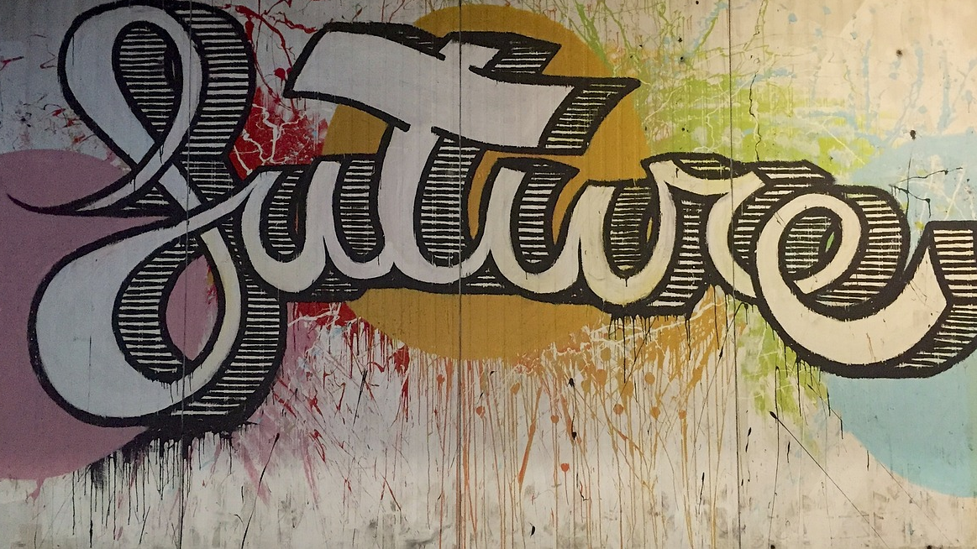
Determining what caused a prior relapse is vital in avoiding future relapses.

Slide 19
Assess Students History with Drugs and Alcohol
Was there a certain time you were more prone to substance use?
Did specific people factor into the times you used?
What thought patterns make you more likely to use?
Why did you relapse before?
This Photo by Unknown Author is licensed under CC BY

Slide 20
Determine Any Signs That Could Lead to a Relapse
Brainstorm a list of scenarios that could lead to a potential relapse and list the warning signs of relapse. Some people begin to feel, think, or behave differently when a relapse is brewing.
Creating list of warning signs can give a person more insight into their replase. Sharing the list with the treatment team can provide them with needed information to prevent relapse in the student.

Slide 21
Establish an Action Plan
What can you do instead of turning to alcohol or drugs?
Example: If going through a breakup could lead to relapse, think of other outlets for your pain and frustration. Instead of drinking or using drugs, plan to attend support meetings, contact a family member or supportive person, or exercise right away. The more specific your action plan, the less likely the student will relapse.

Slide 22
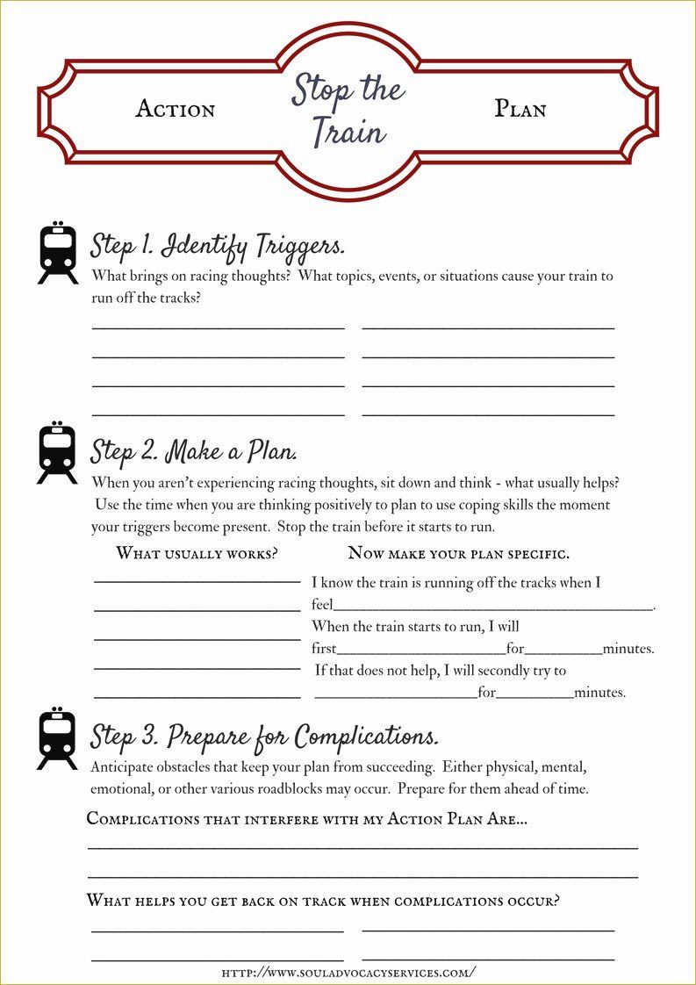

Slide 23
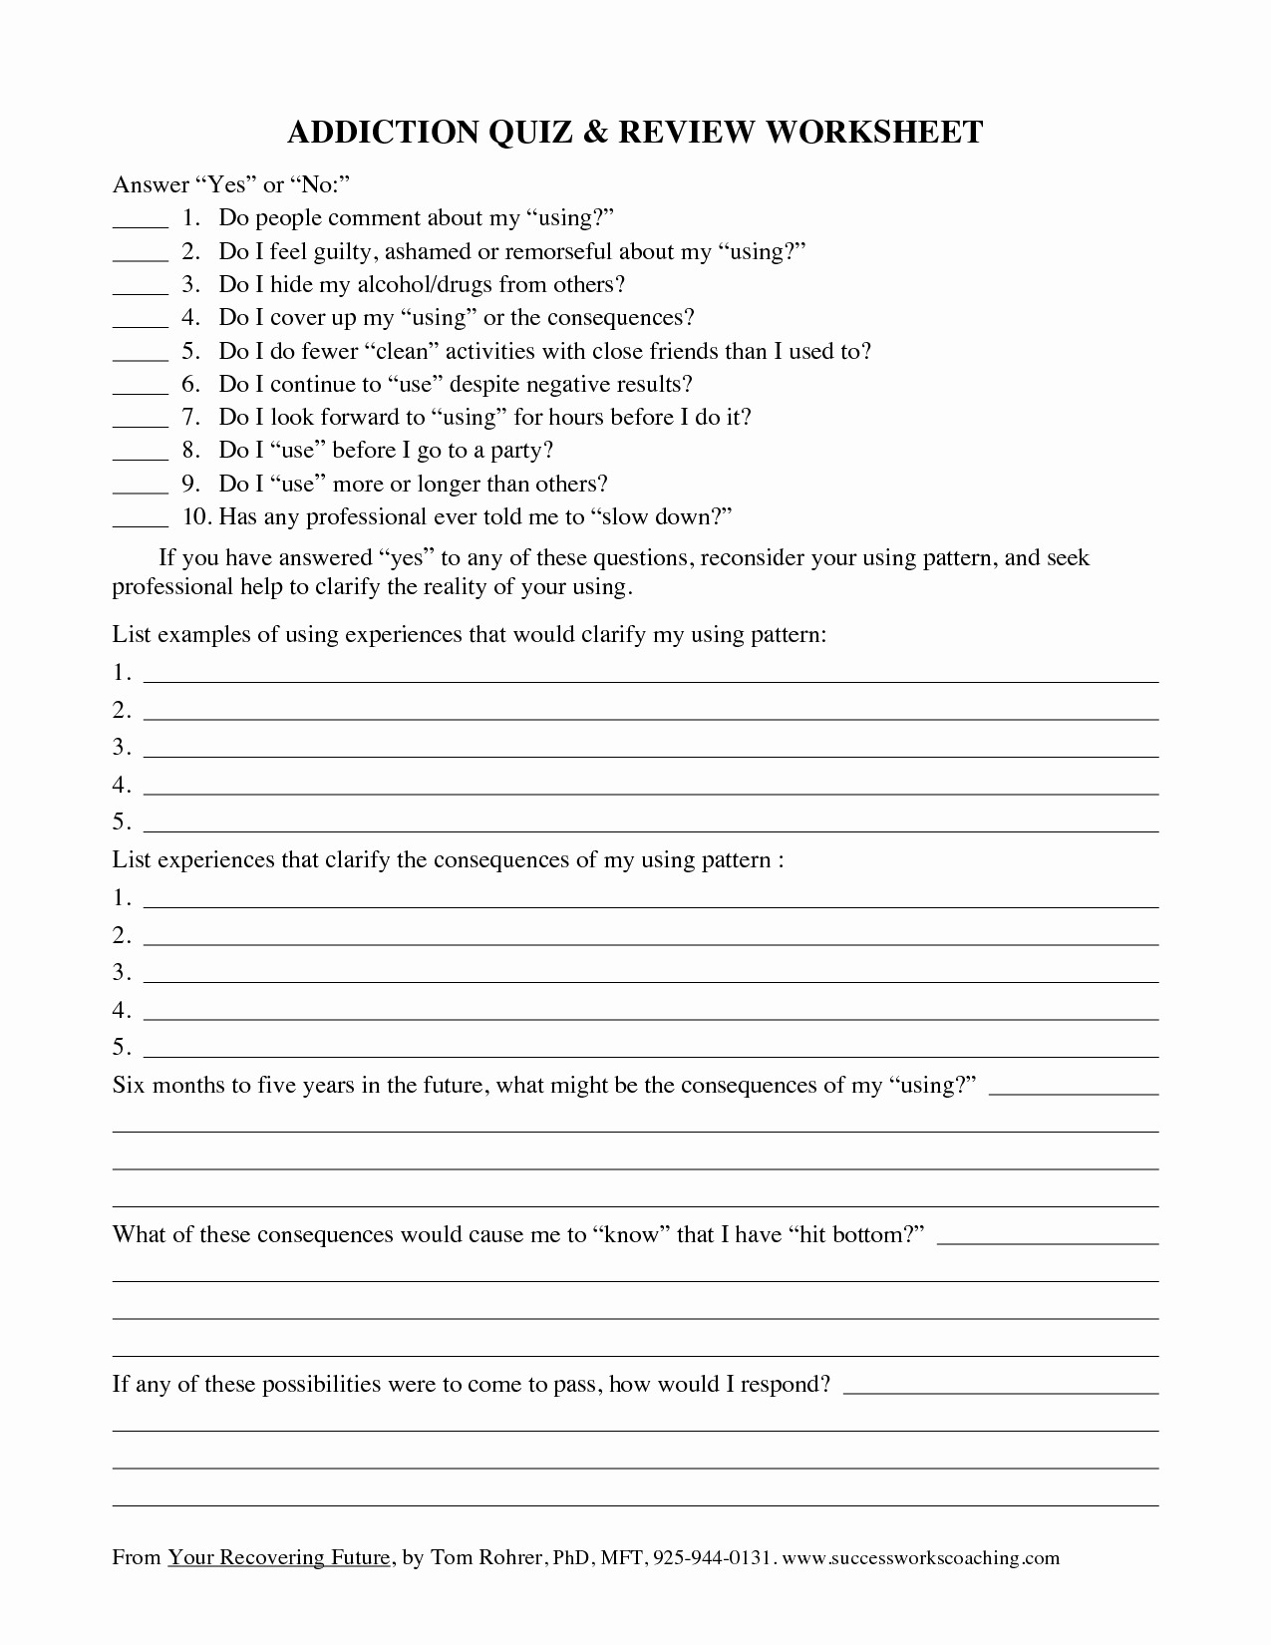

Slide 24
Relapse Prevention Plans
As time passes, plans should change based on resources, needs, and supports.

Slide 25
Let’s relate it to what we do at Job Corps:
Eat well – HEALS participation
Exercise – Recreation for cardio, organized sports, weightlifting, yoga, etc.
Sleep – Collaboration between Wellness, TEAP, and CMHC for good sleep hygiene and mindfulness
Journaling
Providing support groups
Mentoring programs
Role playing, drama clubs, singing clubs
Volunteer work in the community
This Photo by Unknown Author is licensed under CC BY-NC

Slide 27
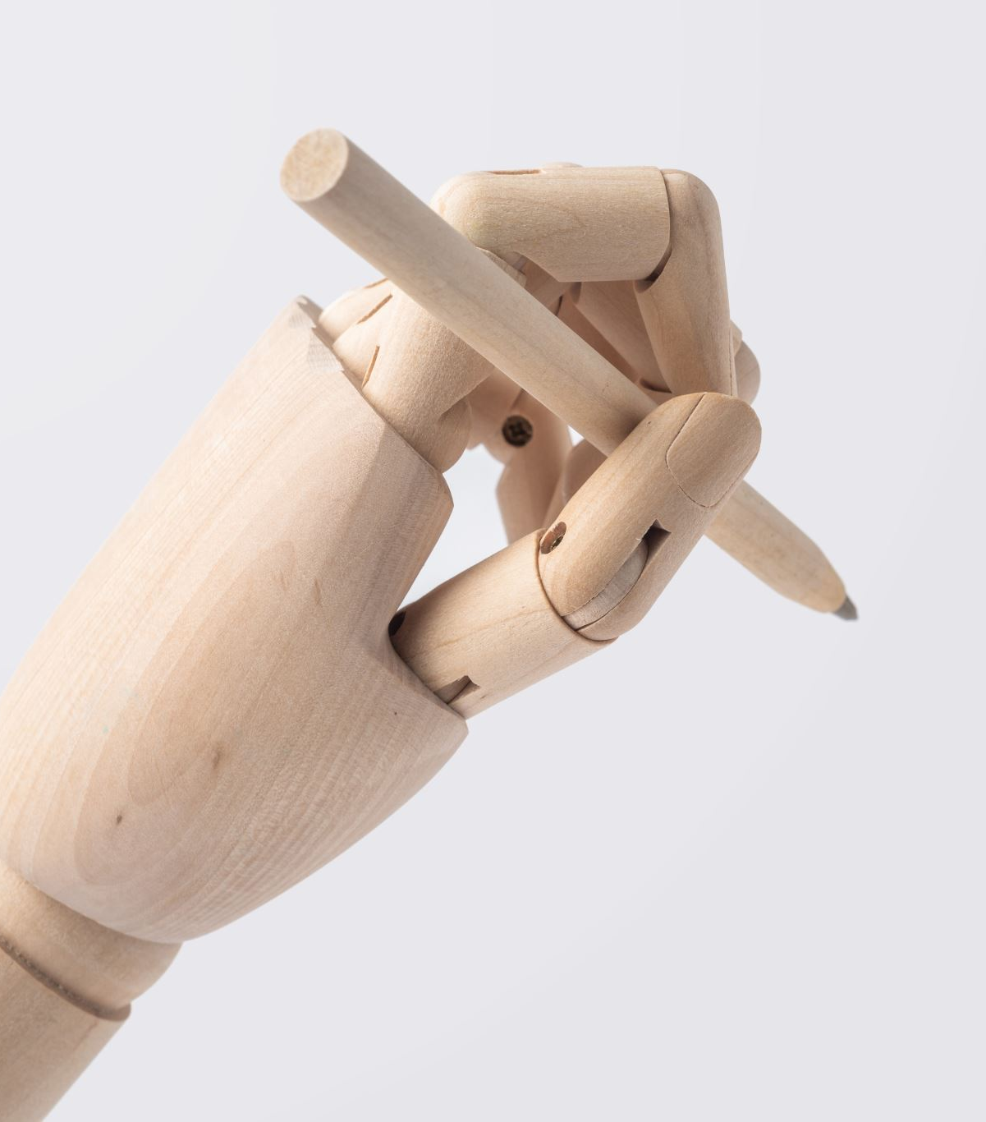
Resources:
TherapistAid.com
The Matrix Model-Relapse Prevention Group Handouts
SMART Recovery.org
Hazelden
SAMHSA
National Institute on Drug Abuse (NIDA)

Slide 28
Questions???
This Photo by Unknown Author is licensed under CC BY

