Slide 1
Employability and Suspicion Testing
Diane A. Tennies, PhD, LADC
Lead TEAP Health Specialist – Humanitas
July 2023

Slide 2
Learning Objectives
1.) Review the importance of being drug-free in the workplace and the impact on employability.
2.) Identify the three steps associated with the suspicion screen process that are behavior-based.
3.) Outline the necessary/Required participants involved in the suspicion screen process.

Slide 3
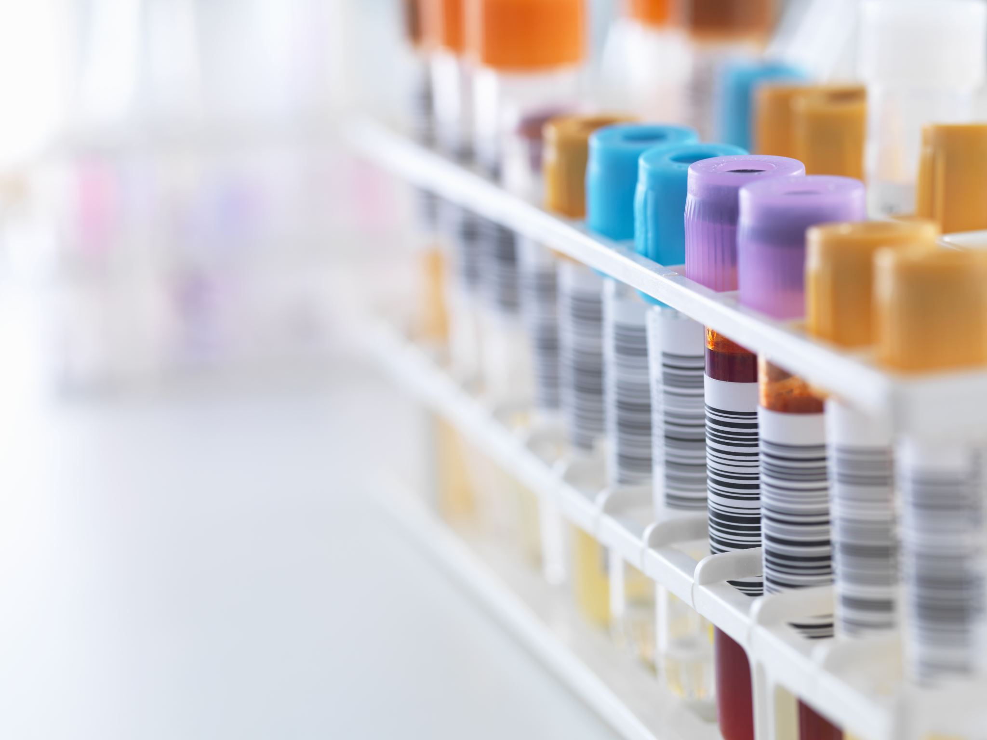
Drug testing is about workplace safety and worker health
More than 74% of current illegal drug users are employed and cause up to 40% of industrial fatalities in the U.S. according to NDWA (National Drug-Free Workplace Alliance)
Substance impairment may lead to 3.5 times more accidents
40% of employee theft is caused by drug abuse according to the U.S. Department of Justice
National Council on Alcoholism and Drug Dependence (NCADD) reported 70% of the 14.8 million Americans who misuse drugs are employed.
Substance misuse increases likelihood of an employee missing eight or more workdays annually
50% of workmen compensation claims are substance use-related
Substance use contributes to lowering productivity (by 33 percent)
Source: NIDA. https://nida.nih.gov/

Slide 4
Drug Testing Benefits – Data to share with Students
Drug Testing employees prevents and detects workplace drug misuse.
Reduces employee healthcare costs
Improves employee morale, productivity, and performance
Decreased absenteeism, accidents, downtime, turnover, and theft
Complies with state or federal regulations
Assist to identify and refer employees with drug and/or alcohol problems
Provide a safe workplace for employees

Slide 5
Suspicion Screen Process
Replicates workplace practices
Teaches healthy workplace procedures through modeling
Enhances Job Corps as a safe and healthy employment and residential site

Slide 6
The Components of an Effective Suspicious Screening Process
Observable signs
Training the staff on the process – ESSENTIAL
SOP for direction/guidance
Clear and concise form (TEAP Referral Form)
Follow your process
Assess referred students and intervene with intervention services

Slide 7
Urine Toxicology Testing
Marijuana (Cannabinoids / THC)
Cocaine (Benzoylecgonine)
Opiates (Codeine, Morphine, 6-AM (Heroin metabolite))
Amphetamines (including methamphetamines)
Phencyclidine (PCP)
Barbiturates
Benzodiazepines
Fentanyl
Hydrocodone/Hydromorphone (Vicodin)
Oxycodone/Oxymorphone (Percocet, OxyContin)

Slide 9
PRH Regarding Suspicion Screen Drug Testing: Drug Testing
PRH 2.3 R5 (TEAP) in section E:
Under Drug testing procedures:
E1 is about drug testing: Students who are reasonably suspected of using drugs at any point after arrival on center must be tested; this testing must take place as soon as possible after staff suspects use.
E3 is about alcohol testing: In Students who are reasonably suspected of being intoxicated or consuming alcohol on center or under center supervision must be tested; this testing must take place immediately after staff suspects use.
Define: “reasonably suspected” is:
Reasonable suspicion is context specific, supported by specific and articulable facts, and may include
direct observation of drug use or behavioral signs or symptoms suggestive of drug use
(2) specific reliable information that a student recently used drugs.

Slide 10
PRH Regarding Suspicion Screen Drug Testing: Alcohol Testing
E3 is about alcohol testing: In Students who are reasonably suspected of being intoxicated or consuming alcohol on center or under center supervision must be tested; this testing must take place immediately after staff suspects use.
(b) Centers must use devices that measure alcohol in the breath or saliva (e.g., breathalyzers or alcohol test strips/tubes/swabs). Alcohol testing must only be administered by a staff member trained in the use of these testing devices. All testing must be documented and the results submitted to the health and wellness center.

Slide 11
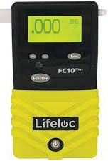
PI 22-02 Life Loc Breathalyzer Utilization
Required use
Requires Annual Calibration
Must have a way of determine BAC if Life Loc unavailable

Slide 12
Other References to Suspicion Screen in the PRH
(c) Students who test positive for drug use by an off-center facility must be retested on center using the Job Corps nationally contracted laboratory as soon as possible, to include:
Work-based learning students who tested positive on a drug test administered by experience sites, union trades, or potential employers;
Students who tested positive on a drug test administered at a referral health facility (e.g., hospital emergency department, urgent care facility).
This retest by the Job Corps nationally contracted laboratory must be classified as a suspicion-of-drug-use test. For students who test positive for drug use on this retest, centers must follow the same procedures outlined in (c) above.
(d) Student drivers who test positive for drug use under 49 CFR Part 382 DOT Federal Motor Carriers Safety Administration must follow the same procedures outlined in (c) above for positive suspicion tests. In addition, during the intervention period, student drivers who fall under DOT regulations are not permitted to drive.
(e) Students who test positive for alcohol use on suspicion must be referred to the TEAP specialist for assistance and the center’s student conduct system for disciplinary action.

Slide 13
What Does Reasonable Suspicion Mean?

Slide 14
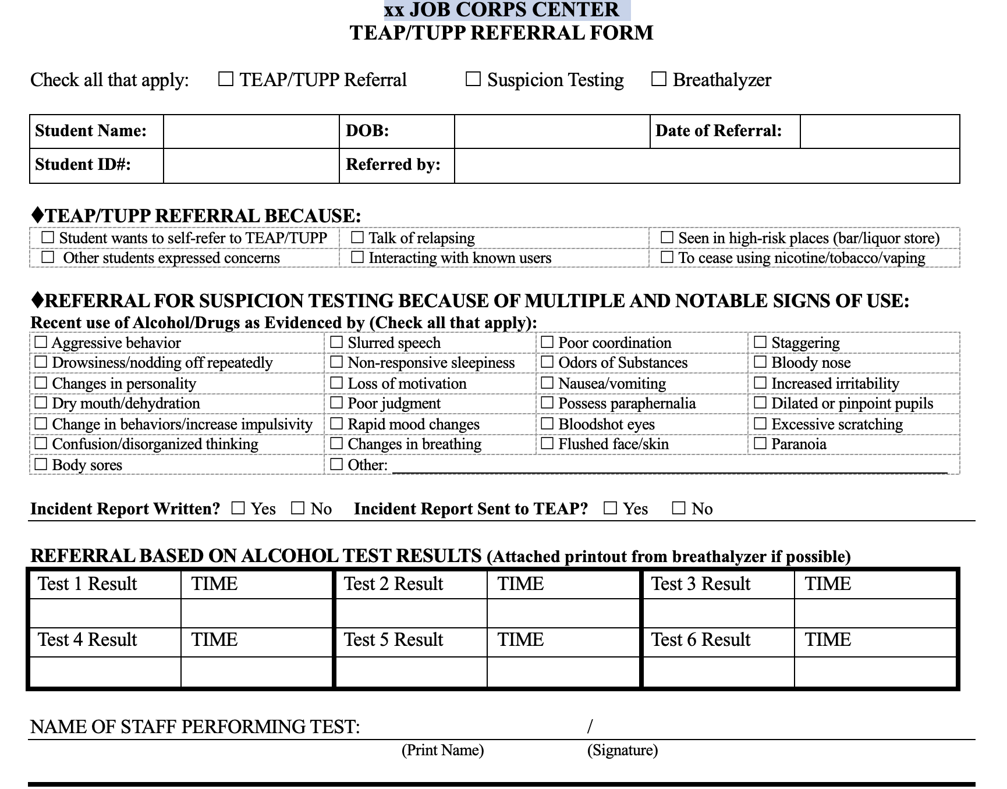

Slide 15
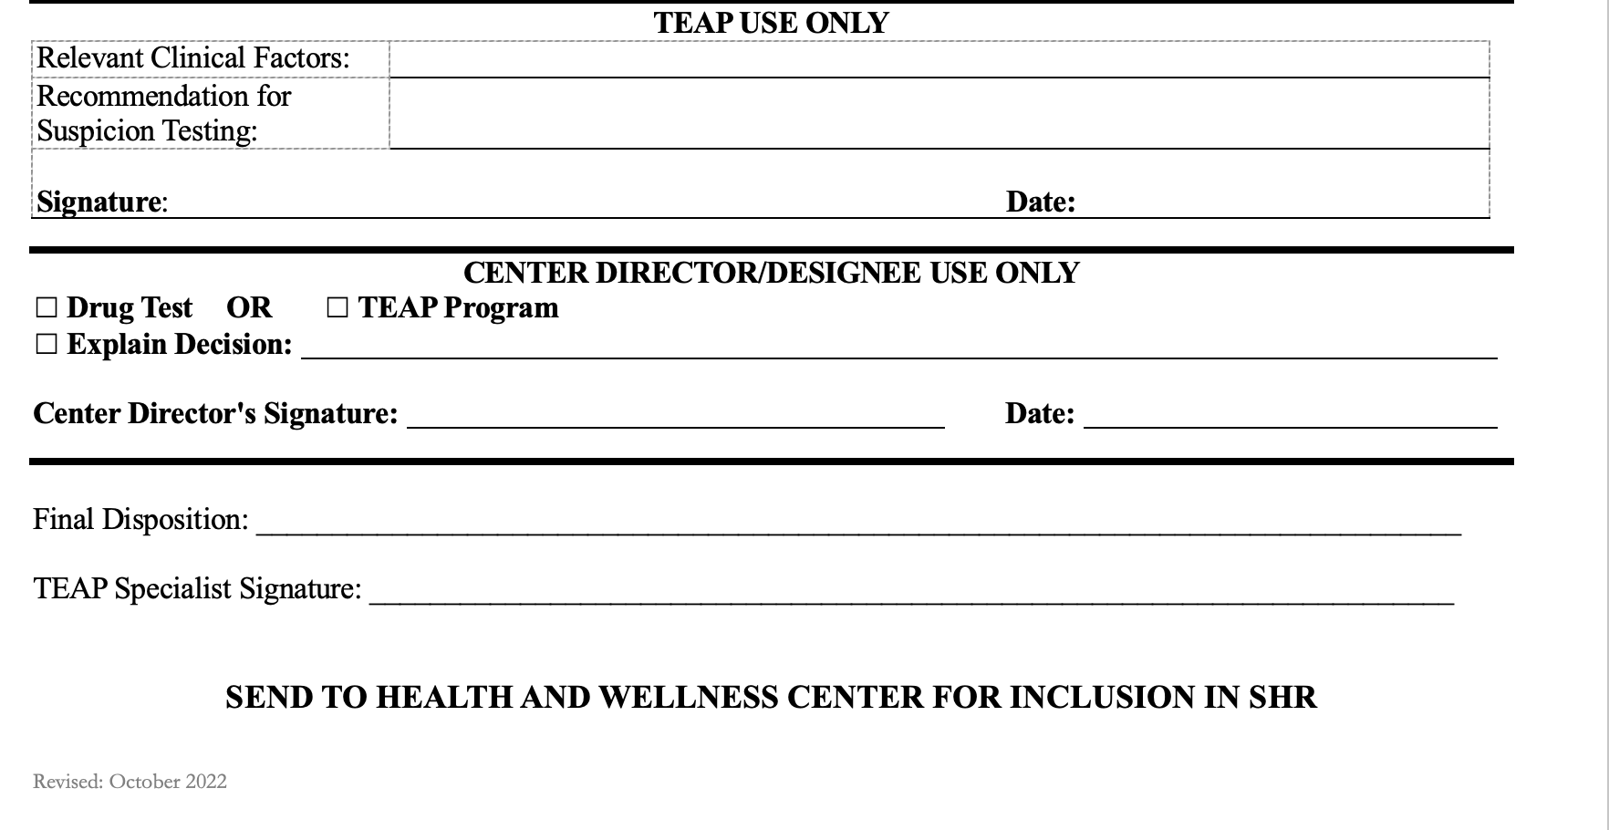

Slide 16
Disciplinary Code Intersection (Exhibit 2.1)

Slide 17
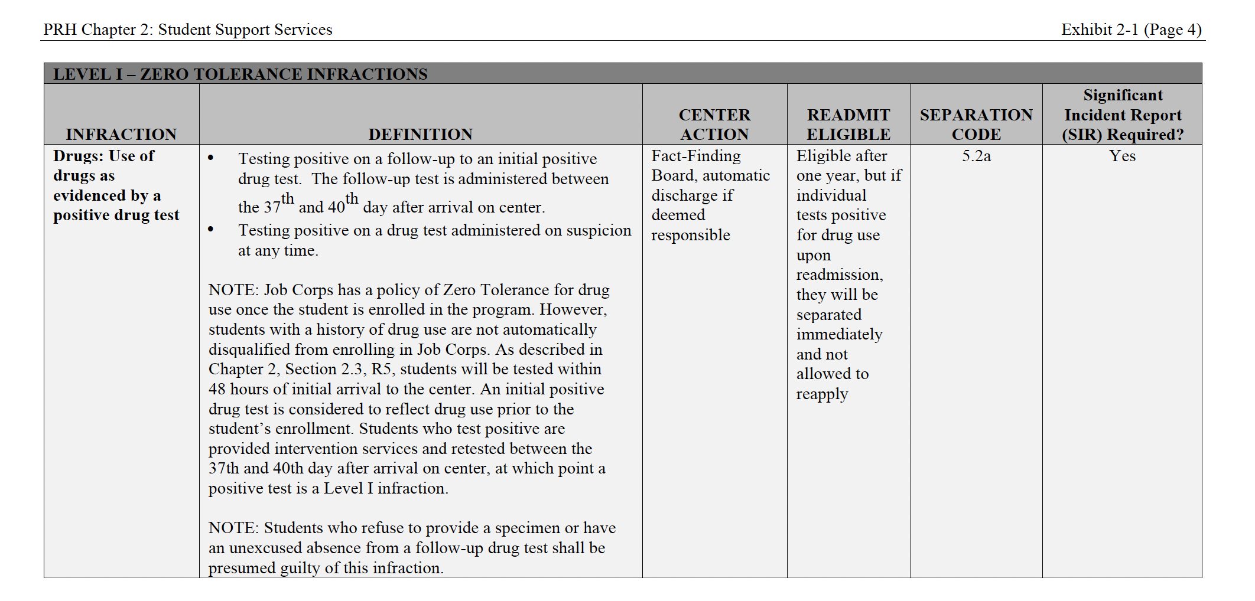

Slide 18
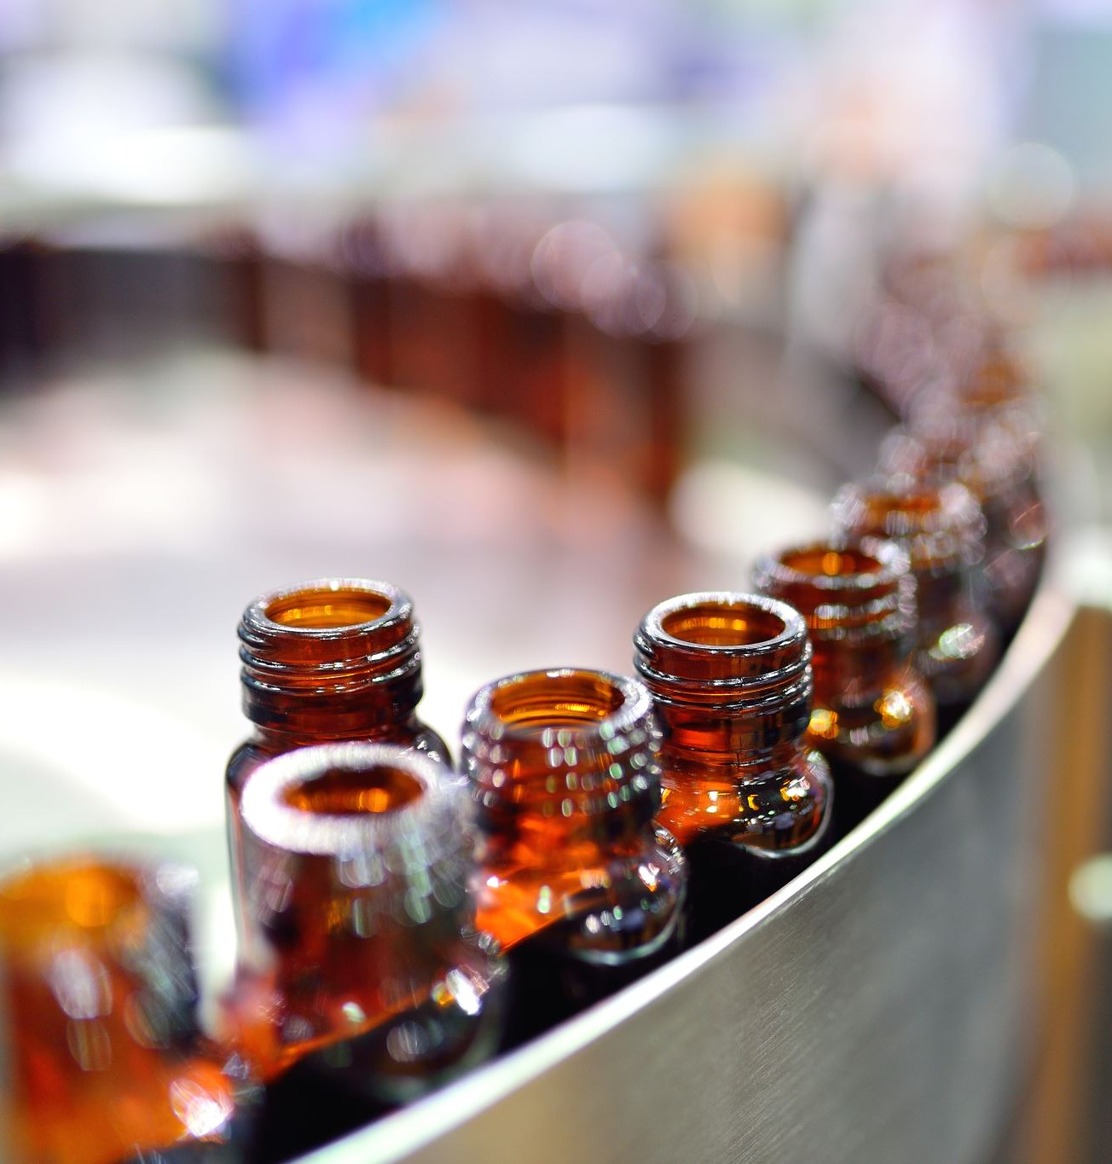
Alcohol Testing and Disciplinary Code
(c) If a student refuses to submit to a breathalyzer or provide a sample for alcohol testing, the student shall be presumed guilty of the Level I infraction Alcohol: Possession, consumption, or distribution while on center or under center supervision.

Slide 19
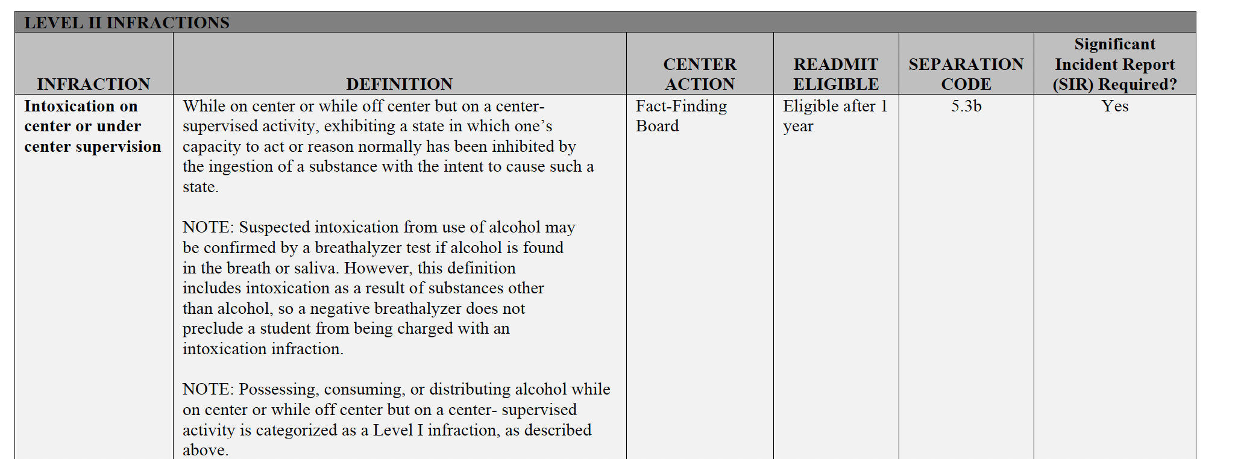
Exhibit 2.1 Disciplinary Code

Slide 20
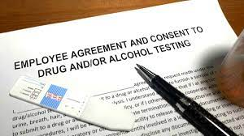
Drug Testing Requirements and Recommendations

Slide 21
Decrease the Likelihood of Adulteration
Provide a private area for specimen collection
Remove all cleaning products from the collection room area
Perform visual and temperature checks. The sample temperature should fall between 90.5 F and 99 F
Visually should appear free of possible contaminants
Turn off additional water sources in the immediate collection area, if possible
Place a blue chemical in the toilet tank to color the water
Have the student wash (with water only) hands and clean under nails and give student a paper towel for hand drying before they provide their sample

Slide 22
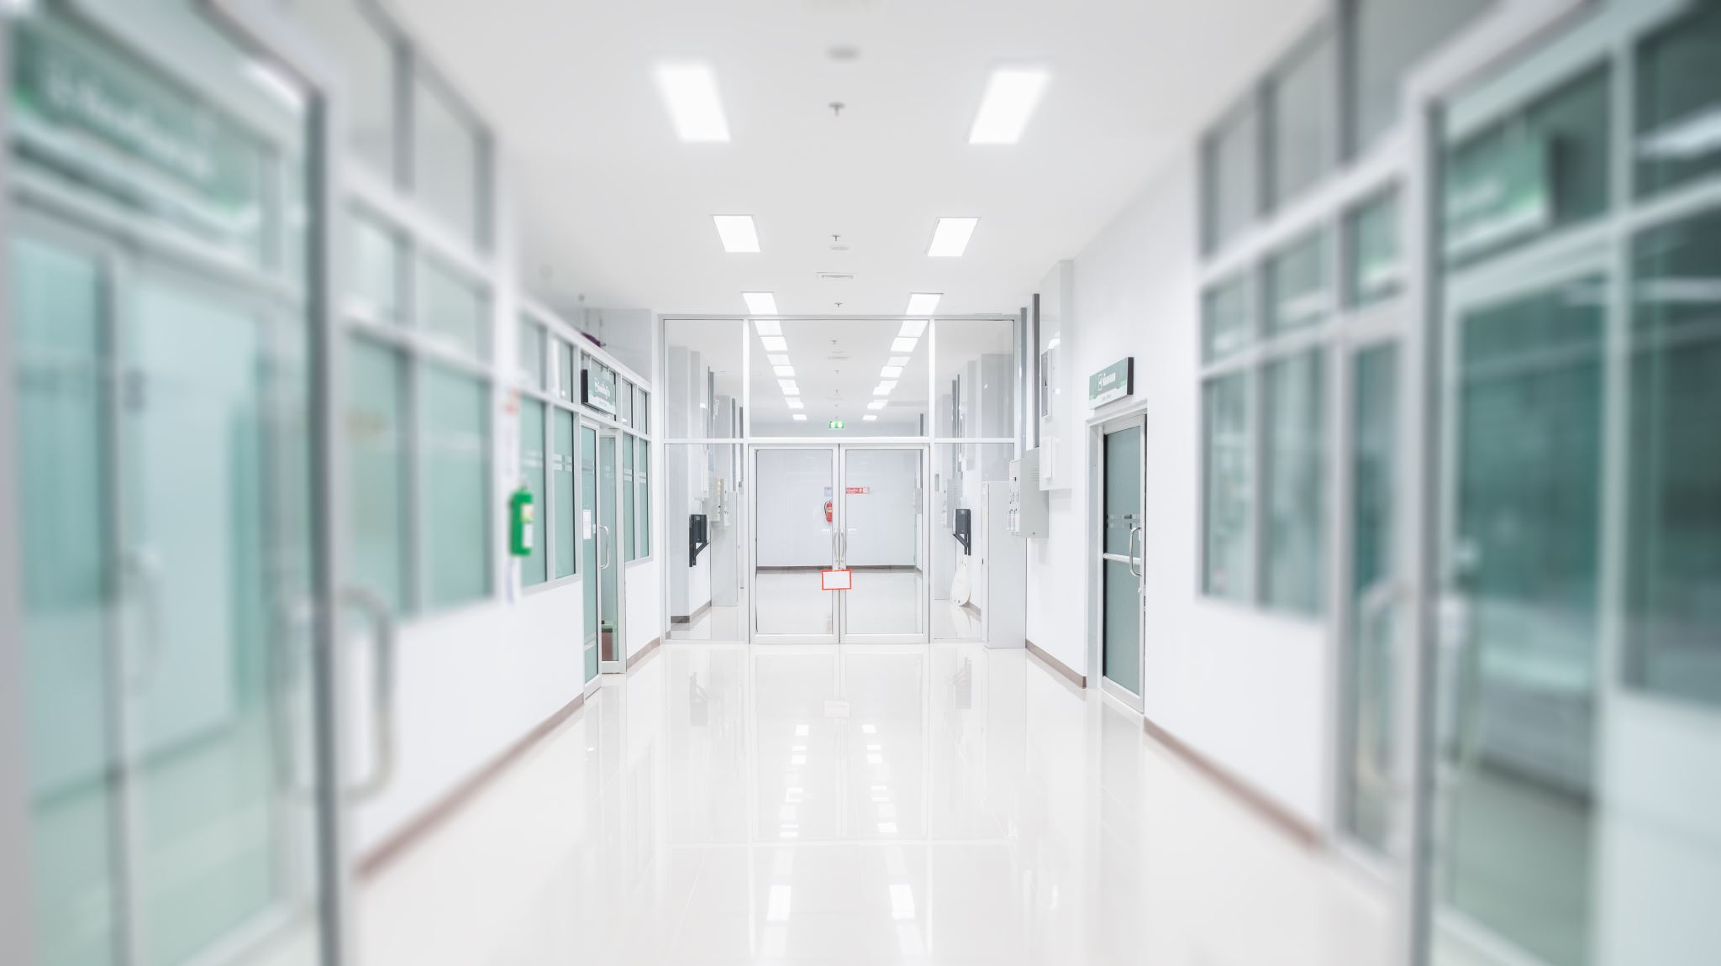
Continued
Have the student remove outer garments (e.g., coats, sweaters, jackets)
Prohibit bags, packages, or purses in the collection area
Have the student provide the specimen while in an examination gown, if urine collection is part of a medical exam
Have collection personnel stand close to the door and be aware of unusual sounds when conducting a routine supervised collection
Make sure the student hands the specimen directly and immediately to collection personnel

Slide 23
Supervised versus Observed Collection
Observed defined as: Watching the urine stream leave the body and enter the specimen container
Observed only recommended if concerns about adulteration as it is intrusive and staff time-intensive
Have clear and consistently implemented SOP about supervised versus observed urine collection

Slide 24
Chain of Custody is Key to Drug Testing Integrity
Chain of Custody Definition: The course of action of documenting the management and storage of a specimen from the moment a donor gives the specimen to the collector to the final destination of the specimen and the review and reporting of the final result.
All urine toxicology screening should have documentation regarding the integrity of the specimen to be tested.
Supervising the collection process and ensuring that there is strict adherence to chain of custody principles

Slide 25
Next Steps: Positive Suspicion Screen
Is there a medical explanation?
Positive for opioids and student had a legitimate prescription for an oral health procedure or to manage chronic pain
A student prescribed stimulants for ADHD
Consult with toxicology professionals if needed
If no medical explanation, then a referral to disciplinary staff for ZT termination and provide student with community referral
Document in SHR

Slide 26
Next Steps: Negative Suspicion Screen
Review results with the student
Further assessment
MSWR
CMHC Referral
Heals Referral
Offer voluntary relapse prevention service
Brief interventions, using SBIRT or motivational interviewing
Document in SHR

Slide 27
Alcohol Testing Procedures
Students who are suspected of using alcohol at any point after arrival on center are immediately tested.
Tested using the Lifeloc Breathalyzer (PI 22-02).
Only administered by trained staff member (TEAP responsible for training).
ALL testing documented (even negative results) and filed in SHR.

Slide 30
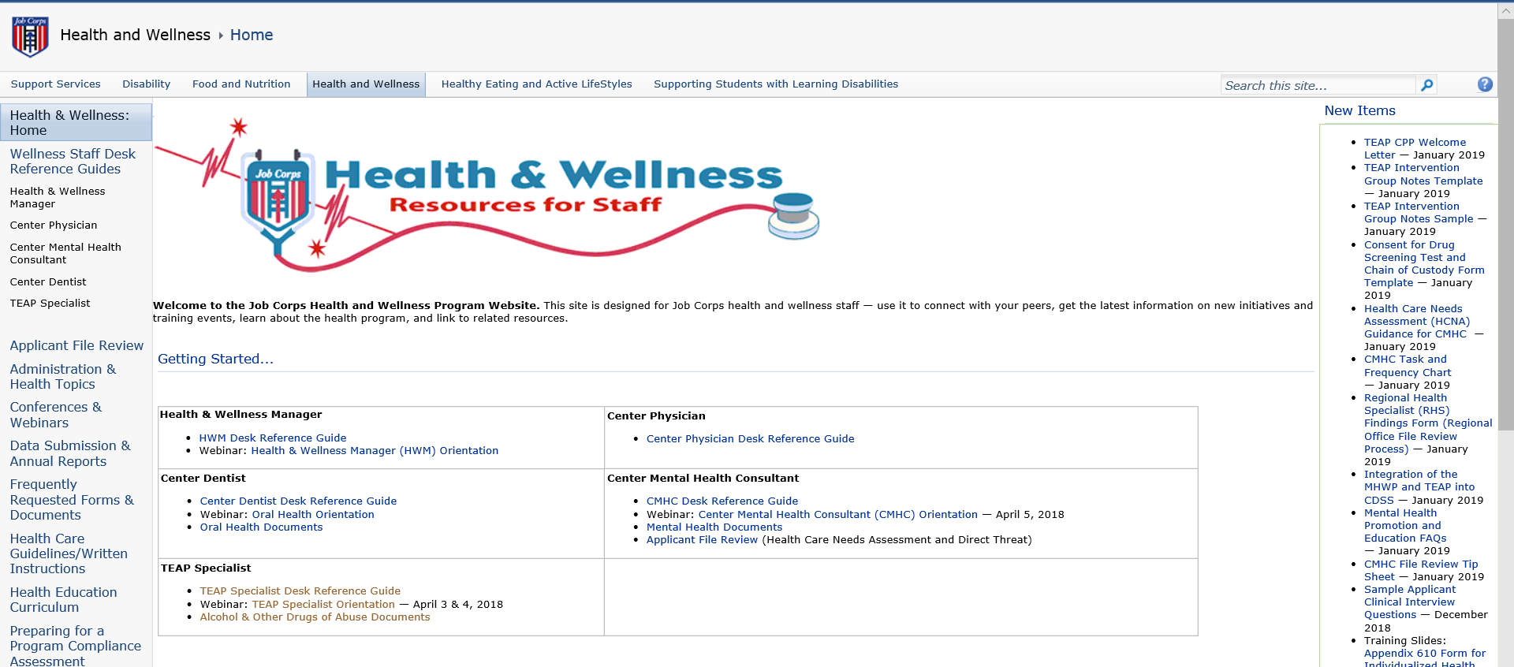

Slide 31
Learning Objectives Achieved
1.) Review the importance of being drug-free in the workplace and the impact on employability.
Safer workplace and healthier employees.
2.) Identify the three steps associated with the suspicion screen process that are behavior-based.
Train staff; staff identify reasonable suspicion; complete TEAP referral (or comparable form) with these specific behaviors listed.
3.) Outline the necessary/required participants involved in the suspicion screen process.
Front line staff (safety/security/residential/recreational/HWC (TEAP specialist or designee) and CD (or designee).

