Slide 1
Center Mental Health Consultant Orientation Part 3- Medical Separation with Reinstatement Rights (MSWR)
PRH Chapter 6.2
R5 Medical Separations
Notes:
Good afternoon or good morning for others! Thank you for joining me for Part 3 of the New CMHC Orientation and again Welcome to the Job Corps family . Hopefully the majority of you took Parts 1 and 2 over the past month. If not, you can find the PowerPoint on the Job Corps Health and Wellness website. The webinar was recorded and the recording should also be available on the website within the next few weeks. https://supportservices.jobcorps.gov/health/Pages/Webinars.aspx
First of all, I would like to have some idea of the audience I am talking with today. Type in your CENTER and HOW LONG you’ve been on center in the chat box.
During this webinar if you have questions you can type them in the chat box as I go along and you can also ask questions at the end of the webinar. And as a reminder, the links in the PowerPoint are live and will take you to the reference resources when the PowerPoint is downloaded.
So let’s start.

Slide 2
What Situations Might Result in a Student Leaving Job Corps?
Can Students Decide to Voluntarily Leave Job Corps?
What is a ZT Separation?
Notes:
Sometimes situations come up and students decide to permanently leave the Job Corps program--for instance, they may have a sick family member or childcare concerns or they decide they are home sick or that Job Corps is not what they thought--and they decide to voluntarily RESIGN from the program and go home. Students (obviously!) can voluntarily resign from the program if they want to. We don't force students to stay in Job Corps.
There are other situations where students might be forced to exit the program on what’s called a “ZT Separation” or a Zero Tolerance/Disciplinary Separation. This might occur if a Student has 1) a positive post intervention drug test, 2) tests positive on suspicion of drug use, 3) or is found in possession of drugs. If a student gets involved in a physical fight with another student a Zero Tolerance/Disciplinary Separation is the likely outcome.
But what about a student who begins to have intensifying mental health symptoms, like difficulty getting up in the morning, extreme fatigue, and low motivation due to depression? Or perhaps a student has auditory hallucinations and paranoia, or they express suicidal ideation with a plan and require inpatient psychiatric hospitalization? This is where MSWRs come in.

Slide 3
Health and Wellness Support Website
MSWR Resource Bundle
Guidance Documents
SPAMIS Separation Medical Separation Codes for JCC — July 2018
Sample Medical Separation with Reinstatement (MSWR) Form​ — December 2023 REVISED
​​​​Formulario de Separación Médi​ca Con Reinstalación (Spanish)​​​ —December 2023 REVISED​​​
MSWR Monthly Contact Sheet
Webinars
CMHC Orientation Part 2: Medical Separations and Applicant File Review
Medical Separations, DTAs, and Disability Discrimination​ Overview Training — December 12, 13, & ​14, 2022
​Medical Separations and DTAs Detailed Training — December 15 & 16, 2022
Notes:
Before we talk about MSWRs- I will be covering a lot of information but do not work,- There are several guidance documents and trainings on the HW Support Website- There is a MH Resource Bundle section with a separate resource section just for MSWRs an when you click on the link on the slide, it will take you directly there.

Slide 4
MSWR
✓
Part 1: Definition/Criteria
Part 2: Process
Part 3: Documentation
Notes:
During our time together today we will review the definition and criteria for MSWRs, the process for initiating and completing MSWRs and what documentation is required per policy -/PRH.

Slide 5
What is an MSWR?
MSWR is analogous to the medical leave offered by employers to allow employees time away from work to address medical/health concerns and return to work.
MSWR is a medical leave from the Job Corps program for a student to obtain treatment to address a medical, mental health, substance abuse or dental condition.
After a condition has been resolved or stabilized, students who meet the requirements to return to center can resume their education and vocational training where they left off with no penalty.
Notes:
This slides tells you what an MSWR is…it can be compared to medical leave you receive as an employee with Job Corps. It allows students to receive treatment for health conditions and when the condition is stabilized – return to the program and pick up their training where they left off with no penalty.

Slide 6
What is an MSWR?
Must be initiated by a health services clinician (not administrative staff and not students).
Center clinician or student’s treating provider estimates that the student will be able to return to the center within 180 days.
The student’s leave should reflect the length of time needed to address a condition.
There is no limit on the number of MSWRs a student can have.
Notes:
Now, MSWRs must be initiated by health and wellness clinicians or by a students; treating provider for conditions that believe will be treated and student can return within 180 days. Important to know that a student can have multiple MSWSRs – but must meet the treatment requirements to return which we will talk more about.
Examples: student requests to be on MSWR or Center Director requests student be put on MSWR before getting separated for disciplinary reasons.

Slide 7
Main Changes PRH Change Notice 22-02 (issued 11/30/22)
What’s Changed With MSWR?
(Straight) Medical Separation no longer exists.
Other types of leave must be tried or considered. MSWR should be considered as a “last resort.”
Student consent (or lack of consent) must be documented. (Note: Student is still placed on MSWR even if they don’t consent.)
More specific documentation requirements.
Notes:
Here are the main changes that occurred in November 2022 related to MSWRs – the biggest one is that a straight medical separation no longer exists- this was a category where a student had to remain out of the program for a year and reapply. In today’s training we will also discuss other types of leave that should be tried or considered before a MSWR, the process steps for student consent, and documentation requirements.
(MSFC “Final Close”) only occur when a student does not come back from an MSWR.
Medical separations are NOT the same as MSFC “Final Close”.

Slide 8
WHO can recommend placing a student on MSWR?
Center Physician
Center Mental Health Consultant
Other appropriate qualified health professional (QHP) including:
TEAP Specialist
Student’s individual threating provider
Notes:
Read the slide

Slide 9
1. QHP has determined that a student to have a preexisting or acquired health condition that requires treatment beyond the basic health services provided by Job Corps and:
Criteria for MSWR #3 and #4
are new
The necessary treatment is unavailable or will be unusually costly to Job Corps; and
Other types of leave (Administrative Leave with Pay, and Personal Leave with Pay, and others), and other methods of addressing relevant medical concerns have been tried or considered and determined to be insufficient.
If the student is an individual with a disability, the center must determine, in conjunction with the student through the interactive process, whether any disability accommodations would address or mitigate relevant medical concerns
Notes:
We have always considered an MSWR when the clinician ( QHP) has assessed that the student’s health condition now requires treatment beyond our basic health services, or it is unavailable or unusually costly . Number 3 and 4 are new – Prior to making a determination of an MSWR, centers must consider or try other types of leave as indicated on the slide – but those leaves would not be sufficient in terms of time usually to address the health condition and if student has a disability, we have reviewed if there are any disability accommodations that might address the medical concerns and allow the student to remain in the program and get treatment.

Slide 10
CAN A STUDENT EVER BE PLACED DIRECTLY ON A MSWR?
YES!
Notes:
Whether to use leave or go directly to a MSWR is a clinical decision. There may be situations where a center has thought about or considered leave but it will not be sufficient, and the student needs to be placed directly on MSWR. This is allowed but should be determined on a case-by-case basis.
For example, a student is in a car accident and has injuries that require surgery and possibly rehab. We know this student is not going to be able to return quickly so the use or consideration of other types of leave would be insufficient. The student would be placed directly on MSWR in this scenario. Or let's say a student made a suicide attempt on center requiring medical attention and has now been admitted to the hospital. This is a situation where a student might be placed directly on MSWR.
A student who is injured on center and claims worker's compensation, commonly referred to as OWCP, must be placed directly on MSWR.

Slide 11
MSWR
✓
Part 1: Definition/Criteria
✓
Part 2: Process
Part 3: Documentation
Notes:
Let’s move on to look closer at the MSWR process

Slide 12
MSWR OUTCOMES
STEP 1
STEP 2
STEP 3
Center clinician or student’s treating provider conducts an assessment
Does the student have health condition that requires treatment
Will other types of leave address health concerns?
STEP 6
STEP 5
STEP 4
Does the student consent to the MSWR?
Are there disability accommodations that would address/mitigate health concerns?
Is the student an individual with a disability?
12
Notes:
There are 6 process questions that should be asked when considering whether a student should be placed on MSWR. We just went through the first 3 steps in the scenario with Jessica. Steps 4 and 5 only need to be considered if the student is an individual with a disability.
The first step is the clinical assessment. We’ll cover what’s required and how to documents it a little later.
At the conclusion of the assessment, the clinician determines whether the student has a preexisting or acquired health condition that requires treatment beyond Job Corps Basic Health Services as described in Exhibit 2-4 and whether the treatment is unavailable or unusually costly. That is step 2.
Step 3 is to consider whether other types of leave would address the health concerns.
Step 4 is determining whether the student is an individual with a disability.
Step 5 is to consider whether there are any accommodations that would address/mitigate the health concerns.
Step 6 is determining whether the student consents to the MSWR.

Slide 13
MSWR OUTCOMES
Continued Enrollment
If treatment needs do not exceed or basic health care or disability accommodations will mitigate or address health concern
Other Leave
Place on other leave
MSWR (consent)
Place on MSWR
3 Clinical Pathways
MSWR
(no consent)
Complete Form 2-05
Place on MSWR
13
Notes:
Read slide- Here are the outcomes for MSWR

Slide 14
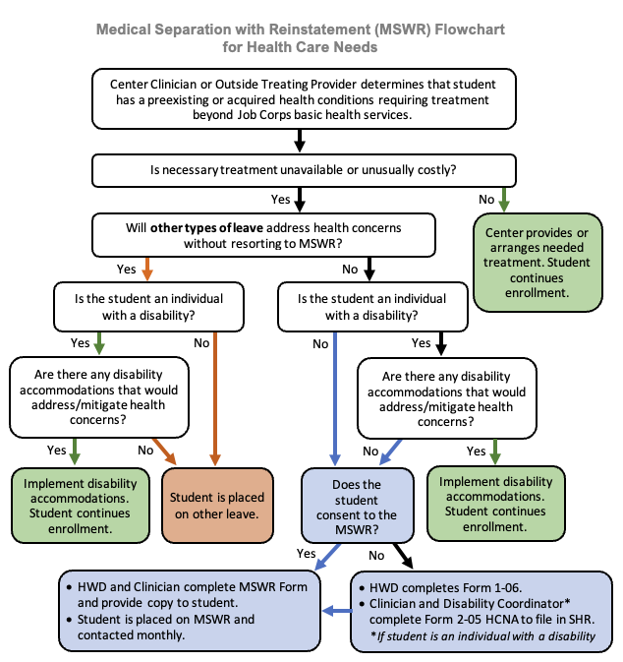
COLOR LEGEND
Continue enrollment
Other leave
MSWR
MSWR Flowchart for Health Care Needs
MSWR Flowchart for Health Care Needs
14
Notes:
This is a flowchart or decision tree that puts together the process questions and the outcomes that I just reviewed. It may look complicated, but it’s actually pretty simple. Each white bubble is a question or decision point. The 3 colors correspond to the 3 outcomes – green bubbles indicate that the student continues enrollment. Orange indicates that the student was placed on another leave. Blue represents an MSWR and, depending on whether the student consents or not, determines the type of documentation that is required. For the sake of time, I am not going to go through the entire flowchart, but you will have it with the PP slides.

Slide 15
Other Leaves
must be tried or considered
Leave Type | Transportation Provided
 | YES | NO
Personal Leave with Pay (PTO)
Administrative Leave
Regional Office Management Leave (ROML)
Bereavement (10 days) – requires confirmation
Not all mental health issues require an MSWR.
Notes:
Now centers must consider other leaves and methods of addressing the medical/mental health concerns. This step is important because not all medical/mental health issues require an MSWR.
This does not mean that another type of leave MUST be used first – other leaves must be tried or considered.
One factor that you may want to take into account when considering other leaves is whether transportation is provided to the student.
Work with your HWD when considering whether another type of leave other than MSWR is available and appropriate based on the student’s situation.

Slide 16
MSWR
✓
Part 1: Definition/Criteria
✓
Part 2: Process
✓
Part 3: Documentation
Notes:
Documentation

Slide 17
MSWR Documentation 2 Types
CMHCs must provide 2 types of documentation for an MSWR:
A clinical assessment in the student health record (SHR)
Complete the recommended MSWR Form and provide a copy to the student and to the parent/guardian (if minor)
Note: If student is not available at the time the MSWR is initiated, the recommended MSWR Form must be mailed to student. If the student is a minor, the MSWR form must be mailed to parent/guardian. Mailing of the form must be documented in the SHR.
Notes:
MSWRs require 2 sets of documentation. First is your clinical assessment, discussed on the next slide, which is documented in the student health record (SHR). Second is the information that is required to be be given to the adult student or the parent/guardian of a minor student. For this second piece, we strongly recommend using the recommended MSWR form, which captures all of the new PRH documentation requirements.

Slide 18
MSWR Documentation Progress Note for SHR
Clinical Assessment
Clinical justification for MSWR*
Current symptoms and behaviors
Functioning: how symptoms/behaviors are interfering with participation/progress in Job Corps
Appropriate SPAMIS diagnostic code
Student consent*
Consideration of other leaves*
Statement about whether MSWR is or is not recommended
Consideration of disability accommodations*
* All can be documented on recommended MSWR form.
Remember to put a note on the SF-600 chronological record “See CMHC MSWR note.”
Notes:
The clinical assessment provides the clinical justification for placing a student on MSWR. The clinical assessment needs to include:
current symptoms and behaviors that the student is experiencing – symptoms and behaviors that are present at the time of the assessment
how the student is functioning on center – in other words, how the symptoms and behaviors are interfering with participation or progress in the Job Corps program.
The clinical assessment should also include:
The appropriate diagnostic code from the SPAMIS list of abbreviated codes, which is available on the Health and Wellness website. [SPAMIS - Student Pay Allotment Management Information System]
A statement about whether or not MSWR is recommended for the student. If MSWR is not recommended for the student, then the clinical assessment will be only documentation needed.
The 3 boxes with the stripes – documentation of student consent, consideration of other leaves and consideration of disability accommodations must also be documented somewhere. The updated MSWR form makes it easy to document all 3. If a center decides not to use the recommended MSWR Form, then these 3 items needed to be documented either in the clinical assessment or on an SF-600 note (which could be done by the HWD).
Finally, be sure to remember to put a note on the SF-600 chronological record to “see CMHC MSWR note.”

Slide 19
SPAMIS Codes There is only one SPAMIS code per disorder rather than separate codes for various specifiers.
F32 is the one code available for Major Depressive Disorder (all types, all specifiers)
You will NOT find:
F32.1 Major depressive disorder, Single episode, Moderate
F32.2 Major depressive disorder, Single episode, Severe
F32.3 Major depressive disorder, Single episode, With psychotic features
F32.4 Major depressive disorder, Single episode, In partial remission
F32.5 Major depressive disorder, Single episode, In full remission
F32.9 Major depressive disorder, Single episode, Unspecified
You also will NOT find:
Any F33 codes for Major depressive disorder, Recurrent episode
Notes:
Job Corps Student Pay, Allotment and Management Information System (SPAMIS)
Just a quick word about SPAMIS codes. You will find that there is only one SPAMIS code per disorder rather than separate codes for the various specifiers. Job Corps does not do billing so there is no need to have that level of detail when assigning codes. So, for example Major Depressive Disorder only has one code F32. You will not find all the different codes for the various specifiers as you see on the slide. Please try to choose the most appropriate code and not rely on “unspecified” codes, if at all possible.
We are currently trying to add some codes related to suicidal ideation and others common problems for cases when the student could not be assessed directly before being sent to a hospital for evaluation.

Slide 20
MSWR Documentation Requirements
Clinical assessment including current symptoms/behaviors, functional impairments, and diagnostic code.
Individualized treatment instructions
Student consent
Referral source(s)
Transportation details, including whether an escort is needed
Dates of separation and anticipated return to center
Individualized student medical expectations to return
Accommodation plan and CIS Accommodation Plan Notes if student is an individual with a disability
….
SHR note
8 specific elements in PRH 6.2, R5(e2).
Notes:
Here is a list of all required MSWR documentation elements from the PRH. So we just covered the first bullet – the clinical assessment. We’ll discuss the other items when we get to the recommended MSWR form. The good news is that ALL of the other elements can be documented on the required MSWR Form.

Slide 21
Recommended MSWR Form
Notes:
If you attended any of previous MSWRs in 2023, the recommended MSWR Form has gotten a complete overhaul since that time and it is on the HW website with the date of Dec 2023. . Before we take a closer look on the next few slides, let me say 2 things:
The sections of the form are colored coded -- blue and green – to indicate which health staff may completed the form. Green indicates that the section may be completed by nursing staff. Blue indicates the sections that must be completed by a clinician (CP, CMHC or other QHP).
The “template” watermark that you see on the form is required because the form is recommended not required. Removing the watermark can easily be done in a couple of steps. Just Google it.

Slide 22
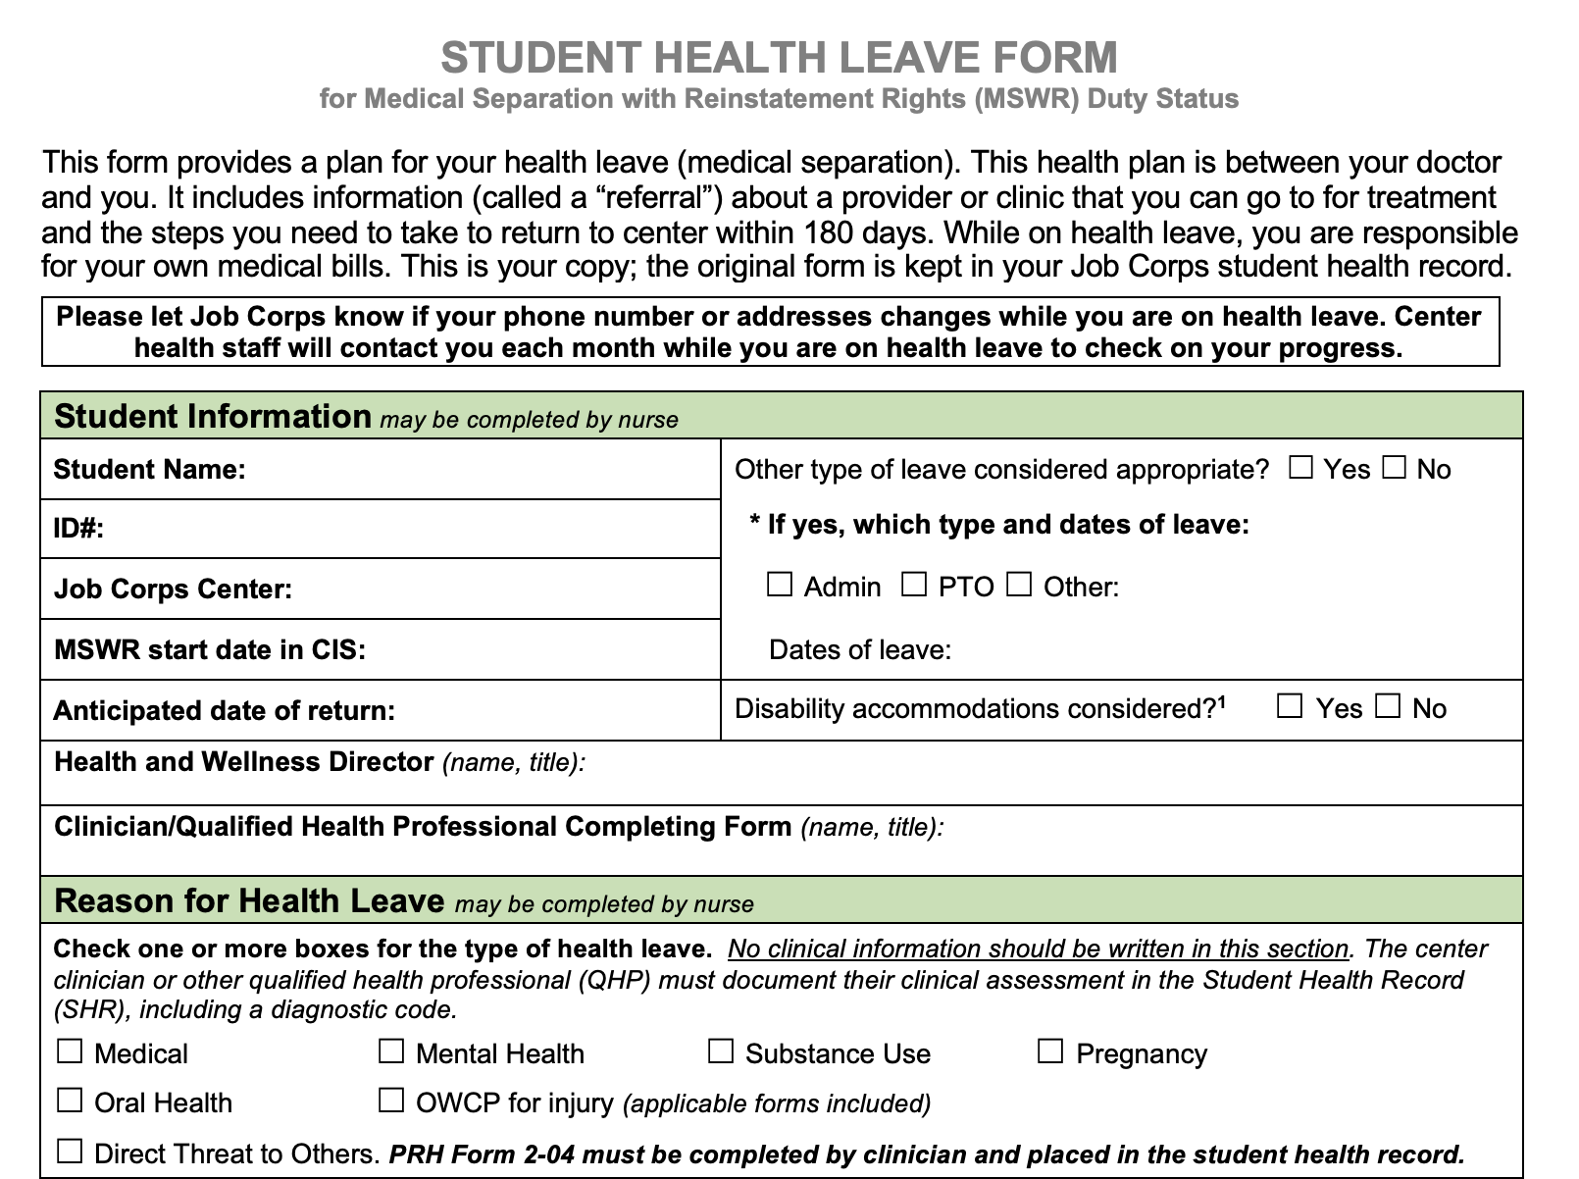
Student Information
Anticipated date of return
Other Leaves considered?
Disability Accommodations considered?
Recommended MSWR Form
MSWR Recommended Form
Reason for Health Leave
Only a check box goes in this section.
Clearer instructions indicate that “No clinical information should be written in this section.”
Reminder: if MSWR is for Direct Threat to Others, Form 2-04 must be completed.
Notes:
The first section – Student Information – documents:
Anticipated date of return. This is important because in many cases it is not expected that the student will need the entire 180 days of MSWR. It also sets up a positive expectation that the student is expected to return from MSWR.
In the right column, you can see where consideration of other leave can be document with a checkboxes. Similarly consideration of disability accommodations can be documented with a quick checkmark.
The next section – Reason for Health Leave – is where the reason or reasons for the health leave are indicated with a checkbox only.
There are clearer instructions that indicate that no clinical information should be written in this section. The appropriate place for clinical information is in the next section.
There is also a reminder in bold that if the MSWR is for Direct Threat to Others, Form 2-04 (DTA) must be completed.

Slide 23
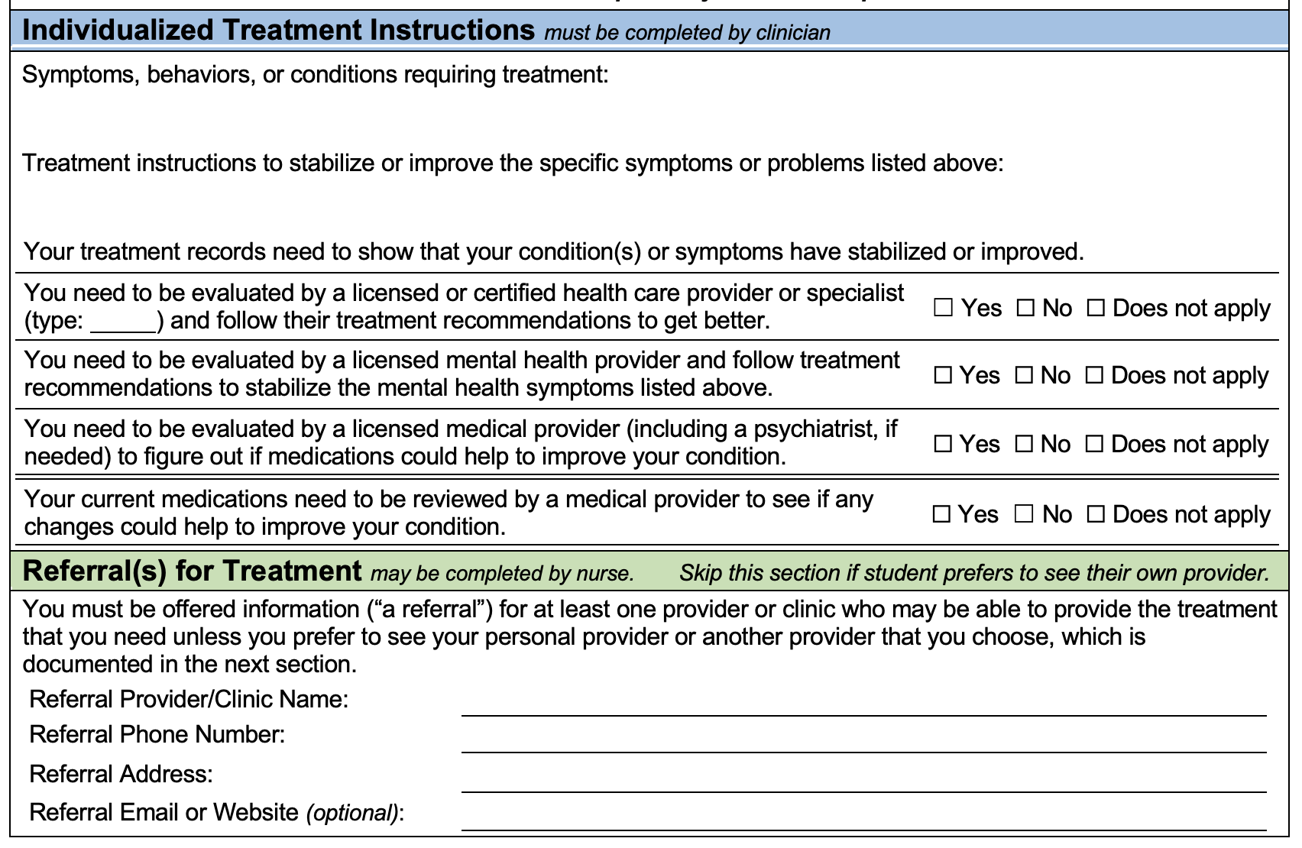
Individualized Treatment Instructions
NEW Headers:
Symptoms, behaviors or conditions requiring treatment
Treatment instructions to improve the specific symptoms or problems
NEW Table of yes/no/NA questions
Recommended MSWR Form
Referrals for Treatment
NEW student-centered instructions using plain language about Job Corps’ obligation to provide a referral and the student’s right to decline referral
Notes:
One of the most important sections of the MSWR form or letter is the section Individualized Treatment Instructions. This section can be used to provide information to the student’s provider about the student's treatment needs. Most importantly, this section sets the criteria for determining when a student has met the criteria to return to center and resume their Job Corps training. A few tips-
The treatment goals should include the target symptoms, behaviors, or functional limitations that should be evaluated and addressed.
The treatment goals should be written in plain language that the student can understand without the use of jargon or specialized vocabulary.
Do not write treatment goals that are too specific, such as requiring a specific number of counseling/psychotherapy sessions or a specific type of therapy such as EMDR (Eye Movement Desensitization and Retraining) or DBT (Dialectical Behavior Therapy). The student’s treating provider should be the one to determine the number of sessions and treatment modality needed to meet the student’s treatment goals.
Do not specify requirements that create significant barriers that could result in the student not being able to return. The recommended treatment modalities should be accessible to the student. Recommending a 6-month intensive outpatient program would not be reasonable if it would take 2 months for the student to be evaluated and accepted into the program, given that the maximum length of an MSWR is 180 days (6 months).
The treatment goals should be reasonable. Full remission of a student’s condition is usually not required for a student to function well enough to continue their training. Typically, stabilization of a student’s medical or mental health condition may be sufficient.
Write treatment goals that provide some flexibility and allow the student’s treating provider to develop a treatment plan to meet the student’s needs.
Do not include anything that suggests that the student’s return is based on a contingency that the student must meet, such as adherence to a medication regimen or continued treatment after returning to center.
Centers are encouraged to contact the appropriate Regional Health Specialist for additional guidance with questions related to writing Individualized Treatment Instructions.
3. Referral for Treatment
Students must be given at least one referral for treatment in their local area. If a student wants to get treatment from their own provider or a provider that they have seen in the past, the center does not need to provide a referral. The contact information for the student’s provider/agency/clinic must be recorded on the optional MSWR Form or in the SHR.
The name of the provider/agency/clinic, address, and phone number should be provided to the student for all referrals.
To facilitate initiation of treatment and the student’s return, centers should:
• Provide referrals that are meaningful and that the student can access based on cost and health insurance status. For example, if a student does not have health insurance, referrals to providers who require insurance or paying out of pocket are not meaningful.
Arrange a first appointment prior to the student leaving center. Many students tend to delay seeking treatment and cannot get sufficient care before the MSWR leave period expires.

Slide 24
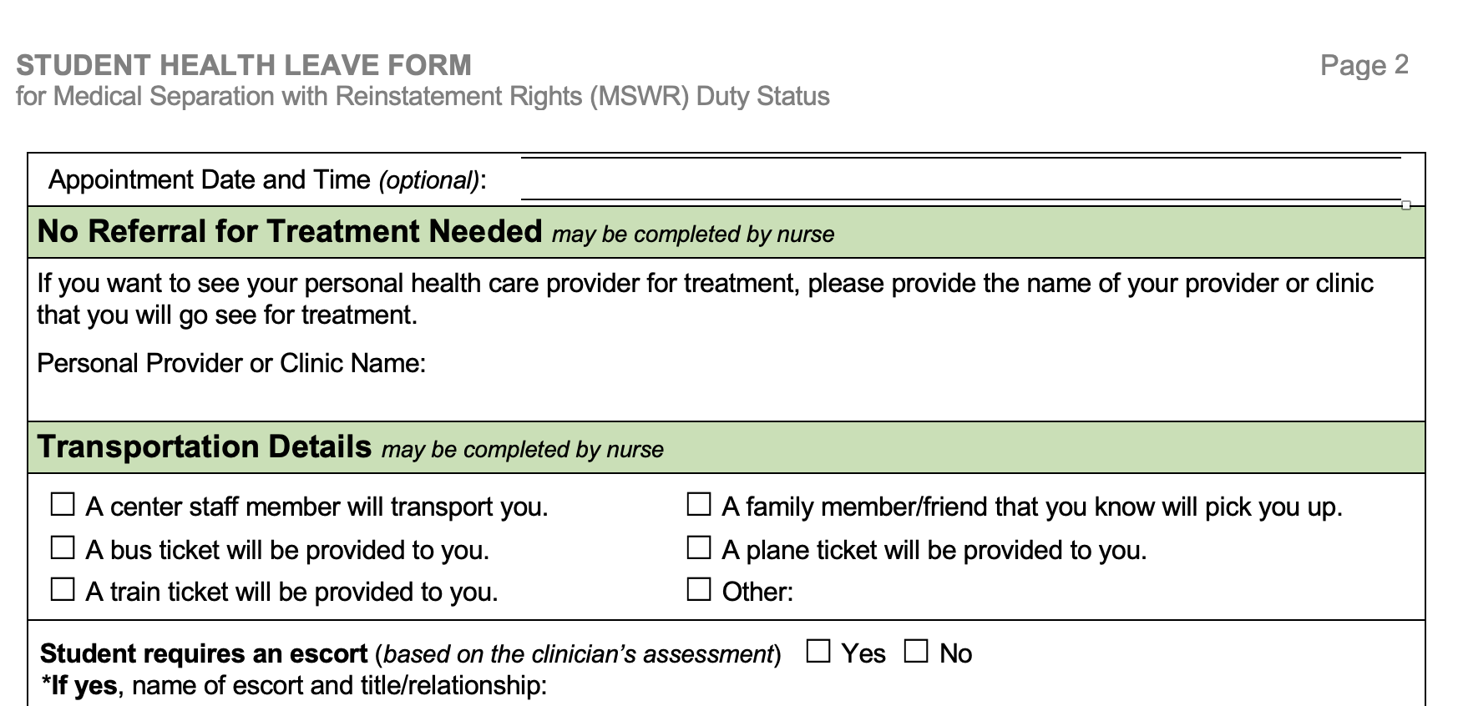
Page 2
No Referral Needed
Provides a place to indicate that student declined referral
Student must provide name of provider or clinic they plan to use
Recommended MSWR Form
MSWR Recommended Form
Transportation Details
Checkboxes for most common scenarios
If escort is needed, name of escort and relationship must be specified
Notes:
Date of Anticipated Return to Center
An anticipated date of return is simply an estimate of how long it will take for the student to complete treatment and return to center. Many conditions do not require the maximum 180 days of MSWR leave.
Providing an anticipated return date is a new requirement. It is simply an estimate based on the student’s treatment needs. Not all conditions require the maximum time of 180 days.
Transportation Details, Including Whether an Escort is Needed
Document how the student will be transported home and whether the student needs an escort while being transported. The optional MSWR form has checkboxes for common transportation scenarios and a yes/no checkbox for “Escort needed.” If an escort is needed, the name and title/relationship of the escort should be recorded in the space provided.
Escorts are generally needed if there are safety concerns related to the student, particularly if the student will be going home using public transportation. Escorts should be considered if a student is being given an MSWR for direct threat to others.

Slide 25
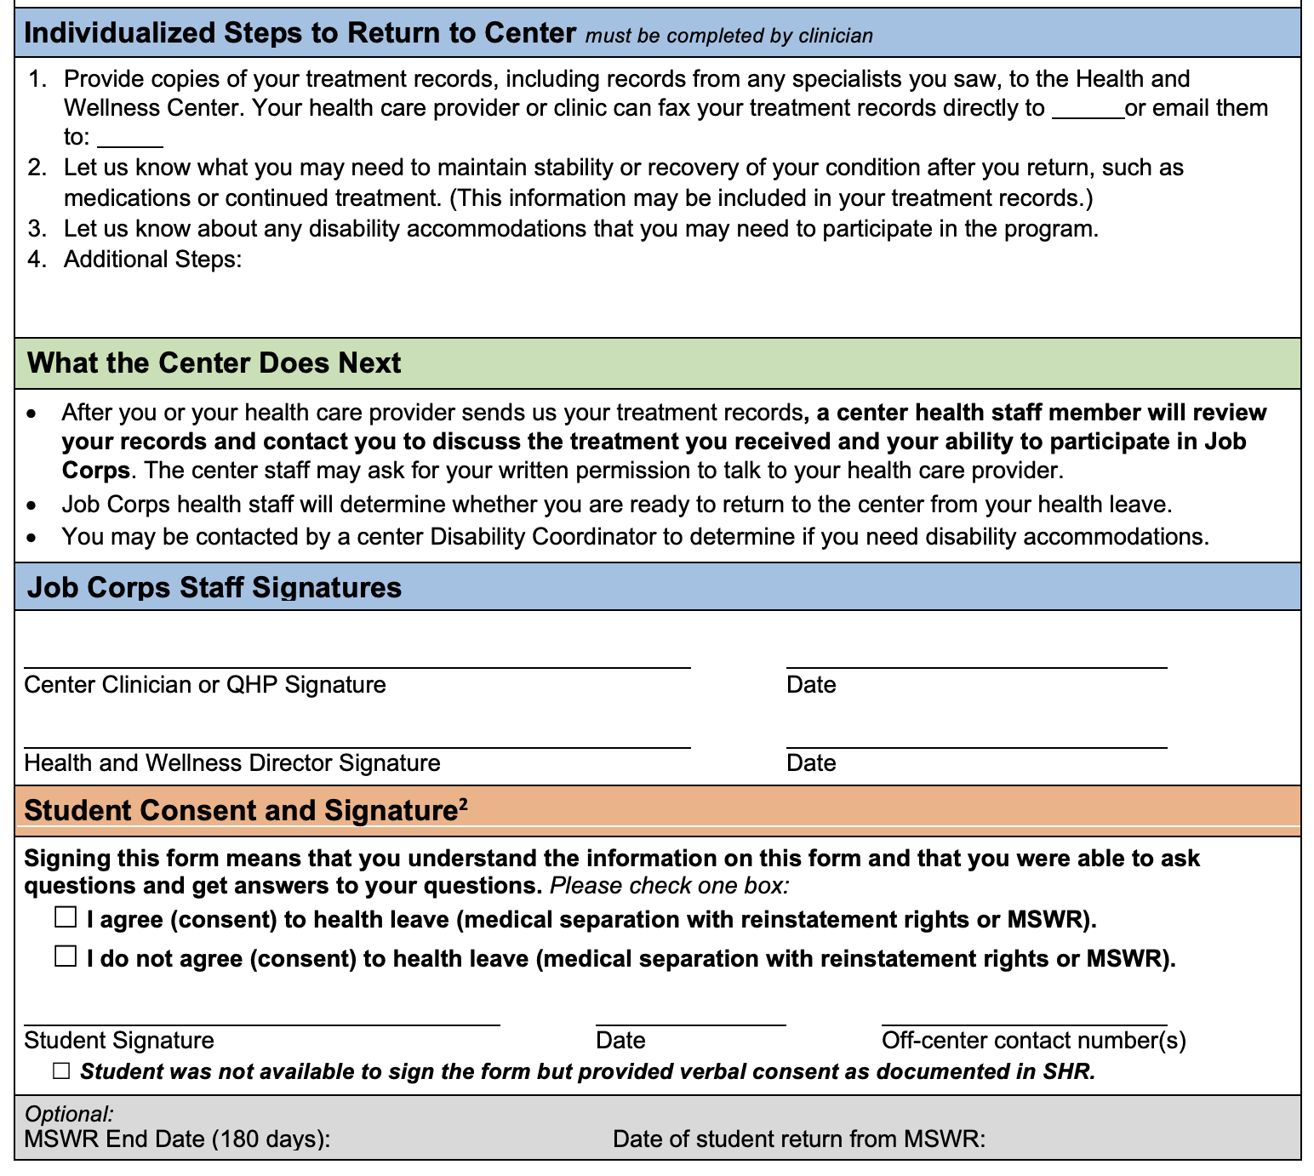
Individualized Steps to Return to Center
Updated instructions including option for student’s provider to fax records with fax number provided.
What the Center Does Next
NEW section, makes it clear that records need to be reviewed and student may be contacted and may request written permission to talk to student’s provider
Recommended MSWR Form
MSWR Recommended Form
Student Consent and Signature
NEW section to clearly document student consent
Checkbox to indicate that student was not available to sign and that verbal consent is documented in SHR.
Notes:
6. Individualized Student Medical Expectations to Return
• The PRH requires that students provide documentation showing resolution of the medical, mental health, alcohol, or drug abuse conditions and ability to participate in the program [PRH 6.2, R6a(2)].
• In addition to treatment records, the optional MSWR form specifies that students need to inform the center about any continuing treatment needs (such as medications) after returning to center and about any disability accommodations needed. There is space to add additional
Although centers may specify additional steps for returning, centers cannot add requirements that put any conditions on returning or on enrollment. For example, centers cannot require that students take prescribed medications or engage in specific treatment as a condition of returning.
2. Student Consent
• Student consent can be documented by the student’s signature on the optional MSWR Student Health Leave Form or in a note on the SF-600.
• If a student is not on center when the MSWR is initiated (for example, they are already home or have been admitted to a hospital), an explanation for why the student’s signature could not be obtained must be documented on the SF-600 or elsewhere in the SHR. The optional MSWR Student Health Leave Form has a checkbox below the student signature area to indicate that the student was not available. An explanation must still be provided in the SHR.
• If a student does NOT consent to an MSWR based on health care needs, then Form 2-05 HCNA must be completed.

Slide 26
What if student doesn’t agree with (consent to) MSWR?
You must complete Form 2-05 (Health Care Needs Assessment) to place in the SHR.
You do not need to do a separate progress note because Form 2-05 provide a more detailed assessment.
You must complete the ENTIRE assessment just as you would for AFR including the disability accommodations if the student is an individual with a disability.
You do NOT need to send the HCNA for regional review. The HCNA provides additional documentation for you and the center.
Notes:
• If the student consents to the MSWR, then the student is placed on MSWR. The clinical assessment must be documented in the SHR (e.g., using a progress note or the SF-600), and the center can choose how to document the Other MSWR Documentation Requirements
• If the student does not consent to the MSWR, the QHP documents their health care needs assessment on Form 2-05 HCNA that must be completed to document the student’s health care needs.

Slide 27
Documentation: 2 Special Circumstances
MSWR for Direct Threat to Others
Student does not consent
(MSWR for health care needs)
Must complete Form 2-04 Individualized Assessment of Possible Direct Threat (DTA)
Regardless of whether the student consents to the MSWR.
Must complete Form 2-05 Health Care Needs Assessment (HCNA)
A separate clinical assessment/progress note is NOT needed.
The ENTIRE assessment must be completed including the disability accommodations if the student is an individual with a disability.
Do NOT send the completed DTA or HCNA for regional review. File in the MSWR section of the SHR.
27
Notes:
There are 2 special circumstances when the documentation requirements for an MSWR differ.
One situation is when the MSWR is initiated because the student’s condition or disability is a direct threat to others.
The second situation is when the student does not consent to an MSWR that is initiated due to health care needs.
If the MSWR is due to a direct threat to others:
The center must complete Form 2-04 Individualized Assessment of Possible Direct Threat
Form 2-04 must be completed regardless of whether the student consents to the MSWR. So, even when the student consents to the MSWR, if the MSWR is based on a direct threat to others, the DTA must be completed.
When an MSWR is initiated for health care needs and the student does NOT consent to the MSWR:
The center must complete Form 2-05 Health Care Needs Assessment (HCNA).
A separate clinical assessment/progress note is NOT needed because the HCNA provides a more detailed assessment.
In either case,
The entire assessment must be completed including the disability accommodations if the student is an individual with a disability.
Finally, the center should NOT send the completed DTA or HCNA for regional review. The completed assessment should be filed in the MSWR section of the SHR.

Slide 28
WHAT IF … ?
A clinical assessment must be conducted to initiate MSWR; could be done by Center Physician/ARNP.
If not, a different type of leave should be considered for student until clinical assessment can be conducted. Discuss options with your HWD.
Otherwise, document what you know about the student and what occurred (based on HWD/staff report, documentation from hospital, etc.) as soon as you can.
Student is taken to the hospital or the MSWR question comes up on a day that you are not on center?

Slide 29
How do I determine if a student is ready to return to center?
Obtain records if not provided by student.
Review clinical information.
Get a release and talk directly with provider, if possible.
Interview the student.
Evaluate the student’s progress in terms of the individualized treatment instructions you provided on the MSWR form.
Is student stable enough to resume educational and training?
Notes:
In order for a student to return to center from an MSWR, an appropriate QHP will need to determine whether the student’s condition has stabilized or improved sufficiently for the student to return to center and resume their training. The ideal choice would be the QHP who conducted the assessment and made the recommendation for an MSWR. If that QHP is not available, then another QHP in the same discipline or the Center Physician (CP) can make the determination about whether the student is ready to return to center from an MSWR. The Center Dentist should make the determination in the rare case that a student is given an MSWR for an oral health condition.
For many medical and oral health conditions, a letter from the student’s provider indicating that the student is ready to return to center may be sufficient to clear the student to return. For more complex cases, including most mental health conditions, here are some general guidelines for determining the student’s readiness to return.
If the optional MSWR Form was used, refer to the expectations that were outlined in the “Individualized Treatment Instructions” and the “Steps to Return to Center.”
Obtain the most recent laboratory results, if applicable, and determine the need for periodic monitoring upon returning to center.
Obtain and review treatment records from the student’s provider if the student has engaged in at least some treatment. A signed Form 1-02 Records Release Authorization from the student will be needed to obtain records and to be able to communicate directly with the student’s provider. It is usually easier to have the student sign the release form used by the student’s provider. This will avoid the problem that is sometimes encountered when providers or clinics are not willing to accept Job Corps authorization.
If needed, contact the student’s provider directly to discuss the student’s treatment progress and ongoing treatment needs.
Conduct a clinical interview with the student to assess their treatment progress and ongoing treatment needs. Improvement and/or stabilization of the student’s condition enough to enable the student to resume participation in the program should be the primary focus of the interview.
There is no requirement for students to fulfill all of the “Individualized Treatment Instructions” or “Steps to Return” before returning to center. The primary criterion when determining whether a student is ready to return is whether there has been sufficient improvement and/or stabilization of the student’s condition to enable them to resume their education and training.
If the student has not engaged in treatment, the center clinician’s determination must be made based on the clinical interview alone.
If the student is making good progress but will not complete their treatment goals prior to the end of the 180-day MSWR period but will meet their treatment goals within a set time frame according to their treating provider, the center should consider obtaining an extension of the MSWR period for the student.
The QHP’s assessment, including record review (if applicable) and interview with the student, should be documented in the SHR in a progress note or on the SF-600. The assessment should end with a statement about the QHP’s opinion about whether the student is ready to return to center and any additional support or treatment needs the student may have after returning to center.

Slide 30
MSWR Extensions PRH 6.2 R5 e(4)
Submit request to the Regional Office (RO)
2 reasons for an extension:
Extenuating circumstances
Request for an accommodation related to a change in the date of the student’s return
Must be accompanied by supporting documentation from student’s health-care provider verifying that extension of leave is medically necessary
Reviewed on a case-by-case basis
Don’t wait until the last minute!
30
Notes:
We’ve covered all of the requirements. Now there is only 1 item left to cover. The first is MSWR extensions. These are probably underutilized by centers, but they are an important consideration for students who need a little more time to finish treatment before returning to center. Extension requests must be submitted to the Regional Office
There are 2 reasons that the RO may grant an extension:
If there are extenuating circumstances – this could be any number of things such as difficulties with transportation, a medical or therapist office closing, a treatment provider leaving a clinic, an unexpected complication related to the condition like a reinjury or infection
The other reason is if the student makes a request for an accommodation related to a change in the date of their return
The extension request to the RO must be accompanied by supporting document from student’s health-care provider verifying that extension of leave is medically necessary
Reviewed on a case-by-case basis
The process for the RO to review an extension request may take some time, so it is something that want to anticipate ahead of time if you can. Also, if you are running short on time or you are unsure whether the situation is one that the RO would consider an request, it is recommended that you email/call your PM or COR to discuss.

Slide 31
Consultant Role
Consultant Role
As with applicant files, your role as a CMHC is to make a recommendation about placing a student on MSWR based on the clinical information available.
The final decision about the student’s disposition is made by the Center Director.
Detailed documentation related to your assessment, recommendation, and any relevant discussions is important to record your clinical decision-making.
31
Notes:
One final note related to MSWR – is about your role as a consultant. While you are using your clinical skills to arrive at a recommendation about whether or not a student should be placed on MSWR, it is important to note that with this particular assessment activity you are operating in your consultant role.
Like with applicant files, where you review the clinical information and make a recommendation to admit or deny enrollment, with MSWR, you are making recommendation for or against placing a student on MSWR based on the clinical information available.
The final decision about whether the student is actually placed on MSWR rests with the Center Director.
Thus, it is important to record your clinical decision-making using detailed documentation about your assessment of the student, your recommendation and any relevant discussions.
The good new is that the overwhelming major of MSWR recommendations are supported by Center Directors, but there are cases when they are not.
Being in this consultative role is new for most clinicians who come to work at Job Corps and it can take some getting used to. In fact, it may even be uncomfortable at times. You can always reach out to your RMHS to discuss any specific MSWR cases before and after making a recommendation.

Slide 32
Questions/Discussion

Slide 33
Regional Mental Health Specialists
Regions 1 (Boston) & 3 (Atlanta) Liz Jarski, LCSW
Jarski.Elizabeth@jobcorps.org
Region 1 (Puerto Rico) Maria Acevedo, PhD Acevedo.Maria@jobcorps.org
Lead/Region 2 (Philadelphia) Valerie Cherry, PhD Cherry.Valerie@jobcorps.org
Regions 4 (Dallas) & 6 (San Francisco) Tamara Warner, PhD Warner.Tamara.D@jobcorps.org
Region 5 (Chicago) Helena Mackenzie, PhD Mackenzie.Helena@jobcorps.org
Notes:
Have more questions or need more help—PLEASE contact your regional health specialist.

Slide 34
Thank you for listening and your participation! Questions?

