Slide 1
Center Mental Health Consultant Orientation Part 1- Overview of PRH Requirements
Welcome to Job Corps!
Notes:
Review who is in attendance and welcome! Ask attendees to type how long they have been in JC in the chat box.
Please type questions in the chat box as I go along, and you can also ask questions at the end of the webinar.
This is part 1 of our 3 part CMHC orientation series. Part 2, which will be offered ______ covers the Applicant File Review process for CMHCs. Part 3, which will be offered ______ covers the MSWR process for CMHCs. It is imperative that you attend all three live orientations or listen/read the slides, which can be found on the HW website.

Slide 2
Job Corps’ Mission
To educate and train motivated young people for successful careers in the nation’s fastest-growing industries.
Notes:
One of the first things to understand about JC and your role is the mission.
READ SLIDE
JC’s focus is on helping youth become employable and independent…..it is not a mental health treatment program although at times it may feel that way. Your focus is on helping students manage and improve mental health symptoms to become employable.

Slide 3
Health & Wellness Organization
Health and Wellness Program
Health and Wellness Director (HWD)
May also serve as a Disability Co-Coordinator
Center Physician (CP) or Nurse Practitioner (NP)/ Physician Assistant (PA)
Nurses (RN, LPN)
[Medical records clerk]
Oral Health and Wellness Program
Center Dentist, Dental Hygienist, Dental Assistant
Mental Health and Wellness Program (MWHP)
Center Mental Health Consultant (CMHC)
Trainee Employee Assistance Program (TEAP)
Trainee Employee Assistance Program (TEAP) specialist
Tobacco Use and Prevention Program (TUPP)
Staffing levels are based on the center’s On Board Strength (OBS) – total number of students
Notes:
To understand your new work environment, let’s first talk about the H&W center and how it is organized:
Each H&W center has four different health programs, which are overseen administratively by the Health and Wellness Director. Regardless of center size, all centers have a full time Health & Wellness Director, or HWD. If you haven’t noticed already, Job Corps loves acronyms and we’ll review many of them today. The HWD may also serve as one of the two Disability Coordinators for the center- there is usually one in wellness and the other in academics.
Then, every center has a primary medical provider – usually this is a Center Physician but it could also be a Nurse Practitioner or a Physician Assistant. There will be at least one nurse (or more) depending on the number of students on center. The center is required to have 50 nursing hours/100 students. Some centers, but not all, have a Medical Records Clerk, who often helps with filing and scheduling.
Then there is the Oral Health and Wellness Program consisting of a Center Dentist along with a dental hygienist or dental assistant.
There is the Mental Health and Wellness Program, which is managed by you, the CMHC.
The Trainee Employee Assistance Program provides services for students with substance use concerns. The person who oversees it is called the TEAP specialist (in some places it is called TEE-AP) . At most, but not all centers, the TEAP also runs the Tobacco Use and Prevention Program, or TUPP.
Finally, there are a number of related health programs that are managed by various wellness staff.
Let's now talk about your role and responsibilities as a CMHC

Slide 4
Your Role as a CMHC [PRH Chapter 2.3, R4 MHWP]
Mental Health Matters
3 Sets of Tasks for implementing a
Job Corps Mental Health and Wellness Program
ASSESSMENT
TREATMENT
MENTAL HEALTH PROMOTION & EDUCATION
Notes:
First, it's important to note that, depending on the size of your center, you may be the lone CMHC or you may be one of several CMHCs. If you have co-CMHCs you will want to talk and collaborate with each other and sort out the division of the job tasks– who does what.
So, let’s now take a closer look at what a CMHC does. Generally, the CMHC responsibilities can be broken into three (3) major tasks: Assessment (Clinical), Treatment (Clinical, Administrative) and Mental Health Promotion and Education (Consultative). Another way this can be thought of is in terms of: Clinical, Consultative and Administrative. While many CMHCs are familiar with and anticipate working in a clinical– or treatment-- capacity, it is equally important to become familiar with and comfortable working in consultative and administrative roles, as those are important aspects of the CMHC position. You'll notice a reference at the top of this slide to the PRH or the Policy and Requirements Handbook (https://prh.jobcorps.gov/). The PRH describes all the required components for the entire Job Corps program, including your role as CMHC. I’ll provide more information about the PRH toward the end of this webinar, but remember, if you ever have trouble finding a resource, like the PRH, you can always ask your HWD, co-CMHC, or RMHS to show you.

Slide 5
Your Role as a CMHC: Overview of Assessment Related Tasks
Applicant File Reviews
Screening of Students
Clinical Assessments
You are strongly encouraged to do a Mental Health Intake Assessment on any student you see for the first time following a positive mental health screening or referral for treatment
Treatment Using an EAP Model
Notes:
Assessment
So, let’s now talk about what we consider to be the CMHC assessment-related tasks in Job Corps. They fall into three main categories, which you see listed here. 1) An important part of your role includes reviewing the files of applicants with mental health histories and conducting assessments to determine if there are any safety or health concerns. This is a detailed process, which will be covered in Part 2 of the Orientation. Today, we will focus on assessment of students .
Assessments with students are done in several ways:
First, you will regularly SCREEN students to determine if they have mental health needs based on the SIF, staff referrals and identified concerns.
If the screening indicates possible mental health difficulties, you will then likely conduct an intake/more thorough clinical assessment. Sometimes, after conducting an intake assessment, you may discover that a student has a significant mental health history, which was not reported on their JC application (ETA-653).
At other times, you may become aware that a student has both mental health and substance use issues that may necessitate collaborating with the TEAP specialist.
Clinical/intake assessments will help you make decisions around whether students need more ongoing and/or intensive treatment than provided within an EAP model. At times, you may connect students with an off-center provider for additional treatment. An intake assessment might also help you determine that a student has a mental health history, but is currently doing well and you may simply monitor them or see them on a drop-in basis rather than provide treatment.
In some cases, a crisis situation might result in you completing an urgent clinical assessment and determining the appropriate level of care.
If you decide that a student would benefit from therapy, it's important to remember that the focus of Job Corps is on getting young people ready for the workforce, which translates into using an EAP mental health treatment model. An EAP model is brief, solution focused and designed to maintain employability by focusing on factors that might get in the way. This model differs significantly from traditional models of psychotherapy in terms of time in treatment and depth of treatment.
Now, let’s talk a bit more about each of these types of assessments, starting with your first ASSESSMENT contact with students when they arrive on center/start the program....

Slide 6
Your Role as a CMHC: ASSESSMENT [PRH Chapter 2.3, R4 MHWP]
Screening All New Students
Review the Health/History and Physical Exam Forms
Review and sign SIFs within one week
Notes:
ASSESSMENT (Clinical function)
Because early identification of students with mental health problems is a priority in Job Corps, one of your first and most important tasks is screening or assessment of all NEW students. Within the first 48 hours of a new student arriving on center, it is a PRH requirement that the Counseling staff interview them and complete the Social Intake Form, or SIF. The PRH requires that the SIF is reviewed and signed by you within 1 week of the NEW student’s entry into the program. This same requirement also applies to the TEAP specialist. This means that you, as the CMHC, should receive the SIF prior to the 1- week deadline in order to review and sign it. The intention behind this requirement is to ensure that if there are any pressing mental health concerns, you are aware and have contacted the student.
In addition to the SIF, all new students complete a Health History Form and a Physical Exam. When students are referred to you or you’re meeting with them based on their SIF responses, It’s important that you review their Physical Examination and Health History forms, which will be filed in the SHR, as it's not uncommon for students to share information on one form, but not on another (or with one staff member and not with another). Again, the point is to identify potential mental health needs, issues, or crises early in the student’s tenure.

Slide 7
Notes:
This is a screen shot of the SIF (social intake form), which starts with basic demographic and social information. Again, this should be completed by the counselors in an individual session with each new student within 48 hours of them arriving on center.

Slide 8
Social Intake Form
Mental Health Information
Signatures and Referrals
Notes:
The SIF has mental health related questions that you'll want to be familiar with. For instance, this page lists common mental health symptoms, grouped by area. Again, the counselor will ask the student about these symptoms and then check off any reported.
On the right side of the slide, you'll see the last page of the SIF, which has lines for staff signatures. Again, the PRH requires that the counselor completes and signs it within 48 hours of entry and you, the CMHC, reviews and signs it within 1 week of entry. When you sign the form, you are acknowledging that you have reviewed the information and that, if a student has endorsed symptoms suggesting a need for urgent or immediate mental health intervention, that you will prioritize and attend to that student as the symptoms warrant.
The Referral section, found below the signature lines, should indicate if a student is being referred for mental health, TEAP or other services. Be careful that you don’t rely solely on the referral section to determine if a student should be followed up with. It is important that you carefully review symptoms and use your clinical judgment about following up with a student. BOTH you and the counselors can complete the referral section (for instance, perhaps the counselor did not check “referral” but you believe a referral to you is indicated, then YOU can check the box and follow up with the student).
.

Slide 9
Your Role as a CMHC: ASSESSMENT [PRH Chapter 2.3, R4 MHWP]
Assessments
Intake/Diagnostic Assessments
Evidence-based Assessments (PHQ-9, GAD-7, C-SSRS)
Medical Separation With Reinstatement Rights (MSWR) – covered in Part 2
Applicant File Review (AFR) – covered in Part 2
Notes:
ASSESSMENT (Clinical function)
Given the increasing severity of mental health difficulties among JC students, we strongly recommend you complete an intake assessment/diagnostic assessment, during your initial visit with ALL referred students. This is recommended whether you plan to see them for short-term therapy, occasional drop-in visits, or even if you don’t plan to see them for follow up services because they’re currently doing well. Your intake assessment will document all the necessary information to guide your recommended plan.
You also may want to use evidence-based screening tools such as the PHQ-9, GAD-7, or Columbia Suicide Severity Rating Scale (C-SSRS). These measures, which you can ask students to voluntarily complete, can be helpful in identifying current symptoms and their severity.
We’ll review the Intake Assessment form on the next slide. But before going to the form, I want to mention two other forms of assessment that are part of the CMHC position that we'll cover in Parts 2 and 3 of this webinar series:
The first type of assessment is when you assess the stability of an applicant by conducting an Applicant File Review of an individual who is applying to Job Corps. This process involves a very specific procedure that will be covered in the 2nd webinar of this orientation series.
The second type of assessment relates to a medical separation--this is where you may assess a student who is experiencing significant mental health difficulties and struggling to fully participate in the program and recommend that they be temporarily separated from the program to obtain more intensive mental health services needed to stabilize their condition. This process is called Medical Separation with Reinstatement Rights, or MSWR and will be covered in the 3rd webinar of this orientation series.
Now, let’s take a look at the Intake Assessment form.

Slide 10
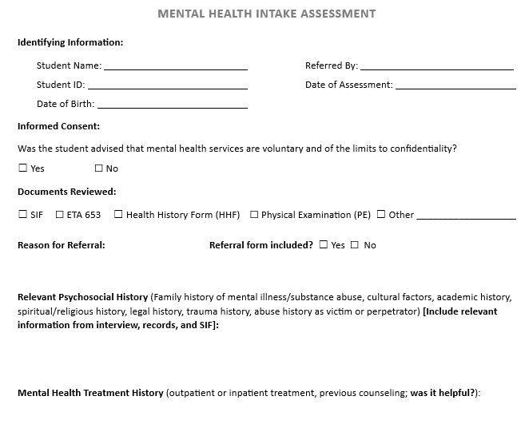
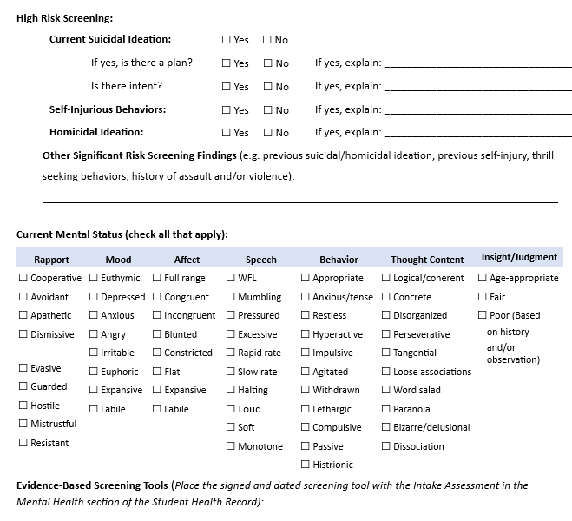
Mental Health Intake Assessment Form
Notes:
Briefly talk through the relevant or shown sections
This is a screen shot of portions of the first and second pages of the MH intake form that we recommend you use to document your initial diagnostic assessment with students. It’s not a requirement that you use this form; however, it’s strongly recommended because it includes all of the necessary information that you will want to have in your intake assessments. There’s a section on the intake form that lists the Documents Reviewed (ETA-653, Health History, SIF), Reason for Referral, Relevant Psychosocial History, and Mental Health Treatment History. There’s also a section that asks you to provide a mental status exam.

Slide 11
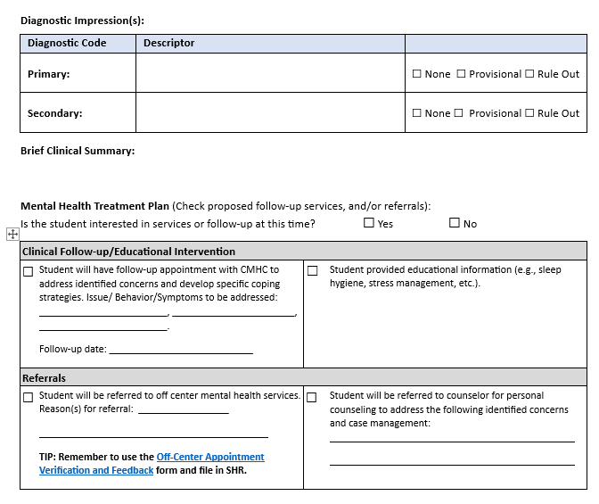
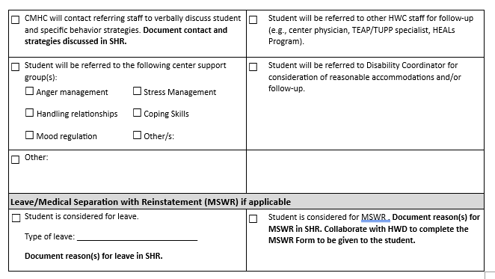
Mental Health Intake Assessment Form
Notes:
The current MH intake assessment form also includes an Mental Health Treatment Plan section. This section has you identify the plan regarding:
Clinical Follow-up (with CMHC)/Educational Intervention (providing educational information such as a Student Fact Sheet),
Referrals (on and off-center), or
Leave/MSWR
Questions about the form?
Now that we’ve covered the assessment pieces of today’s webinar, let’s move on to discussing the TREATMENT components of the MHWP .

Slide 12
Your Role as a CMHC: TREATMENT
[PRH Chapter 2.3, R4 MHWP]
To Treat or Not to Treat?
Drop In Visits vs. Brief Supportive Therapy
Use of CBT and other Evidence-based Approaches
On/Off Center Referrals and Feedback
Referral to center support programs/groups
Referral to community provider
Request for records/ROI
Get familiar with community resources
Notes:
TREATMENT (Clinical function)
As stated earlier, Job Corps utilizes an EAP Model, which consists of short-term counseling with a focus on employability. It’s brief therapy, solution-focused (or problem-focused) treatment aimed at identifying the impact of mental health difficulties on employment and helping remove those barriers. We encourage you to use evidence-based approaches like CBT, DBT, mindfulness, so forth if you have requisite training in these approaches.
You also may also refer students to on-center groups that you or the counselors lead. There are times when a student needs more intensive services and it may be necessary to refer them to an off-center provider for ongoing, more intensive treatment in individual or group programs. The programs may be ‘virtual’ OR in–person.
As the manager of the MH&WP, it's important that you track the student’s adherence to appointments and request updates from the off-center provider, as needed, so be sure to secure a Release of Information (ROI) form for outside providers.
There are many different situations where you might need to utilize Community Resources: 1) a student might need longer term therapy than an EAP program provides and/or a specific type of tx program (DBT group, sexual abuse survivors’ group), or 2) a student might need a medication evaluation by a psychiatrist. Your CP should initiate basic psychotropic medications; however, if a student has a complicated presentation or a CP is not comfortable initiating medications, then the student should be referred to an off-center psychiatric provider. 3) A student might be in the midst of a mental health crisis and require inpatient psychiatric hospitalization.
There is a tracking form on the HW website that can assist you in keeping track of your students’ adherence to treatment with off-center providers. It’s called the Off Center Appointment Verification Form and can be found in the TREATMENT section of the Mental Health Resource Bundles web page
To aid in your documentation, let’s take a look at some forms that we recommend you use to document your work, like the Tx Progress Notes and Referral and feedback form.

Slide 13
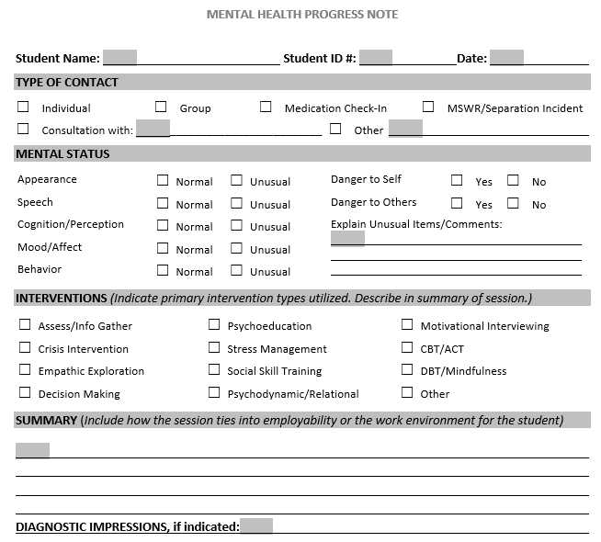
Treatment/Progress Notes
Notes:
This form is on the HW website and can be used to document a student’s group or individual sessions (it can also be used to document other things per boxes at top, but we'll stick with the therapeutic sessions for now).
This form has many check boxes so that it’s easy to complete, and there’s a brief summary section where the content and process of the session should be noted.
If a diagnostic change was made (either you might add a diagnosis or you might change the diagnosis that you initially provided on the diagnostic assessment), be sure to note it on your session note. If you prefer, you can create your own therapy note form, however, it should have, at a minimum, the same components of this form.

Slide 14
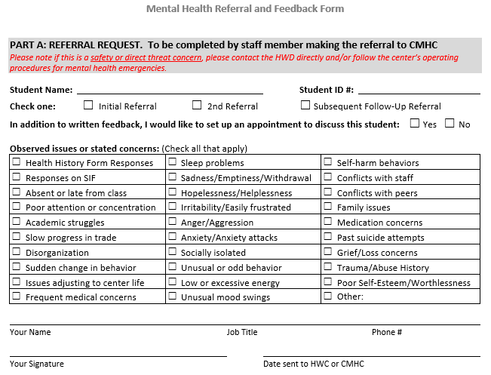
On Center Referral and Feedback Form
Notes:
The students you work with will often often be referred to you by teachers, trade-instructors, as well as your colleagues within the HWC. In some cases, these referrals may be somewhat informal, for instance, a staff may see you walking across campus and suggest you follow up with a student. Or, your CP might catch you in the hallway or write a note on the SF600 in the SHR indicating you should meet with a student. Some staff might send you student referrals via JC email.
It’s important to know that the PRH requires two things when it comes to referrals: first, that we have a way to document (in writing) when a referral occurs AND second, that the referral source is given feedback. Documentation of referrals and feedback is key because it ensures that there is follow through (e.g., a student doesn’t fall through the cracks) and that we are working as a team to support students (for instance, not only is your support of the student key, but the teacher being aware of ways to support the student is also highly important). Remember: to meet the PRH requirements you MUST document the referral and feedback in the individual SHR.
So how do you do that? There is a recommended Referral and Feedback Form on the HW website, which you see a screenshot of here. This is a recommended (not required) form. However, it’s really important to remember that if you don’t use this form, your system MUST meet both PRH requirements described above. The Referral and Feedback form can be used by Counselors, HWC staff, TEAP or any other center staff who want to make referrals to the CMHC, OR if the CMHC wants to refer to Counselor groups. You can see here that the first page has check boxes to indicate why the referral is occurring (e.g, the symptoms/behaviors of concern). It’s also important that the original referral and feedback form is filed in the SHR and a copy is sent to the referral source, documenting that the feedback occurred.

Slide 15
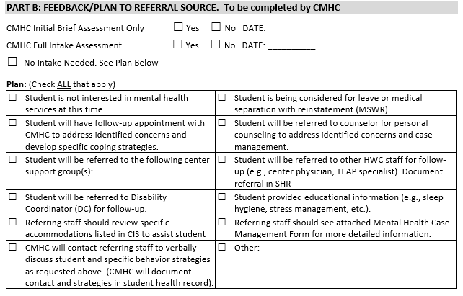
Return: Referral and Feedback Form
Notes:
This screen shot shows the second section or Part B of the Referral and Feedback Form, where you, the CMHC provide feedback to the referrer. Part B is where you let the referral source know what you did, the next steps for the student, or steps they should take, when appropriate. Some options included on this form are:
That you saw or attempted to see the student but the student is not interested in mental health services
You have scheduled a follow-up appointment for the student
Referring staff should review specific accommodations listed in CIS to assist student
You are referring the student to the Disability Coordinator or to the counselor or to a group, etc.

Slide 16
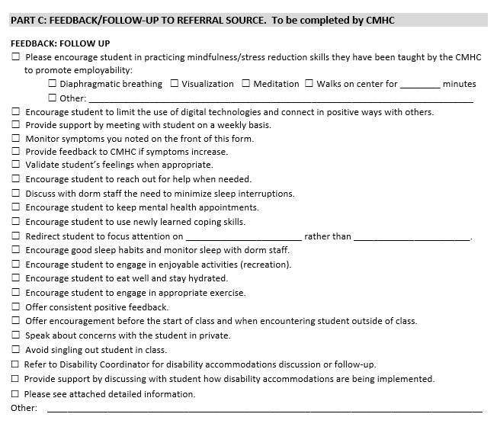
Return: Referral and Feedback Form
Notes:
This is the last page, Part C of the Referral and Feedback Form, which is where you provide what we call “behavioral feedback” to the referral source -- recommendations about the action steps the referral source can take to support the student. Examples include things such as:
☐ Encourage student to limit the use of digital technologies and connect in positive ways with others.
☐ Monitor symptoms you noted on the front of this form.
☐ Provide feedback to CMHC if symptoms increase.
☐ Encourage student to keep mental health appointments.
☐ Encourage student to use newly learned coping skills.
☐ Encourage good sleep habits and monitor sleep with dorm staff.
☐ Encourage student to engage in enjoyable activities (recreation).
☐ Encourage student to eat well and stay hydrated.
☐ Encourage student to engage in appropriate exercise.
☐ Offer consistent positive feedback.
Remember: If a student is referred off center, it will be important to: have the student sign a release of information form and for you to contact the provider and discuss ways to collaborate/receive updates. You should also follow up with the provider to track student progress and medication changes (if necessary). Remember that the Off Center Appointment Verification Form available on the Health and Wellness Website, can be used to track these off-center appointments and services.
SO PLEASE REMEMBER: Student referrals and feedback MUST be documented in the SHR.
Now, more about Treatment…

Slide 17
Your Role as a CMHC: TREATMENT
[PRH Chapter 2.3, R4 MHWP]
Collaboration with TEAP
Students with co-occurring mental health and substance use conditions
Collaboration with Counseling Staff
Case Management/Case Conference
Can include TEAP
Psychoeducational groups
CMHC provides clinical input to groups and lead groups by counselors
Crisis Management (counselors)
Crisis Intervention (CMHC, licensed clinical provider)
Notes:
Continuing with TREATMENT (Clinical function)
In addition to your individual meetings with students, the PRH requires that you:
Collaborate with TEAP: Many JC students have co-occurring mental and chemical health diagnoses, which is why it's important that you collaborate regularly with the TEAP to best support these students. For example. You may want to discuss an intervention plan with TEAP for a student who you believe has a primary need for substance use intervention, in addition to mental health services. Your TEAP specialist will also likely be working with students who they determine could benefit from mental health treatment.
Collaborate with Counseling Staff:
The PRH also requires that the CMHC meet regularly with the counseling staff to review students who may be of concern. Most centers have a weekly case management meeting that is attended by all the counselors and the CMHC. Some centers also include the TEAP in that meeting. Counselors can discuss students who they have concerns about and make referrals to the CMHC. The CMHC can provide feedback regarding students they are working with and may at times request that counselors check-in with students around different concerns. Of importance, the PRH requires two pieces of documentation: 1) First, documentation of regular meetings/collaboration, which might simply be a sign in sheet of who attended the meeting and 2) that any clinically relevant information discussed during the meeting is documented in the individual SHR. I'll show you the recommended case management form on the next slide in a minute.
In addition to the case management meeting, part of the CMHCs role includes helping Counselors develop Psychoeducational Groups such as coping skills development or anger management by providing clinical input. The PRH does not require that CMHCs lead their own groups; however, CMHCs, as licensed providers, can develop treatment/therapy groups, if desired.
Finally, counselors often help support students when crises occur on center. Their role involves de-escalating situations and providing support until the licensed clinical provider can initiate intervention/treatment and/or recommend the student be assessed by a crisis team/off center licensed provider. It's important that counselors receive training in the Symptomatic Management Guidelines and the MH Emergency SOP, if your center has one, as they will often be the first responders to crises. Again, the counselors, as unlicensed staff, will not provide assessment or intervention, which is your role as the licensed clinician.

Slide 18
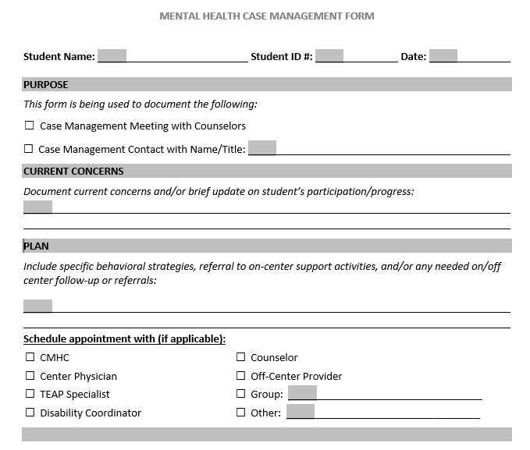
Collaboration with Counseling Staff [PRH Chapter 2.3, R4, d(4)] Case Management/Case Conference
Notes:
This is the form that I referenced on the last slide that you might choose to use to document clinically relevant information discussed during your case management meetings with the counselors. You can find this form on the HW website.
This form is designed to be easily completed by either you or a counselor while you are discussing a student during the case management meeting. This form should be signed by the person completing the form, and the original version should be filed in the Student’s Health Record (SHR) in the MH or CMHC section.
You can find the link to The Mental Health Case Management Form below, as well as links to two "label" versions of the case management form, if you prefer those. https://supportservices.jobcorps.gov/health/Documents/MentalHealth/MH_Case_Management_Form_Final.docx
MH Case Management Label version 1: https://supportservices.jobcorps.gov/health/Documents/MentalHealth/Case_mgmt_label_Avery6878_no_student_sticker.docx
MH Case Management Label version 2: https://supportservices.jobcorps.gov/health/Documents/MentalHealth/Case_mgmt_label_Avery6878_with_student_sticker.docx

Slide 19
Your Role as a CMHC:
TREATMENT [PRH Chapter 2.3, R4 MHWP]
Collaboration with CP, HWC staff on Psychotropic Medication Monitoring
Monthly Review of students on psychotropic medication
Use Medication Monitoring Form
Notes:
There is one final collaborative treatment process to mention: Monthly Monitoring of students who are prescribed psychotropic medications.

Slide 20
Medication Monitoring Form
Notes:
This is a screenshot of the recommended monthly medication monitoring form, which can be found on the HW website. The PRH requires that students’ who are prescribed medications, including psychotropics, be reviewed on a monthly basis by the HWD and the center’s relevant prescribing health professional (CP, NP). As the CMHC, you may also be involved in monitoring students who are prescribed psychotropic medications. Your involvement could take several different forms:
You may be asked to participate in the monthly medication review meetings and share information about students you work with
Medical or nursing staff may refer students to you for diagnostic clarification to assist the CP in prescribing psychotropic medication
You may be asked to meet with students who exhibit poor medication compliance
There are different ways you might document this coordination of care, such as
If you participate in the monthly medication review meeting with the HWD and CP, your signature would be on the medication monitoring form
If you meet with students separately prior to the monthly medication review, you would document medication related discussions on your MH Progress Note by checking the “medication monitoring” checkbox and then writing a note on SF-600 to share key medication related information with other health staff.
It’s important that each center have a process for monthly monitoring of students on medication. Ask your HWD about your center's process and how you can be involved and make sure your involvement is documented.

Slide 21
Your Role as a CMHC:
TREATMENT [PRH Chapter 2.3, R4 MHWP]
Crisis Intervention
Have a plan, consult with CD and HWD
Critical Incident Crisis Intervention Plan on H&W Support Website
With CD, HWD, establish &/or review Mental Health Emergency SOP
Will you take on-call coverage?
24 hours/day, weekends only, joint coverage with HWD
Utilize essential staff (residential/counseling)
Know your community resources
Crisis Center, Mobile Crisis Response Team, sexual assault services, domestic violence, day/partial day treatment programs, homeless STs, substance use treatment
Notes:
TREATMENT (Clinical function)
Earlier we talked about collaborating with the Counselors (and residential staff) for Crisis Management. Crisis Intervention is an important aspect of the CMHC role. We strongly recommend centers develop a Mental Health Emergency SOP, which we’ll discuss a bit later in this webinar.
Crisis Interventions can occur in different ways: it might be you meeting individually with a student after a crisis that only impacted them (e.g., such as a sexual assault) or it might be a small group intervention after several students have witnessed/been part of a traumatic event. Sometimes, it's important that we implement Center-wide interventions. While rare, Center Wide Interventions should occur if there is a loss of life (student or staff death for example) or a serious incident impacting many on center. There is a crisis intervention/debriefing document, which is called the Critical Incident Crisis Intervention Plan, to help guide you and the center through a crisis situations that have broader impacts on your center. A Crisis Intervention document specific to COVID-19 death has also been created and you can find both of these on the HW website.
We strongly recommend you contact your RMHS if there is a critical incident on your center. Your RMHS can provide you with support and necessary resources.
I want to mention the importance of understanding whether your contract with the center includes you being available 24/7 for mental health emergencies. If you are not available, it's essential that your HWD/center RN (or whomever is on-call for emergencies) is aware of the mental health crisis plan for after hours emergencies. All of this (and more!) is covered in the Sample SOP for Mental Health Emergencies, which can be found on the HW website: https://supportservices.jobcorps.gov/health/Documents/MentalHealth/SOP_MH_emergencies.docx
One final point: we strongly recommend you know and connect with your community resources (read SLIDE last bullet)

Slide 22
Your Role as a CMHC:
Mental Health Promotion and Education
[PRH Chapter 2.3, R4 MHWP]
CPP Presentation (not to be conducted by HWD or other staff)
Overview of MH Services
Intro to CMHC hours on center, scheduling appointments, basic skills in identifying and responding to a mental health crisis, etc.
For CPP Presentation, a PPT template is available on Health and Wellness Support Website
Annual Center-Wide Activity
Examples: February is Teen Dating Violence Awareness and Prevention Month, May is Mental Health Awareness Month, September is Suicide Awareness and Prevention Month
See Mental Health and Wellness Program-Related Observances on the HW website.
Notes:
Now we’re going to shift from the treatment related responsibilities of the mental health program and discuss the third, and final component of the CMHC Role: MENTAL HEALTH PROMOTION AND EDUCATION Activities (Consultative function)
The PRH requires the following:
During the Career Preparation Period (CPP), you will meet with each new group of students together to introduce yourself and provide an overview of the mental health program. Your presentation should also cover how to access the Job Corps Safety Hotline information (844-JC1-SAFE) and give a brief "gatekeeper/MH first aid" type training. This is typically the first contact you’ll have with students as they arrive on center.
There is a CPP presentation PPT template on the H&W website that you can use, or you can develop your own presentation, as long as it includes the required elements.
The PRH also requires that CMHC(s) provide at least one Center-Wide mental health prevention/education activity a year. CMHCs meet this requirement in a lot of different ways—you might celebrate Suicide Prevention Awareness Month in September by developing a center-wide activity; you might do a mental health related activity during Mental Health Awareness month, which is in May. Be creative and talk with your co-CMHCs and HWD for ideas.

Slide 23
Integrated Programming with Other Center Departments
TEAP/TUPP, HEALs, SART, residential, recreation
Consultation with Center Director
Monthly meeting with CD. Center Physician is also required to have monthly meeting with CD as well as relevant HWC staff.
Minutes are used to document meetings and must show CMHC and CD (or representative) were present.
Notes:
Part of the Consulting piece of the CMHC position, is developing Integrated Programming with Other Center Departments
There are a lot of different ways in which you might be involved in Integrated Programming. For instance, you might develop a joint program/activity with TEAP/TUPP; you may join the Healthy Eating and Active Lifestyles (HEALs) committee and help integrate mental health into programming (e.g., use of motivational interviewing; bringing an awareness around eating disorders or the impact of diet & exercise on mood regulation). You may provide input or develop training as part of the Sexual Assault Response Team (SART) (e.g., managing personal relationships, emotional safety, healthy dating, etc.). All of these programs and acronyms will make more sense as you get familiar with Job Corps.
We recommend that you make a binder and keep track of your annual mental health education and promotion event/s and the different trainings and collaboration you do with other departments. This will help you remember everything that you’ve done and you can share this information when your center has a site visit.
In addition to integrated programming, The PRH also requires that you and the CD meet monthly. This Monthly meeting/Consultation with Center Director might focus on any MH trends you’ve noticed on center. You might ask for things you need or believe would strengthen the MH program. You might also discuss specific students who have extenuating mental health circumstances and might have specific needs (e.g., may have difficulty matriculating due to mental health symptoms). Remember your role is key to developing an emotionally healthy culture on center and this meeting with the CD helps you build a relationship with your CD so you can collaborate and have support for the MH program. Your CP is also required to have a monthly meeting with the CD so some centers combine this meeting and have you and the CP meet with the CD together, which is fine. Minutes must be kept of this meeting.

Slide 24
Staff Training
Adolescent Growth and Development – 5 hours required annually
SafetyNet (self-guided study on prevention of suicide, bullying, relationship violence) can count for 3 of the 5 hours of training
Usually conducted during Winter Break
Can also use outside/community presenters
Many resources on the Health & Wellness Support Website
Crisis Response and Management
Notes:
MENTAL HEALTH PROMOTION AND EDUCATION (Consultative/Administrative function)
A final piece of the CMHC position involves providing Staff Training. All staff are required to have 5 hours of Adolescent Growth and Development Training annually. Pre-recorded SafetyNet trainings can provide 3 of those 5 hours, but you will often be asked to do other trainings on topics that feel relevant for staff at your center. Adolescent Growth and Development is defined broadly, you may do a presentation on handling challenging student behaviors; or how to use motivational interviewing with students; or strategies for helping anxious students; or helping staff with burnout/compassion fatigue from working with students many of whom have significant trauma histories. You might also consider providing a staff training on crisis responding and how to manage crises on center.

Slide 25
Staff Training (not required)
Staff Introduction to CMHC (PPT template)
https://supportservices.jobcorps.gov/Health/Pages/MentalHealth.aspx
“New Hire Orientation – CMHC Introduction”
Mental Health Training for Center Staff
Trauma-Informed Approach (TIA)
https://supportservices.jobcorps.gov/health/Pages/TIA.aspx
Notes:
I want to touch on a few additional trainings that aren't required, but are important so I want to highlight.
First, as a new CMHC, you may choose to do a brief presentation to introduce yourself to staff, explain how to make a mental health referral on your center, and share strategies they can use when working with students. We've developed a "Staff Introduction to CMHC" training, with PPT template on H&W website that you could use. Again, this is not a required training, but something you might want to do to increase your visibility on center.
During the COVID pandemic, there was a required staff training on developing a Trauma Informed Approach on center. While this training is no longer required, it's strongly recommended that you consider continuing to use it as a regular staff training. Many Job Corps students have experienced significant trauma and understanding and implementing a Trauma Informed Approach helps us best support them. The PPT training, which is available on the HW website, has detailed notes that allow you to walk staff through the training even if you don't have much experience yet yourself in teaching a Trauma Informed Approach. There are also additional tools and trainings that can be used to help implement a Trauma Informed Approach, and these can be found on the web page shown above.
Now we’re going to spend a bit of time on the next slides discussing different helpful resources to be aware of:

Slide 26
Standard Operating Procedures (SOPs) and Center Operating Procedures (COPs)
SOPs are documents required by JC to ensure that centers are meeting compliance requirements and have policies & procedures in place for different situations.
The Health and Wellness Program (HWP) has 4 required SOPs. The only one that includes the CMHC is the Staffing SOP.
Additional recommended COPs:
Mental Health and Wellness Program (MHWP)
Mental Health Emergencies
template on HW website
Talk with your HWD to obtain and review copies of relevant SOPs/COPs.
Notes:
Job Corps has developed guidance documents to ensure that centers are meeting compliance requirements--these are called SOPs (Standard Operating Procedure) or Center Operating Procedure (COPs) (same thing).
The Health and Wellness Program has 4 required SOPs. The only one that includes you, the CMHC, is the Staffing SOP. There are, however, two strongly recommended SOPs/COPs that relate to the MH program. The first is the Mental Health Emergency SOP, which we mentioned earlier in the webinar--it's the SOP that guides staff in how to manage mental health emergencies, particularly if they occur after hours, when you're not on center. Please ask your HWD to see any existing SOPs and consider developing one for MH emergencies, if your center doesn't already have one. There is a template/example MH Emergency SOP on the HW website. The second recommended SOP describes the MHWP—you’ll want to check if your center has one and make sure it’s consistent with your role.
Now let's shift to talk about Health Care Guidelines.

Slide 27
Job Corps Health Care Guidelines
Written documents of accepted practices for managing common health problems
Must be reviewed, approved and signed annually by the appropriate provider.
Treatment Guidelines (TGs)
Symptomatic Management Guidelines (SMGs)
Health Staff
8 TGs for Mental Health
Anxiety Disorders (Including Panic & Phobic Disorders)
AD/HD
Bipolar Disorder
Depressive Disorders
PTSD or Acute Stress Disorder
Psychotic Disorders
Suicidal Self-Directed Violence
Non-Suicidal Self Injury Behavior
Non-Health Staff
3 SMGs for Mental Health
Behavior Changes/Unusual Behavior
Suicidal Self-Directed Violence
Non-Suicidal Self-Injury
Talk with your HWD so you can review current HCGs
Notes:
The PRH requires that centers have Health Care Guidelines, which must be reviewed, approved and signed annually by the appropriate health provider. Your HWD should ask you to review and sign the mental health related HCGs each year.
Health Care Guidelines are broken up into 2 types.
There first are Treatment Guidelines for Health Staff, which are Written documents that basically guide health staff in managing different medical, mental health, dental treatments. There are 8 mental health related TGs (see dx on slide).
2) The Symptomatic Management Guidelines are for non-health staff. They direct non-health staff (like residential advisors, security, so forth) on what to do in different emergent situations when no health staff are present on center. There are 3 SMGs for MH (read titles in slide)
A few things to REMEMBER:
Treatment Guidelines are for health staff only. The 8 mental health related TGs are for health staff (such as the RNs, LPNs, so forth) to follow to help them manage mental health related situations when you might not be available. Similarly, the physical health related TGs are for the RNs to follow under the CP's authorization. Non-health staff should NOT attempt to follow TGs unless for some reason they have a written personal authorization to do so.
Ask your HWD about details of when your HCGs need reviewing and updating!
Now, let’s take a quick look at an actual TG and SMG… Going forward, all forms will be outlined in Red.

Slide 28
Treatment Guidelines
Each TG contains:
Common Symptoms of the mental condition
What to do first
Assess Symptoms and Behaviors
What to do next
Evidence-based questionnaire(s) in English and Spanish
Each TG contains:
Common Symptoms of the mental condition
What to do first
Assess Symptoms and Behaviors
What to do next
Evidence-based questionnaire(s) in English and Spanish
Notes:
Here you see the Treatment Guideline for Health Staff for Depressive Disorders:
FORMAT: Each MENTAL HEALTH Treatment Guideline (remember, these are for health staff only) starts with:
Common Symptoms of the mental condition
What to do first
Assess Symptoms and Behaviors, and
What to do next
At the end you’ll find relevant evidence-based questionnaire(s) in English and Spanish that can be easily administered to students who voluntarily agree to complete them.

Slide 29
Symptomatic Management Guidelines
Each SMG contains:
What to do first
What to do next
A flow chart for easy decision-making
Notes:
This slide on the right shows the Symptomatic Management Guidelines for Non-Health Staff for Behavior Changes/Unusual Behavior
FORMAT: Each Symptomatic Management Guideline (SMG) Contains:
What to do first
What to do next
A flow chart for easy decision-making

Slide 30
SMG Flow Chart: Behavior Changes/Unusual Behavior
Notes:
The flow chart provides options for decision-making for the non-health staff, in this case, depending on whether the student demonstrates:
Dangerous Behavior
Odd or Unusual Behavior
Suicidal Thoughts and gestures
Suspected Alcohol and/or Drug Use
The staff is given practical steps like ensuring the safety of the affected student and others, when to contact other center staff, or when to use another SMG.
Included in this SMG is a brief 6-item list of questions that non-health staff can use to better understand if a student’s behavior is possibly due to drugs/alcohol, psychosis (or a mental health condition).
Once the situation with the affected student is managed or resolved, there are also suggestions for follow up.
Have you signed the TGs on your center???

Slide 31
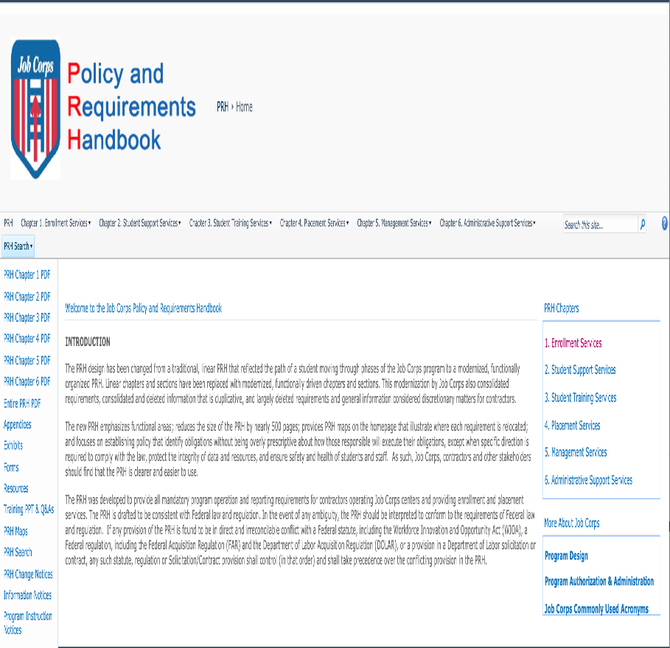
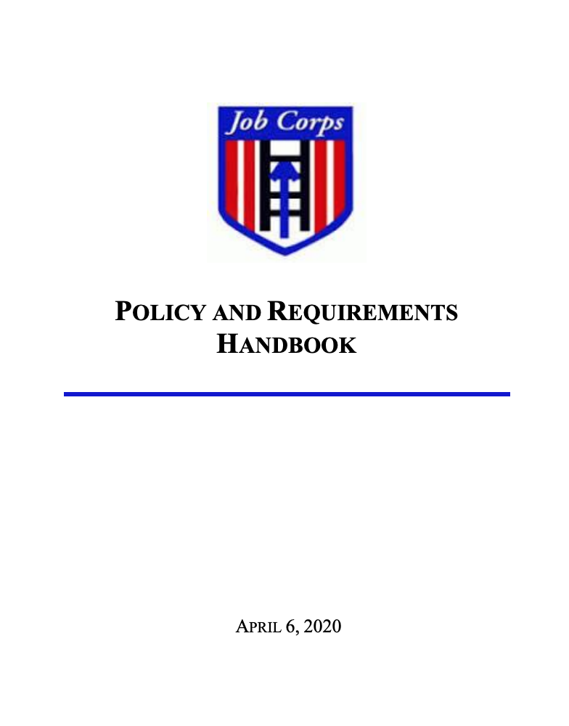
Policy and Requirement Handbook (PRH) and Desk Reference Guide (DRG)
Notes:
Finally I just want to spend a few moments directing you to some key resources. 1) The PRH or “policy and requirements handbook" includes all the required components for the entire Job Corps program. This can be found online at the address listed on the slide. You can also simply type Job Corps PRH in your search engine and you will find this document online. The PRH is a huge document, which is divided into 6 chapters. You should focus on reading Chapter 2 (Section 2.3), which focuses on ensuring students receive health and wellness services, support, and education. The other chapter to focus on is Chapter 1, which outlines the steps in completing applicant file reviews and how to complete recommendations of denial.
For each of the health and wellness programs, there is a guidance document called the Desk Reference Guide (DRG). The CMHC Desk Reference Guide (DRG) explains in detail how to implement all the PRH requirements for the mental health program. You can access the CMHC DRG on the HW website. You'll notice that within the document are hyperlinks that take you to the sample templates, as well as recommended and required forms. You can then download these forms to use on your center.
Please type yes or no in the chat box if you have reviewed the DRG.

Slide 32
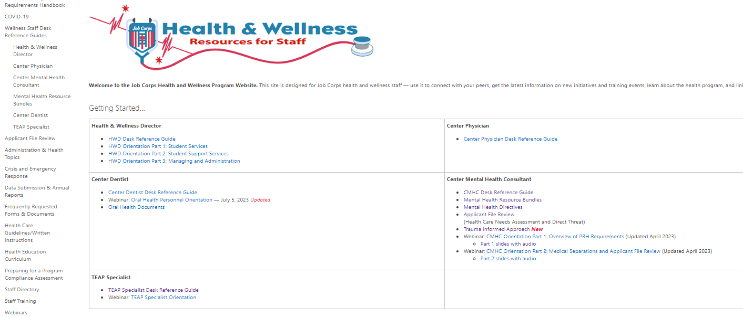
Health and Wellness Support Website
https://supportservices.jobcorps.gov/health/Pages/default.aspx
Notes:
SUPER IMPORTANTLY, This is a snapshot of the HW website home page which can be accessed outside of JC using the link at the bottom of the slide. (You can also find the HW website simply by googling "Job Corps Health Support.")
The first bullet under Center Mental Health Consultant heading will take you to the DRG and you can download a copy onto your computer.
The second bullet takes you to the “Mental Health Resource Bundles” web page that we will look at more closely on the next slide.
The fourth bullet has all the information, guidance and forms you will need to complete Applicant File Reviews
The fifth bullet links to the brand-new Trauma Informed Approach web page mentioned earlier.
Clicking on the sixth and seventh bullets will download the CMHC Orientation slides Part 1 and Part 2, respectively.

Slide 33
CMHC Resource Bundles
2
1
https://supportservices.jobcorps.gov/health/Pages/MH-Resource-Bundles.aspx
Notes:
The CMHC Resource Bundles are where you will find the most important resources related to different topics. Where you see the BLUE number 1 and arrow is a list of the 9 bundles that can be found on this page. Each bundle contains an overview, guidance, and working documents to assist you in developing a comprehensive MHWP that meets all requirements based on Job Corps’ Policy and Requirements Handbook (PRH).
The topics covered by the 9 bundles are:
Applicant File Review (AFR) Essentials
Assessment & Documentation
Treatment & Documentation
MH Promotion & Education
Crisis Intervention
Collaboration
Medical Separation with Reinstatement (MSWR)
Health Care Guidelines
Disability Program Support
At the RED number 2 and arrow are some general CMHC Resources, specifically
Job Corps Organizational Chart
Staff Directory (National Office, Health Support Contractor, and Health Specialists)
MHWP and TEAP Acronyms
PRH Chapter 2, 2.3 Mental Health and Wellness Program
CMHC Task and Frequency Chart
CMHC Desk Reference Guide
Webinar: CMHC Orientation Part 1: Overview of PRH Requirements
Webinar: CMHC Orientation Part 2: Medical Separations and Applicant File Review
PRH Chapter 1 Enrollment Services
Any questions???

Slide 34
Q & A What’s Next?
Download
Download Power Point and Review It
Go
Go to the HW website and review the DRG and the forms discussed today!
Reach out
Reach out to your RMHS often!!!
Notes:
So what next!? First, I realize this is a lot of information so take time to digest it and know that it will likely take you 6-12 months to feel completely comfortable with all the different mental health related requirements. I recommend you download this PowerPoint and review it again and make sure to check out the HW website and review the DRG and other forms we discussed today. Your HWD and co-CMHC/s are also great resources. And always know you can reach out to your Regional Health Specialist with questions!

Slide 35
Regional Mental Health Specialists (RMHS)
Region 1 (Boston)
Elizabeth Jarski, LCSW
Maria Acevedo, PhD (Puerto Rico)
Region 2 (Philadelphia)
Valerie Cherry, PhD
Region 3 (Atlanta)
Elizabeth Jarski, LCSW
Regions 4 (Dallas) & 6 (San Francisco)
Tamara D. Warner, PhD
Region 5 (Chicago)
Helena Mackenzie, PhD
Notes:
Here is a list of the RMHS names for each region.
Job Corps has 6 regional offices– Boston ( PR), Philadelphia, Atlanta, Dallas, Chicago, and San Francisco (includes Alaska and Hawaii). Every Regional Office has a regional nurse specialist, (RNS), regional medical specialist (RMS), regional mental health specialist (RMHS), regional trainee employee assistance (TEAP) specialists, regional dental specialists (RDS), and regional disability coordinators (RDCs).
Your RMHS provides technical assistance to you and other center health and wellness staff members, conducts monthly teleconferences with the center mental health consultants (CMHCs) in their region, and conducts periodic center assessments for quality and compliance with the Policy and Requirements Handbook (PRH).
***********OPTIONAL*********************
If you are not sure of what region you are in or who your regional mental health specialist is, please type your name in the chat box and your center and I’ll follow up to connect you with your RMHS.

Slide 36
Please Plan to Attend: CMHC Orientation Part 2: Applicant File Review CMHC Orientation Part 3: Medical Separation with Reinstatement Rights (MSWR)
Notes:
CMHC Orientation Part 2 on AFR will be on Tue April 2nd at 2 ET
CMHC Orientation Part 3 on MSWR will be on Wed April 24th at 2 ET
If you want to review the slides from today’s presentation (or listen to it again!) it should be uploaded to the H&W website by tomorrow.
Thank you all!

