Slide 1
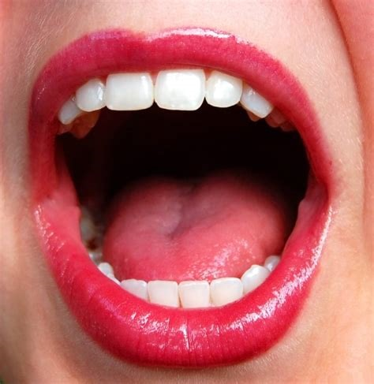
Dental Readiness Inspection Training
Presented by:
Dr. Pam Alston
Lead Oral Health Specialist

Slide 2
Webinar Objectives
1) To train the dental hygienists, dental assistants, and nurses on the DRI armamentarium, technique and documentation requirements
2) To train the center dentists, center physicians, nurse practitioners, and physician assistants on their responsibilities related to authorizing other Wellness staff to perform the DRI, granting waivers for the DRI and documentation requirements
3) To train the Health and Wellness Directors on their responsibilities related to ensuring the inspectors have the resources they need to accomplish the DRI and overseeing the process to ensure that the DRIs are done effectively and efficiently

Slide 3
The Dental Readiness Inspection gets its name from the Medical Readiness
Medical readiness involves a series of assessments to ensure that uniformed service members are free of health-related conditions that endanger others or limit their ability to achieve their assigned mission.

Slide 4
Dental Readiness Inspection (DRI)
Dental readiness involves an inspection to ensure that newly enrolled students are free of oral health-related conditions that limit their ability to perform at Job Corps.
A process for checking for the possible presence of a particular problem.
It is not a process for defining the nature of that problem, determining a diagnosis, or developing specific treatment recommendations for addressing the problem or diagnosis.

Slide 5
Opportunities for students to learn about the Oral Health and Wellness Program during the Career Preparation Period
Dental Readiness Inspection (DRI)
Health history review
Introduction to Health Services
Clinical evaluation of the mouth during the Physical Exam

Slide 6
PRH-2.3, R3 Oral Health and Wellness Program
Centers must provide basic dental services including—
b. A dental readiness inspection must be completed within 14 days after arrival by the center dentist or designee as determined by the center dentist who authorizes the activity by a written personal authorization.
The dental readiness inspection must be documented in the appropriate section on the Job Corps Physical Examination Form.

Slide 7
Agreement for Dental Services between the Center Operator and Subcontractor Oral Health Program Scope of Work and Statement of Work

Slide 8
Dental Readiness Inspection Authorization
Personal Authorization for Center Nursing Staff
Personal Authorization for Center Dental Staff
The Center Physician (or NP or PA)
signs the authorization if there is no
on-center dentist.

Slide 9
Dental Readiness Inspection Authorization
Personal Authorization for Center Nursing Staff
Personal Authorization for Center Dental Staff
Viewing the Dental Readiness Inspection Training
Video is a Pre-requisite to receiving authorization

Slide 10
Each time new arrived students have an encounter that relates to their oral health, they should be encouraged to access Oral Health and Wellness Program services if they don’t have a dental home and even if they do not believe they have dental problems.

Slide 11
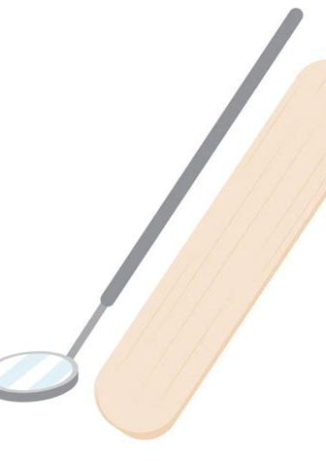
Armamentarium
Gauze
Personal Protective Equipment
Tongue depressor or mouth mirror
Light source

Slide 12
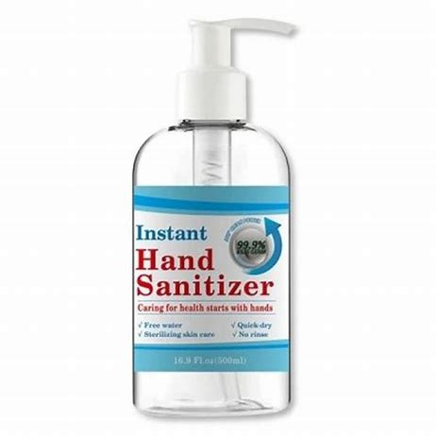
A handheld mirror for the student Hand sanitizer between students Seating

Slide 13
Student Health Record
Document in Section 14 on the Oral Examination form

Slide 14
At the beginning of the DRI encounter
Welcome the student.
Tell the student your name and classification.
Confirm with them their name and birthdate.
Let them know that you will be inspecting the mouth using only a tongue depressor or mouth mirror and gauze. Let them know what you will be looking at and looking for.
Let them know approximately how long the DRI takes to complete.
Explain the purpose of the DRI.
Reassure them that it is not to see if they need to be separated from Job Corps.
Reassure them that the purpose is to see if they need oral health services on an urgent basis.

Slide 15
Inspectors, position the student and your self where you can see the mouth best

Slide 17
Optional Questionnaire

Slide 19
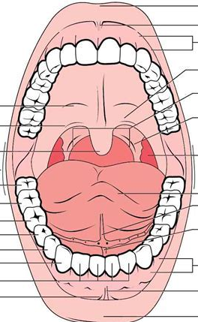
swelling
Holes in teeth
Bleeding gums
sores

Slide 20
Bleeding Gums

Slide 21
Bleeding Gums

Slide 22
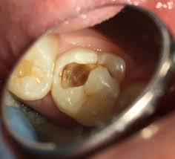
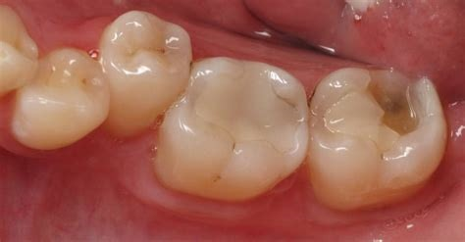
Hole in Tooth
Hole caused by a piece of filling missing
Hole caused by caries disease
UL = Upper Left LL = Lower Left UR = Upper Right LR = Lower Right

Slide 23
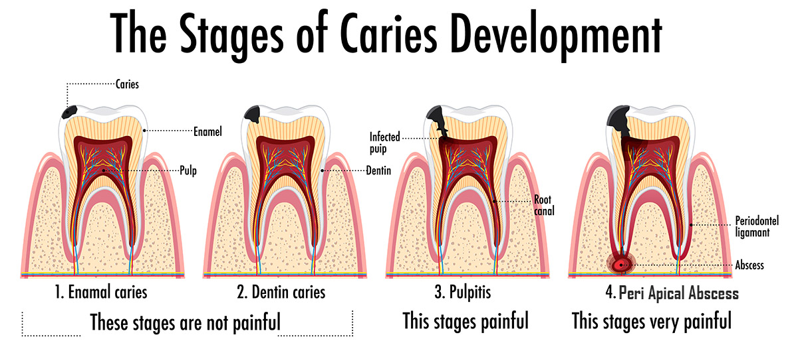

Slide 24
Common sores on the outside and inside of the mouth

Slide 25
Sore at corner of the mouth—right side

Slide 26
Angular Cheilitis

Slide 27
Sores on the buccal mucosa or tongue

Slide 28
Sore—Aphthous Ulcer (Canker Sore)

Slide 29
Sore on Lip

Slide 30
Sore—Herpes Simplex

Slide 31
Over the counter products

Slide 32
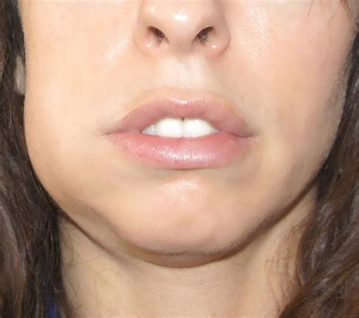
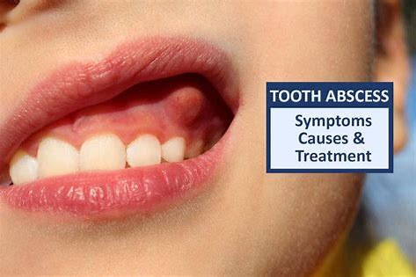
Swelling in the Mouth or Jaw
Extraoral Swelling
Intraoral Swelling

Slide 33
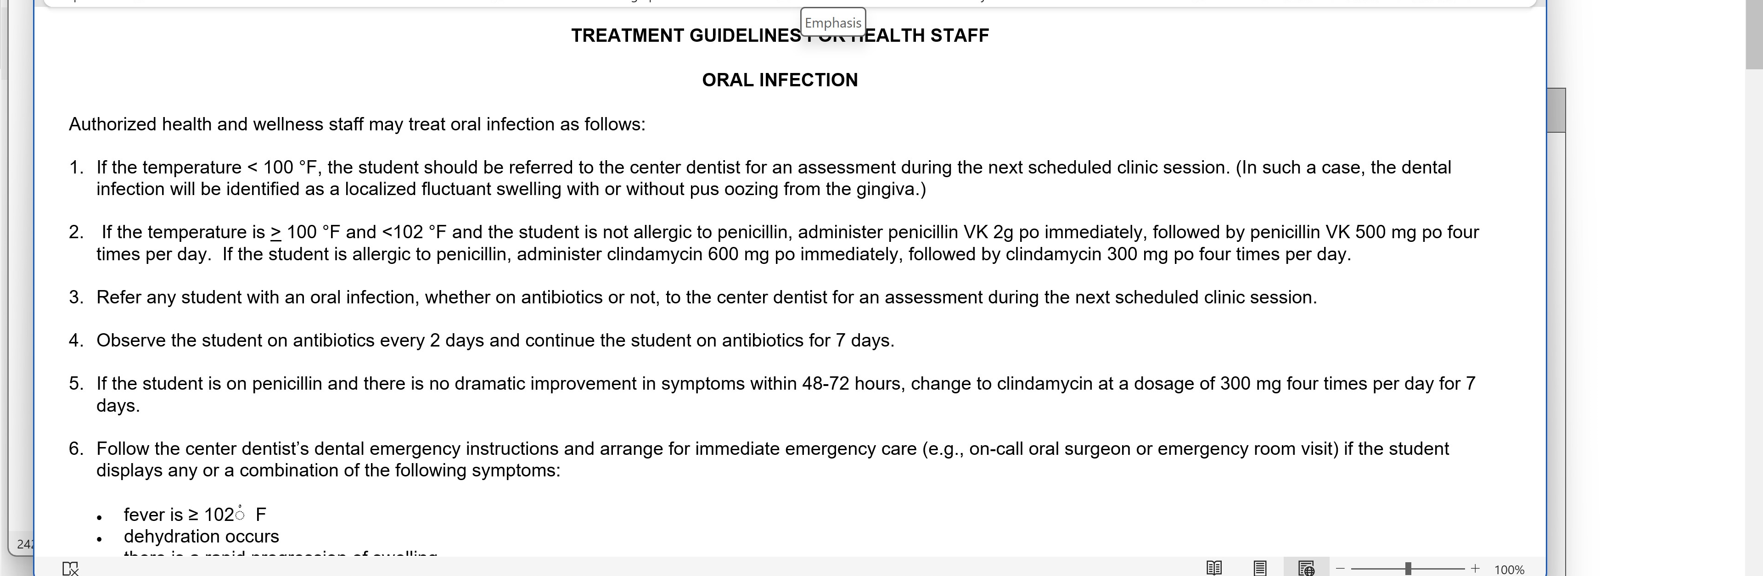
Health Care Guideline for Oral Infection

Slide 36
Reported Moderate to Severe Pain

Slide 37
Questions to Ask
Moderate Pain
Severe Pain
Does the pain interrupt some activities?
Is the pain hard to ignore?
Does the pain cause you to avoid your usual activities?
Is the pain the focus of your attention?
Does the pain prevent you from doing daily activities?
Is the pain awful, making it hard for you to do anything?
Can you not bear the pain and are unable to do anything?
Is the pain as bad as it can be and nothing else matters?

Slide 39
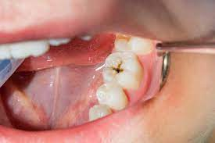
DRI findings
Hole in tooth
Moderate pain
Job Corps Physical Examination Form—Section 14
Job Corps Physical Examination Form—Section 38
Standard Form 600—Chronological Record of Medical Care

Slide 40
Health Care Guideline for Oral Pain

Slide 41
“Other”—White Tongue

Slide 42
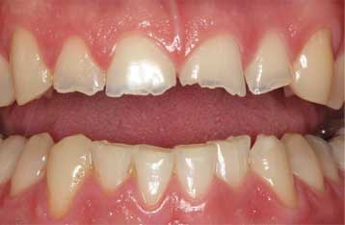
“Other” Teeth Grinding or Clenching

Slide 43
“Other”—cheek biting

Slide 44
Share findings with the student
Point out to the student what you observed.
Remind the student that the DRI has limitations.
Encourage the student to follow-through with any referral made and with consenting to an oral examination

Slide 45
What happens if the student does not want a DRI?

Slide 47
PRH-2.3, R3 Oral Health and Wellness Program
Centers must provide basic dental services, as described below:
b. A dental readiness inspection must be completed within 14 days after arrival by the center dentist or designee as determined by the center dentist who authorizes the activity by a written personal authorization.
The dental readiness inspection must be documented in the appropriate section on the Job Corps Physical Examination Form.

Slide 48
Chapter 2.3 R15. Waiver of Medical Care
a. The Center Physician/Nurse Practitioner (NP)/Physician Assistant (PA) may waive any portion of the medical examination and laboratory testing except for the entrance drug testing if in his or her opinion there is sufficient justification or if a student refuses. Such a waiver must be clearly documented by the Center Physician/NP/PA in the student’s health record and include an explanation as to why the decision was made.

Slide 49
Documentation for the DRI Waiver
On the Physical Exam form, Section 14, draw a line through “completed by.” The center
Dentist or in the absence of the Center Dentist, then the MD/NP/PA will enter “waived
by” and sign and date it.
The center dentist will enter on the Chronological Record that the DRI was waived, state the reason
for the waiver, and sign the entry. When there is a dentist vacancy, the MD/NP/PA will make the entry.

Slide 50
Section 19. Mouth and Throat Clinical Evaluation

Slide 51
Reasons why a student may refuse a DRI may be:
The student has a dental condition that they think may result in them being given a MSWR
The student may be embarrassed about the condition of their mouth
The student may be embarrassed because they have bad breath
The student may have experienced a distressing or disturbing experience related to dentistry that had a profound physical or emotional impact.
The student may not feel that their oral health is important.
The student may have a dental home already and seen the dentist recently.

Slide 52
The Oral Health Team does not want empty chairs.

Slide 53
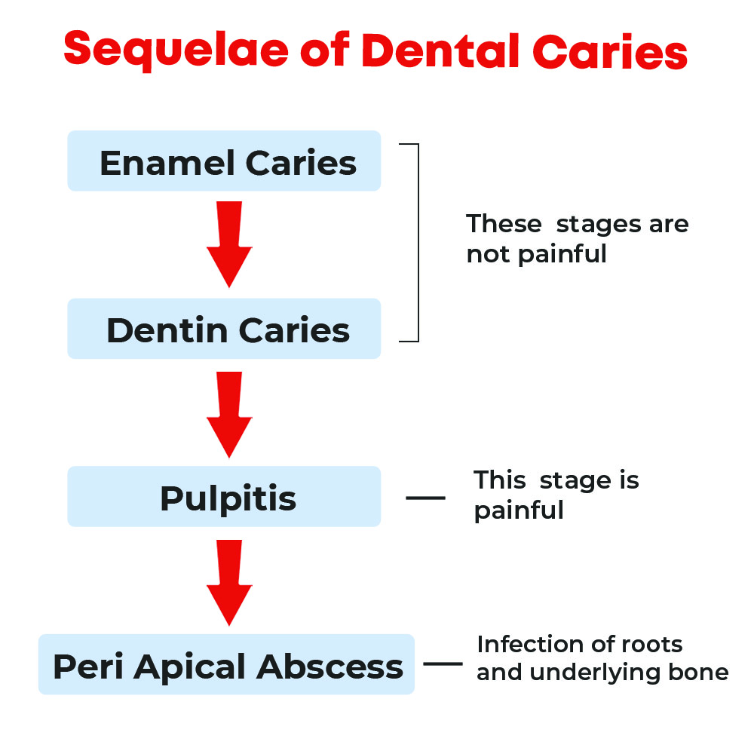
Sequelae of Dental Caries
Reference: https://drpraveens.com/2023/01/16/sequelae-of-dental-caries/

Slide 54
“An average of 320.8 million work or school hours were lost annually for dental care in the United State”
92.4 million hours for emergency (unplanned) care
159.8 million hours for routine (planned) care or orthodontic care
68.6 million hours for cosmetic care
Reference: Kelekar U, Naavaal S. Hours Lost to Planned and Unplanned Dental Visits
Among US Adults. Prev Chronic Dis 2018;15:170225.
DOI: http://dx.doi.org/10.5888/pcd15.170225external icon

Slide 55
Make the most of DRI encounters
Use a questionnaire to gather some information
Utilize the Oral Health Personnel to make the Oral Health and Wellness Program (OHWP) presentations during the Students’ Introductions to Wellness and explain the DRI encounters
Explain the OHWP as an employee benefit

Slide 56
Make the most of DRI encounters--continued
Match vocabulary to students’ health literacy levels to improve their understanding
The nurses who perform the DRIs should obtain talking points from the center dentists/dental subcontractors
Give written instructions on how to make appointments
See students the same day for DRIs and EOEs if time permits

Slide 57
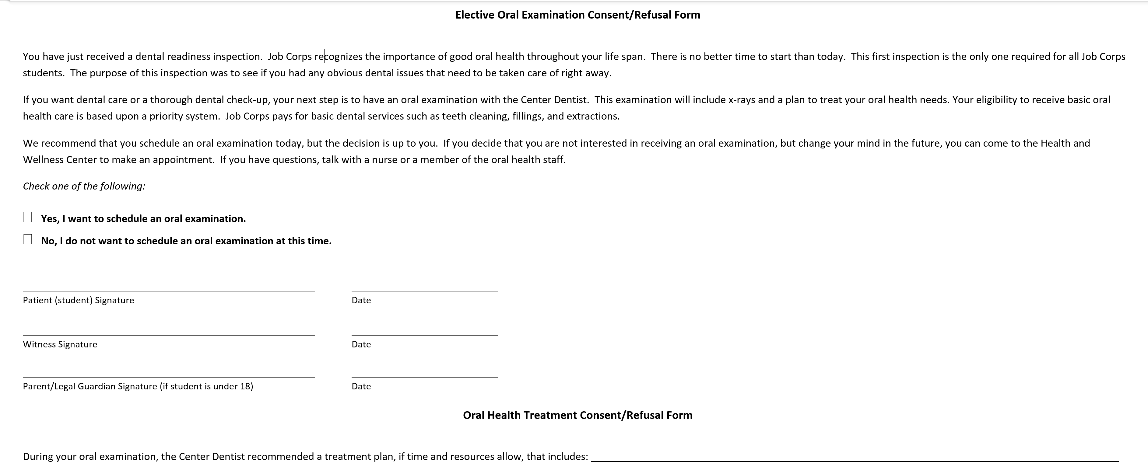

Slide 58
Dental Readiness Inspection Checklist
Source: https://supportservices.jobcorps.gov/health/Pages/OralHealth.aspx
Forms and Documents Assessment and Diagnosis DRI Checklist
58

Slide 59
Oral Health Personnel Teleconferences provide a forum to share effective practices

Slide 60
Pamela Alston, DDS, MPP
Region 1/Boston-Region 5/Chicago-Region 6/San Francisco
Lead & Oral Health Specialist
Pamela.Alston@humanitas.com
Brian Swann, DDS, MPH
Region 2/Philadelphia-Region 3/Atlanta-Region 4/Dallas
Oral Health Specialist
Brian.Swann@humanitas.com
Your Center Dentists

