Slide 1
Management of chronic health conditions:
How can we make healthy behaviors easier?

Slide 2
After this presentation, participants will be able to:
Identify factors that influence health behavior at the individual, interpersonal, community and environmental levels
Describe actions you can take to make healthy behaviors the easier choice.
Identify 1-2 actions to implement to improve chronic care

Slide 3
PIN 23-09: Managing Respiratory Viruses on Job Corps Centers
Rescinds previous covid pins
Encourage centers to:
Be familiar with new CDC guidance
Encourage immunizations – flu and COVID-19
Promote good hygiene
Educate and support precautions to prevent spread of respiratory illness
Evaluate and treat, as indicated
SIR if 10 percent of greater students respiratory illness

Slide 4
Impact on Health Systems from COVID-19 and the Role of Social Determinants of Health
Pandemic strain on health care systems
Exacerbated shortages: staffing, supplies
Social Determinants of Health
Economic stability
Education access and quality
Health care access and quality
Neighborhood and built environment
Social and community context
Call to Action:
SDoH influence outcomes and we can help
Recognize and tailor approach to optimize care
Schneider, A. (2024) Family Practice Management; 31(2):23-26

Slide 5
Exhibit 2-4 Job Corps Basic Health Care Responsibilities (excerpt):
Assessment and diagnosis of illness & injury
Treatment, as highlighted below, will be provided when necessary. Third-party payer information will be given to providers when off-center care is required
Treatment of urgent and other conditions not needing specialized care and that are within the capabilities of qualified health professionals on staff
Management of chronic health conditions as directed by qualified health professionals
Notes:
https://emergency.cdc.gov/newsletters/coca/2024/012524.html

Slide 6
How you might identify conditions requiring chronic care:
Form 653
Health History Form
Entrance Physical Examination
Medication review at arrival
Social Intake Form (SIF)
Walk-in visits
Referral from other center staff
Pre-arrival/arrival
Ongoing

Slide 7
Other ways that you identify chronic care needs?

Slide 8
Approaches to Chronic Care: Patient-Centered Medical Home
Not new in primary care (Dates back to Pediatrics 1967)
Model or philosophy of primary care that is:
Patient-centered
Comprehensive
Team-based
Coordinated
Accessible
Focused on quality and safety
Notes:
Patient-centered: A partnership among practitioners, patients, and their families ensures that decisions respect patients’ wants, needs, and preferences, and that patients have the education and support they need to make decisions and participate in their own care.
Comprehensive: A team of care providers is wholly accountable for a patient’s physical and mental health care needs, including prevention and wellness, acute care, and chronic care.
Coordinated: Care is organized across all elements of the broader health care system, including specialty care, hospitals, home health care, community services and supports.
Accessible: Patients are able to access services with shorter waiting times, "after hours" care, 24/7 electronic or telephone access, and strong communication through health IT innovations.
Committed to quality and safety: Clinicians and staff enhance quality improvement to ensure that patients and families make informed decisions about their health.

Slide 9
Patient-Centered Medical Home:

Slide 10
Approaches to Chronic Care: Interprofessional Collaboration (IPC)
Improves health care delivery outcomes
Motivates patient participation and engagement in self-managing medical conditions
Improves health care providers’ work environment and job satisfaction

Slide 11
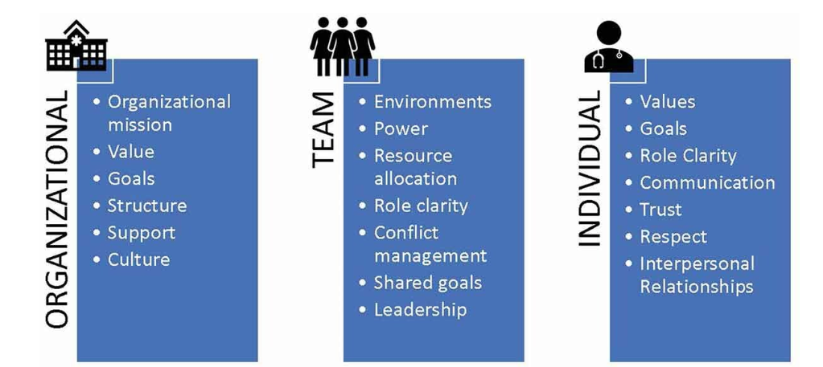
IPC Facilitators:
Notes:
Team level: defined roles and standards, shared-leadership, open communication,
Individual: each plays significant role on the team; feel valued

Slide 12
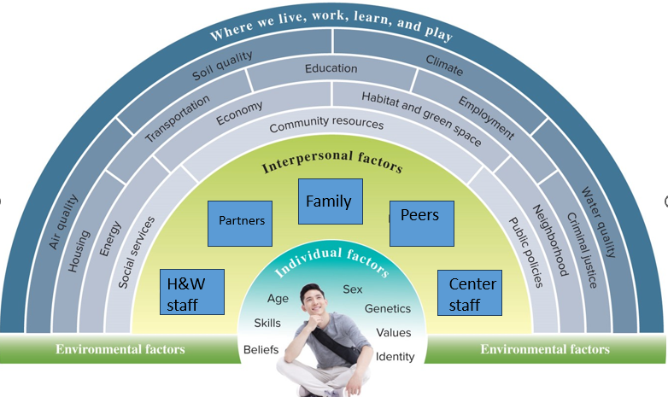
Why Job Corps Is An Ideal Setting to Enhance Health & Health Behaviors:
Social Ecological Model: Acknowledges our health is shaped both by our unique set of individual characteristics and by the context in which we live.
Individual, interpersonal, community, systemic/policy

Slide 13
Who are the members of the care teams you meet with regularly?

Slide 14
Health & Wellness Care Teams (Webinar last week):
Multidisciplinary health and wellness team
As part of the health and wellness team, you will be working with individuals from different disciplines.
HWD
RN
LPN
Wellness Clerk
MD
NP/PA
Dentist
Dental Hygienist
Dental Assistant
CMHC
TEAP Specialist
Notes:
Touch on the importance of developing good relationships with off-center providers like the optometrist, MH clinics, etc.

Slide 15
Center-wide Care Teams:
Healthy Eating and Active Lifestyle (HEALS)
Health and Wellness
Food services
Recreation
Counseling
Residential Staff
Trade instructors
Administration staff

Slide 16
Off center community resources:
Optometry
Emergency/Urgent Care Facilities
Laboratory
Public Health Department
Specialty Care providers
…

Slide 17
Policy factors: Insurance - Medicaid expansion states
Centers support students signing up for Medicaid
Greater challenge in states that have not expanded or have restrictions based on residence

Slide 18
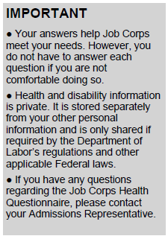
Case 1:
Student arrives on center with no prior history of health concerns on Form 653
Arrives with an albuterol inhaler (security identifies)
Day 2: Completes Health History Form in H&W

Slide 19
Case 1:

Slide 20
What actions would you do next based on this information?

Slide 21
Case 1:

Slide 22
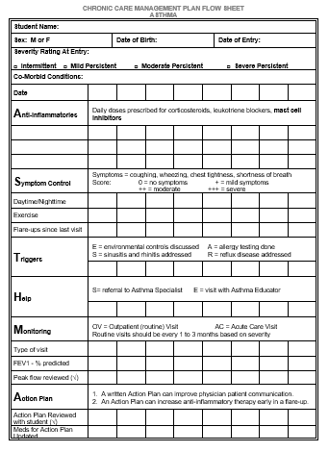
Case 1:
Resources to support care available
Health Care Guidelines (jobcorps.gov)

Slide 23
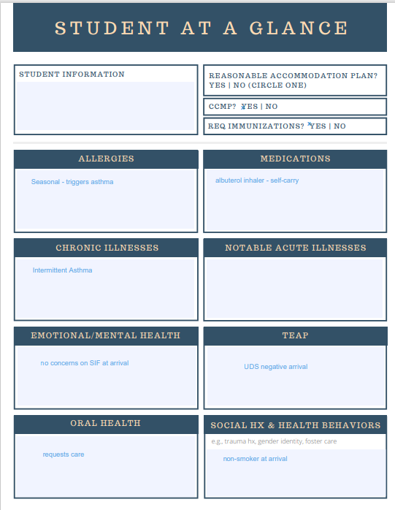
Case 1:
If everyone takes responsibility to check, enter and update – most likely to be accurate
Opportunity to support positive behaviors & chronic illness at each visit

Slide 24
Health & Wellness system supports:
PRH 2.3 R6: Tobacco Use Prevention Program (TUPP)
TUPP coordinator must be appointed
Educational materials and activities that support delay and/or cessation of to tobacco use
Scheduling system
Follow up appointment made in 1 month
Student notified and aware at time of scheduling
Student notified by center system day before/day of
If no shows- appointment serves as trigger to pull chart or review reason for visit and reschedule

Slide 25
Center-wide supports to healthier behavior:
Activities and gathering spaces that are tobacco-free
Monitor Air Quality (AirNow.gov)
R6. Tobacco Use Prevention Program
Smoke-free, tobacco-free environment
Center policy toward tobacco use
Non-smoking center
Limited smoking areas

Slide 26
Case 2:
Applicant File Review identified diabetes and depression in past medical history – MD, CMHC reviewed
Arrives with medications: metformin and sertraline (security identifies)
Completes Health History Form in H&W

Slide 27
Case 2:

Slide 28
Case 2:

Slide 29
How do you ensure follow up on your center?

Slide 30
Case 2:
Nursing: Medication Administration Record
RA & Nursing: Medication Observation Record
Opportunity to assess adherence
If missing doses, nursing engages and refers earlier if necessary
Procedure
Side effects
Other?
Nursing, Medical Provider, CMHC: Monthly Case Management

Slide 31
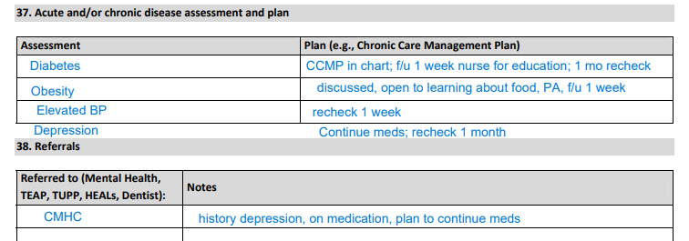
Case 2:

Slide 32
What activities outside of health and wellness can support this student?

Slide 33
Case 2: PRH 2.3 R9 Health Eating and Active Lifestyles
Planning:
HEALS Committee
HWD, Food Services Manager, Recreation Supervisor, TEAP, Residential Manager and Student representative
Environment
Variety of fitness activities open to all students
Healthy eating selections and limit non-nutritious eating selections
Education and Counseling
Educational activities to all students to support regular PA, nutrition, and achieving health weight
Individualized weight management and counseling – motivational interviewing and goal setting based on readiness to change
Assessment

Slide 34
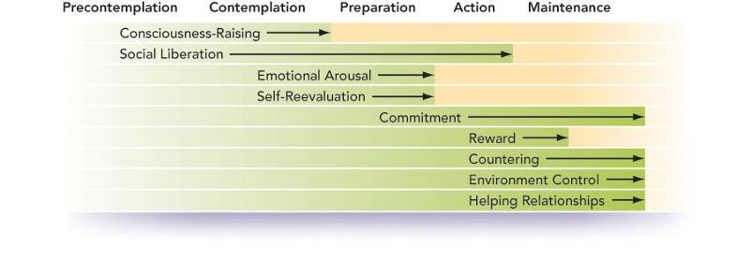
Stages of Change:
Based on readiness to change concept
Move through stages (often back and forth) at different rates
Different actions/motivators at different stages (do the right thing at the right time)

Slide 35
Stages of Change:
Maintenance – doing new behavior for 6 months; working to prevent return to old habits
Termination – new behavior is now part of life; 100% confidence in ability to maintain

Slide 36
Case 2: Center-wide supports
Food services:
Labeling foods
Healthier options for all
Recreation:
Range of activities
Tracking tools
Groups/social
Peer support:
Support groups
Residential
Counseling
Academic & Trades instructors

Slide 37
Actions for Systems To Enhance Care Coordination:
Care Teams
Clear roles
Scheduled check ins (quick huddle, weekly meeting, monthly case review)
Easily identifiable to students
At-A-Glance/ Problem Lists
Everyone plays role!
Standard of care

Slide 38
Actions for Systems To Enhance Care Coordination:
PRH 2.3 (h) An Appointment System for treatment of chronic, urgent and other conditions within the capabilities of center health professionals
Coordinate
Missed appointments
Reschedule/review chart – use as prompt for chronic care management

Slide 39
Why Job Corps Is An Ideal Setting to Enhance Health & Health Behaviors:
Social Ecological Model: Acknowledges our health is shaped both by our unique set of individual characteristics and by the context in which we live.
Individual, interpersonal, community, systemic/policy

Slide 40
After this presentation, participants will be able to:
Identify factors that influence health behavior at the individual, interpersonal, community and environmental levels
Describe actions you can take to make healthy behaviors the easier choice.
Identify 1-2 actions to implement to improve chronic care

Slide 41
References:
Domino ME. Unpacking the patient-centered medical home. Health Serv Res. 2021 Jun;56(3):350-351. doi: 10.1111/1475-6773.13661. Epub 2021 Apr 19. PMID: 33876428; PMCID: PMC8143687.
Ortiz MR. Patient-Centered Medical (Health) Home: Nursing Theory-Guided Policy Perspectives. Nurs Sci Q. 2020 Jan;33(1):91-96. doi: 10.1177/0894318419881795. PMID: 31795884.
Wei H, Horns P, Sears SF, Huang K, Smith CM, Wei TL. A systematic meta-review of systematic reviews about interprofessional collaboration: facilitators, barriers, and outcomes. J Interprof Care. 2022 Sep-Oct;36(5):735-749. doi: 10.1080/13561820.2021.1973975. Epub 2022 Feb 6. PMID: 35129041.

