Slide 1
Networking with Community Partners
By: Christy Hicks, LCADC/CSS
Regional TEAP Specialist
Atlanta, Dallas, and Chicago Regions

Slide 2
Community-based partnerships bring people together around a shared practice, purpose, place, product or set of circumstances to create insights and closer, more valuable relationships with prospects, customers and other stakeholders to deliver organizational value.

Slide 3
What is Professional network?
Professional networking is when you build relationships with other professionals both in your career field and in other related fields.
The goal of professional networking is typically to be able to ask factors of people in your network and to help them in return.
You can build a professional network in various places both online and in person.

Slide 4
Common places and people where you can network with others include:
Networking events
College alumni clubs
Sports groups or teams composed of professionals
Conferences and expos
A current job
Social events
Online social media sites that are geared towards professionals
College professors
Previous classmates
Friends

Slide 5
Objectives
List three community resources you can use to enhance your program.
Define what a community resource is.
Define different ways of finding resources in your area.

Slide 6
Why do you want to engage Community Partners?
Program Growth
Enhance what you currently have
Find out what you can add to your program
Mentorship
Job Offers for our students
Referral partners
Moral support for programing

Slide 7
Key Ingredients for Community-Based Partnerships and Making Them More Effective
Active Listening
Building rapport
Playing an active role in the group/ groups
Giving without the expectations of receiving
Making connections
Notes:
Active Listening-one of the most important elements in establishing a relationship is active listening. Active listening is a conscious effort to hear or read not only the words that another person is saying but more importantly, the complete message being communicated.
To do this you must carefully pay attention to the other person. It is a skill that many have to work hard at, especially when they are keen to talk about themselves.
This should help you spot opportunities to build rapport.
Building rapport-If two people or groups have a rapport, they have a healthy relationship in which they can understand each other’s ideas or feelings. Rapport is based on commonality and harmony: shared values, interests, experiences, goals and concerns.
Playing an active role in the group/ groups- PAARITG builds your reputation and authority. It also make you more visible and memorable to potential connections.
Giving without the expectations of receiving- Being generous and supportive means you don’t always get a reward. You are still contributing your attention, expertise, and appreciation all have value. People will notice you for the right reason.
Making connections- Don’t be afraid to introduce yourself to someone once you’ve done the ground work.

Slide 8
Building a Strategy
Make the plan (the why)?
What is/are your goal(s)?
Write them down to be clear on the path
Host or attend a community presentation on what you do at JC
Brainstorm with staff and students on center to find your possible partners
Notes:
You need to plan how you will build your program using your partner. No one like to come to the table and not be used. For example: Oh I want you to come and work with my students but you never make time for the group or person.
Have more than one goal in mind: More is better
My mindset should be to build connections to build more effective, strategic community partnerships.

Slide 9
Pro tip: Visualizing your shared interests to help with rapport
Your Interest
Their Interest
Notes:
Identify the overlap of the two circles- where do your interests coincide with another person or group?
Increase the size of this overlap in the interests by asking questions- is there a connection between your interests and theirs that is less obvious and perhaps more valuable?
Keep the conversation in that overlap as much as you can- concentrate on what you have in common.

Slide 10
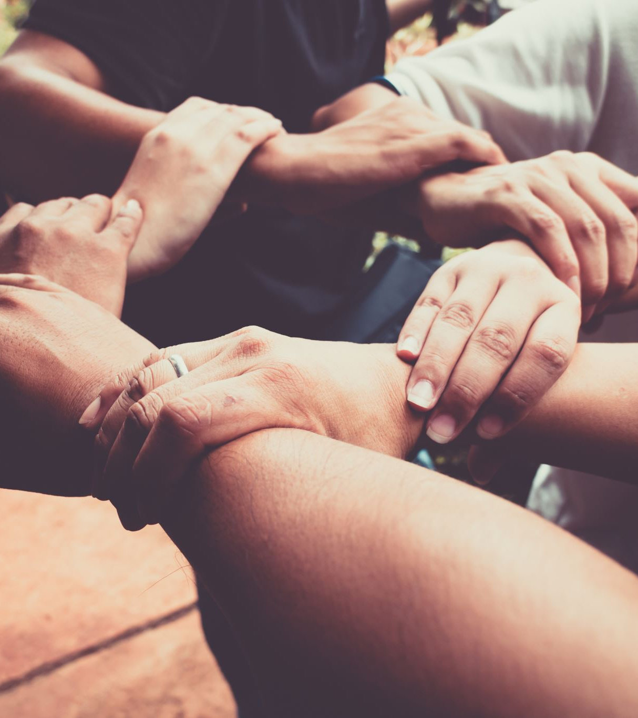
How to build partnerships with Community Organizations?
What are your goals and their goals? Do they match?
What kind of value are you looking for?
Where are there existing trusted relationships?
What role will this partner play in your network?
How can you diversify your partnership?
Notes:
Every partner has a unique history, context and goals but many of the same categories to consider when building partnerships.
Thinking through each of those questions in relation to your community partnership work will help you devise a strategy that fits your specific needs.
Goals are the glue that hold collaborative together, providing a shared sense of vision across organizational boundaries to drive collaborative action and resource sharing.
There are many different forms of value when it comes to collaboration. Some partners provide more traditional forms of value, like funding or staff support. Others provide information, lived experience and data. Consider all the various types of value that align with your goals.
These are long term relationships with you or your agency. You can count on them, They are natural places to start. But don’t forget to beyond those relationships.
If there is not value for you and your program don’t build the partnership at this time (it will just take precious time and energy with no outcome).
Try to consider unlikely partners you would not ordinarily work with, along with other stakeholders that impact or are affected by the issue being dealt with.

Slide 11
Now you should be ready to identify Community Organizations that fit your strategy and plans
Look for community gatekeepers and other key stakeholders, they can help!
Local and regional nonprofits
City, County, and State Government Agencies
Educational and Research Institutions
Healthcare Providers and Institutions
Notes:
Community Gatekeepers are influential and well connected leasers in the community you seek to connect with. They are typically well trusted and can connect you with other partners that may be helpful and that you can build partnerships with.
Local and regional non-profits- A good place to start. United Way, YMCA, local prevention offices (SUD, MH, physical health), local SUD groups and entities,
City, County and State Government- You may have some cross over with the non-profits as many are funded through government. They folks are deeply imbedded into the community. Police, firemen, unemployment office,
Educational and research Institutions- Local colleges or universities, community colleges, workforce development and research institutions maintain practice-oriented partnerships with the community.
Healthcare Provider and Institutions- Hospitals and clinics take part in may in the community.

Slide 12
Don’t use the scattergun approach!!!!!
Scattergun Approach is asking everyone you meet to join your network.
This won’t get you very far and might even backfire.

Slide 13
National Resources
NAADAC
Addiction Counselor.org
American Addiction Centers
NIH
SAMHSA
CDC
NA/AA/Celebrate Recovery/NAR ANON/
Notes:
Guild- Help employees build the careers they want by gaining the skills your company needs. Has resources.

Slide 14
Local Resources
Health Departments
Police
ASAP Boards
Family Resource/Youth Service Centers
Prevention Centers
College and Universities in your town
Other Job Corps

Slide 15
Let’s brainstorm resources in the chat

Slide 16
A student-driven board
Why?
Who should be on that board?
What should you call it?
How could you use that board?

Slide 17
Questions???

