Slide 1
TEAMWORK
Building a team within the Health and Wellness Department
Working effectively through multidisciplinary healthcare teams
Notes:
Give a little background on my work experience with teamwork and patient satisfaction

Slide 2
Goals & Objectives
Goal:
The purpose of this training is to build an effective, multidisciplinary team within the health and wellness department, resulting in quality healthcare for students
Objectives:
Improve communication within the Health and Wellness Department and with students
Understanding of what constitutes an effective healthcare team
Build trust with students and staff
Develop relationships with students and staff
Identify challenges to effective teamwork within the health and wellness department and develop practical methods to overcome them effectively.
Reflect on personal and professional responsibilities within a team and identify methods to improve performance and overall student care.
Boost the morale of your team
Enhance engagement between students and staff
Reduce turnover
Improve health and wellness student satisfaction
Notes:
Discuss some of the road blocks to working as an effective multidisciplinary team within Job Corps. Touch on barriers that will be covered.

Slide 3
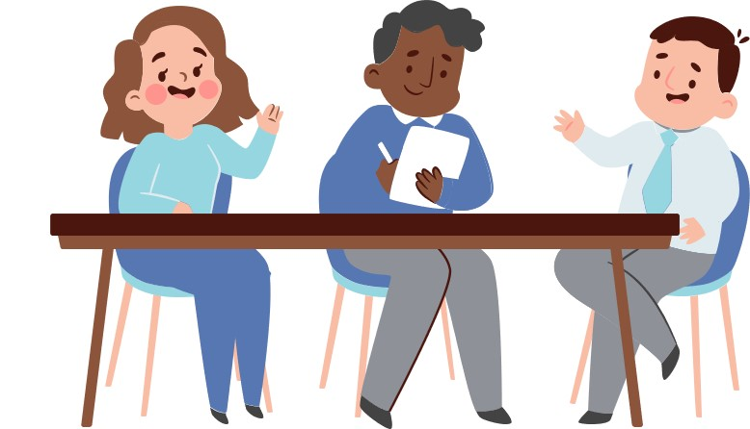
Wha
Introduction
What is a multidisciplinary team?
A multidisciplinary team is a unit of healthcare professionals who specialize in different fields and work together. A multidisciplinary team may work with multiple students, but each student receives individualized attention from each team member. This unit then collaborates on a detailed care plan to organize its services, optimize treatments, and define specific objectives.
Why is having a strong multidisciplinary team within health and wellness important?
A strong multidisciplinary, health and wellness team is important because they allow students to receive comprehensive, individualized care from experts in specific disciplines. Collaboration between Mental Health, TEAP, Medical, and Dental specialists can help a student receive the services and treatments they need. They can work together to meet the student’s complex needs without neglecting or ignoring issues that may exacerbate existing conditions or poorly affect their employability.

Slide 4
Multidisciplinary health and wellness team
As part of the health and wellness team, you will be working with individuals from different disciplines.
HWD
RN
LPN
Wellness Clerk
MD
NP/PA
Dentist
Dental Hygienist
Dental Assistant
CMHC
TEAP Specialist
Notes:
Touch on the importance of developing good relationships with off-center providers like the optometrist, MH clinics, etc.

Slide 5
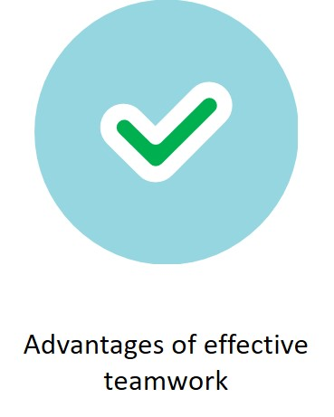
TEAMWORK
Barriers to effective teamwork and ways to overcome them
Notes:
What are 3 pieces of effective teamwork. Notice I use the word effective and not efficient. Maybe discuss the difference between efficient and effective teamwork and how it can benefit the team and students.
Effective is producing a result that is wanted. Efficient means capable of producing the desired results without wasting materials, time or money.

Slide 6
Advantages of teamwork
Based on your knowledge, reflect on the advantages of good teamwork in a multidisciplinary healthcare team.
Improved Student Responsiveness
Improved overall student satisfaction
Improved Efficiency
Increased Effectiveness
Decreased staff turnover
Notes:
Can anyone tell me are there any other advantages, not listed on this slide?

Slide 7
Improved Student Responsiveness
When the health and wellness department works as a team, they can be more responsive to student changes. When a student’s condition worsens, the team looks to the leader, knowing that each person on the team will carry out their respective duties and work with others to provide appropriate care to the student. This approach allows the formation of trust in one another, increasing confidence in the team, and knowing they will carry out their duties during a time of need. Healthcare teams working together tend to make fewer mistakes, which leads to improved student outcomes.
Notes:
Discuss compliance with medications and appointments. Provide honest communication with wellness staff.

Slide 8
Overall Improved Student Satisfaction
When the health and wellness team collaborates, students are more satisfied with their care. The team and the student experiences less stress when the team fulfills their duties, knowing their counterparts are working towards a common goal. When expectations are clear among the wellness team, there is less confusion about the students’ care. When communication between the team and the student is clear, students experience greater clarity about their treatment and expected outcomes. This leads to improved compliance and increased employability for the student.
Notes:
Improved satisfaction fosters more trust for students and staff

Slide 9
Improved efficiency
Health and wellness teams “committed” to treatment plans and delivery of care to the student tend to be more efficient and utilize resources better. When the team approach is adopted by the health care providers, our centers become more successful in treating our students, improving student employability, and reducing student and staff turnover. Efficiency is realized even more when the health and wellness team is empowered or delegated to perform actions that fit their skill and resources.
Notes:
We spoke earlier about effectiveness vs efficiency. When teams are effective, efficiency improves as well.

Slide 10
Increased Effectiveness
For a health and wellness team to be effective, each member of the team needs to be familiar with each other’s responsibility in completing student treatment plans. Each individual in wellness needs to understand the duties of each team member to work effectively, increasing the team’s skills as duties sometimes overlap. As part of the wellness team, appreciation develops for the roles of each wellness team member as all work together in the best interest of the student.

Slide 11
Reduced Staff Turnover
Better staff engagement
Encourage teamwork with staff
Give recognition
Education and continual learning
Notes:
Recognize high performing employees
Honor teamwork
Conduct surveys
Act on the results of the surveys
Communicate change effectively
create a positive patient experience in healthcare, teamwork among healthcare professionals on the care team is essential. It is rare for healthcare practitioners to deliver care on their own, so it is vital to develop communication skills among team members. This will help reduce errors, resolve conflicts, and create a sense of transparency with task assignments.
Yes, students do thank the staff for their work, but it is also essential that leadership shows gratitude. Consider the following ideas:
Recognition dinner
Exceptional service awards
Rewards drive engagement, which improves employee retention. Recognition of your healthcare staff for their contributions will significantly help your chances of retaining your valuable employees.
Education and professional development are crucial to improving your employees’ technical and people skills. These skills are essential for delivering an exceptional student experience, improving productivity, and increasing employee satisfaction.

Slide 12
Pieces of effective teamwork
Notes:
Discuss the 3 pieces of effective teamwork and how staff and students respond to it.

Slide 13
Staff Communication
What constitutes effective communication among a healthcare team?
Communication is a powerful tool that addresses growing and complex health challenges. It can help to change staff knowledge, attitude, and behaviors, empowering them to make positive choices that protect and improve their productivity, health, and well-being.

Slide 14
Student Communication
Why is it important for Job Corps students?
A health and wellness team who takes time to listen and understand student concerns and barriers are better prepared to address issues as they arise, which results in better student outcomes.
In contrast, poor communication, or lack of communication in a health and wellness department can lead to distrust among students, misunderstanding of care directions, and failed treatment protocols.

Slide 15
Barriers to Effective Communication
Student distrust and discomfort
Common language barriers
Health and wellness team working short-staffed
Mismanaged healthcare information
Notes:
They feel intimidated by their provider, they believe their provider won’t listen to them, they feel disrespected, they question medical advice, and they struggle with physical or psychological trauma.

Slide 16
Strategies to improving communication:
Students need to feel safe and respected enough to communicate honestly and openly with the health and wellness team to receive effective care.
The health and wellness team needs to provide treatment plans and health education, respectfully, accessibly, and emphatically so students can receive optimal care.
The healthcare team needs to share information ethically and responsibly to protect the student’s confidentiality.
The health and wellness department should apply culturally responsive measures to enhance communication gaps with students.

Slide 17
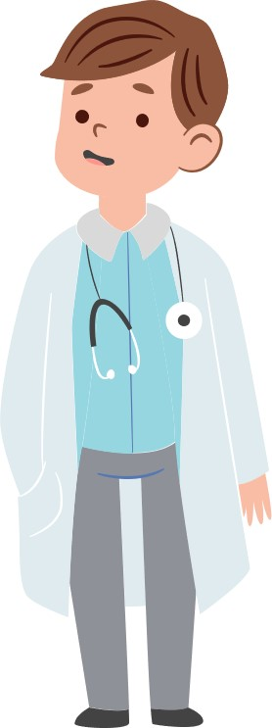
Collaboration within Health and Wellness
What does this look like?
At its most basic, collaboration is simply a process by which multiple stakeholders — whether individuals (including medical, TEAP, CMHCs, Oral Health), departments, or student body — come together to share information, identify gaps in performance, and develop solutions to improve care and employability.
Notes:
Discuss SPO, Security, Counseling, HR, etc.

Slide 18
Collaboration with students
Why’s it important for our Job Corps students?
Improving the health and lives of our students is something we all strive for in Job Corps. One way this can be done is by improving student engagement. Evidence shows that when students are actively involved in their care experience, it can lead to better outcomes and healthier lives.
Notes:
TRY: Supportive statements like “Let's think about this problem together; maybe we can come up with something that will work for you.” Use teach-back to ensure understanding of the care plan AVOID: Close-ended questions like “Does this make sense to you?” TRY: “What is your understanding of what we've discussed today?”

Slide 19
Barriers to Collaboration
Lack of student and staff engagement
Not keeping it simple and understandable
Lack of time
Lack of support
Not being transparent
Notes:
Staff in healthcare are busy and unfortunately improvement collaboratives can sometimes be viewed as additional workload.
When there are so many possible improvements to be made, it is tempting to cast the net wide and tackle multiple issues at once, but keeping it simple will improve the chance of success.
We all know that healthcare professionals are busy.
If teams are struggling to get up and running, more intensive support could be the answer. EDUCATION. ORIENTATION. TRAINING.
Collaboratives are all about shared learning. To get the most from the process, teams need to be able to see their progress toward improvement, along with that of their peers

Slide 20
Strategies to improve collaboration
Establish a shared purpose
Develop clear norms
Select and align effective team members
Focus on role and process clarity
Empower effective team process and decision-making
Notes:
Who will be affected by our solutions?
What positive outcome would they want?
What is the highest potential outcome for each of those parties?
What would “good” look like?
Job titles don’t matter
Senior members speak last
Listen and don’t interrupt
Ideas can be evaluated, not individuals
Match expertise and experience to the identified purpose and the problem
Ask participants to share strengths they bring to the team
Identify and close expertise and experience gaps
Discuss preferred working styles
Discuss what you need from each other
Full team, partial team, and individual responsibilities
The process to define how to collaborate off-line
Meeting agendas and expected outcomes
Key performance indicators and timelines
Shared view of deliverables
Send out an agenda ahead of time, with clearly defined roles and content topics
Rotate the schedule of call facilitators
Start by asking everyone to answer the same question (walk the table)
Ask every participant for their opinion at least once and acknowledge their answers
Give credit where it’s due; when an individual reiterates an idea that someone else put forward earlier, point out who shared the idea originally
Celebrate different opinions and value different perspectives
Coach team members through potential conflict
Encourage curiosity
Help people take risks and be comfortable with not being right

Slide 21
Respecting the team
What does it entail?
Treating someone with respect means: • showing regard for their abilities and worth • valuing their feelings and their views, even if you don't necessarily agree with them • accepting them on an equal basis, and giving them the same consideration you would expect for yourself.
Notes:
An extremely important part of building a team and building rapport with the students

Slide 22
Respecting the student
Why is it important for Job Corps students?
Displaying respect for students is part of the foundation of excellent healthcare. Respect is the intentional act of showing consideration for another person's interests and well-being. The health and wellness team recognizes another human being as someone with their own likes and dislikes, thoughts and ideas, and values and morals.
Notes:
Continue work on techniques that students respond such as eye contact, not nagging on them, being approachable.

Slide 23
Barriers to earning respect
Not listening to concerns or answering questions
Failing to make eye contact
Not following up on promises made
Disregard for the student and/or staff beliefs
Absence of resources or equipment to provide quality care
Lack of professionalism
Notes:
Eye contact importance-Eye contact helps you maintain concentration and focus while showing confidence in what you're saying or presenting. If you maintain eye contact with another person, you can feel better knowing they're paying attention and thinking about your topic. Improved authority and empathy.

Slide 24
ee
So, when dealing with people,
Remember Tina Turner’s song!!
R- rapport
E- empathy
S- support
P- partnership
E- explanations
C- cultural competence
T- trust
Notes:
R • Connect on a social level • See the patient’s point of view • Consciously suspend judgment • Recognize and avoid making assumptions
E Remember the patient has come to you for help • Seek out and understand the patient’s rationale for his/her behaviors and illness • Verbally acknowledge and legitimize the patient’s feelings
S Ask about and understand the barriers to care and compliance • Help the patient overcome barriers; Involve family members if appropriate • Reassure the patient you are and will be available to help
P Be flexible • Negotiate roles when necessary • Stress that you are working together to address health problems
E Check often for understanding • Use verbal clarification techniques
C Respect the patient’s cultural beliefs • Understand that the patient’s views of you may be defined by ethnic and cultural stereotypes • Be aware of your own cultural biases and preconceptions • Know your limitations in addressing health issues across cultures • Understand your personal style and recognize when it may not be working with a given patient
T Recognize that self-disclosure may be difficult for some patients; Consciously work to establish trust

Slide 25
Barriers to teamwork
Using the table format below, reflect on the barriers that you, as a Health and Wellness director, may face in a clinical/non-clinical setting and potential ways that could be implemented to overcome them. You may use some of the examples outlined on the next slide to help you.
Barriers to teamwork | Ways to overcome these
Staff Turnover | Delegation of duties, where staff’s strengths are utilized. Staggered scheduling when available. Team approaches to med pass and medication lockbox stocking. Asking members of the team for ideas on how we can meet the needs of our students while being down a position.

Slide 26
Barriers to teamwork
Staff Turnover
Personal values and expectations
Personality differences
Scope of practice
Time allotment

Slide 27
Take-home points
The purpose of this webinar is to help health and wellness team understand what constitutes an effective team within the Job Corps program. We’ve shared practices and theories about teamwork and how to work effectively within multidisciplinary healthcare teams.
The following points are a summary of how to achieve effective teamworking within a multidisciplinary healthcare team:
Communication: Be clear! Be concise!
Collaboration: Know your role! Know your goal!
Respect: Respect yourself, your patients and your colleagues!

Slide 28
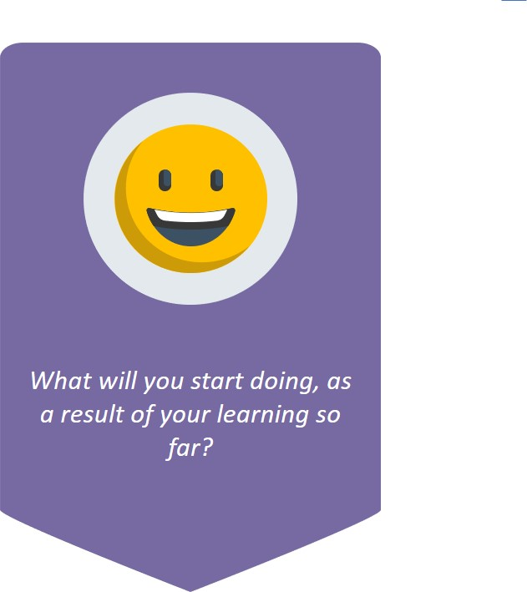
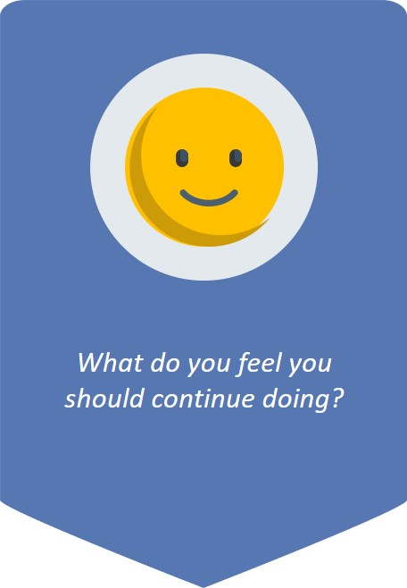
Take some time out to reflect on the following:

Slide 29
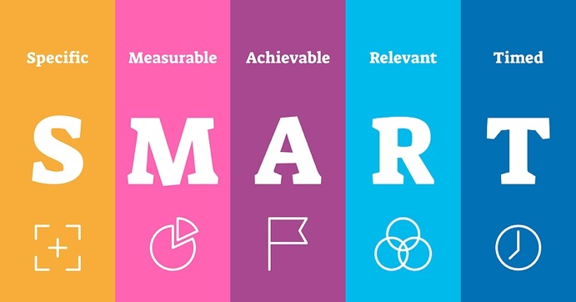
Top tip for structuring your goals: Use the SMART principles!
Notes:
Specific: Increase the chances that you’re able to accomplish your business goals by making sure they’re well-defined. Determine the who, what, where, when and why.
Measurable: Develop criteria for measuring progress toward your business goals. Detail the key indicators that help you decide if and when you reach your goal by quantifying them.
Achievable: Create goals for your business that are attainable and achievable by ensuring that you and your team have the skills and resources needed to reach the goal.
Relevant: Align your company’s goals with the overall objectives of your business and the realities of the market.
Time-based: Give yourself and your staff a deadline for reaching your goal to provide a sense of urgency and the opportunity to schedule the steps needed to achieve the goal.

Slide 30
Student Satisfaction
Train
Train your employees
Educate
Educate the students
Differentiate
Differentiate between clinical and non-clinical staff
Empower
Empower your team
Flexible
Be flexible
Follow-up
Build a follow-up mechanism
Notes:
We touched on it earlier, but lets dive a little deeper in the student satisfaction and what it means to developing an effective health and wellness team.

Slide 31
Training
Make sure your team is focused on delivering service that is not only high-quality but also delivers a positive student experience. The first step to ensuring student-centric care is to make sure that your team has this common goal in mind. Encourage your team to suggest ideas for improving student satisfaction within the health and wellness department. Convey the message to your staff that providing exceptional student service is not an option; rather it is compulsory for every team member. The team needs to realize the significance of providing excellent service to the students. It is critical to hold your team accountable for the overall student experience.
Notes:
training also enhances the synchrony between the individual and the entire team. Without proper training, it is difficult for employees to adapt to their roles.

Slide 32
Student Education
Providing your students with the necessary information is critical to achieving a positive student experience within health and wellness. A student will feel empowered when he or she leaves your office with more knowledge about his or her diagnosis and treatment options. Educate the student on ways they can impact their treatment, thus empowering them. Studies have revealed that greater patient empowerment leads to better patient adherence, which leads to improvements in student satisfaction and clinical outcomes.
Notes:
Education empowers students to improve their health status. When students are involved in their care, they are more likely to engage in interventions that may increase their chances for positive outcomes.

Slide 33
Differentiate
Students find it frustrating when they are surrounded by so many people but are not sure whom to approach when they have a concern or a request. This is especially frustrating for new enrollees. It becomes even more frustrating when the student approaches one of the health and wellness team members only to be directed to another employee. There are multiple ways to differentiate your staff. Start by posting pictures of each team member and what profession they represent. Introduce each team member during the health and wellness orientation, if possible. Always share your name and if you cannot help the student with their request, take them to a team member who can help them.

Slide 34
Empower
Each team member has a critical role in the student experience and improving the satisfaction level of the student body. Team members who are more experienced and independent will provide better patient care as they feel empowered in their work. Consider creating a staffing committee to allow your team to collaborate for better student care and give them the freedom to improve their performance. Share the results of the student satisfaction survey so the team knows where it stands in the eyes of the students.
Notes:
a process through which people gain greater control over decisions and actions affecting their own health. Student empowerment is also twofold. By empowering students to take co-responsibility for the management of their condition, it may not only enhance medical outcomes but also lower costs.

Slide 35
Flexibility
By improving the efficiency of your health and wellness department, you can reduce long wait times both for scheduling appointments and while a student is waiting to be seen. One of the top complaints of students is having to wait too long for care or to be seen. Students can be impulsive and if they wait too long, they may leave without getting the treatment they need. Consider creating a system in which a patient is kept informed about wait times. Consider when “open hours” are scheduled during the day. Does the time benefit the health and wellness department or the student? Yes, it may result in staff not getting to take lunch at the same time. The team may have to be “flexible”.

Slide 36
Follow-up
Students are often irritated by the inability to communicate with their providers between appointments. Maybe the health and wellness team can use technology to build open lines of communication, like email or text, between the health and wellness team and the student. This will not only foster long-term student relationships, but it will create better clinical outcomes by making it easy for students to schedule appointments.
Notes:
Appropriate followup can help you to identify misunderstandings and answer questions, as well as make further assessments and adjust treatments. In addition, followup helps to promote a trusting relationship between you and your students.

Slide 37
Conclusion
Behind every great health and wellness department are team members who keep the department running smoothly. Staff members are usually the first point of contact for students and therefore require several professional skills. Each staff member needs to have a thorough understanding of Job Corps health services and should be trained to treat each student with respect, friendliness, and compassion. Great hiring is key but a large number of the skills covered require training and continuing education. Clear expectations, appropriate delegation, and communication among the multidisciplinary team will result in better student health outcomes, better compliance, improved student relationships, reductions in staff turnover, improved student satisfaction, and student retention.

Slide 38
Questions or Comments

Slide 39
References
R. Katzenbach, J. and Smith, D., 1993. The Discipline of Teams. [online] Harvard Business Review. Available at: <https://hbr.org/1993/03/the-discipline-of-teams-2> [Accessed 1 September 2021].
2021. Topic 4: Being an effective team player. [ebook] WHO. Available at: <http://www.who.int/patientsafety/education/curriculum/who_mc_topic-4.pdf> [Accessed 1 September 2021].
Dutta, D., Tweedie, D., Peake, D. and Goddard, D., 2017. Improving teams in healthcare Resource 3: Team communication. [ebook] Royal College of Physicians. Available at: <https://www.rcem.ac.uk/docs/External%20Guidance/ITIH%20R3%20Final.pdf> [Accessed 1 September 2021].
Weller, J., Boyd, M. and Cumin, D., 2014. Teams, tribes and patient safety: overcoming barriers to effective teamwork in healthcare. Postgraduate Medical Journal, [online] 90(1061), pp.149-154. Available at: <https://pmj.bmj.com/content/90/1061/149> [Accessed 1 September 2021].
O’Daniel, M. and Rosenstein, A., 2008. Patient Safety and Quality: An Evidence-Based Handbook for Nurses.. p.https://www.ncbi.nlm.nih.gov/books/NBK2637/
2019. The NHS Patient Safety Strategy. [ebook] NHS. Available at: <https://www.england.nhs.uk/wp-content/uploads/2020/08/190708_Patient_Safety_Strategy_for_website_v4.pdf> [Accessed 1 September 2021].
nhs.uk. 2019. Consent to treatment - Children and young people. [online] Available at: <https://www.nhs.uk/conditions/consent-to-treatment/children/> [Accessed 22 September 2021].
2016. Achieving good medical practice: guidance for medical students. [ebook] GMC. Available at: <https://www.gmc-uk.org/-/media/documents/achieving-good-medical-practice-20210722_pdf-66086678.pdf?la=en&hash=AE1A1C9484F7E3D7F510EC7D892F278F547704F4> [Accessed 1 September 2021].
Rosen, M., DiazGranados, D., Dietz, A., Benishek, L., Thompson, D., Pronovost, P. and Weaver, S., 2018. Teamwork in healthcare: Key discoveries enabling safer, high-quality care. American Psychologist, [online] 73(4), pp.433-450. Available at: <https://www.ncbi.nlm.nih.gov/pmc/articles/PMC6361117/> [Accessed 22 September 2021].

Slide 40
Hunter Patch Adams: You treat a disease, you win, you lose. You treat a person, I guarantee you, you'll win, no matter what the outcome.

