Slide 1
Health and Wellness Orientation
Part 2
Student Support Services

Slide 2
The Policy and Requirements Handbook
PRH Chapter 2, sections 2.3 R5-R10
Refer to PRH for policy
Policy in this presentation has been paraphrased

Slide 3
TEAP
PRH 2.3 R5

Slide 4
TEAP Services
The general emphasis of TEAP must be on:
Prevention
Education
Identification of substance use problems
Relapse prevention
Helping students overcome barriers to employability
Notes:
The general emphasis of TEAP must be on prevention, education, identification of substance use problems, relapse prevention, and helping students overcome barriers to employability.
1. Minimum of a one-hour presentation on substance use prevention for all new students during the Career Preparation Period. This presentation must explain (1) TEAP prevention, education, and intervention services, (2) Job Corps drug and alcohol testing requirements and procedures, and (3) the consequences of testing positive for drug or alcohol use while in Job Corps

Slide 5
Substance use prevention and education, to include:
Minimum of a one-hour presentation on substance use prevention for all new students during the Career Preparation Period. This presentation must explain (1) TEAP prevention, education, and intervention services, (2)Job Corps drug and alcohol testing requirements and procedures, and (3) the consequences of testing positive for drug or alcohol use while in Job Corps
Presentation(s) on managing substance misuse, abuse, and dependency symptoms and issues in the workplace for students during the Career Development and Transition Periods
At least three annual center-wide substance use prevention and education activities
Notes:
The presentations can be from outside groups; multiple departments can put a presentation on together; Use the resources sent out each year by the National Office with resources for TEAP and Mental Health

Slide 6
Drug and Alcohol Testing [PRH 2.3, R5(e)]
Drug testing procedures – who gets tested:
New and readmitted students
Students who tested positive on entrance shall be retested between the 37th and 40th day after arrival on center.
Students who are suspected of using drugs at any point after arrival on center (if positive = ZT termination)
Biochemical testing is never permissible on a random basis
If a student refuses to provide a specimen or has an unexcused absence from his or her follow-up (both 45-day and suspicion) drug test this is a ZT Termination
Students who state they are unable to produce a specimen shall be referred to the center physician or designee for follow up
Notes:
Make sure to document Chain of Custody and have the student sign the tamper proof sticker that this is their urine
Make sure when an suspicious screen is turned in that the reason is for behavior recommend using the Suspicious/TEAP Referral form found on the Job Corps Support Services website under TEAP

Slide 7
Identification of Students at Risk
c. Assessment for identification of students at risk for substance use problems to include:
1. Review of Social Intake Form (SIF) or intake assessment of all students performed by counseling staff within one week of arrival
2. Formalized assessment measures (e.g., SASSI3 or SASSIA2), and clinical judgment to determine students’ level of risk for substance use
3. Collaboration with the Center Mental Health Consultant to determine when a MSWR or medical separation is appropriate and should be recommended for a student with substance use conditions (see [PRH 2.3, R5(e5)])
Notes:
c. Assessment for identification of students at risk for substance use problems to include:
1. Review of Social Intake Form (SIF) or intake assessment of all students performed by counseling staff within one week of arrival
2. Formalized assessment measures (e.g., SASSI3 or SASSIA2), and clinical judgment to determine students’ level of risk for substance use
3. Collaboration with the Center Mental Health Consultant to determine when a MSWR or medical separation is appropriate and should be recommended for a student with substance use conditions (see R1, e5 below)
d. Intervention services for students identified at an elevated risk for substance use, to include:
1. Individual and group intervention services with a focus on behaviors that represent employability barriers
2. Collaboration with the Center Mental Health Consultant for students with co-occurring conditions of mental health issues and substance use
3. Referral to off-center substance abuse professionals or agencies for ongoing treatment and/or specialized services. Any student separating from Job Corps who has a substance use condition must be provided with a referral for support services in his or her home community

Slide 8
Other Duties
4. Clinical consultation with Center Director, management staff, Center Mental Health Consultant, and Health and Wellness Manager regarding substance use prevention and education efforts for students and staff
5. Coordination with other departments/programs on center, to include, but not be limited to, residential, recreation, student government association, and Healthy Eating and Active Lifestyles (HEALs), to develop integrated prevention and education services.

Slide 9
Education
d. Intervention services for students identified at an elevated risk for substance use, to include:
1. Individual and group intervention services with a focus on behaviors that represent employability barriers
2. Collaboration with the Center Mental Health Consultant for students with co-occurring conditions of mental health issues and substance use
3. Referral to off-center substance abuse professionals or agencies for ongoing treatment and/or specialized services. Any student separating from Job Corps who has a substance use condition must be provided with a referral for support services in his or her home community

Slide 10
TEAP Scenario 1
Cheryl is a 20-year-old-student who tested positive for THC, Opiates and Benzodiazepines. Your TEAP Specialist has been concerned about Cheryl from day one. Cheryl has been on center for 35 days and she comes to you and the TEAP Specialist to inform you she thinks she needs more support and is afraid she may fail her 2nd drug screen.
How should this situation be handled?
Have the TEAP Specialist conduct an assessment to determine if she needs inpatient or intensive outpatient treatment
Have the TEAP Specialist and the CMHC meet to discuss
Both A & B are correct
Notes:
C is correct

Slide 11
TEAP Scenario 2
Jeremy is a 16-year-old student who tested positive on entry. Jeremy is called down for his Intervention Urine Drug Screen and informs the nurses he is not going to give a urine sample and no one can make him.
What should you do next?
Call his mother and inform her he refuses to give a urine sample
Explain to Jeremy if he refuses to provide a urine sample he will be separated from the program for refusing.
How did you arrive at your answer?
Notes:
Know your state informing laws before talking to parents.
B. Is correct and is in the ePRH see
PRH 2.3, R5, e, (1c) If a student refuses to provide a specimen or has an unexcused absence from his or her follow-up drug test, he or she shall be presumed guilty of the Level I infraction Drugs: Use of drugs as evidenced by a positive drug test. Students who state they are unable to produce a specimen must be referred to the center physician or designee for follow up.

Slide 12
TEAP Scenario 3
Mark is a new student who was positive on entry, and he developed some medical issues and was placed on MSWR on day 15.
Does the count stop while on Mark is on MSWR?
Mark is out on MSWR for 30 days. What will the count be when he returns?
A. depends on how long Mark is on MSWR
B. day 16
C. day 15
D. day 1 the count starts over when he returns to center.
E. does not matter you need to test Mark when he returns to center.
Notes:
Yes the count does stop for MSWRs.
It will be day 16 when Mark returns to center.
Correct answer is B Day 16.
Use CIS to keep track of student enrollment and how long the student has been in the program

Slide 13
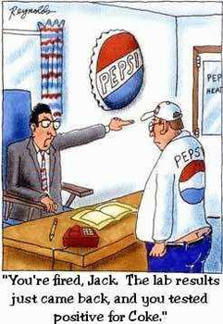

Slide 14
Tobacco Use Prevention Program (TUPP)
PRH2.3 R6

Slide 15
Tobacco Use Prevention Program (TUPP)
Be aware of federal and state laws regarding use of tobacco products by minors (center must adhere) Some states the legal age has increased to 21.
Promote smoke-free environment or no smoking during the training day
If center operators choose to allow tobacco use, designated smoking areas must be located at least 25 feet away from all building entrances (or whatever your state law says)
What is policy on vaping and e-cigarettes (now called Electronic Nicotine Delivery Systems – ENDS)?
Notes:
A TUPP Coordinator shall be appointed (he or she need not be a health services staff member can be any center staff member).
Minors who use tobacco products shall be referred to the TUPP.
All services provided should be documented in the student health record.

Slide 16
Family Planning
PRH 2.3 R7

Slide 17
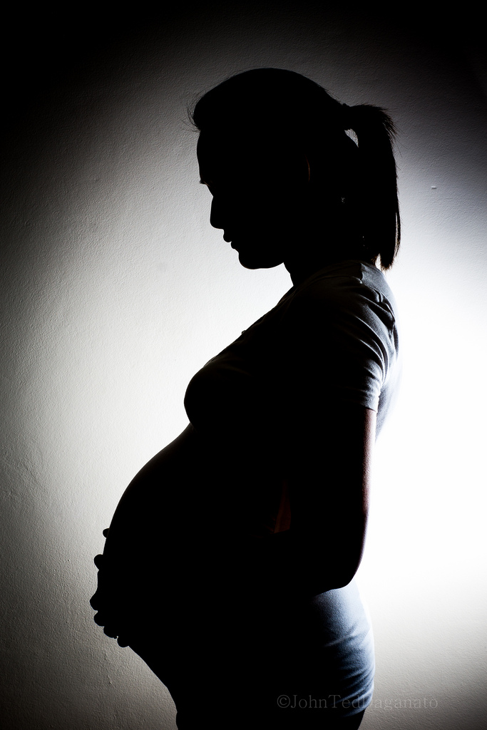
Family Planning Program
A family planning program shall be provided to all students on a voluntary basis. At a minimum, this program shall include counseling, health promotion activities, and medical services, including birth control. The Center Director shall appoint a staff member to implement and monitor this program.
Students who are pregnant and/or experiencing pregnancy-related medical conditions shall be afforded the same access to medical services, leave and medical separation as any other student experiencing a medical condition, unless otherwise provided by law.
Notes:
Best Practices include use of a Baby Think It Over Program, having community speakers, and involvement of the local health department

Slide 18
Family Planning Program
Once a center learns that a student is pregnant, pregnancy-related services shall include:
1. Prenatal services on center and/or in the community until separation, to include a comprehensive gestational record.
2. The center physician, in conjunction with an obstetrical/gynecological provider and the student, will agree upon a care-management and separation plan that takes into account the health and safety of the pregnant student before and after childbirth.
Notes:
Obtain records from OB/GYN appointments this can be sending questions with the student to the appointment.
EDC any work related restrictions
Make sure to inform the OB/GYN what type of trade the student is?

Slide 19
Family Planning Program
The center shall identify available community health/social resources and services and will make arrangements for transportation for the purpose of obtaining such resources and services consistent with PRH 6.7 R9 (d). In lieu of the center providing transportation, the center may approve a student’s request to be transported by a friend, partner or family member.
The center shall not pay for an abortion unless the pregnancy is the result of rape or incest or unless a physician has certified that the student suffers from a physical disorder, injury, illness, or condition that places her in danger of death unless an abortion is performed.
Notes:
Check with your local health departments for resources
Know your community connections

Slide 20
Family Planning Program
A student that is experiencing a pregnancy-related medical condition may be placed on paid administrative leave in accordance with PRH Exhibit 6-1. See Pay status: Paid, Duty status: Not Present for Duty-Administrative Leave with Pay.”
Pregnancy-related services shall include information on the options of continuing or terminating the pregnancy.
If required by applicable state laws in which the center is located, the Center shall notify the student’s parent/guardian of her pregnancy if she is a minor, and if required by applicable state law, inform the student of this requirement prior to the disclosure.”

Slide 21
Family Planning Scenario 1
When reviewing an applicant file on 17-year-old Susan, you determine she is 5 months pregnant and has had no problems with her pregnancy.
Do you recommend denial because she is 5 months pregnant and won’t have time to complete the program?
Notes:
There is no reason to deny Susan since she is not having problems with her pregnancy.

Slide 22
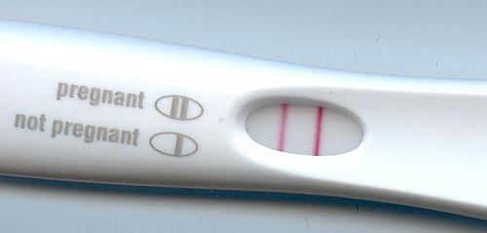
Family Planning Scenario 2
Marsha is a 16 year old who has been on center for 5 months. She requests a pregnancy test and it is positive. What do you do?
Automatically notify Marsha’s guardian of the pregnancy
Check your state’s informing laws
Encourage Marsha to call her guardian
a. only
b. and c.
Notes:
E is the correct answer. Know your states informing laws and encourage Marsha to call her guardian. You can tell her you are happy to be with her when she tells them.

Slide 23
HIV/AIDs
PRH 2.3 R8

Slide 24
HIV/AIDS
HIV/AIDS program includes:
Education
Testing
Provide pre- and post-test counseling according to your state and local laws
Follow up
Case management for HIV-positive students
Have student sign that they received their results (Promising practice)
Submit specimens for HIV testing to the nationally contracted laboratory. Centers shall not be reimbursed for HIV tests performed at other than the nationally contracted lab.
Notes:
Test students for HIV infection under the following circumstances:
1. As part of the cursory medical examination (see Section 6.10, R1.c).
2. If a student exhibits signs and/or symptoms of a possible AIDS-related
condition.
3. Upon reasonable suspicion of student exposure to HIV.
4. When student is diagnosed with a newly contracted sexually transmitted
disease.
5. When student is discovered to be pregnant.
6. Upon student request and after physician consultation.
Be knowledgeable of timelines for providing student with HIV-test results
Provide all students with information on HIV infection, including transmission
and prevention

Slide 25
Education
Go over the HIV Information sheet (Form 2-02) and have the student sign. Conduct Pre-HIV Testing Counseling
Contact your local Health Department to determine what should be covered in Pre- and Post- Test Counseling
When giving students their results make sure to cover Post-Test Counseling
Talk about safe sex

Slide 26
HIV Testing
Test students for HIV infection under the following circumstances:
As part of the cursory medical examination (see Section 2.3, R2.c).
If a student exhibits signs and/or symptoms of a possible AIDS-related condition.
Upon reasonable suspicion of student exposure to HIV.
When student is diagnosed with a newly contracted sexually transmitted disease.
Upon student request and after physician consultation.
Submit specimens for HIV testing to the nationally contracted laboratory. Centers shall not be reimbursed for HIV tests performed at other than the nationally contracted lab.

Slide 27
Case Management
The CMHC needs to be present when students testing positive for HIV are given the results.
Coordinate care and case management of students seeking off center care either at home or in community.

Slide 28
HIV Scenario
Johnny arrives on center and is HIV positive. You educate him on safe sex and safety precautions.
Do you have Johnny sign a behavior contract regarding having sex with other students?
Yes or No
Notes:
No you do not have students sign behavior contracts as this is discrimination. Johnny should be informed what the state laws are regarding disclosing to other partners prior to sex.

Slide 29
HIV Question
Who do you notify on center that Johnny is HIV positive?
Dorm Life Manager
Center Career Counselor
Only share information with the student’s written permission
Trade Instructor
Parent or guardian
Notes:
Parent or guardian is not on center
Best answer is c. only share information with students written permission. Only persons with a need to know should be informed of Johnny’s status by you.

Slide 30
Healthy Eating and Acting Lifestyles (HEALs)
PRH 2.3 R9

Slide 31
HEALS
At a minimum the HEALs Programs should consist of:
Planning
Environment
Education and Counseling
Assessment
Center Director establishes a Healthy Eating and Active Lifestyles Committee to oversee and coordinate this program.
Notes:
Centers shall provide students with an environment that supports healthy eating and
active lifestyles, and provide students with education and experiences that promote
lifelong health and physical well-being.
1)Planning: The HEALs committee shall include at a minimum the Health and Wellness Manager, Food Services Manager/Supervisor,
Recreation Supervisor or Specialist, TEAP Specialist, Residential Manager, and student representative. Planning should incorporate students interests in planning activities and there should be collaboration between various departments on center. Need to plan activities that will foster student involvement, participation, and accountability.
2) Environment: should consist of a variety of fitness activities, nutritious and healthy food choices and limit non-nutritious selections on center
3) Education and Counseling: provide a variety of educational materials that promote fitness, good nutrition and healthy choices, provide individual weight management program and counseling, and incorporate motivational interviewing and goal setting to assist student’s in being successful with healthy choices
4) Assessment: Document, monitor and asses the program. Make changes as necessary

Slide 32
HEALs
Planning: The HEALs committee shall include at a minimum the Health and Wellness Manager, Food Services Manager/Supervisor, Recreation Supervisor or Specialist, TEAP Specialist, Residential Manager, and student representative.
Planning should incorporate students interests in planning activities and there should be collaboration between various departments on center. Need to plan activities that will foster student involvement, participation, and accountability.
See the HEALs website https://supportservices.jobcorps.gov/HEAL/Pages/default.aspx

Slide 33
HEALs
Environment: should consist of a variety of fitness activities, nutritious and healthy food choices and limit non-nutritious selections on center
Education and Counseling: provide a variety of educational materials that promote fitness, good nutrition and healthy choices, provide individual weight management program and counseling, and incorporate motivational interviewing and goal setting to assist student’s in being successful with healthy choices
Assessment: Document, monitor and asses the program. Make changes as necessary; do the “Making the Grade” to assess the program every 6 months
Notes:
See the Health Education Curriculum for vignettes and lesson plans

Slide 34
HEALs Question 1
Are all centers required to have a HEALs committee?
Notes:
Yes

Slide 35
HEALs Question 2
Does the HWM have to be the HEALs Coordinator?
Notes:
No, the HWM is not required to be the coordinator, but the HWM should be a committee member.

Slide 36
Health Aspects of Sports
PRH 2.3 R10

Slide 37
Health Aspects of Sports
All students must be medically cleared to participate in organized sports activities by the center physician or designee
Staff certified in CPR and First Aid are present at all sports events including practice sessions
Adequate transportation must be available in the event of an emergency at all sponsored events
Notes:
Document on the Job Corps Physical Exam Form or use a center-generated sports clearance form with copy in chart
Notify recreation manager of any students NOT cleared or if on sports restriction
Repeat sports physical yearly for clearance to participate

Slide 38
Important Resources
PRH—2, 2.3 R5-R10
Desk Reference Guide (DRG) HWM (update pending)
Desk Reference Guide (DRG) TEAP
TAGs
Family Planning TAG Revised Date: July 2020 Versions: PDF format​ or online

Slide 39
Resources (websites)
Health and Wellness website https://supportservices.jobcorps.gov/Health/Pages/default.aspx
Healthy Eating and Active Lifestyles website https://supportservices.jobcorps.gov/HEAL/Pages/default.aspx
Health Education Curriculum https://supportservices.jobcorps.gov/health/Pages/HECurriculum.aspx
Reporting Laws https://rainn.org/public-policy-action

Slide 40
Additional Resources
Appendices
Appendix 201 Communicating With Persons With Disabilities
Appendix 202: Transmission, Storage, and Confidentiality of Medical, Health, and Disability-Related Information
Appendix 203 Medication Management Guidelines
Appendix 601 Student Rights to Privacy and Disclosure of Information

Slide 41
Additional Resources
Exhibits
2-4 Job Corps Basic Healthcare Responsibilities
5-1 Standard Operating Procedures
5-2 Plan and Report Submission Requirements
5-3 Minimum Staff Qualifications
5-4 Required Staff Training Staff Training
5-6 Center Health Services Staffing Requirements
6-1 Duty/Pay/Leave Status Chart
6-3 Student Transportation

Slide 42
Additional Resources
Forms
2-01 Notice of Medical Information Use, Disclosure, and Access
2-02 HIV Testing Information Sheet
2-03 Definitions and Documentation Requirements Related to Reasonable
Accommodations for Applicants and Students With Disabilities
2-04 Individualized Assessment of Possible Direct Threat
2-05 Exceeds Health Care Needs Assessment

