Slide 1
Health and Wellness Orientation
Part 3: Managing and Administration

Slide 2
The Policy and Requirements Handbook
PRH Chapter 2, sections 2.3 R11-R19
Refer to PRH for policy
Policy in this presentation has been paraphrased

Slide 3
Health and Wellness Manager Responsibilities
Health Administration
Staffing
Authorizations
Basic Health Services Provided by Job Corps Centers
Health and Medical Costs Exceeding Basic Health Services Provided by Job Corps
Professional Standards of Care
Controlled Substances
Waiver of Medical Care
FECA/OWCP

Slide 4
Health and Wellness Manager Responsibilities, cont’d.
Health Care Guidelines
Student Introduction to Health Services
Medical Separations
Death
Communicable Disease and Infection Control
Equipment and Supplies
Continuous Quality Improvement
Monthly Meetings with Center Director
Reporting

Slide 5
R11. Basic Health Services Provided by Job Corps Centers
a. Center operators are responsible for providing and paying for basic health care as detailed in Exhibit 2-4 (Job Corps Basic Health Care Responsibilities).
b. Job Corps shall not pay for any health-related costs incurred by a student while on leave or pass unless previously authorized by the Center Director upon recommendation of a center health professional.

Slide 6
R12. Health and Medical Costs Exceeding Basic Health Services Provided by Job Corps Centers
a. Centers should assist students in seeking third-party health insurance coverage that will be available should the student have medical needs or costs beyond the basic health services provided by the center.
b. If a student is determined to have a pre-existing or acquired health condition that significantly interferes with or precludes further training in Job Corps, or if a student is determined to have a health problem that is complicated to manage or for which necessary treatment will be unusually costly, the center must follow medical separation procedures.
Notes:
b. (see MSWRs PRH 6.2 R5 below, and PRH Chapter 6, Section 6.2, R2.c.5) and determine whether a referral to the Office of Workers’ Compensation Programs (OWCP) is required (see R8 below).

Slide 7
Affordable Care Act – PIN 13-09
5. Health and Wellness staff must do the following:
Review and begin using the Health and Wellness script (Attachment D) with each entering student and students currently on center.
Provide each student the Health Insurance Resources Fact Sheet (Attachment E).
Assist students with contacting Health Insurance Navigators if the student has not enrolled in a health insurance plan.
Have the student sign the Acknowledgement Form (Attachment F), and place the signed form into the student’s medical record.
Use the Health Exit Script (Attachment G) during the Health and Wellness exit interview. Health and Wellness staff should also provide the student with the Accessing Health Care After Job Corps Checklist (Attachment H).

Slide 8
R13. Professional Standards of Care
All center health staff and providers must follow accepted professional standards of care and are subject to prevailing state laws, including but not limited to:
a. Maintaining a copy of current provider’s license, Drug Enforcement Agency (DEA) registration, and proof of liability insurance, if applicable, in center health facility.
b. Documenting all prescribed medications and treatment in student health record.
c. Documenting all laboratory procedures ordered and recording the results in student health record.
d. Following current standards of care when providing health services and treating illnesses and injuries.
Notes:
Keep copies of your state practice acts for nursing and pharmacy; Know if your NP can practice independently, with a collaborative agreement or under the direction of a physician (Restrictive Practice)
Keep copies of licenses, DEA and Malpractice Insurance for subcontracted personnel and copies of certifications and licenses for your center staff

Slide 9
Scenario Professional Standard of Care
A student comes in and complains of a headache you give them a Tylenol. Do you need to document this in the SHR?
Yes or no
Who needs to sign the student laboratory results?
a. Center medical provider
b. Nurse
c. Nurse and medical provider
d. Student
Notes:
Yes
Correct answer is a. Center medical provider
A nurse can provide normal and negatives if approved to do so by the center medical provider and is on their personal authorization
A best practice is to have the student sign the results as well.

Slide 10
R14. Medication Management (See Appendix 611, Medication Management Guidelines)
a. Centers must comply with all state and federal regulations regarding prescribed non-controlled medications, prescribed controlled substances, and over-the-counter medications.
b. Centers must follow medication management guidelines as specified in Appendix 203​.

Slide 11
Medication Lockboxes
Key information that should be included in Medication Lockbox SOPs
Statement the center is in compliance with State Nursing and Pharmacy Acts
Location of lockboxes and additional security measures to monitor unauthorized access
How will the center monitor student compliance?
How many doses are in the lockboxes?
Lost key policy

Slide 12
Scenario
How many required medication SOPs are there?
a. One
b. Two
c. Three
d. five
Notes:
c. Three is the correct answer OTC, Medication Lockbox Prescribed Control and Lockbox Prescribed Non-Control

Slide 13
Medication Question
You are required to only report prescribed control medication errors and miscounts.
True
False
Notes:
False
All medication errors and miscounts should be reported to the RO and the Nurse Specialist. This should be included in your PC and PNC SOPs

Slide 14
R15. Waiver of Medical Care
a. The Center Physician/Nurse Practitioner (NP)/Physician Assistant (PA) may waive any portion of the medical examination and laboratory testing except for the entrance drug testing if in his or her opinion there is sufficient justification or if a student refuses.
b. The Center Physician/NP/PA may grant waivers of immunization requirements for valid medical and/or religious reasons.
Notes:
a. Such a waiver must be clearly documented by the Center Physician/NP/PA in the student’s health record and include an explanation as to why the decision was made.
b. Such a waiver must be clearly documented by the center physician in the student’s health record and include an explanation as to why the decision was made.

Slide 15
R16. Health Care Guidelines
a. All health care guidelines must be approved and signed annually by the Center Physician, Center Mental Health Consultant, or Center Dentist, as appropriate.
b. Current signed and dated health care guidelines must be kept in the Health and Wellness Center.
c. Annually, each center must submit a memorandum to the Regional Office indicating which health care guidelines have been modified. Copies of any individual health staff authorizations and health care guidelines that have changed must be sent to the Regional Office for approval. (Refer to Exhibit 5-2, Plan and Report Submission Requirements, for reporting deadlines.)
See https://supportservices.jobcorps.gov/health/Pages/HCGuidelines.aspx
Notes:
Review Health Care Guidelines on the Health and Wellness website for the most up to date guidelines (TG and SMG).

Slide 16
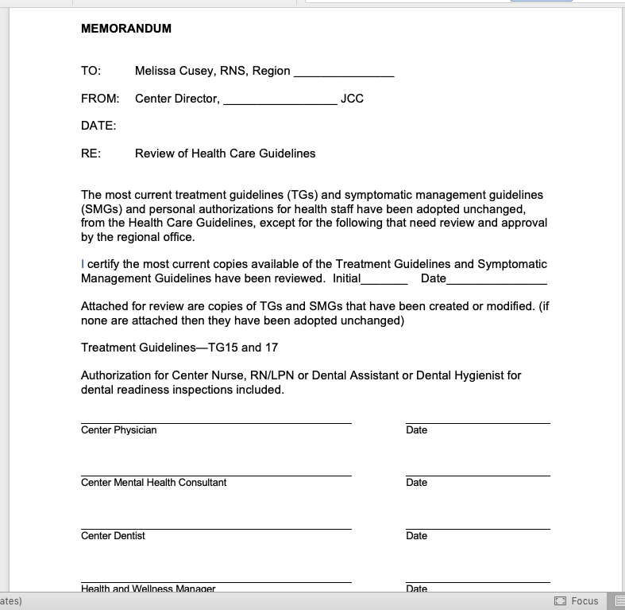

Slide 17
Question: Health Care Guidelines
How frequently are the health care guidelines submitted?
Annually
Annually and with changes made to guidelines
Once every 2 years
Never
Notes:
A or b are correct.
At minimum HCGs should be submitted annually on the centers contract anniversary or the start of the program year for Forest Service Centers.
If centers make changes to the guidelines the changes should be highlighted and submitted for review.

Slide 18
question
If the center has a physician only and the physician dies, retires, leaves for medical reasons, or does not renew their subcontract, can you still use the health care guidelines until a new subcontract is in place?
Yes
No
Notes:
No you cannot use the guidelines once the physician leaves and a new physician is not in place.

Slide 19
Scenario: Health Care Guidelines
Sue works in the cafeteria and changes positions to the Residential Advisor. Does she need a new Personal Authorization signed by the center physician?
Yes or No
A new center physician is hired. Does that person need to sign all personal authorizations for health and non-health staff?
Yes
No
Notes:
Personal Authorizations for Non-Health Staff only need to be done one time, unless the person changes positions.

Slide 20
R17. Communicable Disease and Infection Control
The center must:
a. Report cases of disease to state and local health departments in accordance with state and local laws.
b. Manage all cases of communicable disease and use protective measures as recommended by the Centers for Disease Control and Prevention (CDC).
c. Biologically monitor the function of autoclaves and maintain a log of spore test results.
d. Follow infection control measures as mandated by state and federal law.

Slide 21
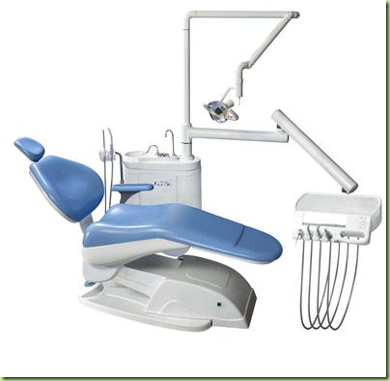
R18. Inventory records
The center must:
Maintain records on the dispensing, inventory, and disposal of medical and dental supplies and pharmaceuticals.
Notes:
Centers should have 2 Grab and Go kits – 1 located in wellness the other in a central location where accessible to staff when wellness is closed.

Slide 22
R19. Continuous Quality Improvement (CQI)
Center health staff must seek feedback from students, employ mechanisms to document quality of care provided, and document quality improvement activities.
Assessors assess these components as:
Feedback - surveys, focus groups, etc.
Mechanisms - regular chart audits and other frequent means to ensure follow up and referrals, etc.
Quality Improvement (CQI) - active measures to ensure a solution of an observed problem in the last year such as conducting studies, survey results, comments/complaints.

Slide 23
CQI continued
Identify the problem or issue and document the improvements or changes made. Examples:
Students not showing up for appointments & fixing pass system in some way
Broken appointment rates before and after documented
Students showing up randomly without appointments & staff education
Daily appointments in Health Utilization before and after
Flu vaccine uptake - offering outside of HWC and seeing if increase
Compare prior year percentage vs. current
High pregnancy or STI rate & increased student education to see if decrease
Rate before and after education
Notes:
Centers should do studies to address student complaints and services
Studies can be a statement of what the problem identified is, what they did and the result they achieved.
Examples Students coming to wellness during the training day – being sent by the instructors; Training provided to the instructor – What was the outcome? Was additional training needed?

Slide 24
Other PRH Chapters that fall under wellness Responsibilities

Slide 25
Program Management
PRH Chapter 5

Slide 26
Standard Operating Procedures (SOP)
See PRH 5.1 R3 & Exhibit 5-1
Center contractors, agencies, and OA/CTS contractors must:
a. Establish Standard Operating Procedures (SOPs), as shown in Exhibit 5-1 (Standard Operating Procedures), and submit them to the Regional Office for approval within 90 days of contract award. Updates and revisions shall be submitted as changes occur.
b. For agency-operated centers, provide up-to-date SOPs, as shown in Exhibit 5-1, with annual plans and amendments to SOPs submitted to the Department of Labor (DOL) Regional Office for approval by June 1 for the upcoming program year.
Required Wellness SOP/COPs
Over the Counter Medications
Prescribed Non-Control Medications
Prescribed Control Medications
Wellness Staffing

Slide 27
Reporting
Refer to PRH 5.1 R4 and Exhibit 5-2 for required reports
Health and Wellness Center Annual Program Description
Health Services Utilization Report (HMIS)
Quarterly Alcohol Testing Summary Report
Refer PRH 5.4 R2 Significant Incident Reports (SIRs) Must be completed for all serious or unusual medical, mental health, sexual assault, and drug/alcohol incidents
Maintaining a significant incident log will assist you in monitoring the frequency of specific incidents which can then be part of your total quality management program
Notes:
PRH Chapter 5, 5.4 R2 and Exhibit 5-2
The Annual Program Description is Due August 15th each year; provides an overview of the health and wellness program and staffing. Report is submitted online
Health Service Utilization Report (HMIS) – data is collected monthly providing statistical data collected from mental health, oral health, and medical programs (these reports remain on center for review by the Regional Office Center Assessment team)
Quarterly Alcohol Testing Summary Report – is completed on line and is due quarterly on 1/10, 4/10, 7/10 and 10/10. Record the number of tests on suspicion and the number that are positive.
SIRs see PRH Chapter 5, 5.4 R2 SIRs

Slide 28
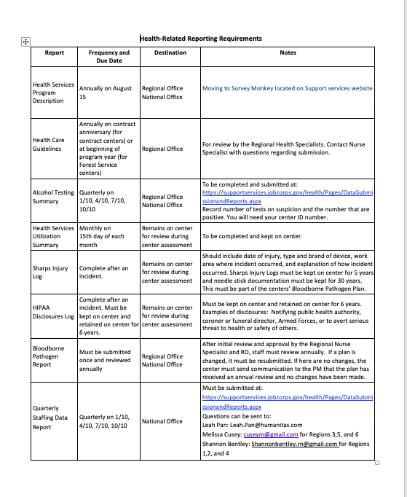
Notes:
Insert Screenshot of Required Reporting documents and where to find on the website

Slide 29
Personnel
PRH Chapter 5

Slide 30
Health Services Staffing
PRH 5.2 R3
a. Ensure the wellness center is staffed with qualified persons (See Exhibit 5-3) and hours meet the minimum requirements in Exhibit 5-6
b. Contract center​s, employ or subcontract with medical, dental, TEAP, and mental health professionals who are subject to the prior approval of the Regional Office, in consultation with the Regional Health Specialists.
c. USDA Forest Service Civilian Conservation Centers (CCCs), employ or subcontract with medical, dental, TEAP, and mental health professionals that are subject to the prior approval of the National Office, in consultation with the Regional Health Specialists.
d. Ensure that a health professional cannot serve as a consultant to, or an employee of, two or more Job Corps-related entities concurrently, when one entity has review and/or oversight responsibilities over the other(s). (Entities include Job Corps centers, health support contractors, and center operators.)
Notes:
Ensure that health services staffing is in compliance with the staffing levels presented in Exhibit 5-6 (Center Health Services Staffing Requirements)​ and the minimum staff qualifications identified in Exhibit 5-3 (Minimum Staff Qualifications).

Slide 31
Staffing SOP
Each center is required to submit a Staffing SOP (see PRH CN 16-02) and Exhibit 5-1.
The Staffing SOPs should include state practice acts.
coverage for LPN/LVN when the RN or HWM is on vacation or ill; and coverage for center wellness staff.
Recruitment plan for when a center employee (nurse, dental assistant, TEAP) or subcontracted staff position is open
Coverage for short- and long-term absences of a subcontract staff (physician/NP/PA, Dentist, RDH, Dental Assistant, CMHC, TEAP)

Slide 32
Health Services Staffing
Contract Centers
USDA Forest Service Civilian Conservation Centers (CCC)
Employ or subcontract with medical, dental, TEAP, and mental health professionals
Prior approval by Regional Office in consultation with the Regional Health Specialists
Employ or subcontract with medical, dental, TEAP, and mental health professionals
Prior approval by National Office in consultation with the Regional Health Specialists
Notes:
Prior to hire o subcontracting the candidates credentials should be sent either to the RO or the NO for review.
Review Exhibit 5-3 for minimum qualifications
Review Exhibit 5-6 for minimum hour requirements

Slide 33
Waivers
PRH Chapter 5, 5.2 R5 e(1&2), f(1&2), g
If candidate does not meet the ePRH qualifications found in Exhibit 5-3, a waiver request will be needed. Sample waivers can be obtained from the Nurse Specialist, Regional Mental Health or Regional TEAP Specialists.
1. Trainee Employee Assistance Program (TEAP) Specialist:
A one-time, one-year waiver for the TEAP Specialist
Must include a professional development plan identifying the steps necessary to meet the minimum requirements within one year of employment.
A copy of the license or certification must be shared with the National Office once obtained.
If the license or certification is not achieved within one year, the waiver is terminated, and the staff member can no longer be employed as the TEAP Specialist.
Notes:
e. Centers must request a waiver from the National Office prior to filling the following health and wellness positions if the minimum requirements set forth in Exhibit 5-3 are not met:

Slide 34
Waivers
2. Center Mental Health Consultant (CMHC):
A one-time waiver may be issued for CHMCs with a master’s degree or higher in behavioral health, and a license to practice independently in the state.
This one-time waiver will only be considered if there is unsuccessful recruitment for a clinical/counseling psychologist or clinical social worker. Those approved for the one-time waivers will not be required to have a professional development plan.
Providers must meet all requirements for license renewal to maintain an active license as set forth by their state boards. The one-time waiver for the CMHC covers the hiring period and is automatically renewed on an annual basis.
Notes:
Centers should keep a copy of the waiver on center.

Slide 35
Waivers
Nurse Practitioners and Physician Assistants:
f. Centers must request a waiver from the National Office prior to hiring the following health and wellness positions if the minimum coverage requirements set forth in Exhibit 6-5 are not met:
1. Nurse Practitioner (NP):
A one-time waiver for the NP may be requested if an NP assumes more coverage than 2 hours/100 students/week with supervision. The supervising physician will be the center’s Medical Director. This supervision arrangement must be clearly defined as part of the NP contract and in the collaborative agreement.
An annual waiver for the NP may be requested in independent practice states, where an NP with an active Drug Enforcement Agency (DEA) registration could serve as Medical Director.
2. Physician Assistant (PA): A one-time waiver for the PA may be requested if a PA assumes more coverage that 2 hours/100 students/week. Supervision is always required, and the supervising physician will be the center’s Medical Director. This supervision arrangement must be clearly defined as part of the PA contract and in the collaborative agreement.
Notes:
Not for a NP the waiver is either a 1x or annual depending on if there is a center physician or not.

Slide 36
Scenario 1
Your current CMHC (PhD) is retiring. The following candidates have expressed interest in the position: a LPC, a LMFT, and a LCSW
Where would you look in the ePRH to find out what the minimum requirements for a CMHC?
a. Exhibit 5-3
b. Exhibit 6-4
If they do not meet the minimum qualifications? Could you ask for a waiver?
Yes or no
Notes:
Exhibit 5-3
Yes a one time waiver can be submitted along with their credentials to the National Office and Regional Health Specialists for consideration of a one time waiver.

Slide 37
Scenario 2
Your center has a Contracted OBS of 300. What are the minimum number of hours the CMHC should be contracted for?
18
21
27
30
Notes:
3 27 is correct 9 hours/100 students (9 x 3.00 = 27.0)

Slide 38
Staffing Question
What is required to be in your Wellness Staffing SOP?
Short- and long-term coverage for center employees only
Recruitment plan only
Short- and long-term coverage for both center employees and subcontract staff
Recruitment plan for employees and subcontracted staff
c and d are correct
None of the above a staffing SOP is not required
Notes:
E is correct

Slide 39
Scenario (TEAP) What You need
Your TEAP specialist resigned and now the position is vacant. You have several eligible candidates and after interviewing them, you narrow it down to two candidates.
Candidate A is not yet CADC certified she will be eligible to take her certification test in 8 months.
You ask for a National Office approved waiver how long is the waiver good for?
a. 6 months
b. 12 months
c. Renewed annually
d. One- time waiver does not need to be renewed
Notes:
b. One time 12 month waiver

Slide 40
TEAP Scenario – Part 2
2.) What four things needs to be included with the Waiver?
a. A professional development plan listing how the candidate can complete the credentialing process in one year.
b. Proof of current professional liability insurance.
c. Number of hours TEAP will be working
d. Candidate's resume/vita that lists previous educational background and past work experience in substance abuse.
e. None of the above
f. All of the above except e
Notes:
Answer f all of the above except e

Slide 41
TEAP Question
Your center has a contracted strength of 350 students. How many TEAP specialists hours are required to be in compliance with Exhibit 6.5 (Center Staffing Requirements)?
Answer Choices: A. 40 hours
B. 21 hours
C. 52.5 hours
Notes:
Correct Answer is C: 52.5 hours.
3.50 x 15 = 52.5 hours

Slide 42
Property
PRH Chapter 5

Slide 43
Medical Equipment and Supplies
PRH 5.6 R2
The center must:
Provide necessary equipment and supplies for routine and emergency delivery of basic medical, dental, and mental health services. All such equipment must comply with federal and state requirements.
Purchase major dental equipment according to the current dental equipment list published periodically by the Office of Job Corps.
Purchase from government supply service centers (General Services Administration [GSA], Health and Human Services [HHS], Veteran Administration [VA]), whenever possible.

Slide 44
Enrollments, Transfers, And Separation
PRH Chapter 6

Slide 45
Transfers
PRH 6.2 R2,c
If the student is receiving or has received medical services, including mental health, oral health, and Trainee Employee Assistance Program (TEAP), the transferring center will provide a legible or typed summary note on student’s current status, medication, and treatment compliance at least two weeks prior to student arrival. The student health record must arrive at the time of student arrival.
Notes:
You must complete and forward a transferring summary to the receiving center
The student Health Record must arrive at the at the same time the student does

Slide 46
Medical Separations
PRH 6.2 R5
Centers must ensure that:
Medical/Mental Health separations are initiated by health services staff.
Students are medically separated when they are determined to have a pre-existing or acquired health condition that significantly interferes with or precludes further training in Job Corps, or the health problem is complicated to manage, or the necessary treatment will be unusually costly.
If the Center Physician estimates that the student will be able to return to the center within 180 days, a Medical Separation With Reinstatement rights (MSWR) will be given.
Health and social service referrals are provided for all separated students.
For MSWR, students are contacted monthly by the Health and Wellness Manager to assess progress and plan their return to Job Corps within the 180 days allowed.
Health and Wellness staff approve a student’s transportation plan for medical separation.
Center staff must submit a request to the Regional Office to extend an MSWR beyond 180 days for extenuating circumstances.
Notes:
c. If the student’s condition cannot be stabilized in 180 days, a regular medical separation will be given and the student may reapply in one year, unless the MSWR is extended (see R11.g below).
g. The request should be accompanied by supporting documentation from the student’s health-care provider verifying that extension of leave is medically necessary. Requests will be reviewed on a case-by-case basis.
Center Director has final say regarding separations.
Hospitalizations are beyond Basic Care and not covered.

Slide 47
Scenario MSWR
Stephanie’s counselor comes to you and tells you Stephanie’s mother is not doing well and will require surgery. There will be no one at home to care for her after surgery. The counselor asks you to place Stephanie on MSWR so she can care for her mother.
Based on the ePRH is this a valid reason for a MSWR?
Yes or no

Slide 48
Other Areas Involved in but Not Responsible
Wellness Center

Slide 49
Bloodborne Pathogen Plans
Chapter 5, 5.1 R23 and Exhibit 5-2
a. Centers must develop, implement, and maintain a Bloodborne Pathogens Control Plan that is in compliance with the OSHA Occupational Exposure to Bloodborne Pathogens; Needlestick and Other Sharp Injuries; Final Rule (29 CFR 1910.1030). The Plan, which is submitted to the Regional Office, must be reviewed and approved by the Regional Health Specialist.

Slide 50
Monthly Meetings with Center Director
PRH 5.1 R35
The CD shall meet monthly with the center physician and CMHC to discuss clinical and organizational issues
Meeting minutes should include documentation of attendees and items discussed

Slide 51
FECA/OWCP
PRH 5.1 R40
a. Students are considered federal employees for purposes of the Office of Workers’ Compensation Programs (OWCP). OWCP benefits do not begin to accrue until the day following a student’s separation from the program.
Complete CA-61 (Notice of Separation of Student)
b. The center must complete the appropriate OWCP form(s) whenever a student is injured, develops an occupationally related illness, or dies while in the performance of duty.
c. If the student dies while in Job Corps – Contact the Nurse Specialist for general questions and Heather Edmonds or for completion of CA-6; SIR should be completed see ePRH 5.5
Notes:
a. The center must immediately comply with the procedures set out in the Employment Standards Administration regulations at 20 CFR Chapter 1​. The CA form portion of the Employee’s Compensation Operations and Management Portal (ECOMP) form and a copy of the ETA Form 6-61 (Notice of Student Separation) must be filed with the OWCP district office only when the injury or illness results in separation and consent is received from the Office of Job Corps. When separation does not occur, such forms must be maintained in the student’s health record.
c. Contact the Nurse Specialist and/or Heather Edmonds/Brittany Jonas in the National Office for guidance on completion of CA-6 or other questions.
Inform the next of kin of any possible FECA benefits if death occurred during the performance of duty. If the student did not die during the performance of duty, the government shall pay only for expenses involved in the preparation and transportation of the remains to a mortuary in the area selected by the next of kin, within the United States and the student's possessions.
Arrange for burial at a site close to the center and at a cost not to exceed the amount authorized in Section 8134(a) of the Federal Employees’ Compensation Act in the event that the next of kin refuses to accept the remains.
Provide the Office of Job Corps with documentation authorizing OWCP eligibility. If next of kin is eligible for benefits, further review by the Office of Job Corps shall determine if any additional gratuity payments, not to exceed $10,000 in accordance with Section 651 of Public Law 104-208 (The Omnibus Consolidated Appropriations Act), shall be awarded.

Slide 52
Authorizations for Treatment
PRH 6.5, R5
Centers must ensure that proper authorizations are obtained prior to delivery of health services to students.
Signed ETA 6-53
Consent for treatment not covered under the blanket consent- written consent from parents/guardian
Consent for Mental Health Services
c. In emergency situations, the Center Director may make an exception to the requirement for consent when a student who has reached the age of maturity cannot give consent or a parent/guardian of a student under the age of maturity cannot be contacted. This must be documented in the student’s health record.
Notes:
a. The signed consent form (ETA 653) serves as authorization for basic routine health care and must be placed in the student health record by the time a student arrives on center. Additionally, each student must have a signed Informed Consent to Receive Mental Health and Wellness Treatment form in the student health record by the time the student arrives on center.
b. Each time a student requires services other than those covered under the blanket consent signed on admission, written consent must be obtained from the student or parent/legal guardian.

Slide 53
Death
In the event of a student's death, the center director must notify multiple parties, arrange for the remains to be sent home, and forward student records to the National Office
A significant incident report (SIR) must be submitted
Refer to the Medical Transfer, Separation, and Referral; Management of Student Injury and Death TAG for details

Slide 54
Death
See PRH Chapter 5, 5.4 SIRs
In the event of a student's death, the center director must notify multiple parties, arrange for the remains to be sent home, and forward student records to the National Office
A significant incident report (SIR) must be submitted
See PRH Chapter 6, 6.4 R19 Records
Entire Student Record sent to Office of Job Corps within 10 days.
Notes:
Contact your Regional Nurse Consultant for assistance and support
In the event of a student’s death, the center must follow Significant Incident Report (SIR) reporting requirements (see PRH Chapter 5, Section 5.4) and send the entire student personnel record (including sealed health record) to the Office of Job Corps by signature-required mail or delivery within 10 days. The sealed health record must include Office of Worker’s Compensation Programs (OWCP) forms and written notification of death, plus the death certificate and autopsy and toxicology reports if available.
Make sure a note is made in the SHR regarding the student death.
Refer to the Medical Transfer, Separation, and Referral; Management of Student Injury and Death TAG for details

Slide 55
Confidentiality of Records/ HIPAA Regulations
Health Insurance Portability and Accountability Act (HIPAA)
Protection of personally identifiable information (PII) [Program Instruction Notice NO. 06-23]
Notes:
regulations mandate strict attention to privacy laws and confidentiality of records (April 2003).
Refer to APPENDIX 607 TRANSMISSION, STORAGE, AND CONFIDENTIALITY OF MEDICAL, HEALTH, AND DISABILITY-RELATED INFORMATION

Slide 56
Important Resources
PRH—The Policy and Requirements Handbook contains the rules by which all centers operate; Chapter 2 (Sections 2.3 R1-R19) provides policy on ensuring students receive health and wellness services, support, and education that will enhance their employability and encourage and maintain a healthy lifestyle.
COPs/SOPs—Center Operating Procedures and/or Standard Operating Procedures for the health and wellness program; these procedures define how your program will operate on a day-to-day basis, describe staff roles and responsibilities, and provide guidance on center specific documentation, reporting, and communication protocols

Slide 57
Important Resources (continued)
DRGs—Desk Reference Guides provide information and strategies to meet and exceed health-related Policy and Requirements Handbook (PRH) requirements, and contain all health and wellness program-related documents and forms. The DRGs will help new center health and wellness staff learn the foundations of their position, and experienced health and wellness staff will find the central location of forms and information useful.
TAGs—Technical Assistance Guides are designed to aid center staff in meeting health and wellness program requirements; they are how-to guides that offer many suggestions but no additional program requirements
Notes:
DRGs are located on the Job Corps Community Website under the Health and Wellness Tab. Presently there are DRGs available for HWMs, center physicians, CMHCs, center dentists, and center disability coordinators.
Required Health DRGs Medication OTC, Prescribed Control and Prescribed Non-Control Staffing

Slide 58
Important Resources
PRH—The Policy and Requirements Handbook contains the rules by which all centers operate;
Chapter 2 (2.3 R1-R19)
Chapter 5 (5.1, R3, R4; 5.2 R3, R5; 5.4 R2; 5.6 R2)
Chapter 6 (6.2 R2 & R5)
Notes:
Chapter 2 (Sections 2.3 R1-19) provides policy on ensuring students receive health and wellness services, support, and education that will enhance their employability and encourage and maintain a healthy lifestyle.
Chapter 5 Section 5.1 Required SOPs & Reporting; Section 5.2 Health and Wellness Staffing and Staff training; Section 5.4 SIRs; Section 5.6 Medical Equipment and Supplies
Chapter 6 Section 6.2 R5 MSWR, 6.2 R2 Transfers

Slide 59
Additional Resources
Appendices
Appendix 201 Communicating With Persons With Disabilities
Appendix 202: Transmission, Storage, and Confidentiality of Medical, Health, and Disability-Related Information
Appendix 203 Medication Management Guidelines
Appendix 601 Student Rights to Privacy and Disclosure of Information

Slide 60
Additonal Resources
Exhibits
2-4 Job Corps Basic Healthcare Responsibilities
5-1 Standard Operating Procedures
5-2 Plan and Report Submission Requirements
5-3 Minimum Staff Qualifications
5-4 Required Staff Training Staff Training
5-6 Center Health Services Staffing Requirements
6-1 Duty/Pay/Leave Status Chart
6-3 Student Transportation

Slide 61
Additional Resources
Forms
2-01 Notice of Medical Information Use, Disclosure,
and Access
2-02 HIV Testing Information Sheet
2-03 Definitions and Documentation Requirements
Related to Reasonable Accommodations for
Applicants and Students With Disabilities
2-04 Individualized Assessment of Possible Direct
Threat
2-05 Exceeds Health Care Needs Assessment

